Slide 1
EDA on Used Cars Dataset
- Harshal Vibhandik
https://www.linkedin.com/in/harshal-vibhandik-84822568

Slide 2
Agenda
To do the EDA on Used Cars Dataset
Generate Data Pre & Post Processing Reports
Data Cleaning using pandas library
Find out the valuable insights from the data
Provide Points on the Actionable Insights

Slide 3
Problem Statement
Cars Absolute, An American company buys and sells second hand cars
Company has good name in market due to sincerity in work & quality of services
But for past few months sales is down
So needs to do the EDA on their data and provide the actionable insights to company

Slide 4
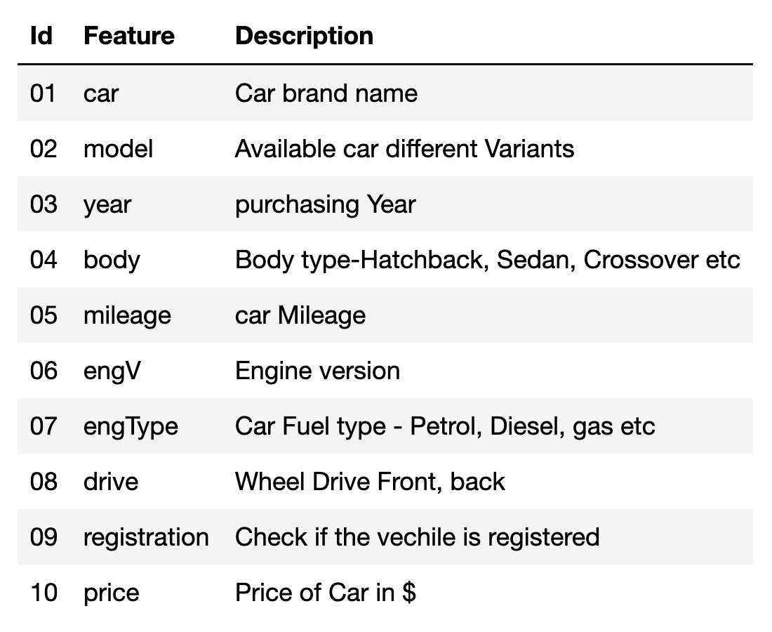
Used Cars Dataset

Slide 5
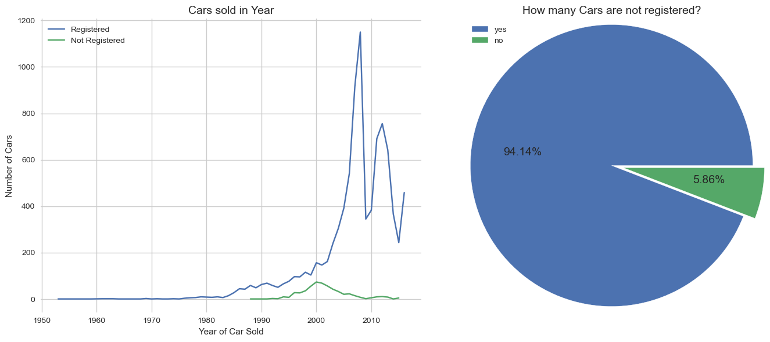
How many cars are registered?
Almost 94.14% cars are registered
Very few means 5.86% of cars are unregistered
OR few of them registered in some other country
Maximum cars was registered in year 2008

Slide 6
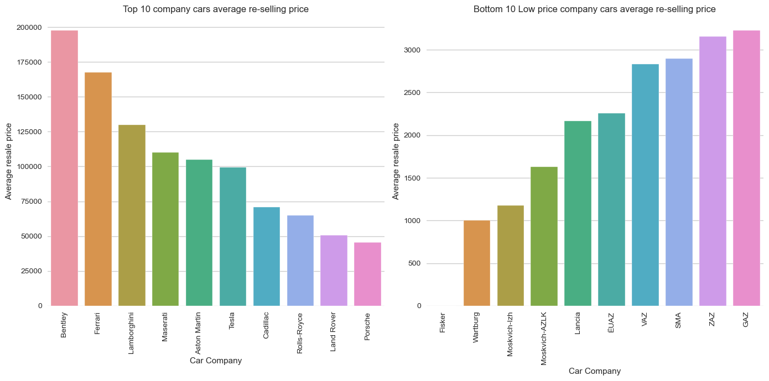
Cars with high and low selling prices?
Few of the cars having very high re-selling price
Few of the cars having very low re-selling prove
Customer might not choose them to buy
Reasons could be the Budget or Performance of car

Slide 7
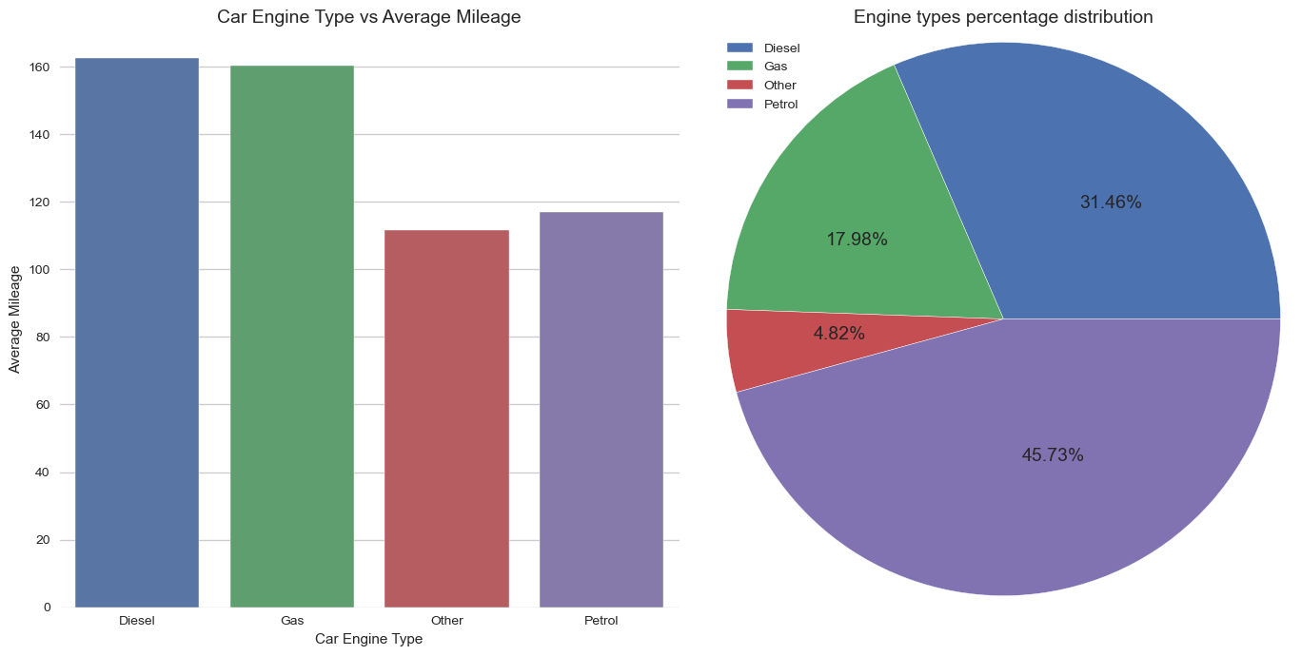
Is Engine type affects on Mileage?
Diesel and Gas Engines having more mileage than Petrol or Others
But Petrol cars are maximum in stock almost 45.73%

Slide 8
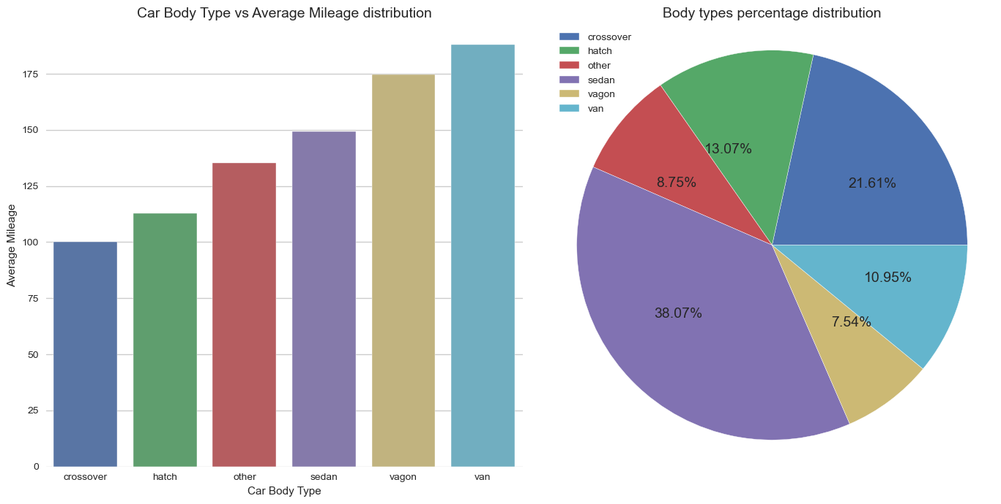
Is Body type affects on Mileage?
Van, Vagon, Sedan body type cars having more mileage than Hatchback, Crossover or Others
And Sedan cars are maximum in stock almost 38.07%

Slide 9
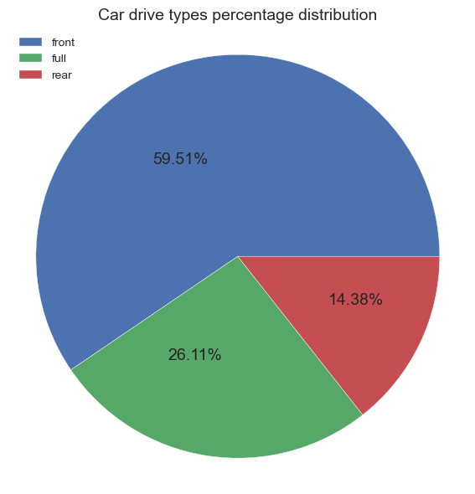
Which Wheel drive is preferable?
Almost 60% of peoples are preferred to use front wheel drive instead of full or rear wheel drive.

Slide 10
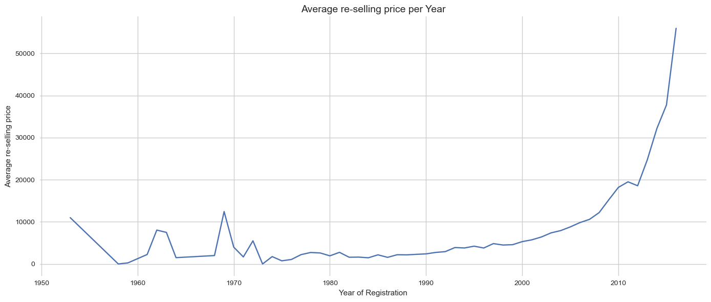
Is Car registration year affects Pricing?
Most recent year’s registered car’s having higher re-selling price then the older ones
Few of the car models from 1953 or 1968 having slightly high re-selling price

Slide 11
Conclusion
Due to budget issues customers are looking for the re-selling car options from the company
Most of the customers looking for the recent year’s front wheel drive cars with a good condition, low maintenance and good mileage
But such cars having higher re-selling prices
So customer might not buy car from company and might be go with the new car options

Slide 12
Actionable Insights
Scrap the older cars which are not in a good condition or having lower mileages
Make a stock of recent year’s registered car’s and not much older ones
Re-selling prices should be in a customers budget e.g. In a range of 40% – 60% of same new car model
Keep front wheel drive and good mileage cars on top
So that customers can happily buy a car and contribute to grow overall sales of the company

Slide 13
Thank You !
- Harshal Vibhandik
https://www.linkedin.com/in/harshal-vibhandik-84822568

