Slide 1
NeuroFleetX
Backend APIs - Taxi Management

Slide 2
Our backend is built using:
• Spring Boot 3.x (REST API framework)
• MongoDB (Flexible NoSQL database)
• Java (Core programming language)
Features:
4 Main APIs (GET, POST, PUT, DELETE)
Smart filtering (by status, battery, zone)
Data validation & error handling

Slide 3
The 4 Main APIs
API 1: GET /api/taxis (Show Taxis)
Get all available taxis. Filter by battery%, by status (IDLE/ON_TRIP/CHARGING), by nearest location, Auto-excludes low battery & charging taxis
API 2: POST /api/taxis (Add Taxi)
Add new taxi. Validates: registration format, battery 0-100%. Auto-sets: if battery < 20% → mark charging , Auto generate ID and Time stamps
API 3: PUT /api/taxis/{id} (Update Taxi)
Update taxi. Smart rules: battery < 20% → force CHARGING, can't start trip while charging, update trip count ,Update location, battery, Auto-update trip metrics (km, trips count)
API 4: DELETE /api/taxis/{id} (Remove Taxi)
Remove taxi Can't delete if ON_TRIP ,

Slide 4
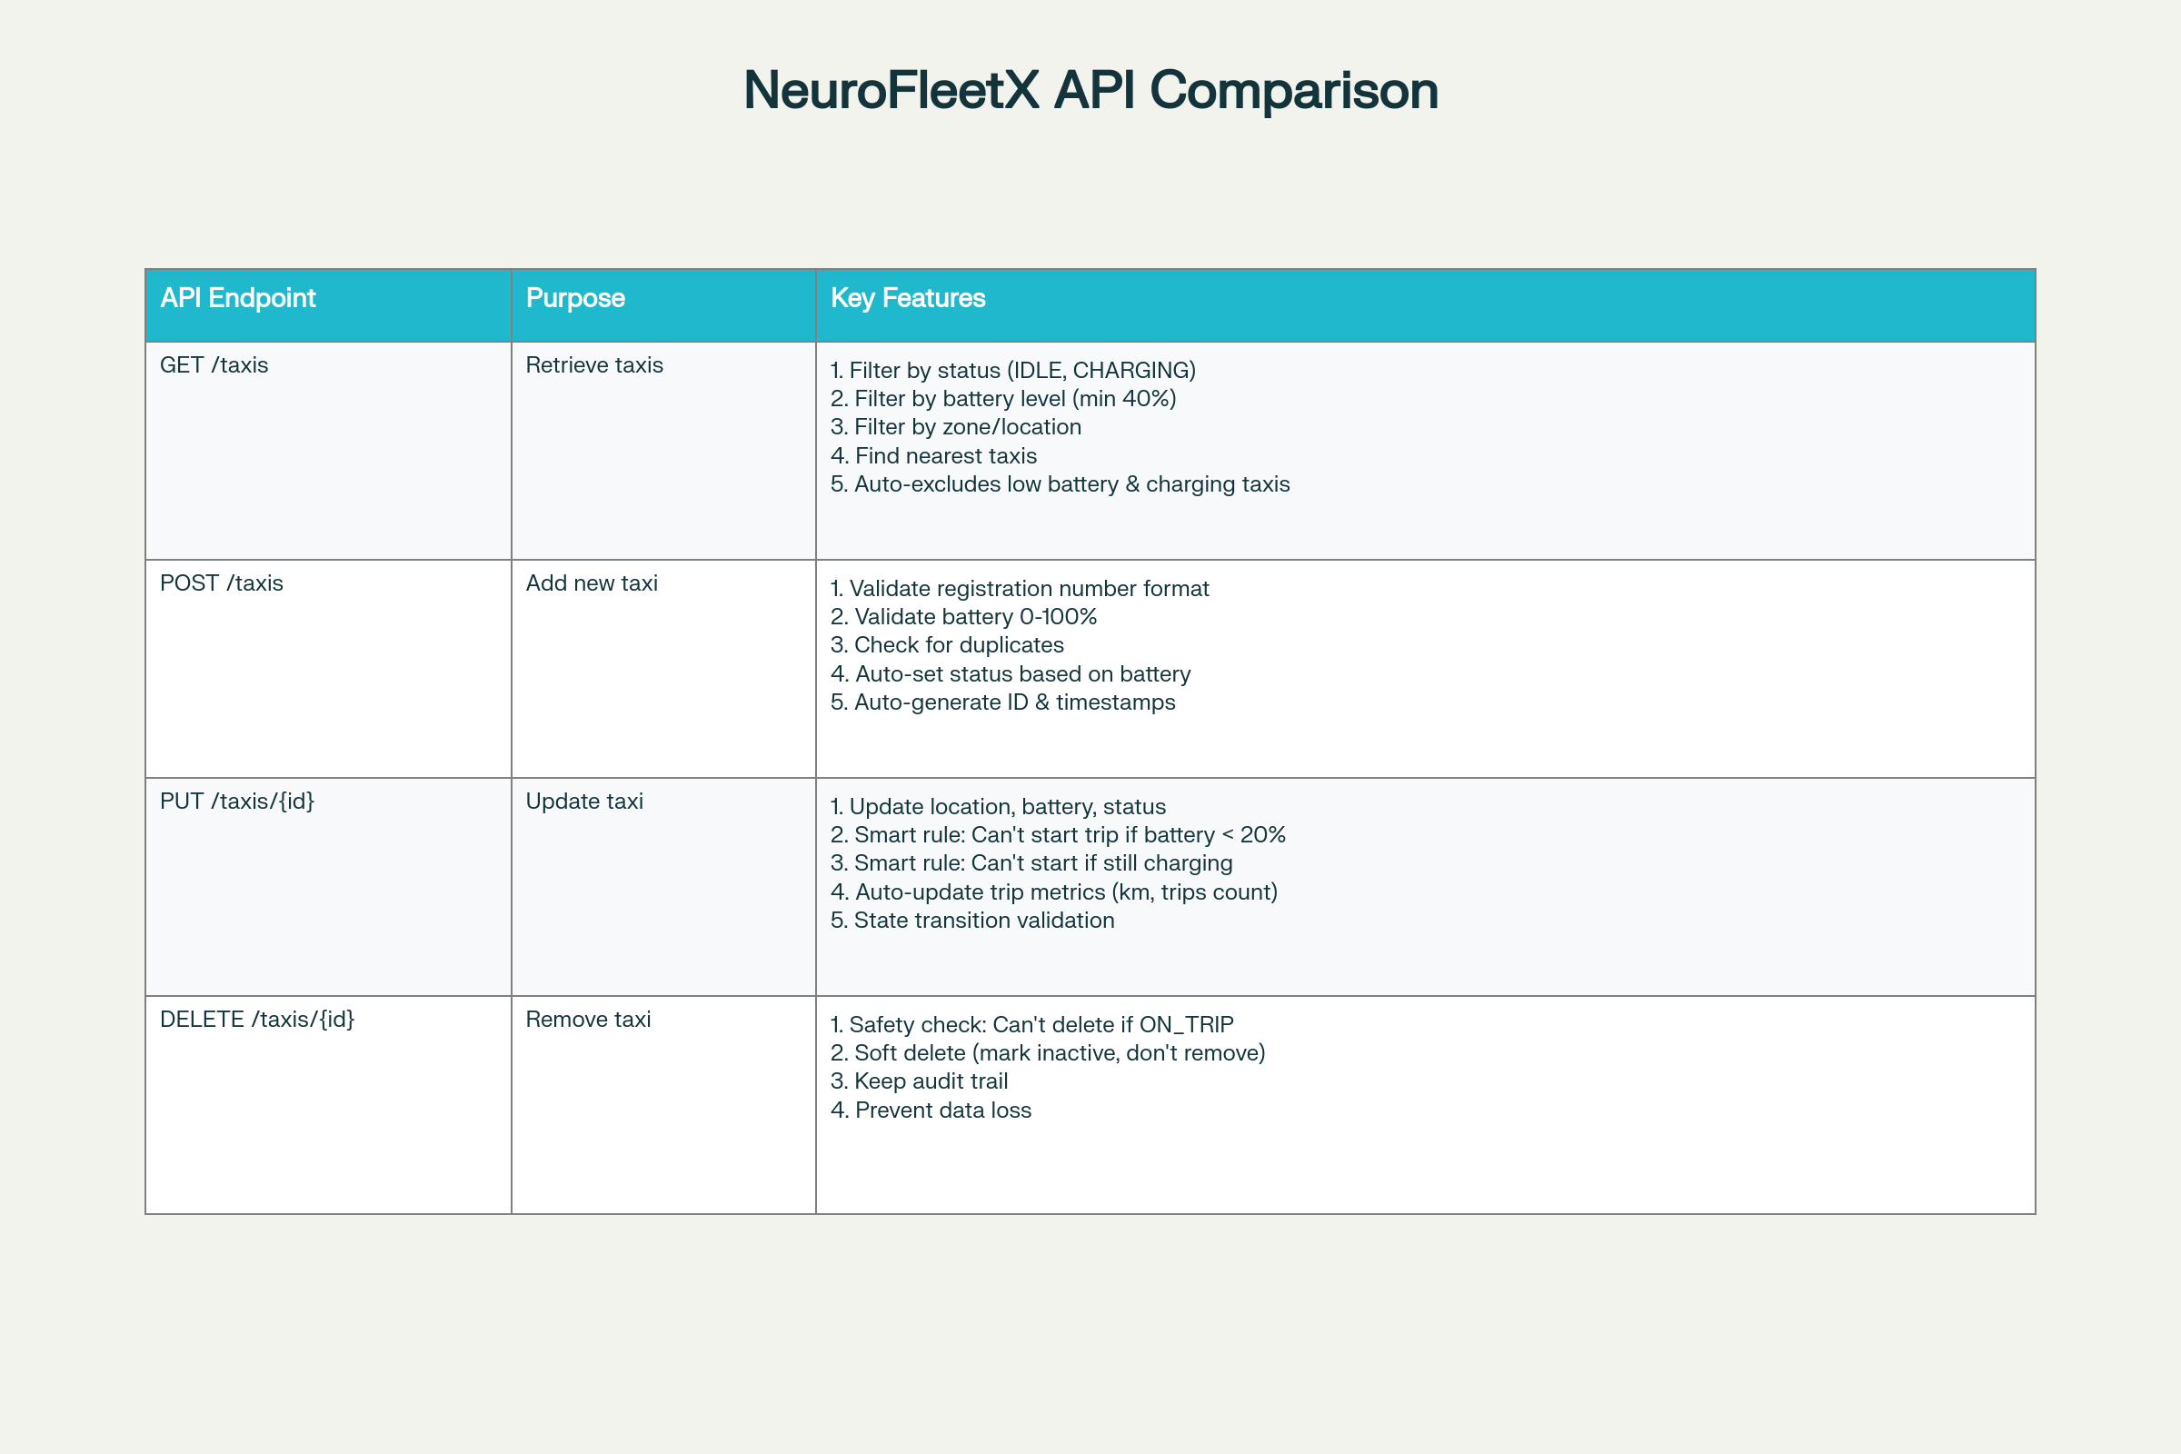

Slide 5
BACKEND FILE STRUCTURE
NeuroFleetX-Backend File Structure│
├── controller/
├── service/
├── repository/
├── model/
└── pom.xml (Maven dependencies)
Controller - This is where REST API requests arrive.
Service - Contains the business logic. Taxi Service applies rules like 'if battery < 20%, mark as CHARGING'.
Repository - Communicates directly with MongoDB. It runs queries and returns data.
Model - Defines the structure of our data. Taxi model defines what fields a taxi has (id, registration, battery, location, etc.).
pom.xml - This Maven file lists all the libraries/dependencies our backend needs to run."

Slide 6
Taxi Information Fields
Basic Info
• Taxi ID
• Registration (KA05AB1234)
• Driver Name
Location
• Latitude
• Longitude
• Current Zone
Status & Battery
• Status (IDLE/ON_TRIP/CHARGING)
• Battery Level 0-100%
• Is Charging? Yes/No
Metrics
• Total Trips
• Total KM
• Capacity (4 passengers)
Maintenance: Last service date, Next service due

Slide 7
Smart Rules Backend Will Apply
✓ Battery Management
If battery < 20% → Auto-mark taxi as CHARGING. Cannot start new trip until charged
✓ Availability Filtering
GET /taxis shows only taxis that are: status=IDLE, battery > 20%, not charging, isActive=true
✓ Nearest Taxi Calculation
Find taxis nearest to user location using latitude/longitude distance calculation
✓ Trip Metrics
After trip ends: Update total trips completed, total KM driven
✓ Safe Deletion
Mark taxi as inactive instead of deleting. Safety: Cannot delete taxi if currently ON_TRIP

