Slide 1

NeuroFleetX: Intelligent Taxi Dispatch System

Slide 2

The Challenge: Inefficient Dispatch
Traditional taxi dispatch systems rely on outdated, static methods, leading to significant inefficiencies and a suboptimal user experience.
Static Allocation
No Real-time Intelligence
Solely based on distance, ignoring real-world dynamics.
Lacks consideration for traffic, weather, or driver load.
Inaccurate ETAs
Poor User Experience
Poor predictability leads to user frustration.
Delays, lack of transparency, and operational friction.
Key Statement : Existing systems lack predictive, AI-driven decision-making, hindering efficiency and user satisfaction.

Slide 3

NeuroFleetX: Our AI-Powered Solution
NeuroFleetX revolutionizes taxi dispatch with an intelligent platform integrating advanced AI and machine learning for superior efficiency and transparency.
ML for ETA Prediction
Multi-Factor Dispatch
Leveraging sophisticated algorithms to forecast arrival times with unparalleled accuracy.
Optimizing taxi assignments based on a comprehensive set of real-world variables.
AI-Generated Ride Insights
Secure Role-Based Access
Providing users and administrators with deep analytics and ride explanations.
Ensuring data integrity and appropriate access for all stakeholders (Admin, Driver, User).
Goal : Smarter dispatch, enhanced transparency, and improved operational efficiency across the entire taxi ecosystem.

Slide 4
Key Objectives: Driving Innovation
Our project is focused on delivering a transformative system that addresses critical pain points in traditional taxi services.
Optimize Taxi Assignment
Improve ETA Accuracy
Using real-time, multi-factor analysis.
Through advanced Machine Learning models.
Reduce Passenger Waiting Time
Provide Real-time Tracking
Streamlining the dispatch process for quicker pickups.
Ensuring transparency throughout the ride.
Offer AI-Based Analytics
Ensure Secure & Scalable Design
Delivering insights and explanations for every journey.
Building a robust and future-proof platform.

Slide 5



System Users & Roles
NeuroFleetX is designed with distinct roles and functionalities to cater to the specific needs of administrators, drivers, and passengers.
Admin
Driver
User
Manage users, drivers, and vehicles.
Accept or decline ride requests efficiently.
Seamlessly request and track taxis in real-time.
Oversee ML model training and monitoring.
Track assigned rides and monitor earnings.
View ride history with AI-generated explanations.
Access system analytics and performance metrics.

Slide 6




Key Features: Enhancing the Ride Experience
NeuroFleetX boasts a comprehensive suite of features designed to elevate both operational efficiency and user satisfaction.
1
Secure Authentication
JWT-based authentication and role-based authorization.
2
Intelligent Dispatch
Multi-factor algorithm for optimal taxi assignment.
3
Real-time Tracking
WebSockets for live ride updates and location tracking.
4
ML-based ETA
Accurate arrival time predictions powered by Machine Learning.
5
AI Ride Explanations
OpenAI integration for detailed ride history insights.
6
Admin Analytics
Comprehensive dashboard for system monitoring and insights.

Slide 7


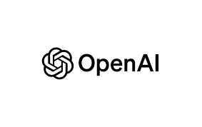

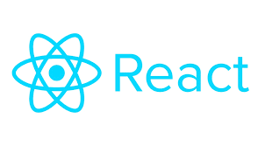



Robust Technology Stack
Our chosen technologies provide a scalable, secure, and performant foundation for NeuroFleetX.
Backend & Frontend
Backend : Java 17, Spring Boot 3, Spring Security, Spring Data JPA
Database : PostgreSQL, Hibernate
ML & AI : SMILE ML (Random Forest), OpenAI API
Authentication : JWT
Frontend : React 18, Vite, Tailwind CSS, Axios, Recharts
Deployment Strategy
Containerization : Docker ensures consistent environments from development to production.
Orchestration : Docker Compose simplifies the deployment and management of multi-container applications.
This setup enables seamless scaling and efficient resource management in a cloud-native environment.

Slide 8
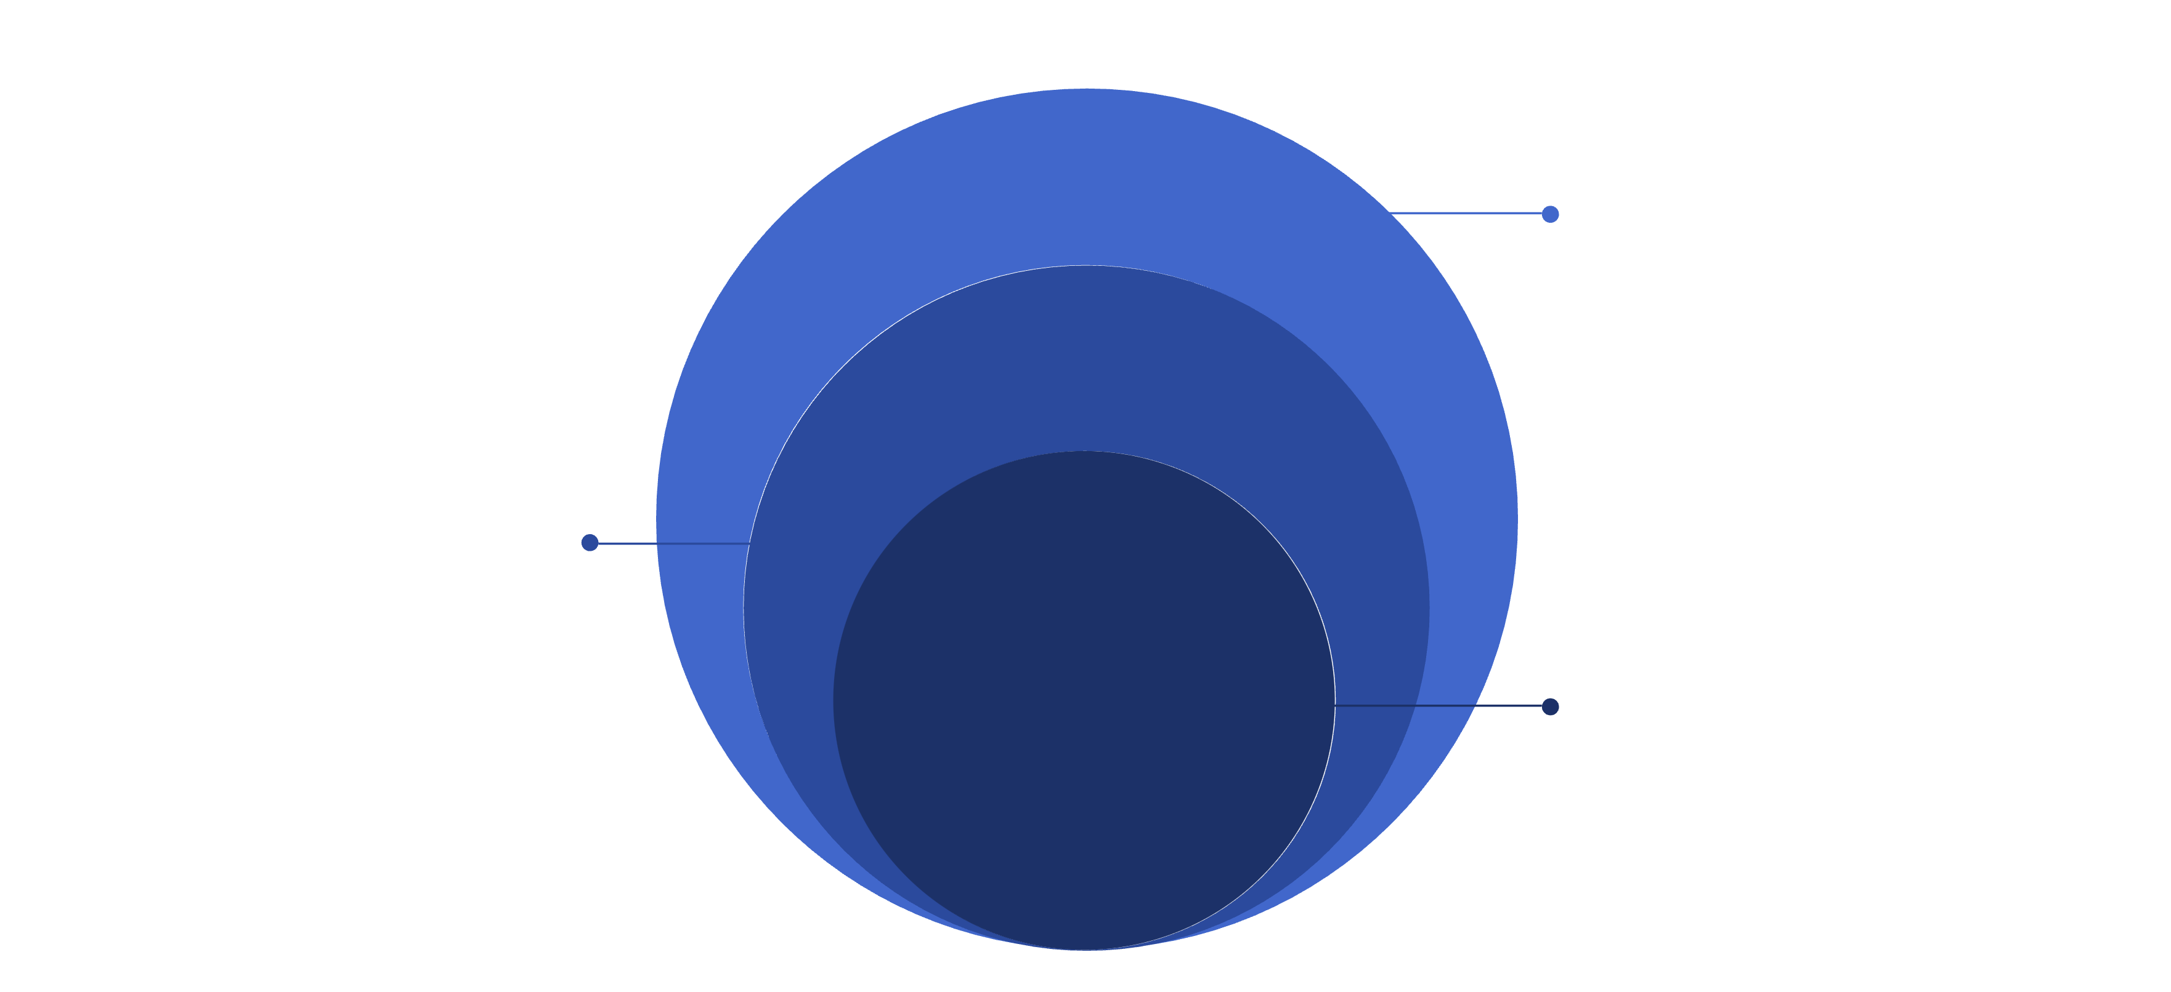
System Architecture Overview
NeuroFleetX is built on a layered, modular architecture, ensuring scalability, maintainability, and robust performance.
Repository Layer
Data persistence and access for services
Service Layer
Business logic; connects to ML and AI services
Controller Layer
Handles REST APIs and WebSockets from Frontend
Advantages: This design promotes a clear separation of concerns, facilitates independent development and deployment of services, and is inherently production-ready.

Slide 9



Intelligent Dispatch Algorithm
Our core dispatch algorithm goes beyond simple distance, dynamically scoring and assigning the optimal taxi for each ride request.
Optimal Taxi Assigned
1
2
Dynamic Scoring
Dispatch Factors
3
Distance, ML-predicted ETA, Traffic, Battery Level, Taxi Availability, Load.
By considering multiple real-time factors, we ensure the most efficient and timely taxi assignments, significantly improving service quality.

Slide 10


Machine Learning for ETA Prediction
The heart of our predictive capabilities lies in a finely tuned Machine Learning model, ensuring highly accurate Estimated Times of Arrival.
Algorithm & Library
Key Input Features
Algorithm : Random Forest
Distance : Haversine calculation for precise routing.
Library : SMILE ML
Traffic Index: Real-time congestion data.
Purpose: Accurately predict ETAs, adapting to dynamic conditions.
Weather Condition: Impact of rain, snow, etc., on speed.
Time of Day: Accounting for peak and off-peak hours.
Battery Level: For electric vehicles, influencing availability.
Average Speed: Historical and real-time speed data.
Why Random Forest?
Chosen for its robustness, ability to handle non-linear data relationships, high accuracy, and resistance to overfitting, making it ideal for complex ETA predictions.

Slide 11

ML Training Workflow: From Data to Deployment
1. Upload Ride Dataset
Ingesting raw ride data, typically in CSV format, to serve as the foundation for model training.
2. Data Preprocessing & Cleaning
Transforming raw data into a usable format, handling missing values, and removing inconsistencies to ensure data quality.
3. Feature Engineering
Creating new predictive features from existing data to enhance model performance and capture complex patterns.
4. Train-Test Split (80-20)
Dividing the dataset into training (80%) and testing (20%) sets to evaluate model generalization accurately.
5. Model Training & Evaluation
Applying various ML algorithms and evaluating their performance using key metrics to select the optimal model.
6. Best Model Auto-Saved
The top-performing model is automatically persisted, ready for integration into the dispatch system.

Slide 12

Key Evaluation Metrics for ML Models
Our machine learning models are rigorously evaluated using industry-standard metrics to ensure reliability and accuracy.
R² Score
RMSE
Measures the proportion of variance in the dependent variable that can be predicted from the independent variables, indicating model fit.
Root Mean Squared Error: Quantifies the average magnitude of the errors, giving higher weight to larger errors.
MAE
Mean Absolute Error: Calculates the average of the absolute differences between predictions and actual observations, representing prediction accuracy.

Slide 13


Robust Database Design
A well-structured database underpins the NeuroFleetX system, ensuring data consistency, integrity, and high performance.
Users Table
Manages administrator, driver, and user profiles and authentication details.
Taxi Table
Stores comprehensive taxi and associated driver information, including vehicle status and location.
RideRequest Table
Tracks the complete lifecycle of each ride request, from initiation to completion, including status updates.
DeclinedRide Table
Records instances of declined ride requests for analysis and system optimization.
ModelMetrics Table
Stores performance metrics and evaluation results of all trained ML models.
Our design prioritizes data integrity and scalability, supporting a high volume of transactions.

Slide 14
Fortified Security Implementation
Security is paramount. NeuroFleetX employs a multi-layered security approach to protect sensitive data and ensure system resilience.
JWT Authentication
Role-Based Access
JSON Web Token-based secure authentication for all API interactions.
Granular access control (Admin, Driver, User) to define permissions.
BCrypt Hashing
CORS & CSRF Protection
Robust password hashing using BCrypt algorithm for maximum protection.
Cross-Origin Resource Sharing and Cross-Site Request Forgery protections enabled.
SQL Injection Prevention
Secure API Policies
Utilizing parameterized queries to safeguard against common database attacks.
Strict access policies for all API endpoints to prevent unauthorized usage.

Slide 15

NeuroFleetX: Real-World Impact
Superior ETA Accuracy
Machine Learning models provide precise arrival time estimates, enhancing user experience.
Intelligent Ride Assignment
Faster and smarter matching of riders to drivers, optimizing routes and reducing wait times.
Enhanced Driver Utilization
Maximizing the efficiency of the taxi fleet and driver network.
AI-Driven Transparency
Users receive clear, AI-backed explanations for dispatch decisions, building trust.
Scalable & Robust
Designed for real-world deployment, handling high demand with ease and reliability.

Slide 16




Future Horizons: Expanding NeuroFleetX Capabilities
Our roadmap includes exciting enhancements to further refine and expand the system's intelligence and user experience.
Live Traffic & Map APIs
Integration with Google Maps and other real-time APIs for dynamic routing and improved ETA predictions.
Deep Learning ETA Models
Implementing advanced deep learning techniques for even more sophisticated and accurate ETA estimations.
Mobile Application Development
Building native mobile apps (React Native) for seamless user and driver interaction.
Surge Pricing & Demand Forecasting
Developing intelligent algorithms for dynamic pricing and proactive demand prediction to optimize revenue and service.

Slide 17

Thank You
We are confident that NeuroFleetX represents the future of smart urban transportation.

