Slide 1
Mid Sem Evaluation
Project Plan,Experimental Schematic and List of Items to be Purchased (with Amazon/Robo Link)

Slide 2
Design Lab 2 - ME306
Group E (Tuesday)
Harsh Sharma - 2023MEB1346
Harsh Alok Shah - 2023MEB1344
Ekamjit Singh - 2023MEB1342
Gunjan Verma - 2023MEB1343
24 - 02 - 2026

Slide 3
Project Title
3-Axis stabilization platform for vehicle-mounted cameras and LiDAR sensors, for rough terrain applications.

Slide 4
Problem Statement
Maintaining the orientation of cameras & LiDAR sensors on moving vehicles is a significant challenge, as vibrations, bumps, and uneven surfaces may cause sensor misalignment.
Our project is to design and implement a compact 3-axis inertial stabilization platform using an accelerometer-based feedback control, capable of keeping vehicle-mounted cameras & LiDAR sensors orientation fixed in real time.

Slide 5
Direct Applications
1 . Imaging stabilization for -
Drone cameras ( as used by DJI )
Vehicle-camera systems
Body-worn cameras ( as used by GoPro )
2 . Satellite attitude control -
Instruments like cameras / sensors can be pointed accurately to a target independent of the satellite’s rotation.

Slide 6
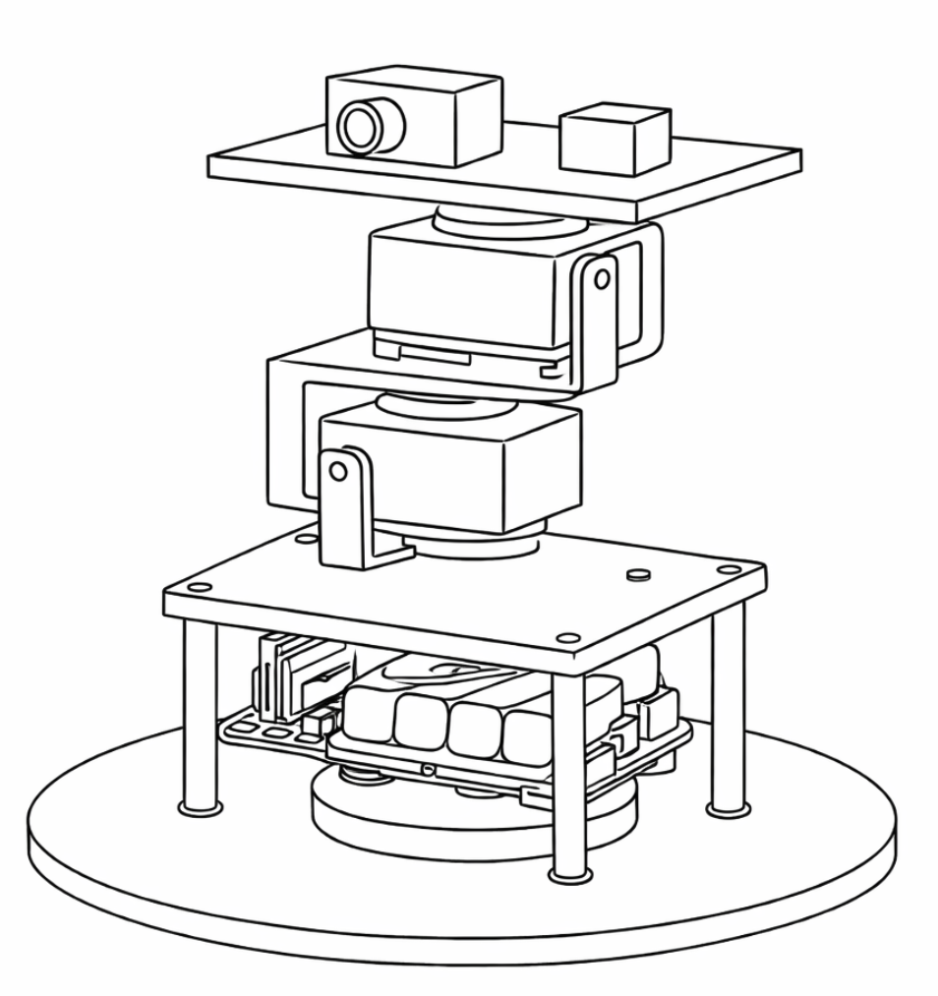
Schematic Diagram
Platform with camera / LiDAR
Accelerometer sensor
Motor 1 - counters rotation along x-axis
Motor 2 - counters rotation along z-axis
Motor 3 - counters rotation along y-axis
y
Controller + Power Supply
x
z

Slide 7
Initial Plan
Modelling the system in MATLAB Simulink.
Defining inputs and disturbances ( base rotation and tilt ).
Implementation of independent PID control loops for three motors.
Tuning the gain values to minimize overshoot and oscillations.

Slide 8
System Architecture ( High Level )
IMU Sensor
( MPU9250 )
PID Controller
( esp32 board )
DC-DC
Buck Converter
3.3 V
12 V
Power Supply
Servo Motor
( MG995 )
Motor Driver
( PCA9685 )
DC-DC
Buck Converter
6 V

Slide 9
Control Flow
Read rotation data from IMU sensor
Calculate error between desired & current orientation
Initialize IMU & servo motors
Orientation corrected
Generate counter torque in the individual motors
PID control

Slide 10
Material Requirements
S. No. | Item | Quantity | Purchase Link
1 | MG995 Servo Motors | 3 | Link
2 | Esp32 board | 1 | Link
3 | 12V Power supply | 1 | Link
4 | MPU9050 Accelerometer | 1 | Link
5 | DC-DC Buck Converter | 2 | Link
6 | Connecting Wires | As Needed | -

Slide 11
8 | Breadboard | 1 | -
9 | PCA9685 Servo Motor Driver | 1 | Link
10 | Servo Mount Brackets | 2 (important) | Link

