Slide 1

Q1 2026 · DIAGNOSTIC READOUT
Q1 2026 grew test volume — now prove what drove it
+10.26%
year-over-year test volume growth
The signal is strong. The cause is still open.
Notes:
Open with the distinction between a strong result and a proven explanation. Q1 test volume grew 10.26% year over year, but the supplied analysis does not establish what caused that increase.

Slide 2
ANALYSIS FRAME
The analysis joins volume, bookings, and campaign-linked revenue
Three views are connected so the growth signal can be tested rather than assumed.
01
02
03
Compare volume
Separate bookings
Link outcomes
Quarterly test volume across 2025 and 2026.
Unique bookings, including campaign-waiver bookings.
New-patient campaign activity, tests, and revenue.
Preparation steps are reconstructed at a high level because the original Python code was not supplied.
Notes:
Explain that the analysis joins three lenses. First, compare volume. Second, distinguish unique bookings from tests and isolate campaign-waiver bookings. Third, connect new-patient campaign activity to tests and revenue. The source did not include the original Python code, so do not overstate the preparation logic.

Slide 3
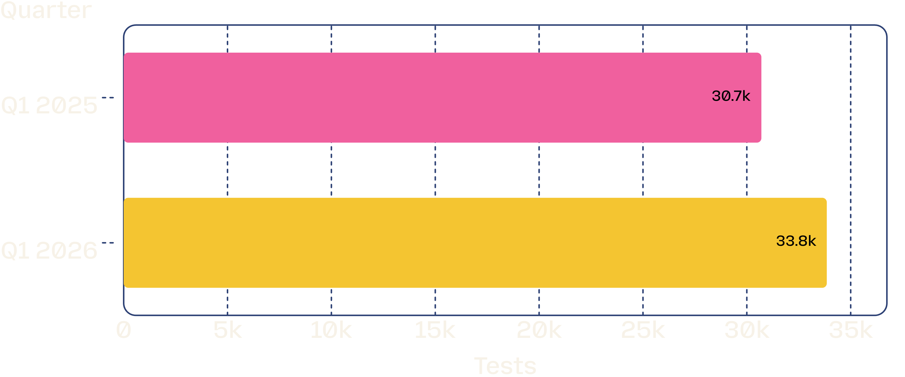
VOLUME SIGNAL
Q1 test volume increased 10.26% year over year
+3,149
tests in Q1
A stronger demand signal, with no causal driver established.
Q1 2025 versus Q1 2026 test volume
Notes:
The chart shows the headline result directly: Q1 2026 reached 33,849 tests versus 30,700 in Q1 2025, an increase of 3,149 tests or 10.26%. The result tells us that demand rose, not why it rose.
Source: q1-2025-test-volume-wfbz79hg.

Slide 4

CAMPAIGN MIX
Campaign-waiver bookings touched nearly half of Q1 tests
46.63%
of Q1 2026 tests
15,784 campaign-waiver bookings across 33,849 tests.
18,065 other bookings.
Campaign-linked activity is material enough to warrant deeper conversion and retention analysis.
Notes:
Use the donut to make the mix tangible. Campaign-waiver bookings account for 15,784 of 33,849 Q1 tests, or 46.63%. That is large enough to investigate seriously, but share of tests is still not the same as incremental impact.
Source: q1-2025-test-volume-wfbz79hg.

Slide 5
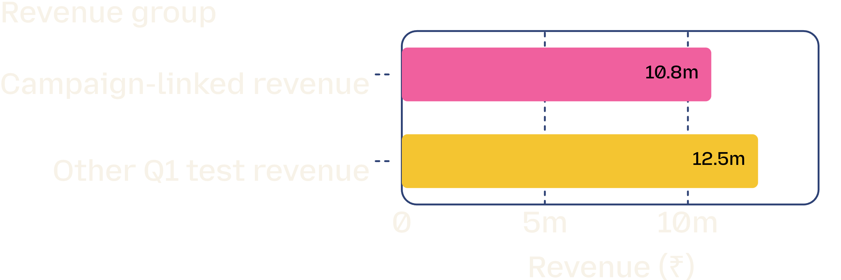
REVENUE SIGNAL
Campaign-linked revenue is meaningful, but not proof of lift
₹10.82M
campaign-linked revenue
₹3.48M came from 1,767 new patients using the campaign waiver, across 5,045 tests.
32.15% of campaign-linked revenue came from these new patients.
Campaign-linked revenue is 14.95% of total Q1 test revenue.
Association is visible; incremental revenue, profit, and campaign ROI remain unproven.
Notes:
The campaign-linked revenue total is meaningful, and the new-patient contribution is specific. But attribution alone cannot show lift. The supplied analysis does not establish incremental revenue, profit, campaign cost, gross margin, retention, or ROI.
Source: q1-2025-test-volume-wfbz79hg.

Slide 6
DECISION PATH
Act on the signal — measure incrementality before scaling spend
01
02
03
Validate the funnel
Test the counterfactual
Measure value
Waiver booking → new patient → tests → revenue.
Compare exposed patients with a matched or holdout group.
Add campaign cost, gross margin, and retention.
Takeaway: campaign activity is large enough to optimize, but the next decision should be based on incremental value rather than attributed revenue alone.
Notes:
Close with a practical next step, not a claim of causality. Validate the funnel, create a matched or holdout comparison, and add cost, margin, and retention to the next analysis. The campaign is large enough to optimize, but spend should scale only when incremental value is demonstrated.

