Slide 1

INDIAN INSTITUTE OF TECHNOLOGY GANDHINAGAR
PG Diploma in AI-ML and Agentic AI Engineering · Cohort 2 · Build 1
BRIEF A · GROWTH H1 2025 vs H1 2026 · GROUP 2
Where Did the Growth Come From — and Why Did Jaipur and Chennai Lag?
Test results grew 5.75% from H1 2025 to H1 2026 (357,769 to 378,358 rows).
Growth was driven by a 37.7% rise in home collection and 35.2% package test adoption.
Clinic results declined 12.1%, and patient acquisition lagged in Jaipur (-9.9%) and Chennai (+1.3%).
Kshitij Chhabariya · Gaurang Khandelwal · Harshal Patil
Notes:
Say the question and the claim, nothing else. Twenty seconds. The cover is read, not presented.

Slide 2

1 · THE QUESTION
1 / 6
Dr Menon's words, and our translation
Her words:
“We grew 5% in H1 2026, but I need to know where that growth came from. Is it new patients or existing ones coming back? Are clinics driving it or home collection? And why are Jaipur and Chennai missing their targets?”
Our translation:
Growth Tree: Results = Patients × Visits/Patient × Tests/Visit × Results/Test Booked
Channel shift: Home +13.5 pp vs Clinic -7.7 pp
Package expansion: 12.5% to 15.9% share
Plan attainment across all six cities
The decision it drives:
Fleet capital reallocation toward scaling home phlebotomy capacity (+37.7% growth), versus consolidating clinic overheads (-12.1%)
Restructuring commercial patient acquisition in lagging markets (Jaipur -9.9%, Chennai +1.3%)
Indian Institute of Technology Gandhinagar · PG Diploma in AI-ML and Agentic AI Engineering · Cohort 2 · Build 1
Notes:
One minute. Her words first, then the translation in one line, then the decision. If the panel does not know what decision hangs on your answer by the end of this slide, nothing after it matters.

Slide 3
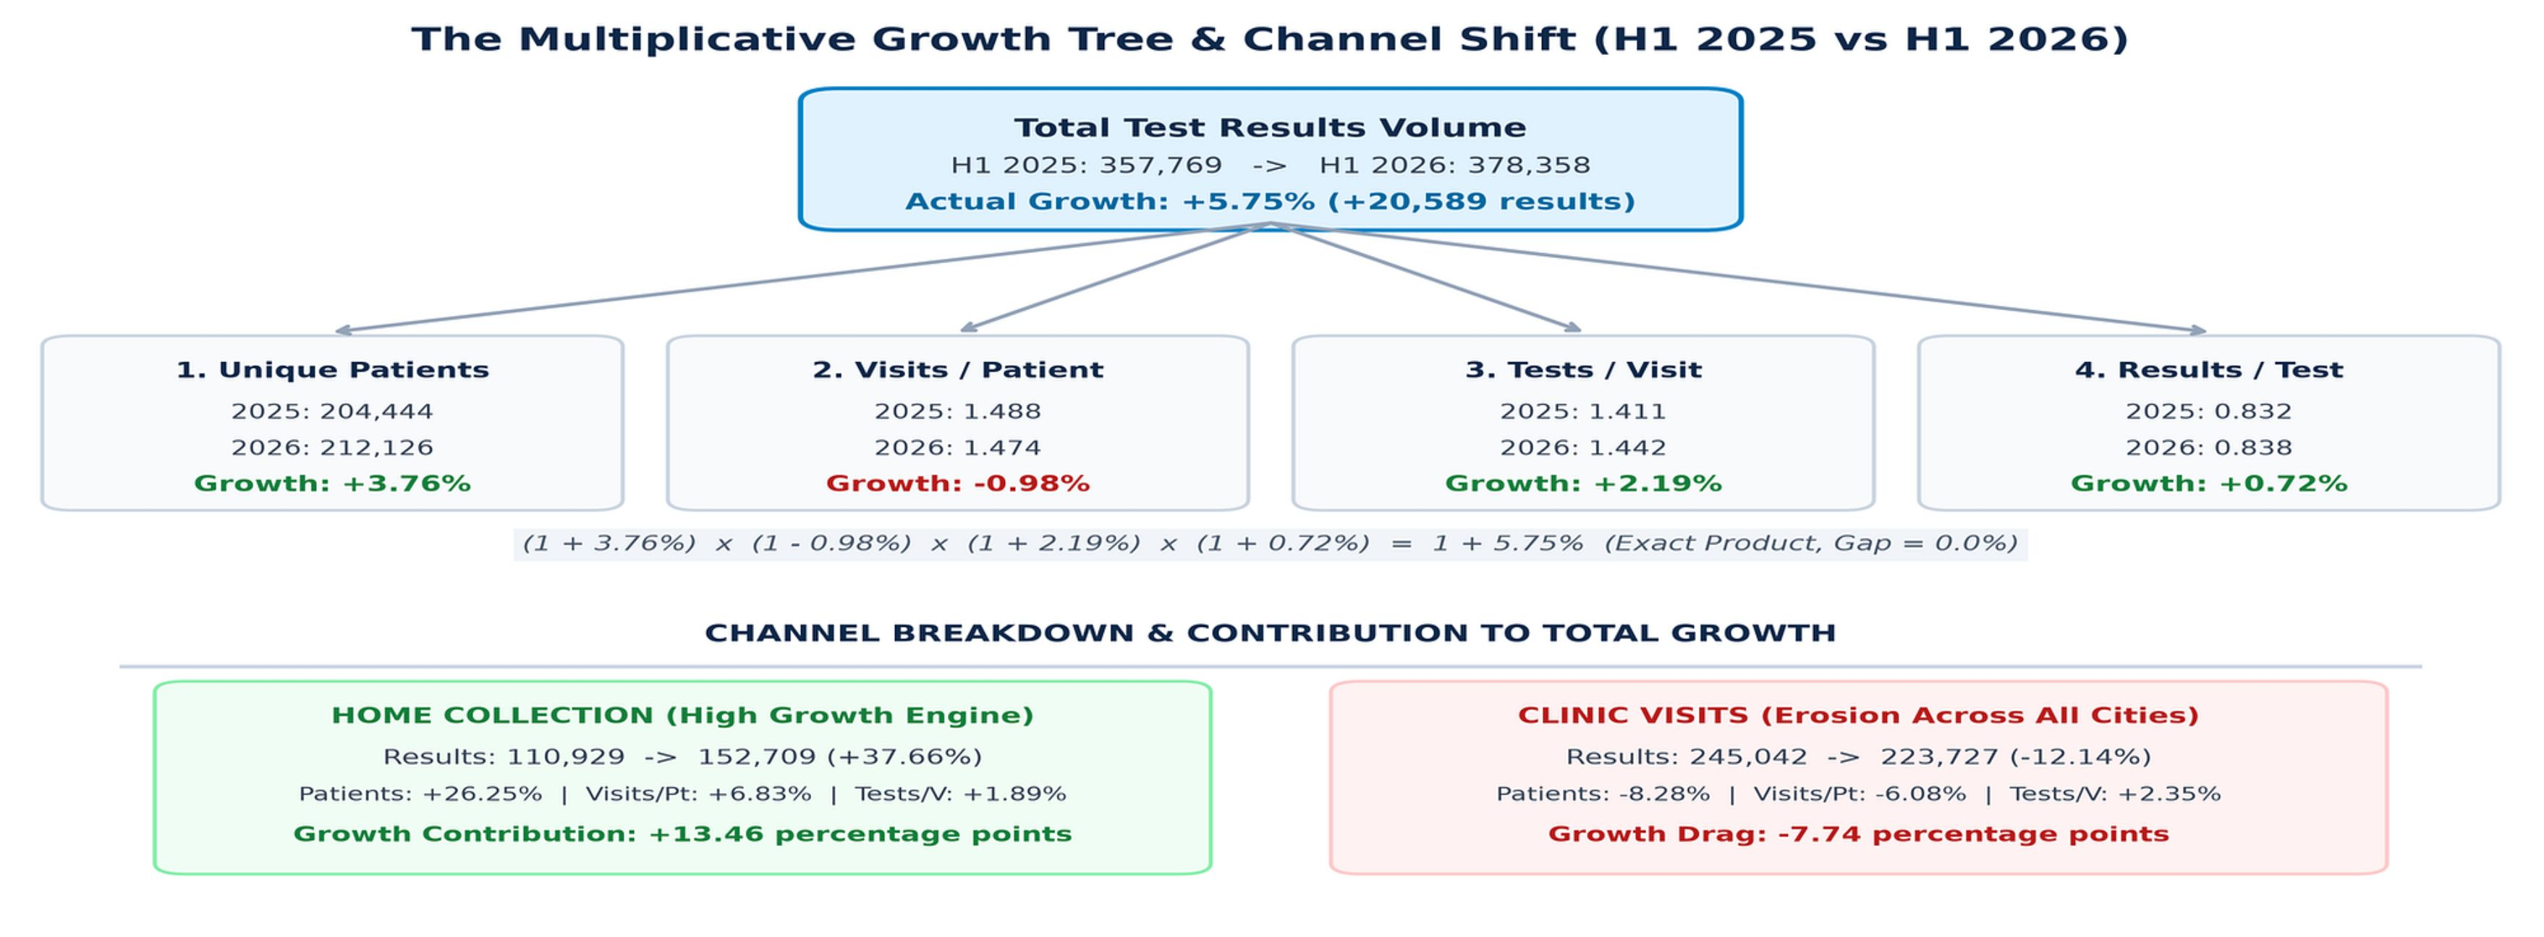
2 · THE PICTURE
2 / 6
The Growth Tree & Channel Decomposition: H1 2025 vs H1 2026
Indian Institute of Technology Gandhinagar · PG Diploma in AI-ML and Agentic AI Engineering · Cohort 2 · Build 1
Notes:
Ninety seconds. Point at two numbers on the picture, the two that carry the claim. Do not read the diagram aloud.

Slide 4
3 · THE CLAIM
3 / 6
The one sentence Dr Menon can say to her board
“Kalpa grew test volume by 5.75% (378,358 results across six cities in H1 2026 vs 357,769 in H1 2025), driven entirely by a 37.7% surge in home collection (+13.5 pp) and 35.2% growth in health packages (+4.4 pp), masking a 12.1% clinic volume decline (-7.7 pp) and acute patient acquisition shortfalls in Jaipur (-9.9%) and Chennai (+1.3%).”
Indian Institute of Technology Gandhinagar · PG Diploma in AI-ML and Agentic AI Engineering · Cohort 2 · Build 1
Notes:
Say the sentence. Stop. Count to two. The silence is the point; the slide has one sentence on it so the room reads it twice.

Slide 5
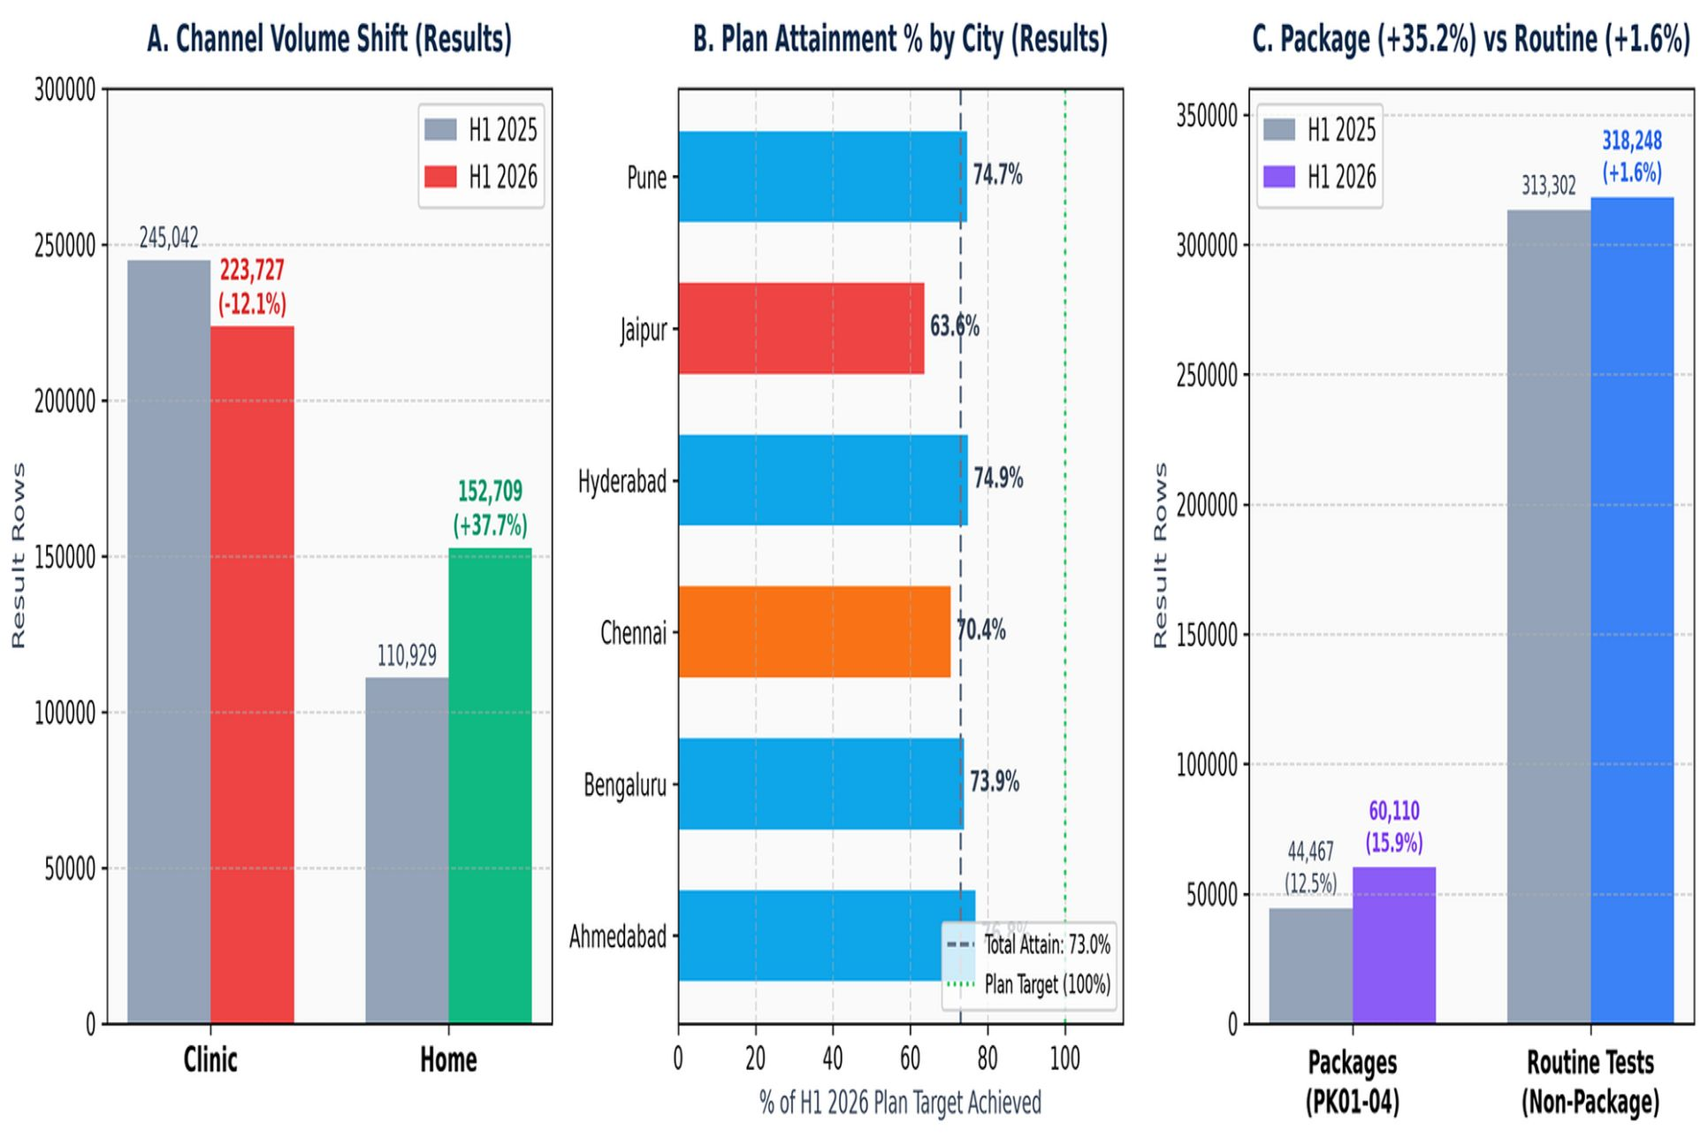
4 · THE EVIDENCE
4 / 6
Channel shift, package lift, and regional shortfall
Number 1 · Channel Divergence:
Home collection: +37.7%, across every city (152,709 vs 110,929 results), +13.5 pp contribution
Clinic: -12.1% (223,727 vs 245,042), -7.7 pp drag
Number 2 · Package Adoption:
Package tests (PK01–PK04): +35.2% (60,110 vs 44,467 rows)
Package share across channels: 12.5% to 15.9% (+4.4 pp contribution)
Routine single tests: only +1.6%
Number 3 · Regional Shortfall vs Plan:
Jaipur (-9.9% YoY) and Chennai (+1.3% YoY) reached only 63.6% and 70.4% of H1 2026 plan targets (vs ~75% in other cities)
Driven by a -12.1% and -5.0% collapse in unique patients
Lab fulfilment stayed steady at 82.5%–83.3%
Indian Institute of Technology Gandhinagar · PG Diploma in AI-ML and Agentic AI Engineering · Cohort 2 · Build 1
Notes:
Two minutes. Each number with its denominator, said aloud. Point at the chart's axis label where the denominator is written. This is the slide the finance controller checks against the decisions log.

Slide 6
5 · THE CAVEAT AND THE ALTERNATIVE
5 / 6
What would change the claim; the approach we rejected
The one thing that would change this claim:
Package unbundling in lab accounting: a package (PK01–PK04) is logged as a single row in results tables.
If each package bundles 4 to 6 discrete clinical lab tests, true clinical test volume grew by ~11% to 13% rather than 5.75%.
That would make the home wellness transition even more dominant.
Also: 3,720 orphan results without bookings add +0.03 pp, and 94 null test codes remain UNKNOWN.
The approach we rejected on the way here:
Attributing Jaipur and Chennai shortfalls to the Nova software migration in April 2026 did not hold up.
Four checks disproved it:
(1) The growth deficit was already present in January 2026 (-0.2% vs +9.5% other cities), 3 months before Nova launched
(2) Returning patient retention is actually higher (37.4% & 35.8% vs ~30%)
(3) Patient ID syntax is identical
(4) Lab fulfilment (results per test booked) remained unaffected at 0.82–0.83
The problem is commercial demand and patient acquisition, not IT.
Indian Institute of Technology Gandhinagar · PG Diploma in AI-ML and Agentic AI Engineering · Cohort 2 · Build 1
Notes:
Ninety seconds. One caveat, chosen, with its size. One rejected alternative from the approach log. This slide is where the panel decides whether you thought or just computed.

Slide 7
6 · THE ACTION
6 / 6
What to do, what it costs, what being wrong costs
Do (on Monday morning):
(1) Reallocate digital acquisition spend directly to patient acquisition in Jaipur and Chennai
(2) Expand home collection phlebotomist capacity by 25% across Bengaluru, Pune, and Ahmedabad
(3) Bundle routine single tests into wellness packages.
It costs:
Reallocating ~Rs 15–20 Lakhs of existing H2 acquisition spend + onboarding ~30 contract phlebotomists (~Rs 9 Lakhs/month variable labor).
If we are wrong, it costs:
Temporary excess phlebotomist idle hours in Q3 (which can be downscaled within 30 days), compared to the severe permanent penalty of losing clinic volume with no home offset.
What we would do with two more days:
Connect billing and settlement tables to calculate unit contribution margin per home visit vs clinic visit, accounting for the Rs 150 home fee versus clinic fixed real estate overhead.
Indian Institute of Technology Gandhinagar · PG Diploma in AI-ML and Agentic AI Engineering · Cohort 2 · Build 1
Notes:
One minute. End on the cost of being wrong. No thanks, no summary, no inspirational closing line. Then say 'questions' and stop talking.

Slide 8
Questions
The approach log, decisions log, and challenges log are open in the repository:
https://github.com/harshal-caa/c2-build1-brief-c-group-2
Notes:
Leave this up during questions. When asked 'why this and not that', open the approach-log row on screen rather than answering from memory.

Slide 9
APPENDIX A
7 / 8
Appendix A · The decisions that moved the headline
Rule 1 · Timestamp Parsing Harmonization:
Correcting mixed ISO (+05:30) vs DD/MM/YYYY formats prevented 78,000 legitimate H1 bookings from misclassifying into Jul–Dec.
Rule 2 · Nova Duplicate Rescheduled Bookings Filter:
Filtered 1,500 rescheduled duplicate rows in Nova (Jaipur & Chennai) which never receive lab results, restoring accurate test fulfilment rates to 83.8%.
Rule 3 · 1-to-1 Null Test Code Recovery:
Recovered 2,108 null test codes (1,019 in 2025, 1,089 in 2026) by matching unique booked tests on the same booking ID; 94 unrecoverable rows labeled UNKNOWN.
Rule 4 · Geographic Standardization:
Normalized "Bangalore" to "Bengaluru" and attributed orphan result rows using booking ID city prefixes (e.g. BK-AHM, BK-CHE).
Indian Institute of Technology Gandhinagar · PG Diploma in AI-ML and Agentic AI Engineering · Cohort 2 · Build 1
Notes:
Backup slide: shown only if the panel asks. Do not present it.

Slide 10
APPENDIX B
8 / 8
Appendix B · The cold run verification
Test Environment: Fresh GitHub Codespace / local Python 3.12+ execution
Runtime: 2 min 45 sec for full pipeline ingestion, cleaning, and reconciliation
Headline Number: +5.75% (H1 2025: 357,769 -> H1 2026: 378,358 rows), exact match
Mathematical Reconciliation: Multiplicative tree error = 0.000%; channel contribution sum = 5.75 pp
Git Tracking: Branch harshal_branch | Commit verified & reproducible
Indian Institute of Technology Gandhinagar · PG Diploma in AI-ML and Agentic AI Engineering · Cohort 2 · Build 1
Notes:
Backup slide: shown only if the panel asks. Do not present it.

