Slide 1
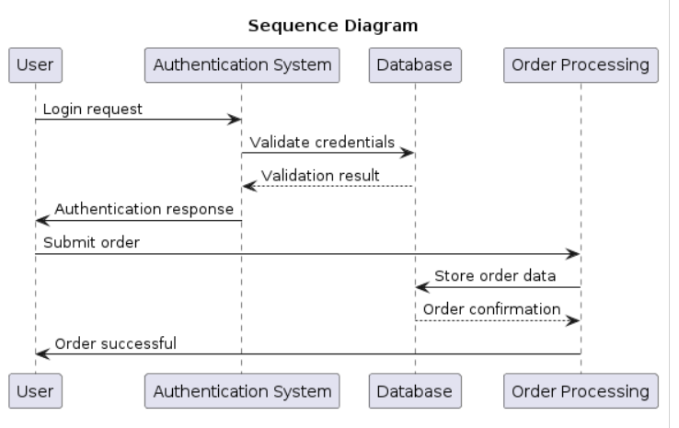
PlantUML: Efficient Diagramming for Developers
What is PlantUML?
PlantUML is a tool that allows users to create diagrams using a plain text language.
It is particularly popular for generating UML (Unified Modeling Language) diagrams, extensively used in software engineering to visualize system designs.
Diagram as code- allows us to track the architecture diagram changes in any version control system
Supported Diagram Types:
Sequence diagrams
Use case diagrams
Class diagrams
Activity diagrams
Component diagrams
State diagrams
And more: https://plantuml.com/
Notes:
If you find traditional diagramming tools cumbersome and time-consuming,
As a powerful, open-source solution, PlantUML allows you to generate a wide variety of UML diagrams, including the indispensable sequence diagram, directly from simple text descriptions.
Let's explore how PlantUML can streamline your software development process, enhance communication, and improve documentation.
@startuml
title Sequence Diagram
participant User
participant "Authentication System" as Auth
participant Database as DB
participant "Order Processing" as OP
User -> Auth: Login request
Auth -> DB: Validate credentials
DB --> Auth: Validation result
Auth -> User: Authentication response
User -> OP: Submit order
OP -> DB: Store order data
DB --> OP: Order confirmation
OP -> User: Order successful
@enduml

Slide 2
Why Should We Use PlantUML
Code-centric: Diagrams are defined as text, promoting consistency and easier maintenance
Version Control Integration: Track diagram history alongside your code changes using Git or similar systems.
Platform Agnostic: Works in project confluence, within your IDE, or as a command-line tool – flexibility is key.
Open Source & Extensible: Free to use, with a vibrant community for support and customization.
Automation: The text-based nature also allows for automation in generating diagrams, making it suitable for dynamic documentation needs.
Notes:
Diagrams become part of your codebase – easier to create, update, and manage.
Integrate it with your version control system for seamless documentation that evolves alongside your project.
PlantUML's flexibility lets you work how you want, and its open-source nature means it's both cost-effective and adaptable to project needs.

Slide 3
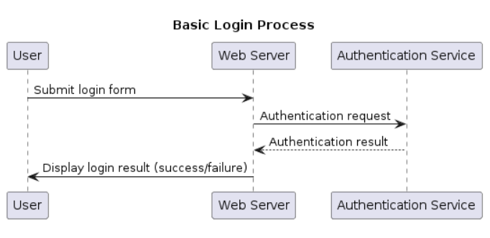
Sequence Diagrams: Understanding Interactions
Modeling the Message Flow: Map out how components in your system or user interactions with your software unfold over time.
Participants: Entities – objects, systems, or actors – represented by vertical lifelines.
Messages: Interactions are visualized as horizontal arrows with varied arrowheads for different message types.
Chronological Order: Top to bottom represents the progression of time.
Notes:
Sequence diagrams are essential tools for unraveling the communication pathways within our application.
They identify the players involved, the exchanges that happen, and the order in which processes occur.
This clarity is invaluable for debugging, designing new features, and onboarding new team members.
@startuml
title Basic Login Process
participant User
participant "Web Server" as WS
participant "Authentication Service" as Auth
User -> WS: Submit login form
WS -> Auth: Authentication request
Auth --> WS: Authentication result
WS -> User: Display login result (success/failure)
@enduml

Slide 4
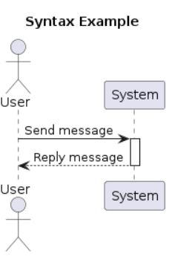
PlantUML Sequence Diagram Syntax
Clarity and Conciseness: PlantUML uses a straightforward textual language.
Start/End: @startuml and @enduml tags enclose your diagram definition.
Participants: Introduced with the participant keyword.
Messages: Arrows (->, -->, etc.) define interactions.
Activation: Rectangles on lifelines show when a participant is actively engaged.
Notes:
PlantUML's syntax is beautifully simple.
In contrast to the tedious drag-and-drop interfaces and complex menus often found in traditional tools, PlantUML uses a small set of keywords and symbols that let you efficiently model complex interactions.
The primary focus remains on the logic of your system, freeing you from time-consuming diagram tweaking tasks.
@startuml
title Syntax Example
actor User
participant System
User -> System: Send message
activate System
System --> User: Reply message
deactivate System
@enduml

Slide 5
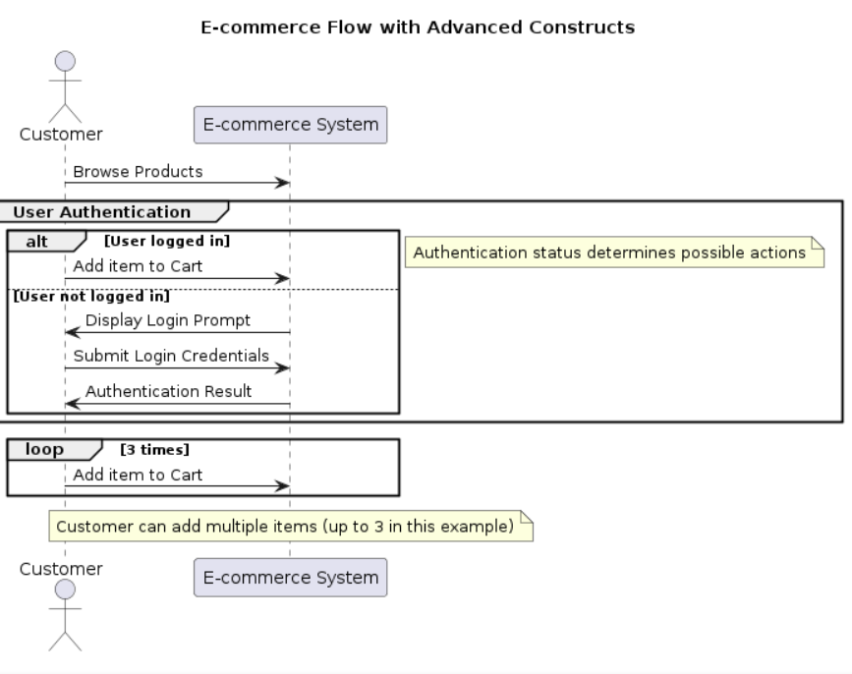
Mastering Advanced Constructs
Loops: loop for repetitive sequences
Conditionals: alt/else model decision points and branching logic.
Annotations: note for adding clarifying comments.
Grouping: group to visually organize related actions.
Notes:
PlantUML's syntax is beautifully simple.
In contrast to the tedious drag-and-drop interfaces and complex menus often found in traditional tools, PlantUML uses a small set of keywords and symbols that let you efficiently model complex interactions.
The primary focus remains on the logic of your system, freeing you from time-consuming diagram tweaking tasks.
@startuml
title E-commerce Flow with Advanced Constructs
actor Customer
participant "E-commerce System" as System
Customer -> System: Browse Products
group User Authentication
alt User logged in
Customer -> System: Add item to Cart
else User not logged in
System -> Customer: Display Login Prompt
Customer -> System: Submit Login Credentials
System -> Customer: Authentication Result
end
note right: Authentication status determines possible actions
end
loop 3 times
Customer -> System: Add item to Cart
end loop
note over System: Customer can add multiple items (up to 3 in this example)
@enduml

Slide 6
Live Demo: User Login Flow

Slide 7
References
PlantUML Website: The definitive source for documentation, syntax, and examples.
https://plantuml.com/
https://github.com/plantuml/plantuml
Online PlantUML Editor:
Test and generate diagrams directly in your browser. http://www.planttext.com/
IDE Integration Guides:
Intellj: https://plugins.jetbrains.com/plugin/7017-plantuml-integration
Eclispe: https://marketplace.eclipse.org/content/plantuml-plugin
More about sequence diagrams:
https://developer.ibm.com/articles/the-sequence-diagram/
https://www.cs.odu.edu/~zeil/cs330/latest/Public/sequenceDiagrams/index.html

