Slide 1

JavaScript
Revisiting the basics

Slide 2

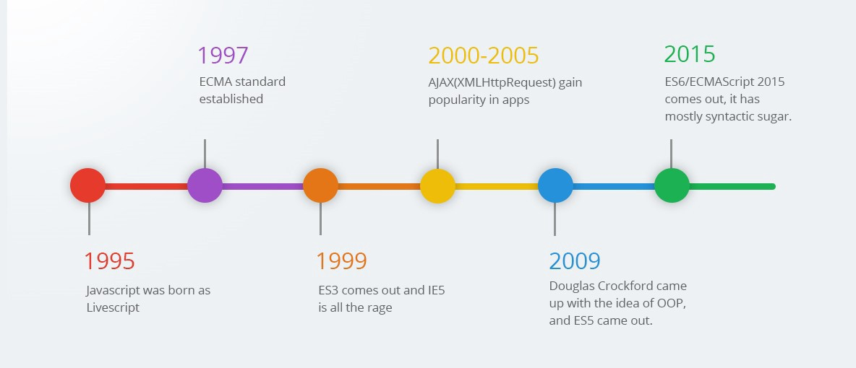
Emergence of JavaScript

Slide 3
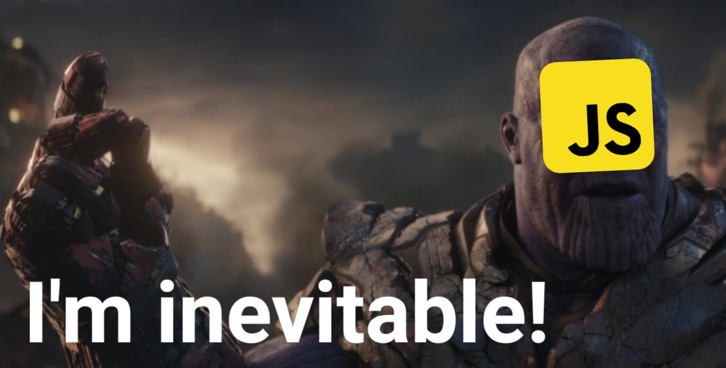
Power of JavaScript
Front End
Back End,
Mobile Development,
AI & Machine Learning

Slide 4
Introduction
JavaScript is a text-based programming language used both on the client-side and server-side that allows you to make web pages interactive. Where HTML and CSS are languages that give structure and style to web pages, JavaScript gives web pages interactive elements that engage a user.
JavaScript can execute on browsers, servers or any device that has JavaScript Engine.
Chrome ,Opera and Edge uses V8 engine & Firefox uses Spider Monkey engine.
The ECMAScript specification is its standardized specification
ES6 introduced in 2015 is widely used and talked about, since it introduced many new features to the language. https://caniuse.com/
Plethora of new languages appeared, which are transpiled (converted) to JavaScript before they run in the browser. E.g., Typescript, Coffeescript

Slide 5
IDE’s (Integrated Development Environment)
VS Code
Atom
Sublime Text
Notepad ++
Browsers Developer Console

Slide 6
Concepts
“use strict” - For a long time, JavaScript evolved without compatibility issues. New features were added to the language while old functionality didn’t change. That had the benefit of never breaking existing code. But the downside was that any mistake or an imperfect decision made by JavaScript’s creators got stuck in the language forever.
It catches some common coding bloopers, throwing exceptions.
It prevents, or throws errors, when relatively "unsafe" actions are taken (such as gaining access to the global object).
It disables features that are confusing or poorly thought out.
"use strict"
x=2;
alert(x);

Slide 7
Concepts
Var
Variables, declared with var, are either function-scoped or global-scoped. Variables declaration is hoisted.
Declarations are hoisted, but assignments are not.
Can be redeclared
Let
It is block-scoped
Not hoisted
Cannot be redeclared
Const
is like let, but the value of the variable can’t be changed.

Slide 8
Concepts
JavaScript, is “dynamically typed”, meaning that there exist data types, but variables are not bound to any of them.
// Below statement is valid let message = "hello"; message = 123456;
There are two types of data types in JavaScript. Primitive data type (String, Number, Boolean, Null, Undefined) Non-primitive (reference) data type - (Array, Object)

Slide 9
Concepts
Primitives are known as being immutable data types because there is no way to change a primitive value once it gets created.
A primitive value can be replaced, but it can’t be directly altered.
Primitive is compared by value. Two values are strictly equal if they have the same value.
Non-Primitives are known as mutable data types because we can change the value after creation.
A Non-Primitive value can be altered.
Objects are not compared by value; they are being compared by reference.

Slide 10
Concepts
Operators
Addition +
Subtraction -
Multiplication *
Division /
Remainder % // 8 % 3 = 2
Exponentiation ** // 2² = 4
For a strict equality check ===
For a non-strict check ==

Slide 11
Concepts
Function Declaration:
function greet() { alert( "Hello" ); } Function Expression:
let greet = function() { alert( "Hello" ); };
Callback Functions
Arrow Functions

