Slide 1
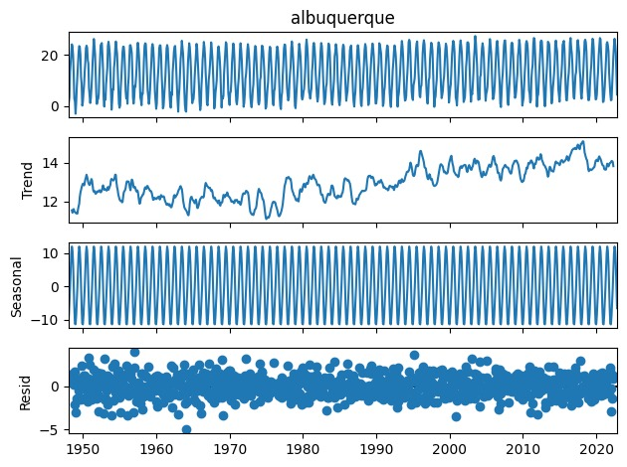
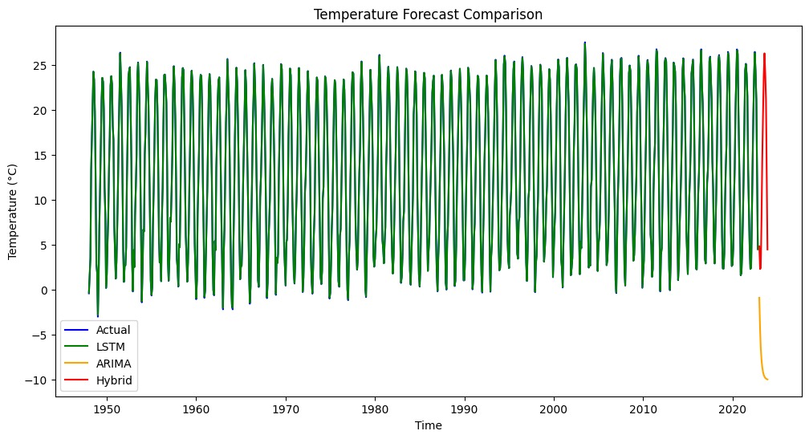
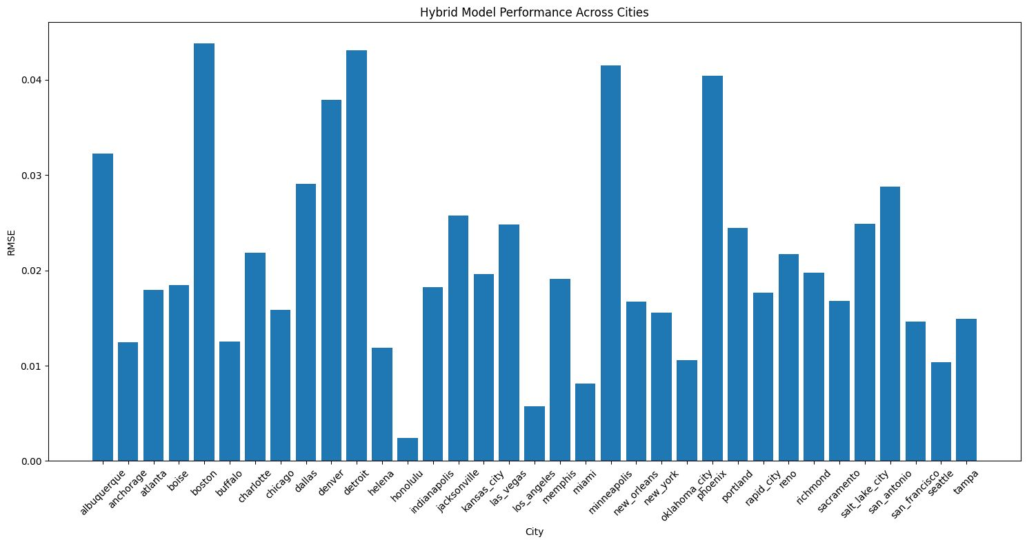
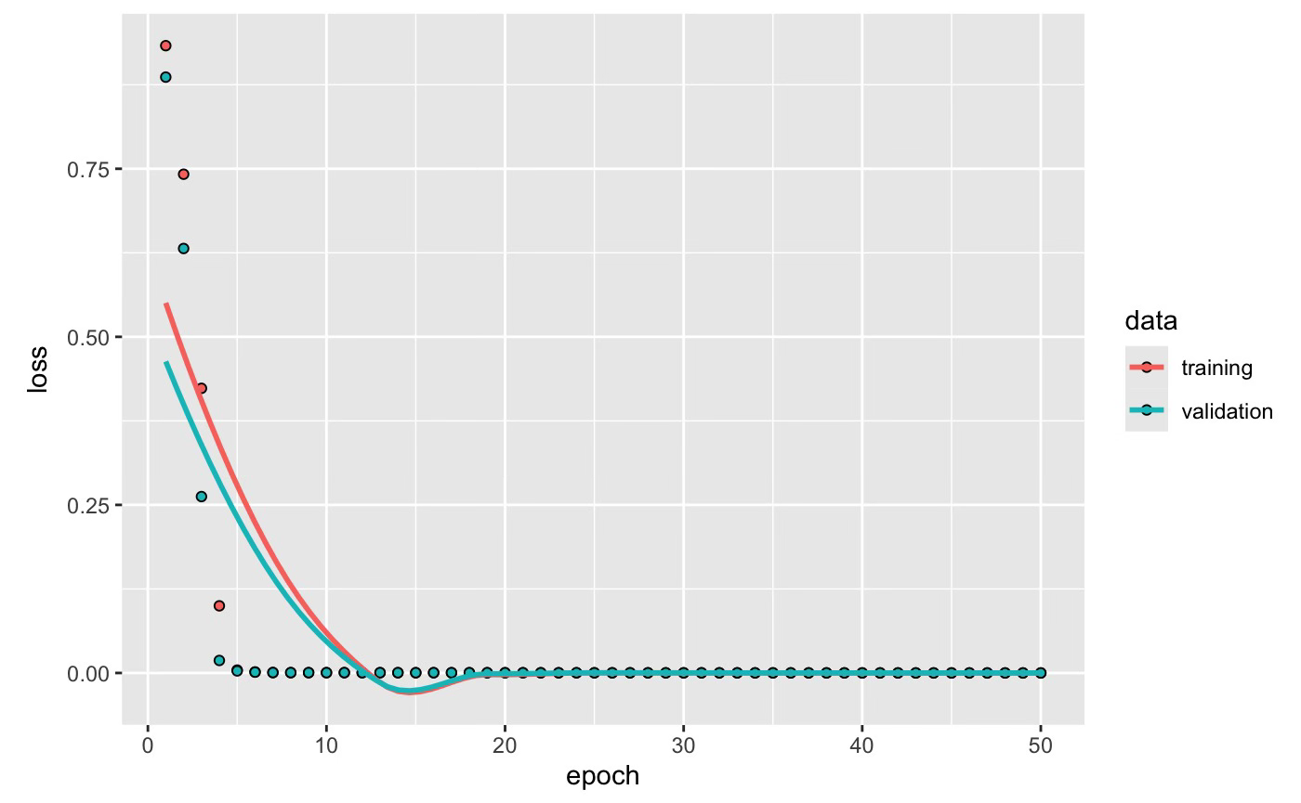

TEMPERATURE FORECASTING USING ARIMA-LSTM HYBRID MODELS.
Harshal Patil , Mrudula Deshmukh , Siddhi Nalawade
Introduction
The purpose of this project is to address an expanding desire for precise weather forecasts in fields such as agriculture, energy, and transportation. It seeks to improve short-term temperature prediction by utilizing ARIMA, LSTM, and hybrid models, empowering companies to make well-informed and effective decisions.
Methods
Developed and compared three approaches :
ARIMA: A statistical model effective for capturing trends and seasonality.
LSTM: A deep learning model ideal for handling long-term dependencies and non-linear patterns.
Hybrid ARIMA-LSTM: This combines ARIMA's precision for linear patterns with LSTM's flexibility, dynamically adjusting weights to adapt to diverse climatic conditions.
Approach
Data preprocessing steps:
Normalization of temperature data
Stationarity checks with Augmented Dickey-Fuller (ADF) test
ARIMA Implementation:
ARIMA(1,1,1) model configuration based on ADF test results
Captures linear trends and seasonal patterns
Struggles in regions with high temperature variability
LSTM Implementation:
Two-layer LSTM with dropout regularization
Optimizer: Adam
Loss Function: Mean Squared Error
Hybrid Model Development:
Initial Simple Hybrid: Equal split of ARIMA and LSTM predictions.
Dynamic Weighting: Adjusted weights based on model performance (RMSE).
Balanced Integration: Prioritizes ARIMA for linear trends and LSTM for non-linear patterns.
Results
Hybrid Model Performance:
Achieved RMSE < 0.03 in diverse climates.
Outperformed ARIMA and LSTM consistently.
Regional Performance:
Best in coastal cities
(e.g., Honolulu, San Francisco).
Moderate in desert (e.g., Phoenix) and continental
(e.g., Boston) regions.
Scalability:
Effective across 35 U.S. cities, adapting to varied climates.
MODEL | RMSE | Weight
LSTM | 0.0977 | 0.9984
ARIMA | 24.1407 | 0.0016
Simple Hybrid | 12.0735 | N/A
Weighted Hybrid | 0.0579 | N/A
LSTM
Conclusion
The hybrid ARIMA-LSTM model successfully integrates the strengths of statistical and deep learning methods, providing highly accurate short-term temperature forecasts. Its adaptability makes it effective across diverse climates, with exceptional performance in stable regions. Looking ahead, there are several opportunities to enhance the model. Incorporating additional weather parameters like humidity and wind speed could improve forecast accuracy, while integrating real-time data through API connections would enable live forecasting capabilities. Furthermore, optimizing the model for regions with high climate variability will help improve its performance in more dynamic environments.
Multi City Model

