Slide 1
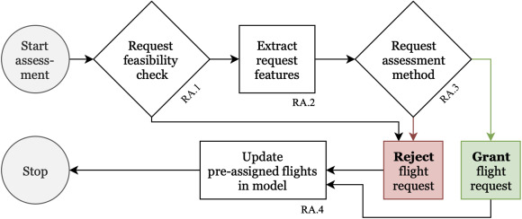
Dynamic rostering framework
Dynamic rostering framework that evaluates flight requests over time
Historical rostering and flight request data (on both submitted requests and corresponding decisions)
Applying the rolling roster modeling approach using the Time Space-Network and the Shortest Path Algorithm
Creating the below Flight Request Assessment FrameWork

Slide 2
Neural Network
01
Use the Historical Data of the request grants
Learn from previously made decisions on whether to grant or reject a request
02
Create Neural Network Model
Scikit Learn Based MLPClassifier
03
Identify Important feature from the model and making informed decisions
Example Important Features void length between the requested pairing and the previously assigned pairing in the roster for the given pilot.
KPI=(# ​granted ​flight ​requests)2(# ​required ​additional ​FTE ​+ ​1)2
FTE = full-time equivalent (FTE) employee

