Slide 1
ECE3099-INDUSTRIAL INTERNSHIP ON ANDROID CONTROLLED ROBOT USING BLUETOOTH at ECIL , Hyderabad
Register No: 17BEC1195
Name: M. B. V. SRI HARSHA

Slide 2
Industry Address & Contact Numbers
Industry Name: Electronics Corporation Of India Limited
Location: Hyderabad
Contact Person: SRIDHARA SHETTY , AGM,ECIL
Contact Number: 040-27125864,27122816

Slide 3
About The Company
Electronics Corporation of India Limited (ECIL) is a Government of India Enterprise under the Department of Atomic Energy, established on April 11, 1967 by A. S. Rao at Hyderabad, to create a strong indigenous base in electronics.
It has a strong presence in indigenous Electronic security, Communications, Networking and e-governance domains.
It also actively supports other strategic sectors such as indigenous Defence Indian Ordnance Factories, (Defence Research and Development Organisation (DRDO)), Space (Department of Space (India))Civil Aviation, Information and Broadcasting, Telecommunications, Insurance, Banking, Police and Para-military Forces, Oil and Gas, Power, Space Education, Health, Agriculture, Steel and Coal
ECIL is credited with producing the first indigenous digital computers, TDC 312 and TDC 316, solid state TV, control and instrumentation for nuclear power plants and first earth station antenna of India.

Slide 4
Objective Of the Training
Study, Analyse and having hands on training in the field of Embedded Systems and developing its applications in Industries like ECIL using various development boards of Arduino or Microcontrollers.

Slide 5
Overview of the Project
Now a days smart phones are becoming more powerful with reinforced processors, larger storage capacities, richer entertainment function and more communication methods. Bluetooth is mainly used for data exchange; add new features to smart phones. Bluetooth technology, created by telecom vendor Ericsson in 1994, shows its advantage by integrating with smart phones.
It has changed how people use digital device at home or office, and has transferred traditional wired digital devices into wireless devices. A host Bluetooth device is capable of communicating with up to seven Bluetooth modules at same time through one link . Considering its normal working area of within eight meters, it is especially useful in home environment.

Slide 6
Overview of the Project
Using a Smartphone as the “brain” of a robot is already an active research field with several open opportunities and promising possibilities. In this paper we present a review of current robots controlled by mobile phone and discuss a closed loop control systems using audio channels of mobile devices, such as phones and tablet computers. In our work, move the robot upward, backward, left and right side by the android application such as Arduino Bluetooth RC Car.

Slide 7
In this project, we will learn how to make Wireless Bluetooth Controlled Robot Car Using Arduino. The robotic car can be controlled wirelessly via a Smartphone. The smartphone has an Android app through which the user can send commands directly to Robot. The robot can move forward, backward, left and right and can also be stopped.
The Arduino’s Bluetooth controlled robot car is interfaced with a Bluetooth module HC-05 or HC-06. We can give specific voice commands to the robot through an Android app installed on the phone. At the receiving side, a Bluetooth transceiver module receives the commands and forwards them to the Arduino and thus the robotic car is controlled.

Slide 8
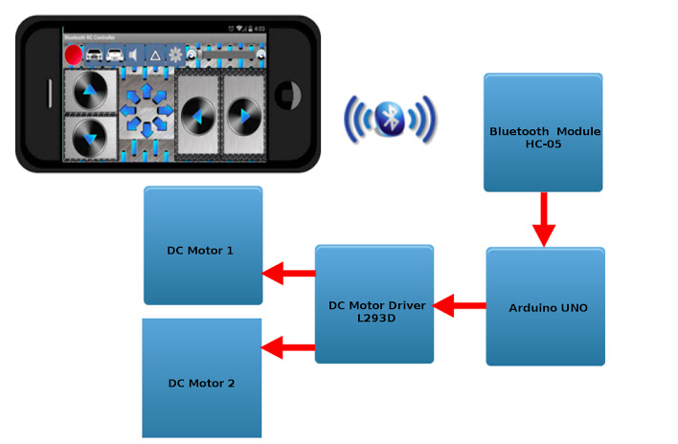
Block Diagram

Slide 9
Components Required
Arduino UNO
Motor Driver L293D
Bluetooth Module HC-05
Jumper Wires
Two Wheel Drive Robot Car Chassis with DC Motor
Bread Board
9V Battery
9v Battery Clip with Male Dc Plug for Arduino

Slide 10
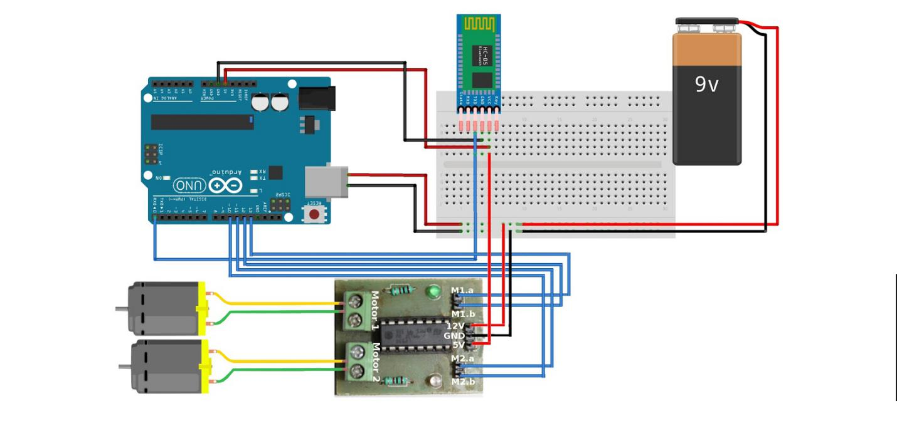
Circuit Diagram

Slide 11
Working
The Android Application that we are going to use for this project. This Application can be downloaded from the Android Playstore.
The Name of the Application is: Arduino Bluetooth RC Car
Now let me try to explain the working of this project. The Circuit will get ready to receive commands once the Android Application is successfully paired with the Bluetooth Module HC-05.
When a button is pressed(Suppose Forward Button) a value will be sent(Value "F") and it will be received by the Bluetooth Module. This Value again will be sent to Arduino UNO by the Bluetooth Module.
Once Arduino receives the Value it will check what action need to be taken according to the value received. In this case Arduino will set digital pins 10 to 13 in such a way that the DC Motor will rotate in forward direction.

Slide 12
working
The digital pins 10-13 of Arduino UNO is connected to the input pins of DC Motor Driver M1.a,M1.b,M2.a and M2.b respectively. Output pins of DC Motor driver will be connected to the DC Motors. This way Arduino will start to control the DC Motors using their Digital pins 10-13

Slide 13
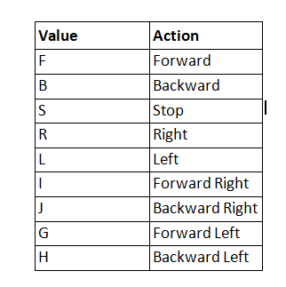
The Table shown below explains the Value and action that are used for this project.

Slide 14
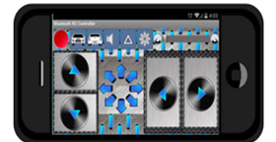
The Android App

Slide 15
Advantages :
Wireless control:- By using this project wireless control can be within the hands of user.
Monitoring:- This circuit allow monitoring of all appliances within range of communication with Bluetooth
Manual control:- Manual control is given so that even an unskilled user can change the current status.

Slide 16
Disadvantages
1. Bluetooth range:
It is good to use Bluetooth for automation but automation is kept within a range 0f 10-30metres. So control can’t be achieved from outside range.
2. ARDUINO
The structure of Arduino is its disadvantage as well. During building a project you have to make its size as small as possible. But with the big structures ofArduino we have to stick with big sized PCB’s. If you are working on a small micro-controller like ATmega8 you can easily make your PCB as small as possible.

Slide 17
FUTURE SCOPE:
It can be built further to work as a HUMANOID robot.
It can have many uses in practical fields like working in industries.
The proposed robot can be further improved in terms of decision taking capabilities by employing varied types of sensors and thus could be used in big industries for different applications.

Slide 18
CONCLUSION
The conclusion of the paper is to realize the smart living , more specifically the home lighting control system using Bluetooth Technology. Robot and smartphones are a perfect match, specially mobile robots. As phones and mobile devices are each time more powerful, using them as robot for building robot with advanced feature such as voice recognition. Android Bluetooth-enable phones and Bluetooth module via HC-06 and communication among Bluetooth devices. It is concluded that smart living will gradually turn into a reality that consumer can control their home remotely and wirelessly.

Slide 19
REFERENCES
www.ecil.co.in
https://www.labcenter.com
www.keil.com
https://www.electronicshub.org
www.wikipedia.com

Slide 20
THANK YOU

