Slide 1
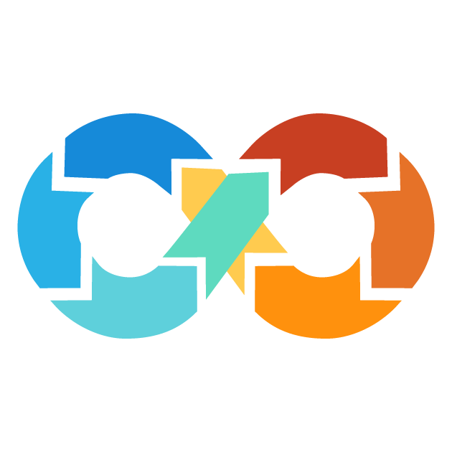






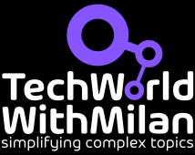








Ending slide
With Learning resources

Slide 2





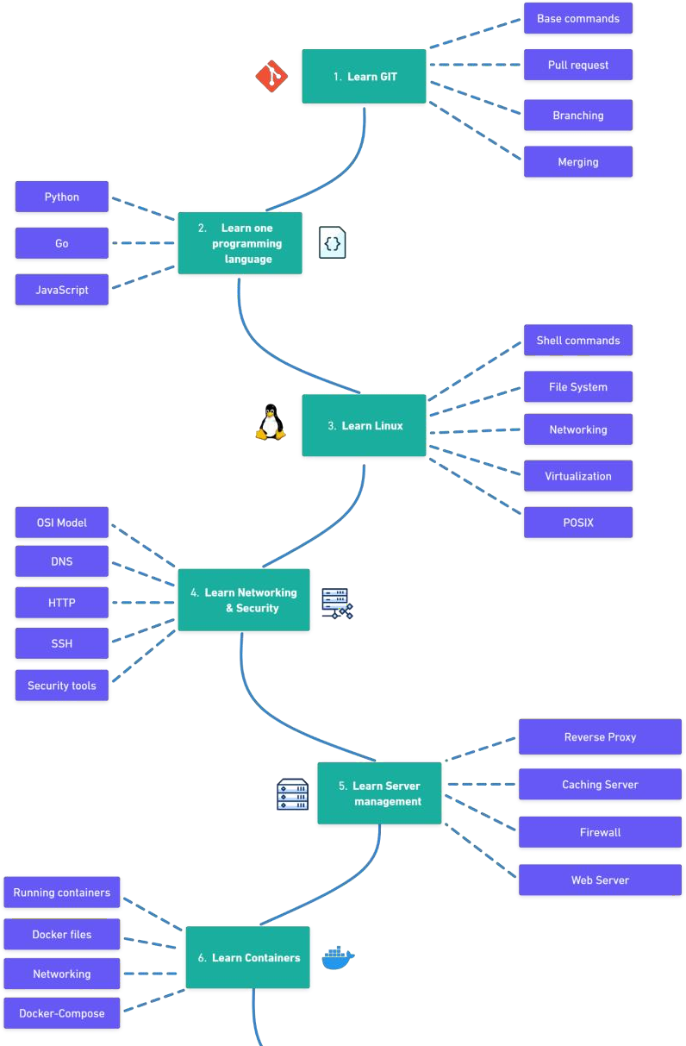

Slide 3
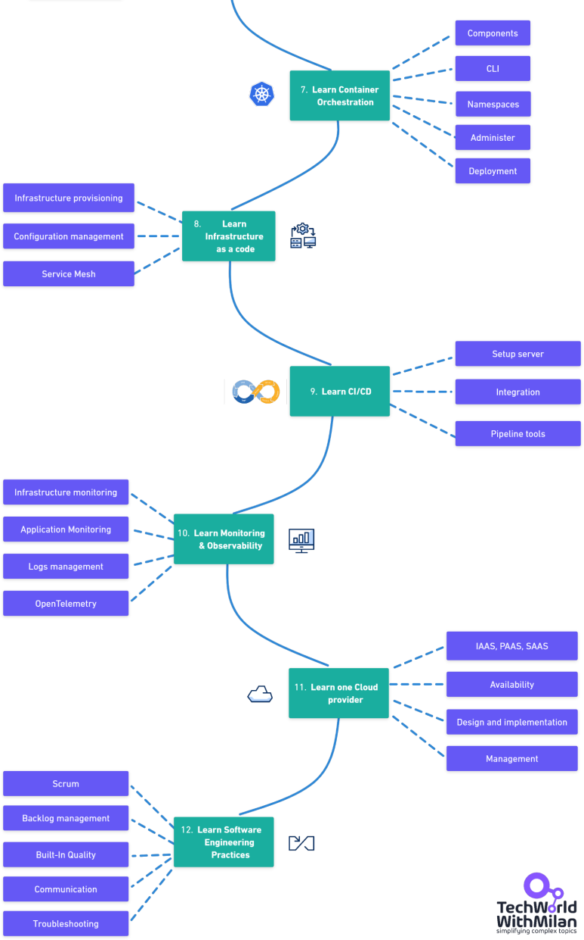

Slide 4


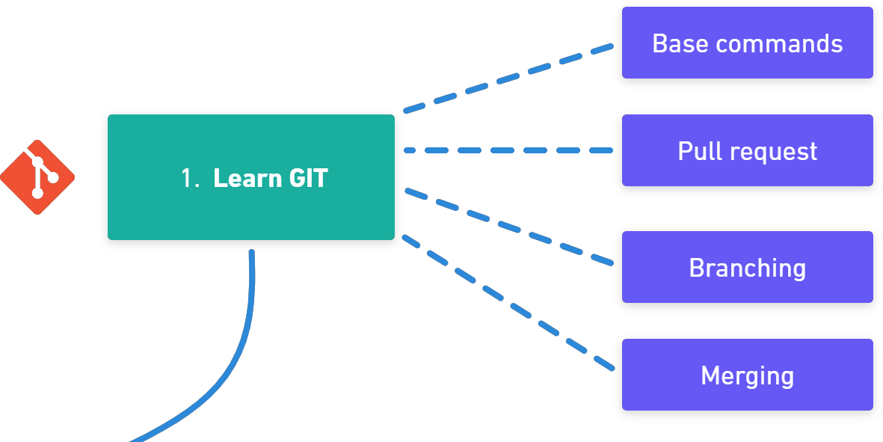


All your resources (files) will be held in a GIT repository. Those files are application code but also infrastructure as a code. Git is a free tool used for source code management. Git is used to tracking changes in the source code, enabling multiple developers to work together on non-linear development. The two most popular Git platforms are GitLab and GitHub. Here you need to learn Git commands, like git clone, branch, merge, and how to collaborate on a project with pull requests.
Learning resources
https://www.atlassian.com/git https://learngitbranching.js.org/ https://www.codecademy.com/learn/learn-git
GitLab
GitHub

Slide 5
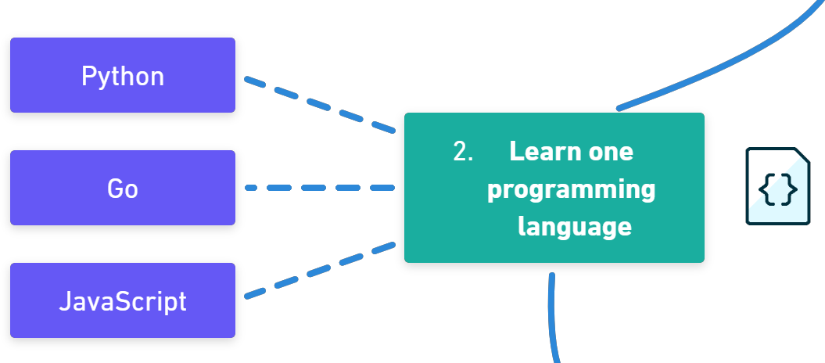


As an engineer, it is recommended to know at least one programming language that you can use to write automation scripts. Some popular programming languages for DevOps-es are Python, Go, and JavaScript. Python is a multi-paradigm language. Being an interpreted language, code is executed as soon as it is written, and the syntax allows for writing code in different ways. Python is frequently recommended as the first language new coders should learn, because of its focus on readability, consistency, and ease of use. Here you need to learn basic concepts of programming languages, such as syntax, if/else, loops, data structures, etc.
Learning resources
https://automatetheboringstuff.com/ https://eloquentjavascript.net/ https://ehmatthes.github.io/pcc/

Slide 6
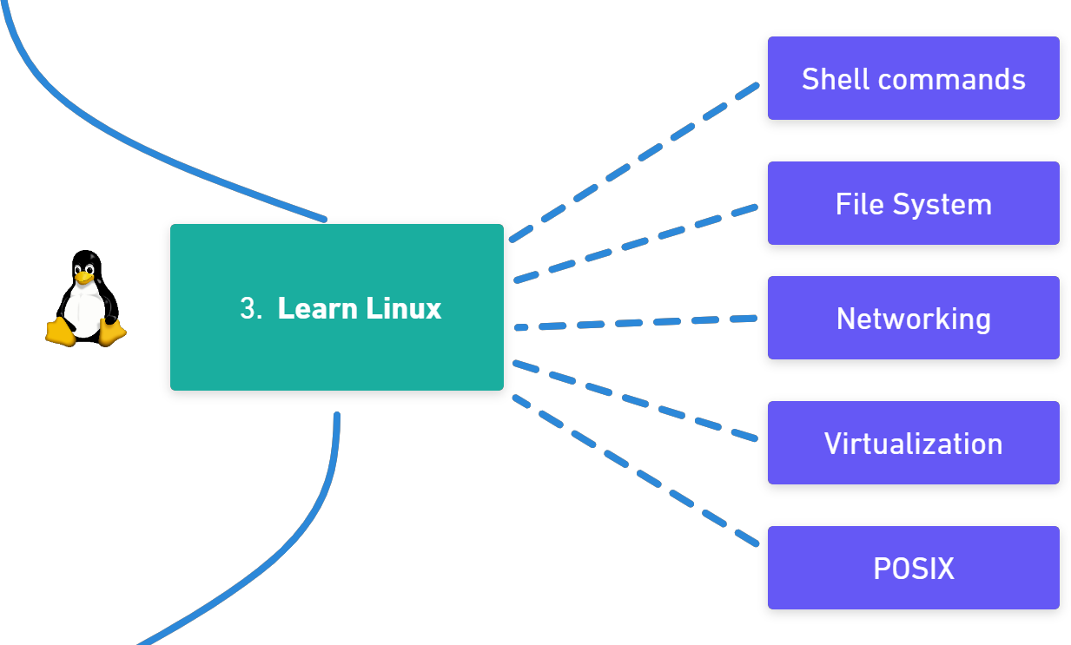
An Operating system serves as a bridge between a computer's user and its hardware. Its function is to offer a setting in which a user can conveniently and effectively run programs. As most servers use Linux OS, you need to make yourself comfortable with Linux and its CLI. One easy-to-start distribution is Ubuntu. In addition, you need to know scripting to automate tasks for development and operations. Here you can learn OS-specific languages, such as Bash or Powershell, or independent, like Python or Go.
Learning resources
https://www.tutorialspoint.com/operating_syst em/os_overview.htm https://www.shellscript.sh/ https://www.guru99.com/powershell- tutorial.html

Slide 7
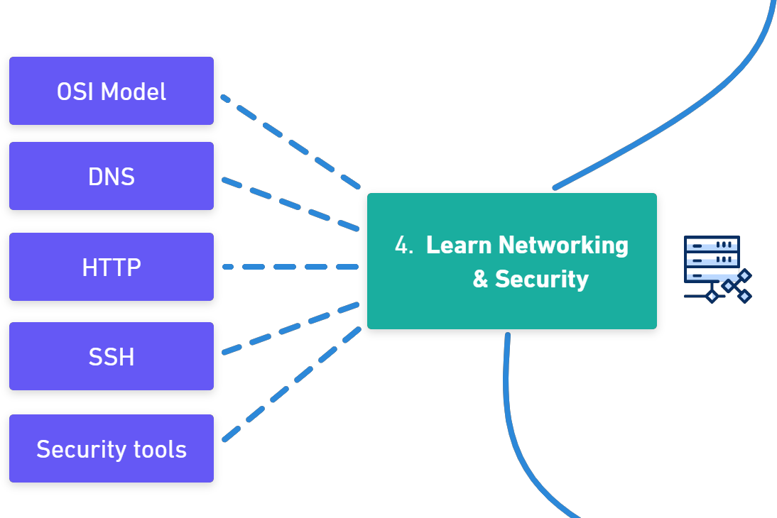
A network protocol is an established set of rules that determine how data is transmitted between different devices in the same network. Essentially, it allows connected devices to communicate with each other, regardless of any differences in their internal processes, structure, or design. Here you will need to know how a network works, how to configure firewalls, understand how DNS works, OSI model, IP addresses, ports.
Learning resources
https://www.youtube.com/watch?v=dV8mjZd1 OtU https://www.amazon.com/Computer- Networking-Top-Down-Approach- 7th/dp/0133594149 https://www.pluralsight.com/courses/tcpip- networking-it-pros https://www.udemy.com/course/devsecops/

Slide 8
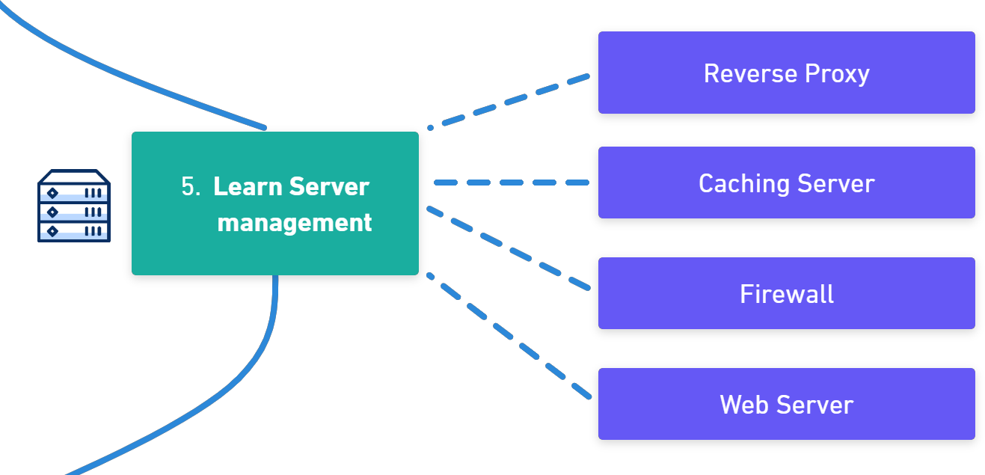
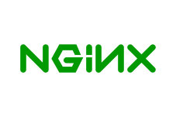

Server management includes all the infrastructure monitoring and maintenance required for servers to operate reliably and at optimal performance levels. The primary goals of an effective server management strategy are to: Minimize server slowdowns and downtime while maximizing reliability. Build secure server environments. Scale servers and related operations to meet the needs of the organization over time. Here you will need to know what is forward and reverse proxies, caching servers, and how to operate Web Servers, such as Nginx, or IIS.
Learning resources
https://www.cloudflare.com/en- gb/learning/cdn/glossary/reverse-proxy/ https://www.cloudflare.com/en- gb/learning/performance/what-is-load- balancing/ https://www.freecodecamp.org/news/the-nginx- handbook/

Slide 9

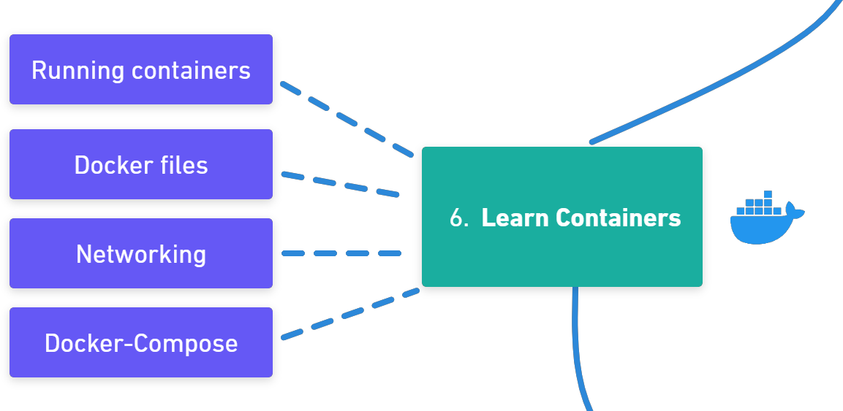
A container is a standard unit of software that packages up code and all its dependencies, so the application runs quickly and reliably from one computing environment to another. Docker is by far the most popular container technology today. A Docker container image is a lightweight, standalone, executable package of software that includes everything needed to run an application: code, runtime, system tools, system libraries, and settings. Here you need to know how to run containers, Docker Networking, Volumes, Dockerfiles, and run multiple containers with Docker-Compose.
Learning resources
https://cloud.google.com/learn/what-are- containers https://iximiuz.com/en/posts/container- learning-path/ https://www.youtube.com/watch?v=3c- iBn73dDE

Slide 10
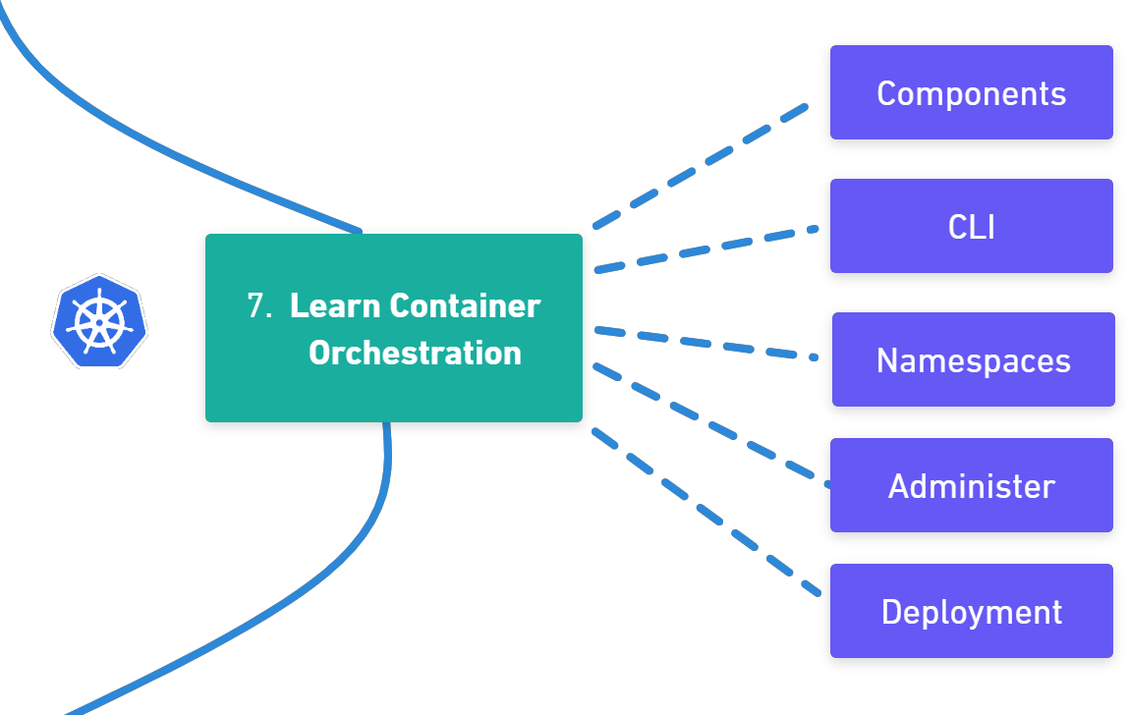
Container orchestration automates the deployment, management, scaling, and networking of containers. Container orchestration can be used in any environment where you use containers. It can help you to deploy the same application across different environments without needing to redesign it. And microservices in containers make it easier to orchestrate services, including storage, networking, and security. Here you need to learn how Kubernetes works, and how to administer the Kubernetes cluster and deploy applications on it.
Learning resources
https://www.youtube.com/watch?v=s_o8dwzRl u4 https://thenewstack.io/primer-how- kubernetes-came-to-be-what-it-is-and-why- you-should-care/ https://kodekloud.com/learning-path- kubernetes/

Slide 11
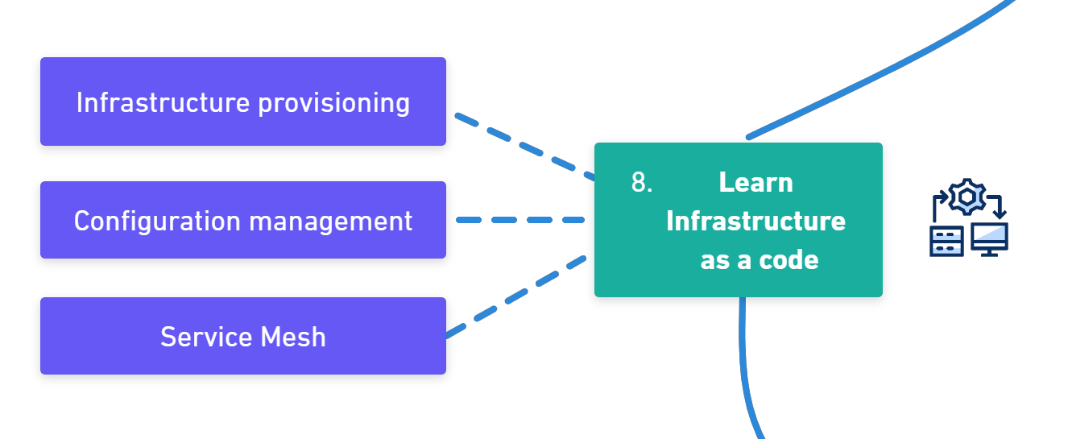

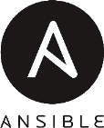
Sometimes referred to as IaC, it refers to the techniques and tools used to define infrastructure, typically in a markup language like YAML or JSON. Infrastructure as code allows Engineers to automate environment setup and teardown. Accelerates and de-risks deployment by provisioning gold copy environments on demand. Terraform is the most popular infrastructure provisioning tool. Here you need to know how to do infrastructure provisioning and configuration management.
Learning resources
https://thenewstack.io/guis-cli-apis-learn- basic-terms-of-infrastructure-as-code/ https://blog.gruntwork.io/a-comprehensive- guide-to-terraform-b3d32832baca

Slide 12

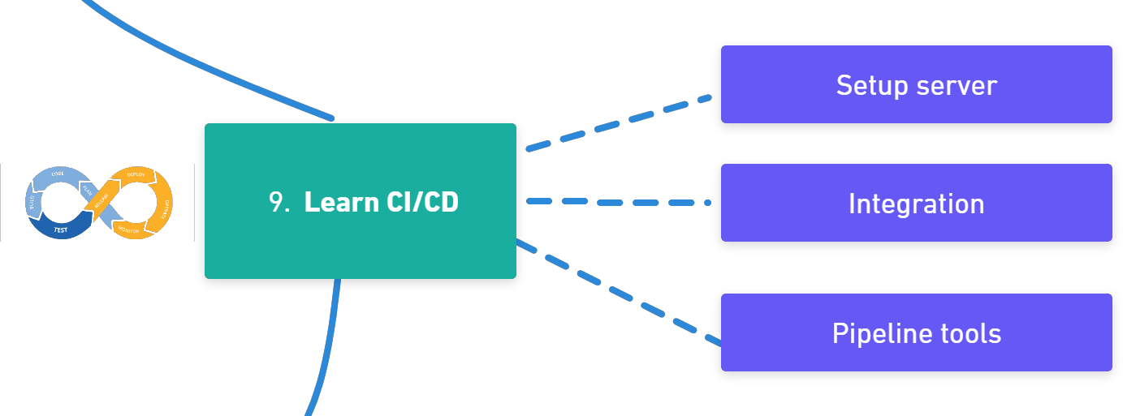



Continuous Integration / Continuous Deployment is a method to frequently deliver apps to customers by introducing automation into the stages of app development. CI/CD is a solution to the problems integrating new code can cause for development and operations. CI/CD introduces continuous automation and continuous monitoring throughout the lifecycle of apps, from integration and testing phases to delivery and deployment. These connected practices are often referred to as a "CI/CD pipeline" and are supported by development and operations teams. Here you need to learn how to set up CI/CD server, integrate code and trigger pipelines automatically, and build and package manager tools.
Learning resources
https://semaphoreci.com/blog/cicd-pipeline https://www.udemy.com/course/jenkins-from- zero-to-hero https://docs.gitlab.com/ee/tutorials/

Slide 13
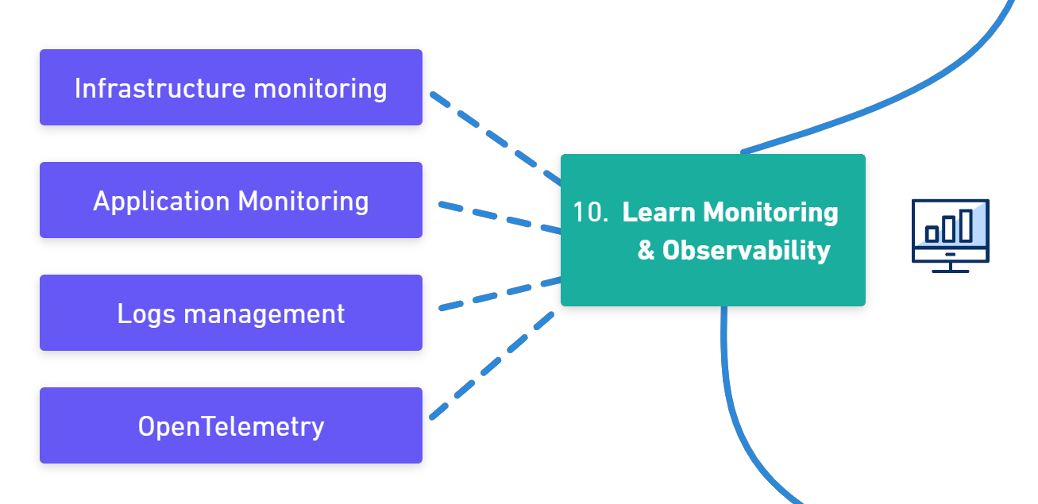


Monitoring entails overseeing the entire development process from planning, development, integration and testing, deployment, and operations. It involves a complete and real-time view of the status of applications, services, and infrastructure in the production environment. This is especially important when our software is in production, and we need to track all kinds of issues in our infrastructure and application. The two most popular tools are Prometheus and Grafana. Here you need to know how to set up monitoring and visualize data.
Learning resources
https://devopscube.com/what-is- observability/ https://www.atlassian.com/devops/devops- tools/devops-monitoring https://thenewstack.io/applying-basic-vs- advanced-monitoring-techniques/

Slide 14
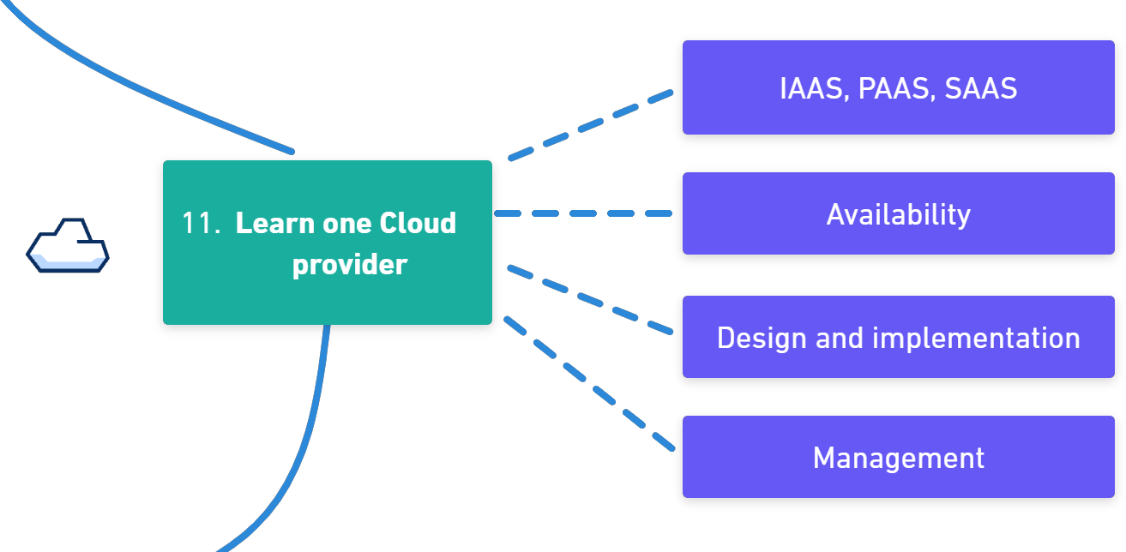


Cloud providers provide a layer of APIs to abstract infrastructure and provision it based on security and billing boundaries. The cloud runs on servers in data centers, but the abstractions cleverly give the appearance of interacting with a single "platform" or large application. The ability to quickly provision, configure and secure resources with cloud providers has been key to both the tremendous success, and complexity, of modern DevOps. The most popular cloud providers in the market are AWS and Azure, as well as Google Cloud. Here you need to know how to manage users and administration, networks, virtual servers, etc.
Learning resources
https://learn.microsoft.com/en- us/certifications/exams/az-900 https://www.udemy.com/course/aws-certified- cloud-practitioner-new https://acloudguru.com/learning-paths/aws- developer

Slide 15
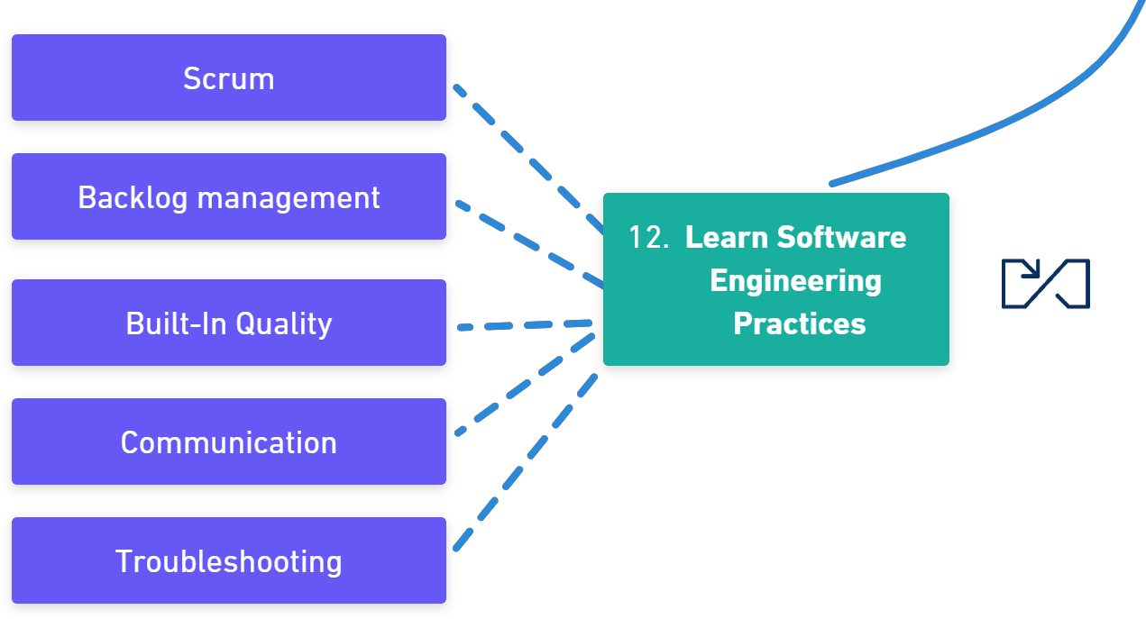



As a DevOps engineer, you will probably work in a team with other developers in an Agile world, such as Scrum. So, it is very important to know different parts of SDLC, as well as the tools which are used there. In addition, it would be good to know how automation testing is working, as you will need to set up it in CI/CD way. Here you need to know what is Scrum, all phases of SDLC, how automation testing is working, etc.
Learning resources
https://www.scrum.org/resources/ways-learn- about-scrum https://www.guru99.com/software- development-life-cycle-tutorial.html https://blog.testproject.io/2020/03/26/automa tion-testing-for-beginners-ultimate-guide/

Slide 16





Ending slide
https://github.com/milanm/DevOps-Roadmap

