Slide 1

CSA0203 - C Programming
Smart Manufacturing Predictive Maintenance System
Presented By:
192314004 ALBERIN JENO V
192412213 HARSHAN V
192412418 SUSHANTH

Slide 2


INTRODUCTION
Predictive maintenance uses machine sensor data to identify abnormal conditions before equipment failure occurs.
Smart manufacturing machines continuously generate temperature, vibration, pressure, and operating-time data.
Monitoring these parameters helps detect early signs of machine degradation and possible faults.
The proposed system uses C programming to collect, process, analyze, and store machine sensor data.
Mutexes, dynamic memory, pointers, recursion, file handling, and IPC are integrated to build a reliable monitoring system.
The system generates an emergency maintenance alert when temperature and vibration simultaneously exceed their safety thresholds.

Slide 3
PROBLEM STATEMENT
Monitoring hundreds of machines manually is difficult and time-consuming.
Sudden machine failures can cause production delays and financial losses.
The system identifies abnormal sensor readings using configurable thresholds.
Temperature and vibration are checked simultaneously for emergency conditions.
Mutexes ensure safe access to shared machine-status data.
IPC transfers critical alerts from sensor processing to the alert module.
An emergency maintenance notification is generated when both thresholds are exceeded.

Slide 4
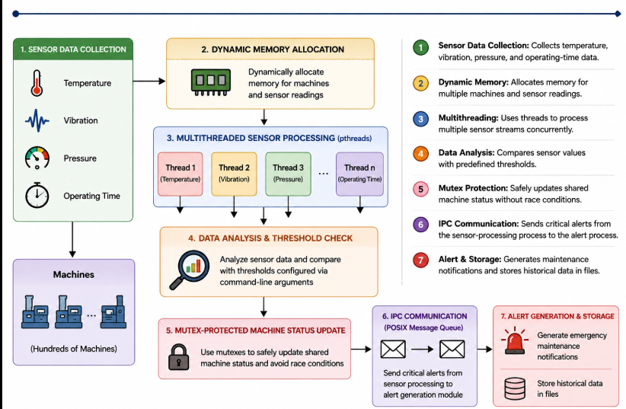
SYSTEM ARCHITECTURE

Slide 5
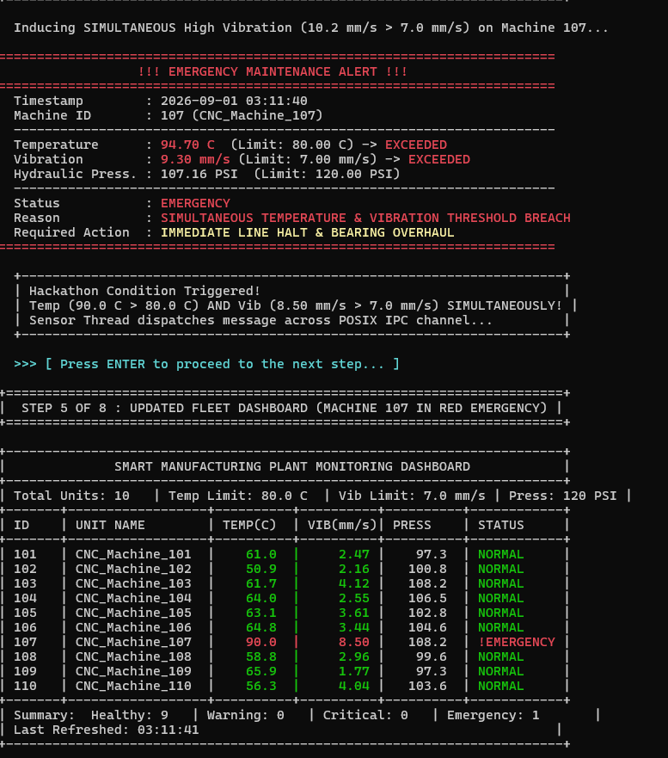
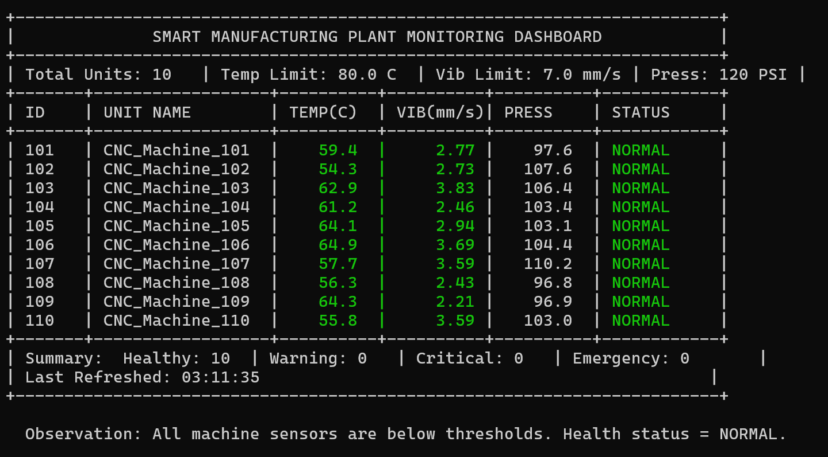
SYSTEM ARCHITECTURE

Slide 6
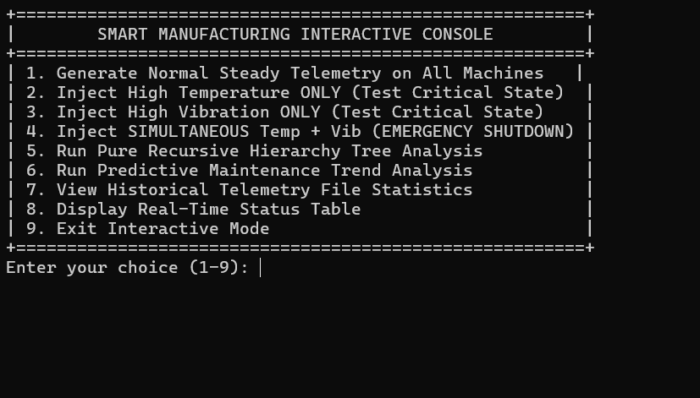
SYSTEM ARCHITECTURE

Slide 7
CONCLUSION
Developed a C-based Predictive Maintenance System for smart manufacturing.
Enables real-time monitoring of temperature, vibration, pressure, and operating time.
Uses dynamic memory, pointers, functions, recursion, pthreads, and mutexes effectively.
IPC enables reliable communication between sensor processing and alert generation.
Historical sensor readings and maintenance alerts are stored for future analysis.
Successfully detects the critical condition where temperature and vibration simultaneously exceed thresholds.
Helps reduce unexpected machine failures, downtime, and maintenance costs through early detection.

Slide 8
THANK YOU
EVERYONE FOR YOUR PATIENCE

