Slide 1
Using ontologies for case finding in clinical datasets

Slide 2
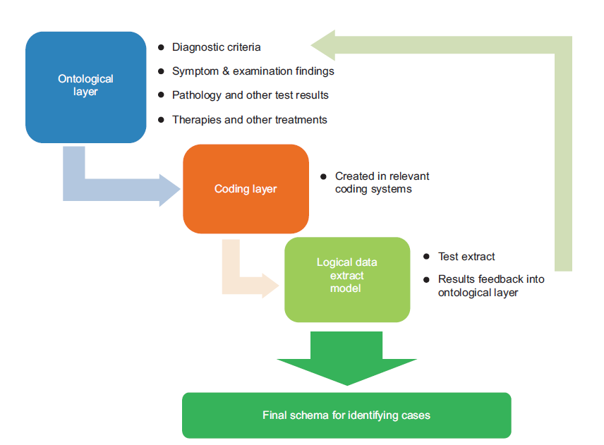
Identifying a case from routine computer data

Slide 3
Step 1: Constructing the ontology
The ontological layer defines the relevant concepts.
For an ontology that defines a diagnosis could include
Aetiology
Diagnosis
Therapy
Process of care
Reflects the requirements and purpose of the investigation.
An ontology for diabetes would explicitly set out the criteria used in a study so that it is possible to understand how a particular prevalence might be defined.
Ontological case definition might be restricted to one or more categories of data or require a combination

Slide 4
Aetiology:
Criteria that enable the validity of case identified in a population to be validated. The prevalence of most conditions is known
For example, Type 2 diabetes is rare in people under 30 years old, more common with increasing age and in men compared with women
World Health Organisation (WHO). Diabetes programme.
Available from: www.who.int/diabetes/action_online/basics/en/

Slide 5
Concepts related to diagnosis:
Recording of a diagnostic code for diabetes, or we might stipulate classification as either Type 1 or Type 2 diabetes
People with Type 1 diabetes mellitus require insulin for survival, whereas people with Type 2 have altered glucose metabolism and may or may not require insulin.
Concepts related symptoms:
Thirst, polydipsia, polyuria, and describing weight loss might be diagnostic of diabetes.
The World Health Organisation (WHO) criteria for diagnosis of diabetes include abnormal blood glucose plus symptoms of diabetes; however the latter are rarely looked for in database studies.
World Health Organisation (WHO). Diabetes programme.
Available from: www.who.int/diabetes/action_online/basics/en/

Slide 6
Examination findings compatible with the diagnosis:
Measured weight loss
Smelling ketotic
Pathology test criteria:
Fasting or random blood test results showing a raised glucose meeting the diagnostic criteria set out by the WHO
Glycated haemoglobin (HbA1c) levels compatible with diabetes
Urine tests positive for glucose
World Health Organisation (WHO). Diabetes programme.
Available from: www.who.int/diabetes/action_online/basics/en/

Slide 7
Medication and prescriptions:
There are some medication and other prescribed items that imply a diagnosis of diabetes; others make the diagnosis unlikely.
Some medicines, such as insulin, and some injectable and oral anti-diabetes drugs are used only in diabetes, whereas metformin is a medicine generally prescribed in diabetes but also used in other conditions.
Prescriptions for testing for blood or urinary glucose or ketones make a diagnosis of diabetes more likely but not definite.
For example, they may be prescribed in pregnancy or where there is impaired fasting glucose
Bagheri A, Sadek A, Chan T, Khunti K and de Lusignan S. Using surrogate markers in primary electronic patient record systems to confirm or refute the diagnosis of diabetes. Informatics in Primary Care 2009;17(2):121–9.

Slide 8
Process of care codes:
There are a number of codes associated with the process of delivery of care, remuneration and administration of care which imply but do not make the diagnosis certain.
‘Seen in diabetes clinic’ and ‘Attending diabetes clinic’. Most people with these codes in their records will have diabetes, but some people with gestational diabetes or impaired fasting glucose may also attend.
Excepted from diabetes quality indicators: informed dissent –declines to attend for review(removes them from the practice pay-for-performance target payment).
DNA – Did not attend diabetic clinic – is an example of an administrative code.
Stone MA, Camosso-Stefinovic J, Wilkinson J, de Lusignan S, Hattersley AT and Khunti K. Incorrect and incomplete coding and classification of diabetes: a systematic review. Diabetic Medicine 2010 May;27(5):491–7. doi: 10.1111/j.1464-5491.2009.02920.x.

Slide 9
Treatment or procedure codes:
There are very rare operations or other procedure codes related to diabetes.
Surgery for very rare tumours can cure diabetes.
Glucagonoma
Phaeochromocytoma
Stone MA, Camosso-Stefinovic J, Wilkinson J, de Lusignan S, Hattersley AT and Khunti K. Incorrect and incomplete coding and classification of diabetes: a systematic review. Diabetic Medicine 2010 May;27(5):491–7. doi: 10.1111/j.1464-5491.2009.02920.x.

Slide 10
Step 2: Coding layer – creating a coding list from the ontology
Each of the types of information included in the ontology should be included in the coding list.
If you restrict your ontology to one or more categories of information (e.g. simply to diagnosis), then the same will apply to the coding list.

Slide 11
Step 2: Coding layer – creating a coding list from the ontology
Diabetes Mellitus Ontology
Ontology
Read Ver 2
---------
--------
--------
--------
CTV 3
---------
--------
--------
--------
ICD
---------
--------
--------
--------
SNOMED
---------
--------
--------
--------
Code Lists

Slide 12
Step 3: Logical data extract model
Check that it is possible to extract the data you anticipate.
Sometimes codes do not have sufficient granularity.
Just because a code exists within a terminology, do not expect that clinicians or those involved in data entry will necessarily use it!
Literature reviews, pilot searches of data sources and speaking to practitioners in the field about their data recording.

Slide 13
Advantages of the ontological approach
The ontological process should enable code lists used in research based on routine data to be constructed in a logical and open way.
This process will enable others to use the ontology and as is, update or modify it, or apply it to other coding systems.
Make use of a wide range of tools to building, manage and query ontologies

Slide 14
Asthma Ontology
Diagnostic codes (including those referred to in Quality Outcomes Framework code lists)
(2) Symptoms of asthma (including wheeze, cough, shortness of breath and chest tightness);
(3) Diagnostic tests (including peak expiratory flow rates (PEFR) and spirometry);
(4) Therapies codes (including short-acting beta 2 agonists, inhaled corticosteroids, long-acting beta 2 agonists, leukotriene antagonists and oral steroids) and
(5) “Process of Care codes” (codes for attending an asthma clinic or an asthma medication review that imply a diagnosis of asthma)

Slide 15
Asthma Ontology
Results of a data extraction using an Asthma ontology
 | Total population (N = 1,595,554)
Participants with a ‘Diagnostic code’ for asthma | 207,103 (12.98%) (95%CI 12.93-13.03%)
Participants with a ‘Process of care’ code for asthma | 175,091 (10.96%) (95%CI 10.92-11.01%)
Participants with either a ‘Diagnostic code’ or ‘Process of care’ code for asthma | 226,740 (14.21%) (95%CI 14.16-14.27%)

Slide 16
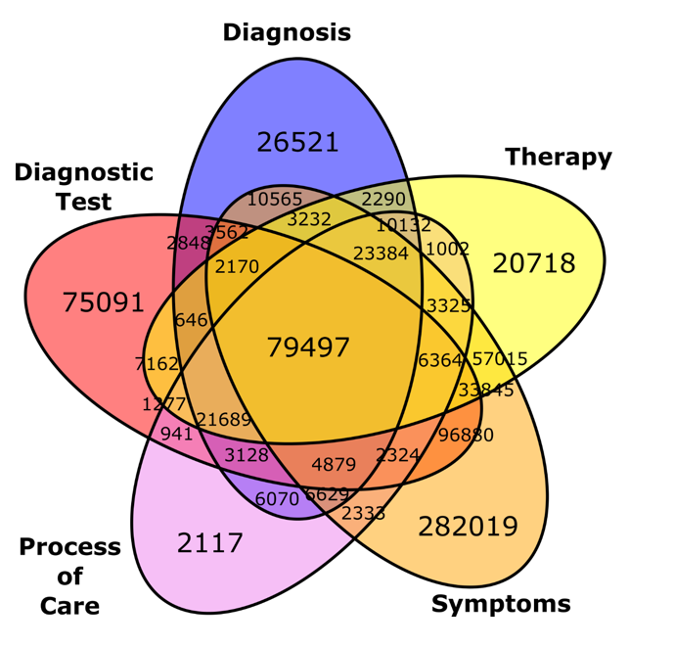
Asthma Ontology
Venn diagram of different combinations of ontological concepts existing in patient records

