Slide 1
Study on the Behaviour of Plane Portal Frames
By
CE17B011- N Leela Venkata Sri Harsha
CE17B039- P Karthic Chinthan

Slide 2
Project Description
Analysing a Portal Frame subjected to Gravity Loading
Frame restrictions
number of bays being twice or more than the number of stories (n_{bays} ≥ 2 n_{stories} )
Base conditions
Fixed ends at all the supports
Loading conditions
Gravity loading on all Beams
Gravity loading on alternate Beams
Self weight of beams and columns are ignored.

Slide 3
Objectives
To arrive at optimal dimensions of steel frames described
To explain the rationale behind the methodology adopted

Slide 4
Frame specifications
Materialistic Properties
Mild steel - Fe 250 (f_{y}) = 250 MPa
Elastic Modulus (E = 200 GPa)
Supports - All fixed
Joints - All rigid
Height of storey = 3.5 m
Span of beams = 5 m
Loading
Gravity loaded - 10 kN/m

Slide 5
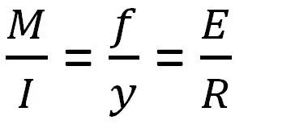
Optimum Section type
Euler’s Bending Theory
Flexural rigidity = EI, the measure of resistance offered by element to bending
Considering various types of cross sections with the Area constant (100 sq.cm) we find out the one that gives maximum Moment of Inertia and Minimum moment
Staad Pro analysis for single storey 2 bay frame is done with uniform cross-sections of different section types and presented in the following section.

Slide 6
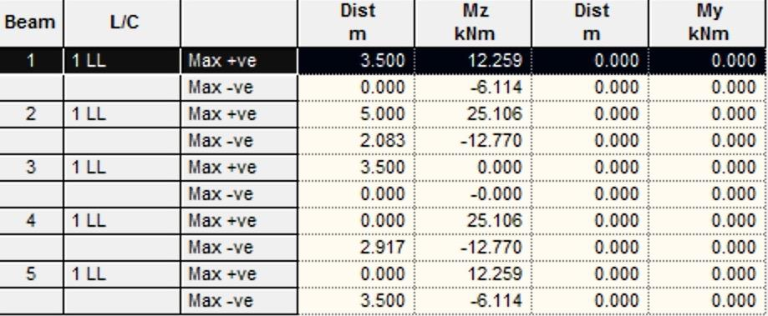
Coming up with the optimal cross-section
Circular section- A =100 cm² , I = 794 cm⁴

Slide 7
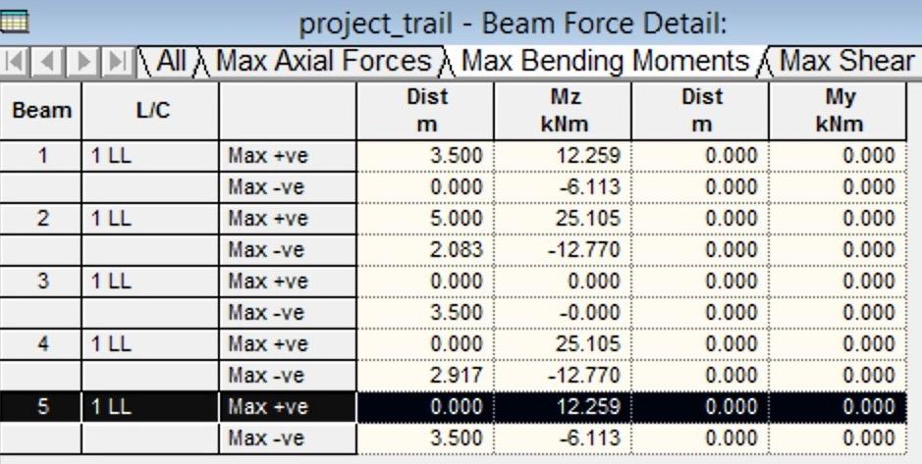
Square section, Area = 100 cm² , Moment of Inertia = 833 cm⁴

Slide 8
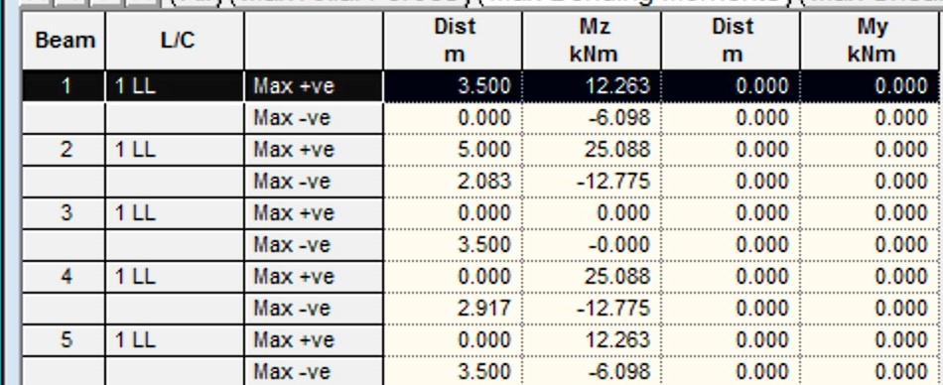
Rectangular section( 2:1) - I = 1670 cm⁴ , A= 100 cm²

Slide 9
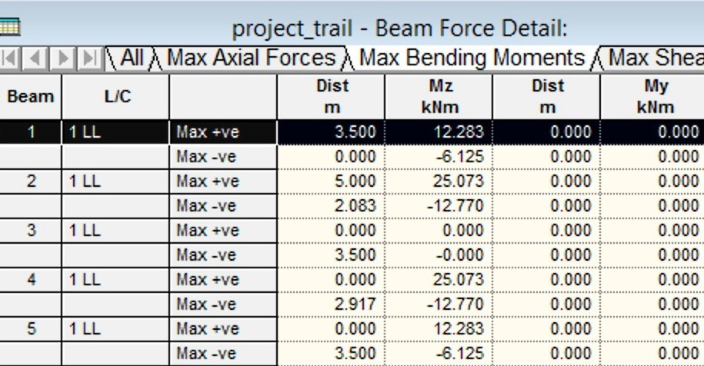
Tapered Square - I= 2601 cm⁴ , A =100 cm²

Slide 10
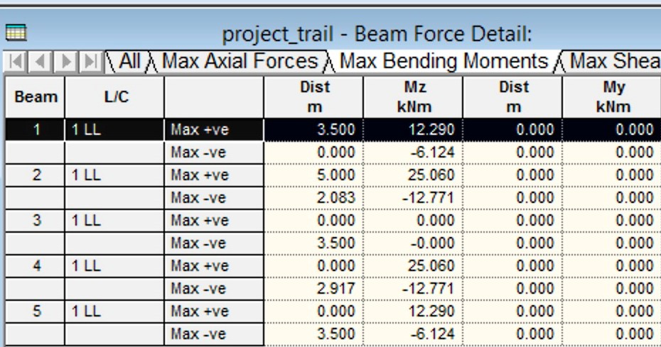
Tapered round - I = 3219 cm⁴ , A = 100 cm²

Slide 11
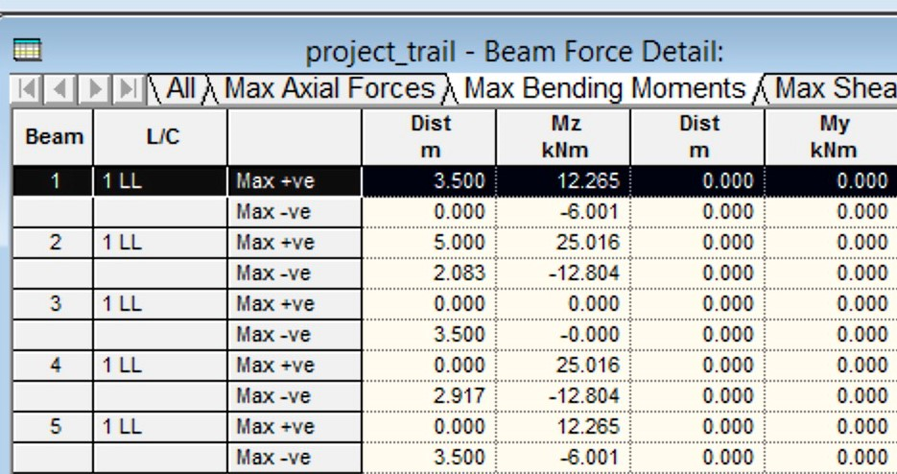
T-section I = 4856.7 cm⁴ , A = 100 cm²

Slide 12
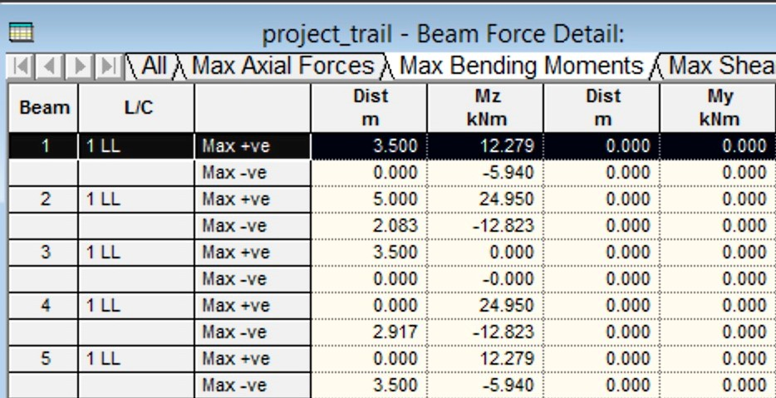
I-section - I = 8021 cm⁴ , A = 100 cm²
maximum moment of Inertia for given cross section

Slide 13
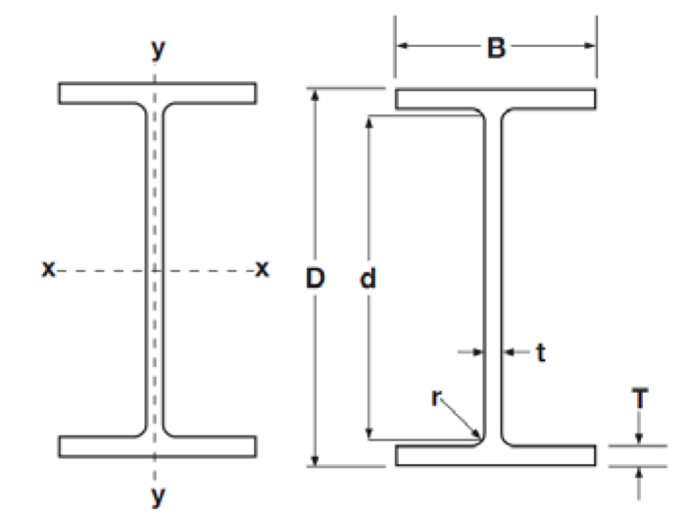
Coming up with the optimal cross-section - contd.
It can be inferred that I-section is the optimum type
Moment of Inertia of an I section depends on its dimensional ratios for a given cross-sectional area.
Further, dimension ratios are obtained
for an optimum I-section
n₁ = d/t
n₂ = B/T
n₃ = T/t
Standard dimensions of I sections are
collected from http://www.rainhamsteel.co.uk/products/universal-beams
REFER to optimal inertia I section.xlsx for methodology to obtain the ratios

Slide 14
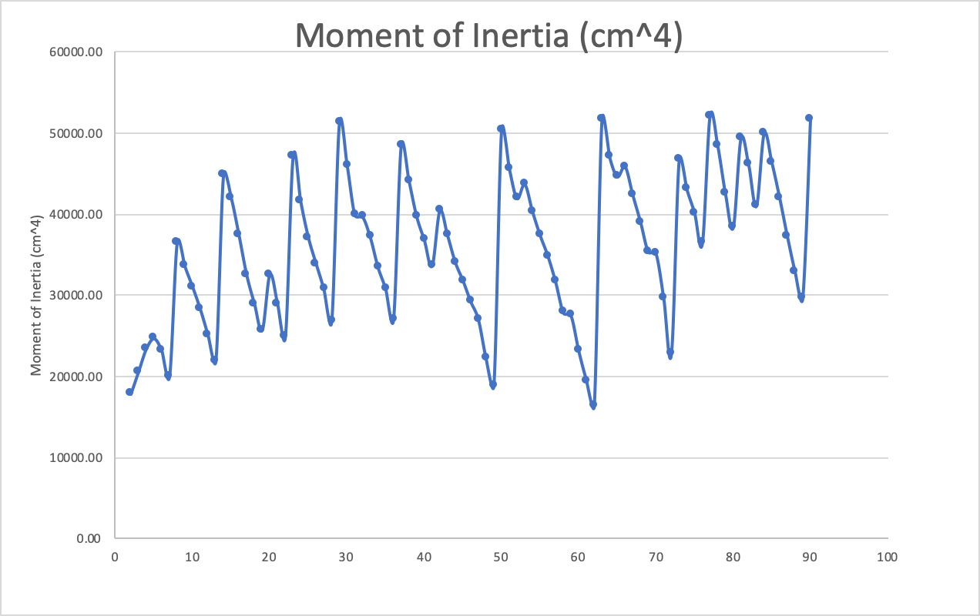
Coming up with the optimal cross-section - contd...
For a given cross sectional area of 100 cm², we find the dimensional ratios leading to the largest moment of inertia
The ratios are
n₁ = d/t = 59.92
n₂ = B/T = 17.06
n₃ = T/t = 1.29
As per IS 800 dimensional ratios imply that section falls under Class I (Plastic)
52191 cm⁴

Slide 15

Program to get section details
Reducing the moment of inertia (I) and cross sectional area (A) to functions of single variable ‘t’ (web thickness)
Total Normal stress will be in terms of the single variable ‘t’
Limiting the compressive/Tensile stress in each member to 0.8*f_{y} = 200 MPa
as per IS 800 (Clause 5.4)

Slide 16
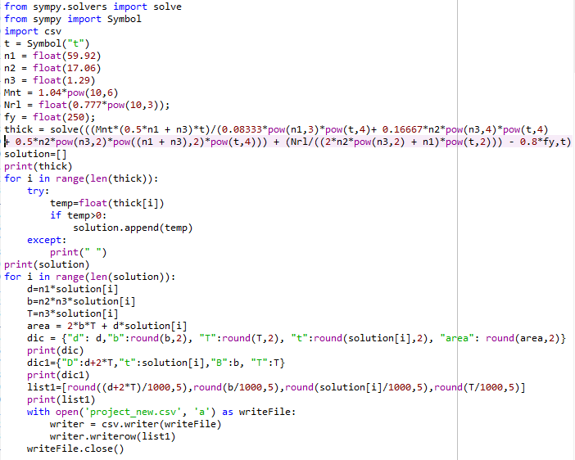
Program to get section details - contd...

Slide 17
Iterative procedure
Model the steel frame in STAAD-Pro
Assume the cross sectional area of 100 cm² with I-section details as Overall depth (D) = 25 cm, Thickness of flange and web (T=t)= 2.5 cm
Run Analysis
Get the Maximum Bending Moment and Axial Force for each member
Input all the maximum values to the program and get the section details for every member
Define the sections in STAAD-pro (as obtained from the program)
Run Analysis
Repeat from Step 4 till the normal stresses of almost all the members tend to 0.8*f_{y} that is 200 MPa

Slide 18
Examples for complete loading - One storey Two bay
Beam no. | BM-staad kNm | Nrn-staad kN | D m | B m | t m | T m | MOI (mm^4) | Area mm^2 | stress -staad | 0.8Fy Mpa | Length (m) | Volume (m3)
1 | 12.265 | 22.455 | 194.06 | 68.33 | 3.10 | 4.01 | 18389216.71 | 1124.73 | 149.00 | 200 | 3.5 | 0.00394
2 | 24.99 | 5.207 | 238.77 | 84.08 | 3.82 | 4.93 | 42012005.87 | 1703.47 | 203.50 | 200 | 5 | 0.00852
3 | 0 | 55.09 | 96.02 | 33.81 | 1.54 | 1.98 | 1093066.29 | 275.66 | 205.60 | 200 | 3.5 | 0.00096
4 | 24.99 | 5.207 | 238.77 | 84.08 | 3.82 | 3.08 | 6364593.59 | 1405.82 | 203.50 | 200 | 5 | 0.00703
5 | 12.265 | 22.455 | 194.06 | 68.33 | 3.10 | 1.81 | 755166.59 | 837.09 | 149.00 | 200 | 3.5 | 0.00293
 |  |  |  |  |  |  |  |  |  |  |  | 0.02338

Slide 19
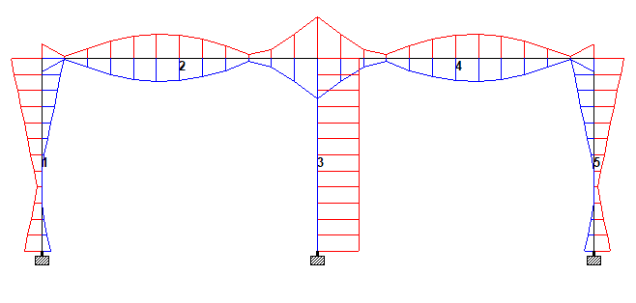
Stress Distribution for 1 storey 2 bay complete loading

Slide 20
Examples for complete loading - One storey three bay
no. | BM-staad kNm | Nrn-staad kN | D m | B m | t m | T m | MOI (mm^4) | Area mm^2 | stress -staad | 0.8Fy Mpa | Length (m) | Volume (m3)
1 | 10.097 | 22.416 | 182.73 | 64.34 | 2.92 | 3.77 | 14366505.43 | 996.68 | 171.24 | 200 | 3.5 | 0.00349
2 | 23.017 | 4.286 | 232.16 | 81.75 | 3.71 | 4.79 | 37439306.37 | 1608.94 | 201.33 | 200 | 5 | 0.00804
3 | 0.507 | 52.584 | 115.88 | 40.81 | 1.85 | 2.39 | 2320477.41 | 400.61 | 157.45 | 200 | 3.5 | 0.00140
4 | 22.51 | 4.069 | 230.40 | 81.13 | 3.69 | 4.76 | 36510144.45 | 1587.40 | 202.35 | 200 | 5 | 0.00794
5 | 0.507 | 52.584 | 115.88 | 40.81 | 1.85 | 2.39 | 2320477.41 | 400.61 | 157.45 | 200 | 3.5 | 0.00140
6 | 23.017 | 4.286 | 232.16 | 81.75 | 3.71 | 4.79 | 37439306.37 | 1608.94 | 201.33 | 200 | 5 | 0.00804
7 | 10.097 | 22.416 | 182.73 | 64.34 | 2.92 | 3.77 | 14366505.43 | 996.68 | 171.24 | 200 | 3.5 | 0.00349

Slide 21
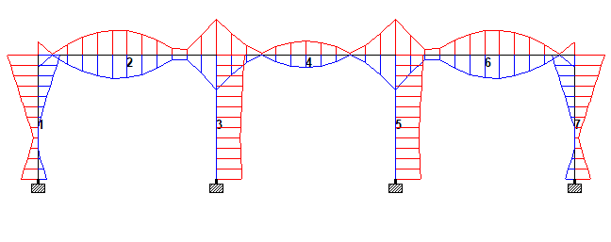
Stress Distribution for 1 storey 3 bay complete loading

Slide 22
Examples- Two storey 4 bay complete loading
Beam number | axial force N | max moment | D (mm) | t (mm) | B (mm) | T (mm) | Stresses (MPa) | volume (m^3) | Length (mm)
1 | 47055 | 3307000 | 142.55 | 2.28 | 50.19 | 2.94 | 148.98 | 0.0021 | 3500
2 | 23098 | 13815000 | 201.57 | 3.23 | 70.98 | 4.16 | 187.73 | 0.0043 | 3500
3 | 103251 | 0 | 131.46 | 2.1 | 46.29 | 2.71 | 212.35 | 0.0018 | 3500
4 | 52158 | 0 | 93.43 | 1.49 | 32.9 | 1.93 | 214.42 | 0.0009 | 3500
5 | 99388 | 0 | 128.97 | 2.06 | 45.41 | 2.66 | 198.65 | 0.0017 | 3500
6 | 49489 | 0 | 91.01 | 1.46 | 32.05 | 1.88 | 199.26 | 0.0009 | 3500
7 | 103251 | 0 | 131.46 | 2.1 | 46.29 | 2.71 | 212.3 | 0.0018 | 3500
8 | 52158 | 0 | 93.43 | 1.49 | 32.9 | 1.93 | 211.85 | 0.0009 | 3500
9 | 47055 | 3307000 | 142.55 | 2.28 | 50.19 | 2.94 | 148.91 | 0.0021 | 3500
10 | 23098 | 13815000 | 201.57 | 3.23 | 70.98 | 4.16 | 187.68 | 0.0043 | 3500
11 | 4495 | 22330000 | 229.9 | 3.68 | 80.95 | 4.75 | 194.14 | 0.0079 | 5000
12 | 7101 | 23324000 | 233.85 | 3.74 | 82.34 | 4.83 | 188.76 | 0.0082 | 5000
13 | 3796 | 20759000 | 224.25 | 3.59 | 78.96 | 4.63 | 206.48 | 0.0075 | 5000
14 | 6321 | 21703000 | 228.19 | 3.65 | 80.35 | 4.71 | 202.36 | 0.0078 | 5000
15 | 3796 | 21010000 | 225.14 | 3.6 | 79.28 | 4.65 | 204.1 | 0.0076 | 5000
16 | 6321 | 21703000 | 228.19 | 3.65 | 80.35 | 4.71 | 202.48 | 0.0078 | 5000
17 | 4495 | 22330000 | 229.9 | 3.68 | 80.95 | 4.75 | 194.2 | 0.0079 | 5000
18 | 7101 | 23324000 | 233.85 | 3.74 | 82.34 | 4.83 | 188.89 | 0.0082 | 5000
 |  |  |  |  |  |  | Total Volume | 0.0836

Slide 23
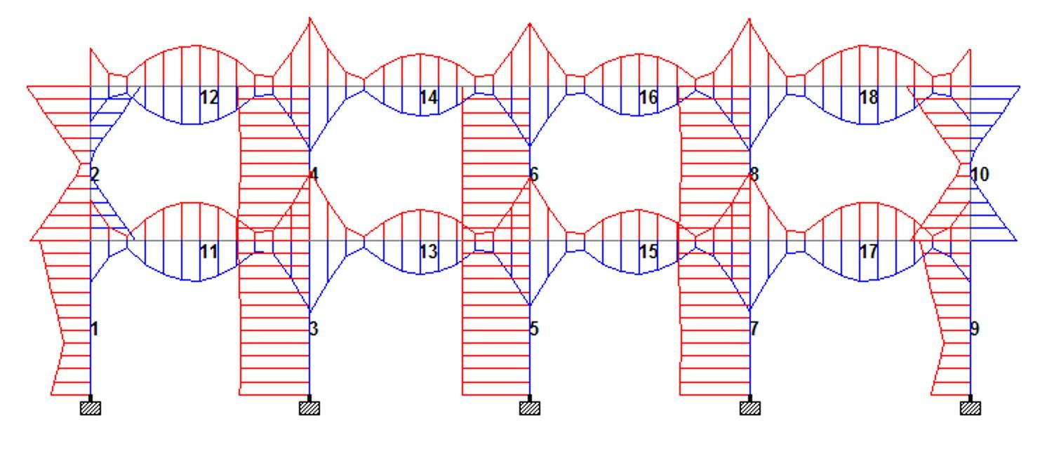
Stress Distribution for 2 storey 4 bay complete loading

Slide 24
Examples for alternate loading - One storey Two bay
Beam no. | BM-staad kNm | Nrn-staad kN | D m | B m | t m | T m | MOI (mm4) | Area(mm2) | stress -staad | 0.8Fy Mpa | Length (m) | Volume (m3)
1 | 15.783 | 24.887 | 210.62 | 74.16 | 3.37 | 4.35 | 25398658.12 | 1325.26 | 194.73 | 200 | 3.5 | 0.00464
2 | 16.348 | 6.268 | 207.91 | 73.21 | 3.33 | 4.29 | 24116193.13 | 1291.37 | 194.90 | 200 | 5 | 0.00646
3 | 14.171 | 25.575 | 203.87 | 71.79 | 3.26 | 4.21 | 22297781.80 | 1241.73 | 207.70 | 200 | 3.5 | 0.00435
4 | 2.177 | 0.045 | 105.33 | 37.09 | 1.69 | 2.17 | 1588548.99 | 331.43 | 49.70 | 200 | 5 | 0.00166
5 | 0.132 | 0.462 | 41.99 | 14.79 | 0.67 | 0.87 | 40135.23 | 52.68 | 13.80 | 200 | 3.5 | 0.00018
 |  |  |  |  |  |  |  |  |  |  |  | 0.01728

Slide 25
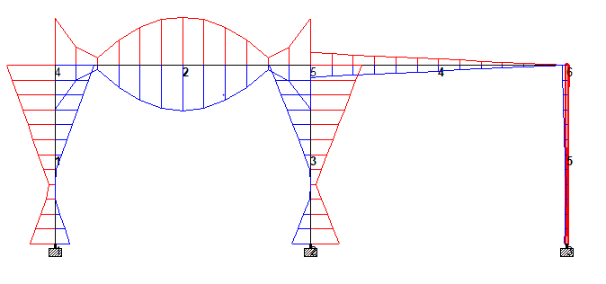
Stress distribution - One storey Two bay

Slide 26
Examples for alternate loading - One storey Three bay
Beam no. | BM-staad kNm | Nrn-staad kN | D m | B m | t m | T m | MOI (m^4) | Area m^2 | stress -staad | 0.8Fy Mpa | Length (m) | Volume (m3)
1 | 15.108 | 25.168 | 207.85 | 73.19 | 3.33 | 4.29 | 24088785.76 | 1291.54 | 204.80 | 200 | 3.5 | 0.00452
2 | 16.561 | 6.408 | 208.83 | 73.53 | 3.34 | 4.31 | 24541144.98 | 1302.53 | 197.32 | 200 | 5 | 0.00651
3 | 13.23 | 24.832 | 199.37 | 70.20 | 3.19 | 4.12 | 20491540.30 | 1188.15 | 212.87 | 200 | 3.5 | 0.00416
4 | 1.04 | 0.777 | 82.85 | 29.17 | 1.33 | 1.71 | 608093.25 | 205.40 | 31.09 | 200 | 5 | 0.00103
5 | 13.23 | 24.832 | 199.37 | 70.20 | 3.19 | 4.12 | 20491540.30 | 1188.15 | 212.87 | 200 | 3.5 | 0.00416
6 | 16.561 | 6.408 | 208.83 | 73.53 | 3.34 | 4.31 | 24541144.98 | 1302.53 | 197.32 | 200 | 5 | 0.00651
7 | 15.108 | 25.168 | 207.85 | 73.19 | 3.33 | 4.29 | 24088785.76 | 1291.54 | 204.80 | 200 | 3.5 | 0.00452
 |  |  |  |  |  |  |  |  |  |  |  | 0.03141

Slide 27
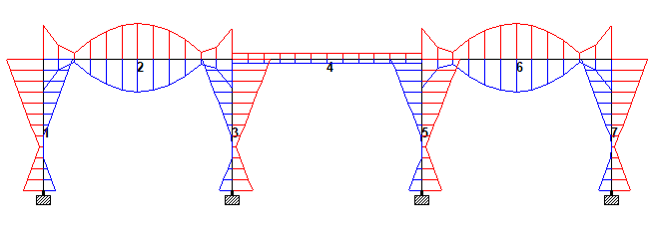
Stress distribution - One storey Three bay

Slide 28
Examples- Two storey 4 bay alternate beam loading
Beam number | axial force N | max moment | D (mm) | t (mm) | B (mm) | T (mm) | Stresses (MPa) | Length (mm) | volume (m^3)
1 | 49936 | 3.551 | 146.23 | 2.34 | 51.49 | 3.02 | 155.61 | 3500 | 0.0022
2 | 24935 | 15.657 | 210.11 | 3.36 | 73.98 | 4.34 | 211.56 | 3500 | 0.0046
3 | 49989 | 3.401 | 144.79 | 2.32 | 50.98 | 2.99 | 156.14 | 3500 | 0.0022
4 | 25012 | 15.421 | 209.14 | 3.35 | 73.64 | 4.32 | 213.86 | 3500 | 0.0046
5 | 49781 | 3.659 | 147.19 | 2.36 | 51.83 | 3.04 | 159.68 | 3500 | 0.0023
6 | 24869 | 14.101 | 203.36 | 3.25 | 71.61 | 4.2 | 226.68 | 3500 | 0.0043
7 | 50749 | 3.716 | 148.15 | 2.37 | 52.17 | 3.06 | 160.19 | 3500 | 0.0023
8 | 25508 | 14.383 | 204.79 | 3.28 | 72.11 | 4.23 | 222.37 | 3500 | 0.0044
9 | 454 | 0.009 | 18.4 | 0.29 | 6.48 | 0.38 | negligible | 3500 | 0.0000
10 | 324 | 0.161 | 44.61 | 0.71 | 15.71 | 0.92 | 15.46 | 3500 | 0.0002
11 | 6858 | 17.174 | 211.45 | 3.38 | 74.46 | 4.36 | 191.53 | 5000 | 0.0067
12 | 8366 | 15.98 | 206.93 | 3.31 | 72.87 | 4.27 | 209.18 | 5000 | 0.0064
13 | 36 | 0.314 | 55.26 | 0.88 | 19.46 | 1.14 | 12.23 | 5000 | 0.0005
14 | 83 | 0.824 | 76.23 | 1.22 | 26.84 | 1.57 | 22.16 | 5000 | 0.0009
15 | 6075 | 16.986 | 210.48 | 3.37 | 74.12 | 4.34 | 192.95 | 5000 | 0.0066
16 | 7672 | 15.843 | 206.16 | 3.3 | 72.59 | 4.26 | 208.43 | 5000 | 0.0063
17 | 78 | 0.518 | 65.32 | 1.05 | 23 | 1.35 | 20.34 | 5000 | 0.0006
18 | 82 | 1.46 | 92.22 | 1.48 | 32.47 | 1.9 | 35.19 | 5000 | 0.0013
 |  |  |  |  |  |  |  | Total Volume | 0.0564

Slide 29
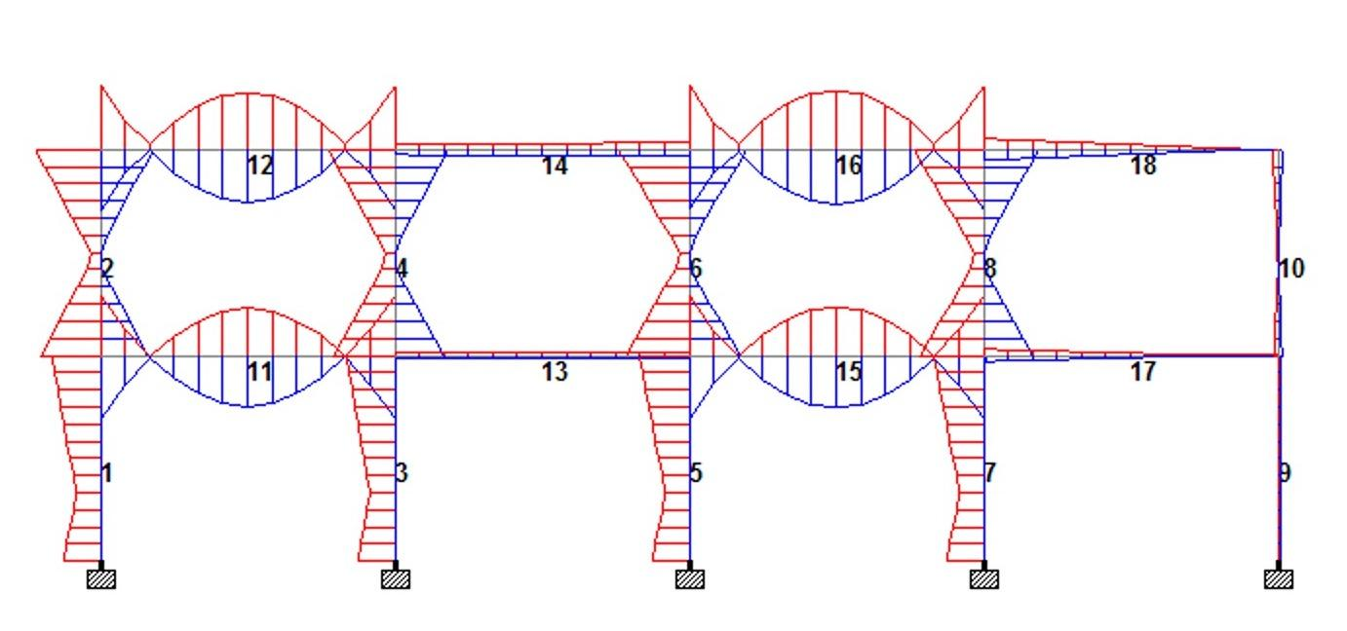
Stress Distribution for Two Storey 4 Bay Alternate Beam Loading

Slide 30
Results
I section gives the maximum moment of inertia among all the sections for a constant area.
Symmetry in loading configuration makes the process of optimization faster.
In the interior columns though the axial force coming onto the columns are larger than those of exterior ones they do not carry any moments so subsequently they require lesser cross-sectional area.

Slide 31
Limitations
We ignored Buckling of columns.
Also some outliers are found after iterations, having normal stresses away from the limiting value.
Analysis is done for Steel members not for composite structure like reinforced concrete.

Slide 32
References
http://www.rainhamsteel.co.uk/products/universal-beams
https://www.scribd.com/presentation/388055180/diff-bwt-is-800-101-ppt
IS 800:2007

Slide 33
Thank You!!

