Slide 1
Baidu Medical Data Analysis
Dr. Hanghang Tong
Harshaneel Gokhale

Slide 2
Objective
Many a times, when people feel something wrong about them medically, they search for the appropriate cause on the search engine, such as Baidu, in natural language text.
This generates a lot of data to analyze which we can use to make a better system for a better user experience.
Our objective of analyzing this data is to understand how such queries are related to the results and to predict possible results for unknown queries.
This will allow us to create a better and more accurate system causing better user experience.

Slide 3
Data format
To perform this analysis we have the data in a tripartite graph. This data is collected by Baidu by storing queries that users have submitted over Baidu search engine and results of those queries.
Three parts of the data consists of users, queries and diseases.
In total there are about 1.7 million nodes with 1 million users, 716k queries and 500 diseases.
In order to work with such a huge graph we have stored them in the sparse matrix format.

Slide 4
Algorithm
We can improve performance of the system by showing good results ranked higher in the results section. That typically means we need to have better ranking in order to succeed.
The baseline algorithm we are using for this system is Random Walk with Restarts (RWR).
RWR ranks the nodes of the network with respect to the query node. This allows us to begin with ranking of diseases with respect to nodes representing queries.

Slide 5
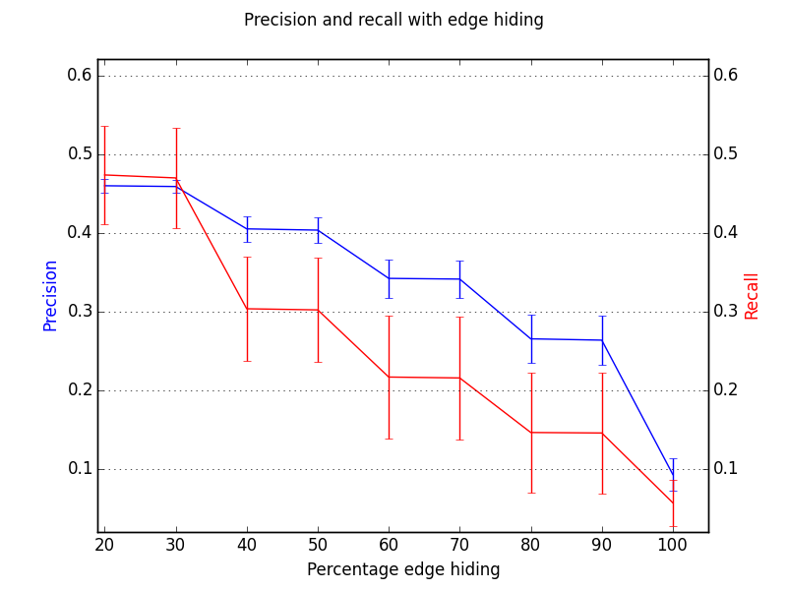
Performance evaluation
In order to see how well the fundamental algorithm behaves, we ran following experiment:
We randomly sampled query nodes and for each of the we hid some percent of the disease nodes attached to them.
We incrementally removed disease nodes and checked precision and recall of the system to get following results-

Slide 6
Performance evaluation (contd.)
As we can see in the results that, precision and recall of the system reduces as we hide more and more diseases from queries.
But even at 100% hiding precision and recall does not become zero.
That is mainly because, though we hide a disease node from a query node, but because of connection with users, query node finds its way to the hidden disease.

Slide 7
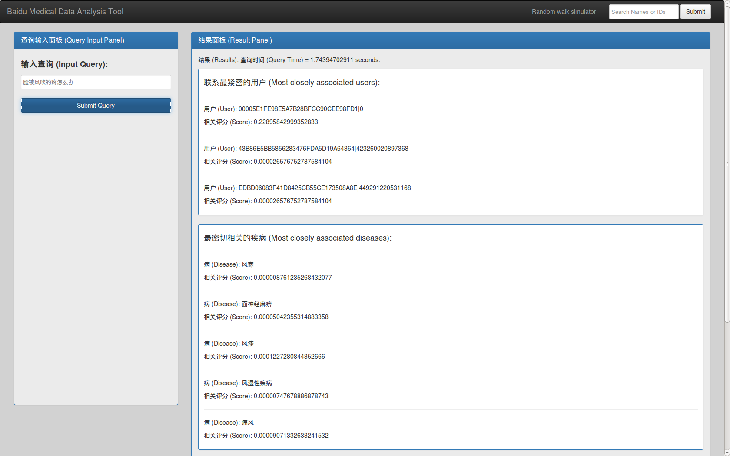
Demo system
To see results over an interactive GUI we have a demo system designed in Python as shown below.

