Slide 1
Analysis and ranking of online reviews for doctors
Harshaneel H. Gokhale
Instructor: Dr. Yu Cheng,
Dr. Huan Liu, Fred Morstatter.

Slide 2
Roadmap
Introduction
Random Walk with Restarts Algorithm
Sentiment analysis
Methodology
Results
Scope of the concept and future work

Slide 3
Introduction
Problem:
We have a bunch of reviews for doctors posted by their patients.
Reviews contain meta-information including scores for different parameters for doctor such as, punctuality, knowledge, staff interaction and etc.
Reviews also contain the textual review expressing overall feeling of the patient about the doctor.
Our task is to come up with a method that helps us to rank doctors with respect to their performance while treating the patients.

Slide 4


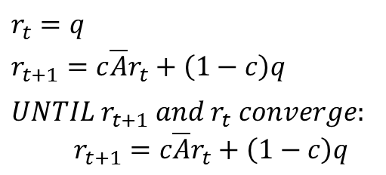


Random Walk with Restarts Algorithm
RWR equation:
2
$$r=c\overline{A}r+(1−c)q$$
1
3
Q =
1 | 0 | 0 | 0
Closed form solution:
4
$$r={(1−c)(I−c\overline{A})}^{−1}q$$
Recursive solution:
0 | 1 | 1 | 1
1 | 0 | 1 | 0
1 | 1 | 0 | 1
1 | 0 | 1 | 0
0 | 0.50 | 0.33 | 0.50
0.33 | 0 | 0.33 | 0
0.33 | 0.50 | 0 | 0.50
0.33 | 0 | 0.33 | 0
$$r_{t}=q$$
$$r_{t+1}=c\overline{A}r_{t}+\left(1−c\right)q$$
$$UNTIL{ r}_{t+1} and{ r}_{t} converge:$$
$$r_{t+1}=c\overline{A}r_{t}+\left(1−c\right)q$$
$A$ =
$\overline{A}$=

Slide 5
Random Walk with Restarts Algorithm (contd..)
Step 0:
2
0.33
1
0.33
3
5
0.33
4

Slide 6
Random Walk with Restarts Algorithm (contd..)
Step 1:
2
0.33
0.33
0.33
1
3
5
4

Slide 7
Random Walk with Restarts Algorithm (contd..)
Step 2:
2
0.25
1
0.25
3
0.25
5
0.25
4

Slide 8
Random Walk with Restarts Algorithm (contd..)
Step 3:
2
0.33
1
3
0.33
5
0.33
4

Slide 9
Random Walk with Restarts Algorithm (contd..)
Step 4: (Restart)
2
0.33
1
0.33
3
5
0.33
4
And so on….

Slide 10
Sentiment Analysis
VADER (Valence Aware Dictionary for sEntiment Reasoning )
VADER is a simple rule based model for general sentiment analysis.
VADER takes into consideration, emoticons and slangs to analyze polarity and subjectivity of the text. This makes it useful for our purpose since online reviews are more likely to have colloquial terms and slangs to express sentiment.
NLTK package has very good implementation for this under package nltk.sentiment.vader.
Reference: Hutto, C.J. & Gilbert, E.E. (2014). VADER: A Parsimonious Rule-based Model for Sentiment Analysis of Social Media Text. Eighth International Conference on Weblogs and Social Media (ICWSM-14). Ann Arbor, MI, June 2014.

Slide 11
Methodology
Feature set:
Meta – features:
Rating (0-5).
Staff (0-5).
Punctuality (0-5).
Help (0-5).
Knowledge (0-5).
Sentiment features:
Overall polarity of the sentiment from 0 to 1.
1 : highly negative.
0 : highly positive.

Slide 12

Methodology (contd..)
Graph construction:
Reviews
Features
r1
$$F≡set\left(Features\right)$$
$$R≡set\left(Reviews\right)$$
$$e\left(f,r\right)≡value A\left[f,r\right]$$
That means, edge between $f_{i}$ and $r_{i}$ indicates value of feature $f_{i}$ for review $r_{i}$.
f1
r2
o
f2
r3
fn
rn

Slide 13
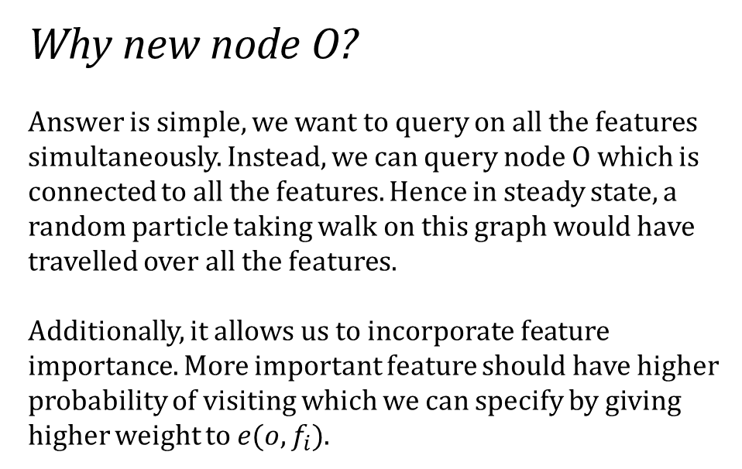
Methodology (contd..)
Why new node O?
Answer is simple, we want to query on all the features simultaneously. Instead, we can query node O which is connected to all the features. Hence in steady state, a random particle taking walk on this graph would have travelled over all the features.
Additionally, it allows us to incorporate feature importance. More important feature should have higher probability of visiting which we can specify by giving higher weight to $e(o,f_{i})$.
Reviews
Features
r1
f1
r2
o
f2
r3
fn
rn

Slide 14
Methodology (contd..)
Why new edges from Reviews to O?
Because, we want to improve the rank of the Adjacency matrix. Adding very weak links does have a strong effect on ranking. If we do not add these edges then overall rank of the matrix is severely hurt. Since we apply column normalization of adjacency matrix before using random walk algorithm, all the information stored in features is lost.
More on this on the next slide…..
Reviews
Features
r1
f1
r2
o
f2
r3
fn
rn

Slide 15
Methodology (contd..)
0 | 1 | 2 | 0 | 0
1 | 0 | 0 | 5 | 1
2 | 0 | 0 | 5 | 1
0 | 5 | 5 | 0 | 0
0 | 1 | 1 | 0 | 0
0 | 0.14 | 0.25 | 0 | 0
0.33 | 0 | 0 | 0.5 | 0.5
0.66 | 0 | 0 | 0.5 | 0.5
0 | 0.71 | 0.62 | 0 | 0
0 | 0.14 | 0.12 | 0 | 0
2
5
4
Rank = 4 ☹
1
5
1
1
2
3
5
1
O
Feat.
Reviews
O
Features
Reviews
0.1
0 | 1 | 2 | 0.1 | 0.1
1 | 0 | 0 | 5 | 1
2 | 0 | 0 | 5 | 1
0.1 | 5 | 5 | 0 | 0
0.1 | 1 | 1 | 0 | 0
0 | 0.14 | 0.25 | 0.009 | 0.06
0.31 | 0 | 0 | 0.49 | 0.47
0.62 | 0 | 0 | 0.49 | 0.47
0.03 | 0.71 | 0.62 | 0 | 0
0.03 | 0.14 | 0.12 | 0 | 0
2
5
4
1
5
Rank = 5 ☺
1
1
2
3
5
1
0.1

Slide 16
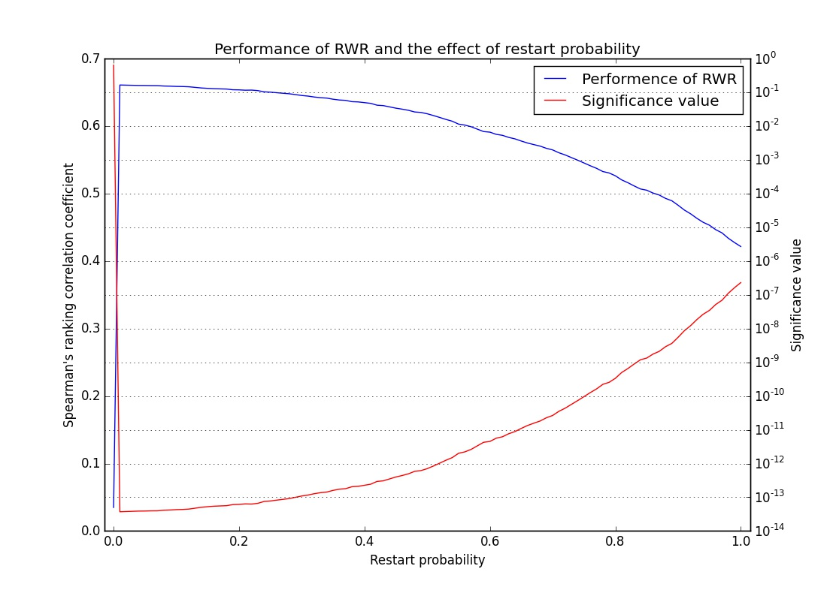
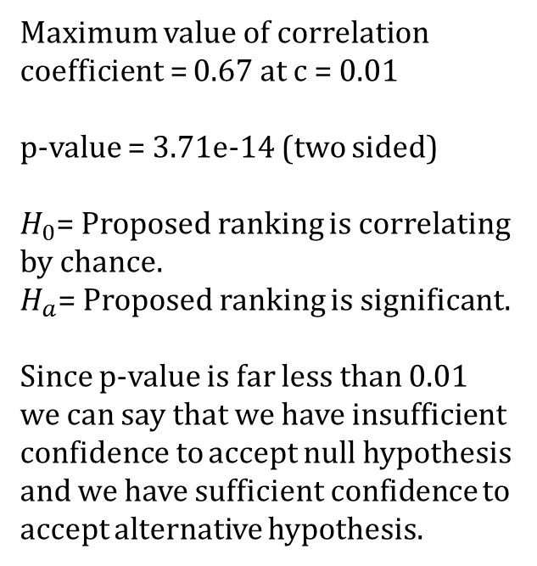
Results
Maximum value of correlation coefficient = 0.67 at c = 0.01
p-value = 3.71e-14 (two sided)
$H_{0}$= Proposed ranking is correlating by chance.
$H_{a}$= Proposed ranking is significant.
Since p-value is far less than 0.01 we can say that we have insufficient confidence to accept null hypothesis and we have sufficient confidence to accept alternative hypothesis.

