Slide 1

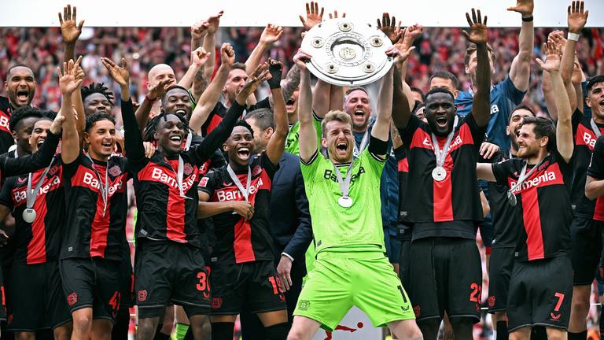
BAYERN
LEVERKUSEN’S
PHENOMENAL 23/24 SEASON
PRESENTED BY
HARSHA NARASIMHE GOWDA

Slide 2
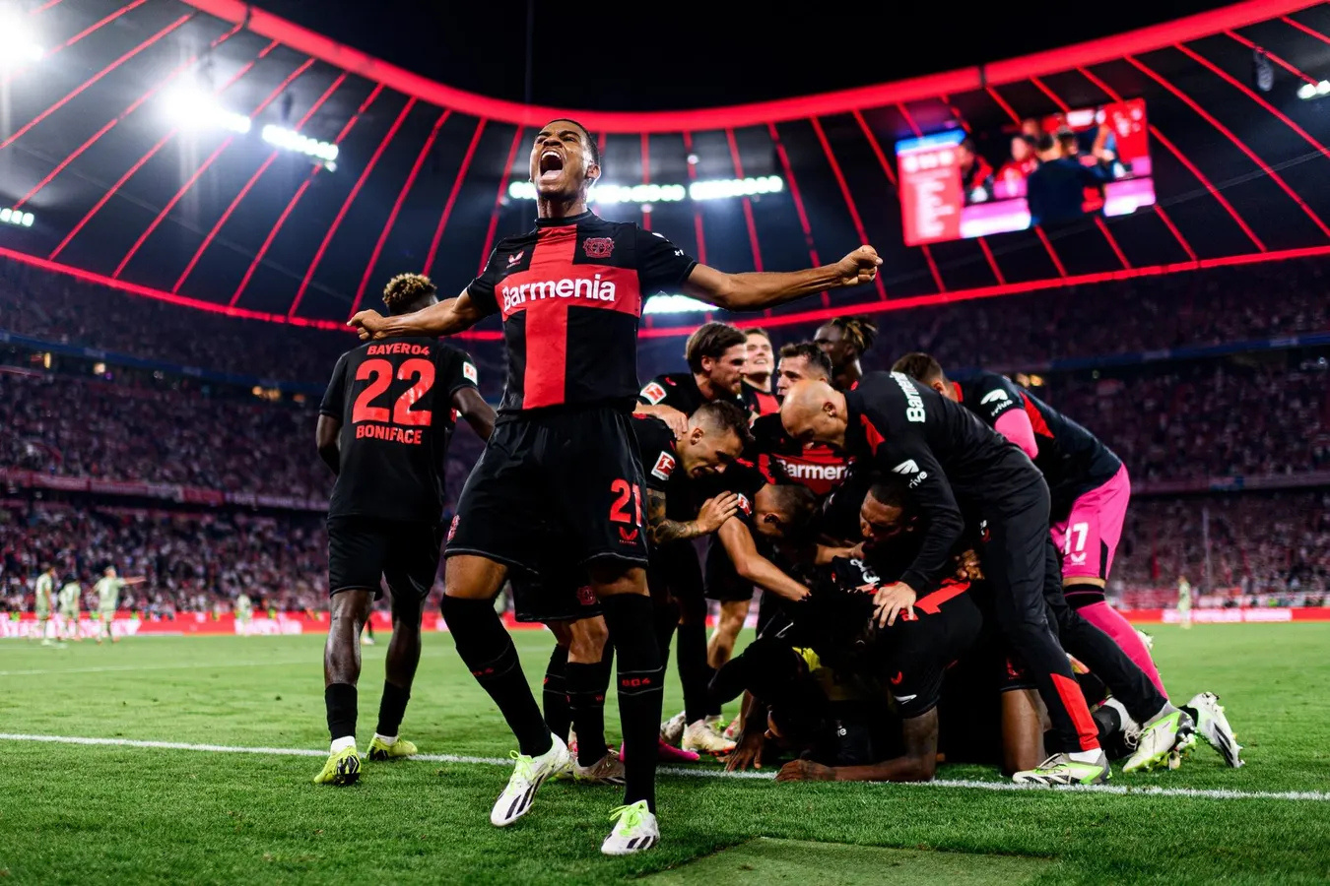
Bayern Leverkusen, under Xabi Alonso won the BundesLiga title in 2024 against all odds. Being a mid-table team, let’s analyse how they shot up to the top spot .
We have used data from Statsbomb which describes all the events that happened in matches.

Slide 3
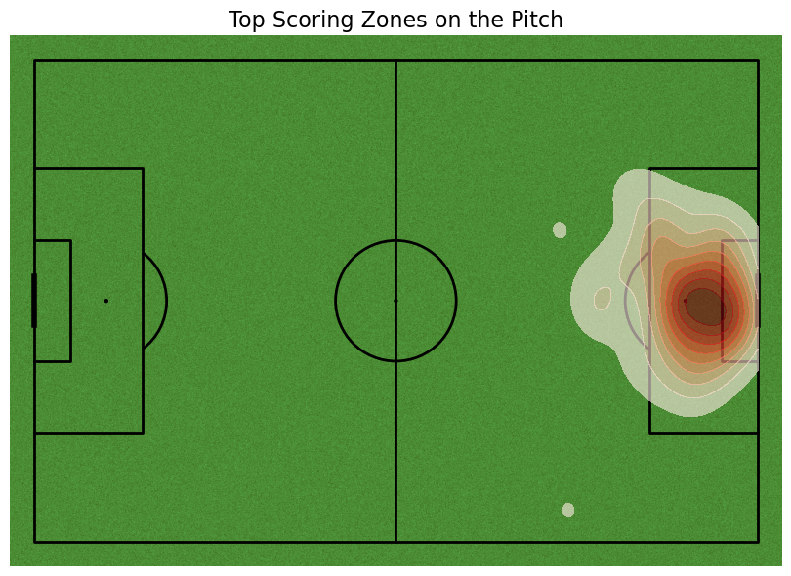
WHAT ARE THE TOP SCORING ZONES ON THE PITCH?
Let’s look at the top-scoring zones where Leverkusen scored most.
Most of the goals have been scored from inside the D. This could tell us that the team relied more upon short passes and cool finishes inside the D, or there could have been crosses coming in from both sides
01
03

Slide 4
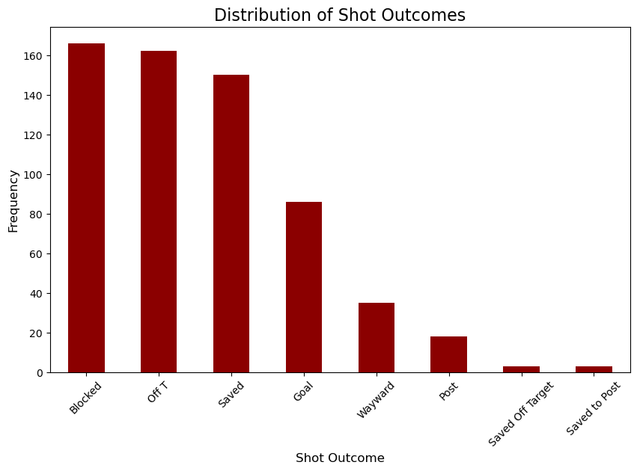
WHAT IS THE DISTRIBUTION OF SHOT OUTCOMES?
We see that Leverkusen have a lot of shots on target but only around 85 of them have led to goals. Their shots off-target are very low telling us that their shot accuracy was pretty accurate.

Slide 5
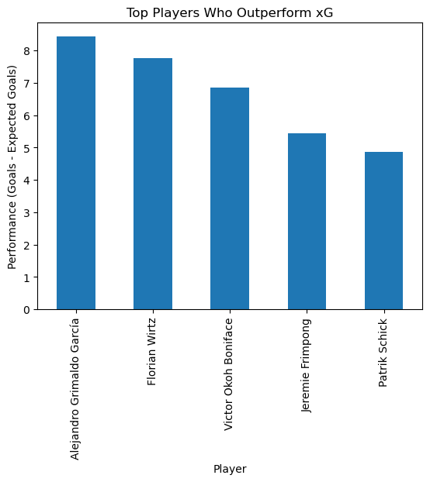
TOP PLAYERS WHO OUTPERFORMED XG
expected goals (xG) is a performance metric used to evaluate player performance. It tells us the expected goals from the player.
For the team to shine, some players must have performed well above expectations. Considering performance to be the difference between
total goals-expected goals, Garcia has been the outshining performer.

Slide 6
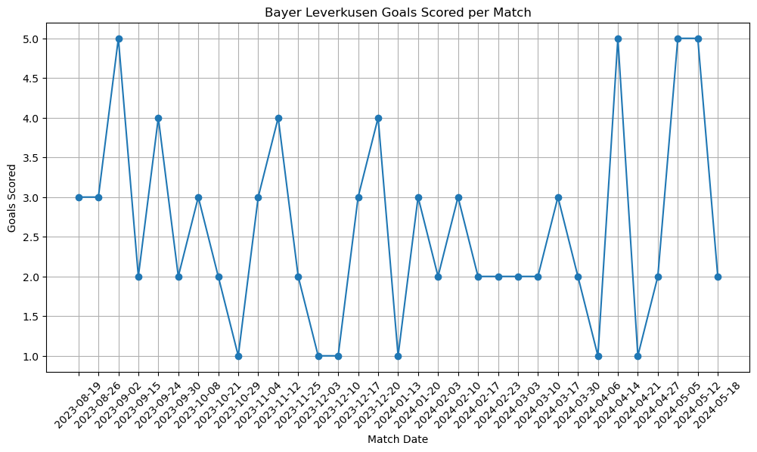
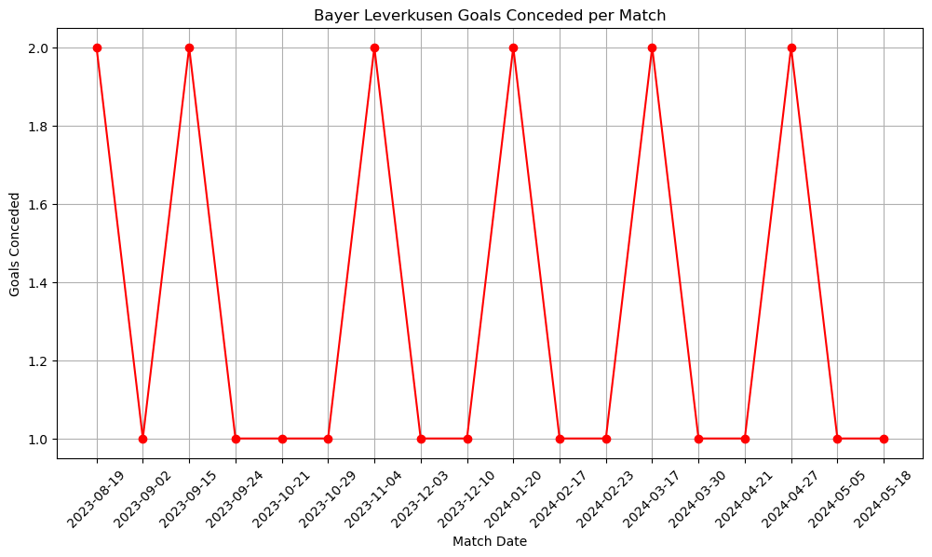
GOAL SCORING TREND VS CONCEDED TREND
As we can see, Leverkusen has consistently scored 2 goals or above throughout the season.
They have also not conceded more than 2 goals in any other match. Their defense has been consistent.

Slide 7
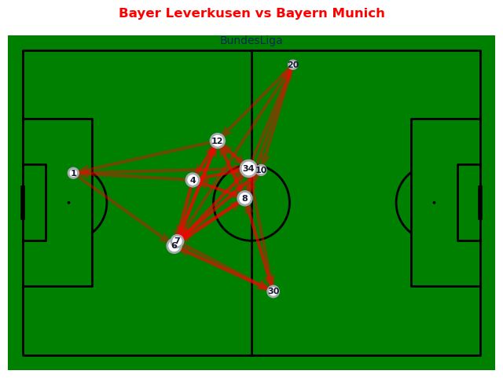
BAYER LEVERKUSEN'S PASSING NETWORK VS BAYERN MUNICH
Bayern Munich were the only close contenders to Leverkusen in 23/24. Let's analyze how the team’s passing network was against them.
We can see that most of the successful passes occurred in the midfield(darker red), with some horizontal passes to the wings. Jersey numbers 20 and 30 mainly operated on the wings. Leverkusen had won this match 3-0. They dominated the midfield as we can see in the passing network.

Slide 8
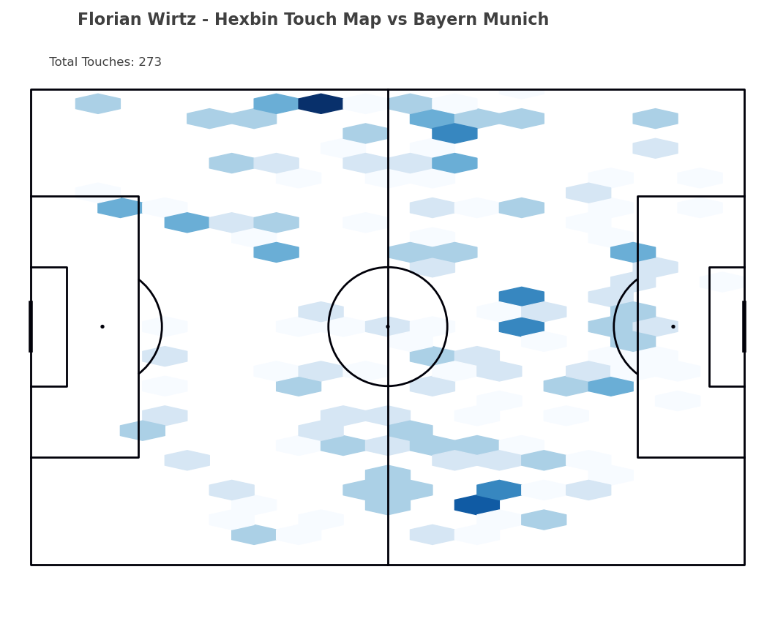
WHERE HAS WIRTZ BEEN DEPLOYED ON THE PITCH?
Florian Wirtz was the Man of the Matcha against Bayern Munich. Let’s see a heatmap of where Wirtz has been playing in that match.
  High-Touch Areas:
  The darker blue hexagons show the regions where Wirtz was most active. These are concentrated:
    In central areas near the halfway line.
    In the right half-space in Bayern's half, possibly suggesting involvement in attacking transitions or buildup play.
  Some activity is also observed near the opposition box, indicating involvement in the final third.
  Spread of Touches:
  Wirtz covered a wide area, suggesting versatility and a box-to-box style of play.
  There's a noticeable bias toward the right side of the pitch, indicating his role or tactical positioning in the game plan.
  Total Touches:
  The map states 273 total touches, which is high, showcasing his centrality to the team's play during this match.
  Tactical Insights:
  Frequent touches near the center circle suggest participation in controlling tempo and dictating play.
  Activity near Bayern's defensive third could imply his role in chance creation or attempts to break down the opposition's defense.

Slide 9
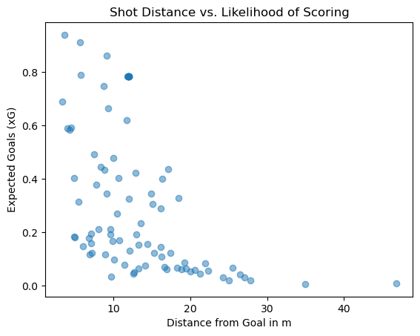
DOES THE SHOT DISTANCE SHOW A LIKLIHOOD TO SCORING?
Understanding metrics becomes important while analyzing the success of some events. Scoring a goal is an important event in the world of football and a number of factors affect it. One such factor is distance.
We have used a scatter plot to check if there’s a likelihood of scoring from a particular distance.
  Trend:
  Shots taken from shorter distances (e.g., less than 10 meters) generally have a higher XG, indicating a higher likelihood of scoring.
  As the distance increases, the XG values tend to decrease, showing that shots from farther away are less likely to result in a goal.
  Spread:
  There is some variability even for close-range shots, meaning factors beyond distance, like angle, goalkeeper positioning, or defenders, may also influence scoring chances.
  Very distant shots (e.g., over 30 meters) have very low XG values, reflecting their difficulty in resulting in a goal.

Slide 10
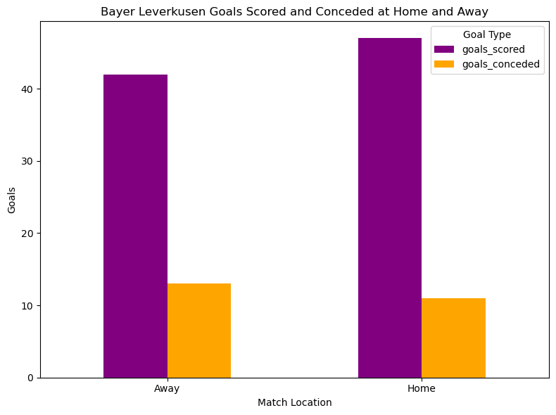
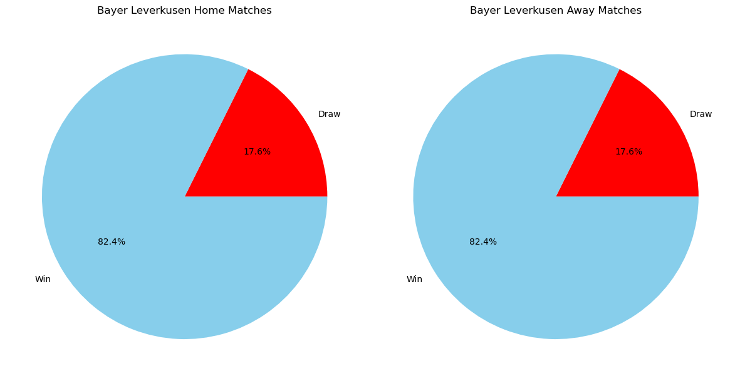
Leverkusen has scored more and conceded less in home matches suggesting that they have been very strong at home.
Regardless of the goals scored or conceded, it’s interesting to see that the percentage of games won and drawn is the same for both and away matches. There’s no question of a loss as they never lost a match the whole season!!!
HOME AND AWAY STATS

Slide 11
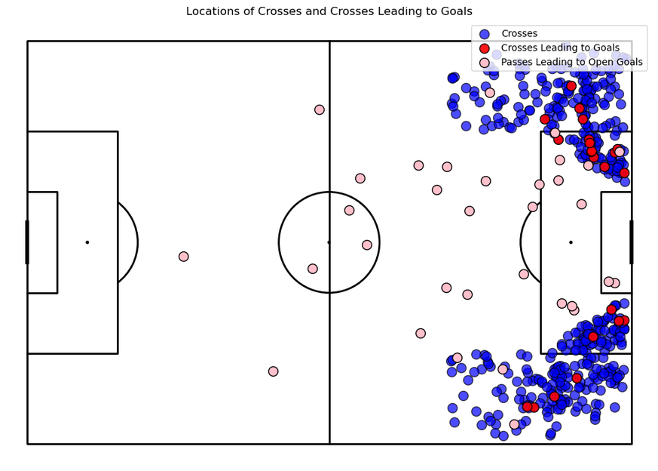
CROSSES AND PASSES
  Blue Points:
    Represent all crosses during the game.
    Most are clustered around the wide areas in the attacking third, especially near the opposition's penalty box and along the wings.
  Red Points:
    Represent crosses that led to goals.
    These are fewer in number and occur closer to the penalty area, particularly near the edge or within the final third.
    Indicates that dangerous crosses tend to originate closer to the goal.
  Pink Points:
    Represent passes that led to open goals.
    These are scattered but more concentrated in and around the penalty box.
    Suggests that direct passes near the goal are crucial for creating clear goal-scoring opportunities.
Observations:
  Wide Play Emphasis:
    The concentration of crosses (blue) near the wings highlights the importance of wide play and crossing as a strategy.
  Effectiveness of Crosses:
    Only a small percentage of crosses (red) lead to goals, suggesting the need for precision in the final third.
  Central Danger Zone:
    Pink points cluster in central, high-value areas near the penalty spot, underlining the importance of creating chances from central spaces.

Slide 12
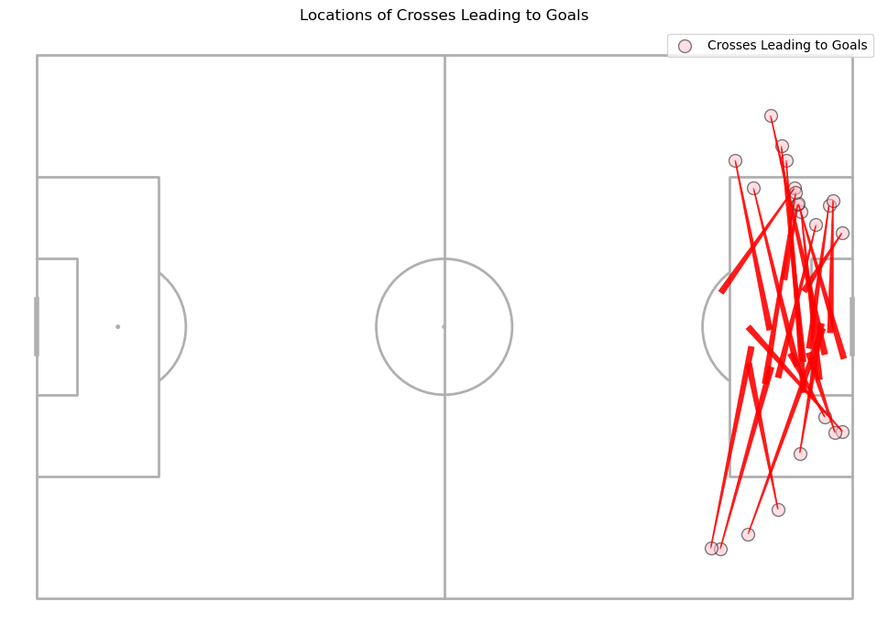
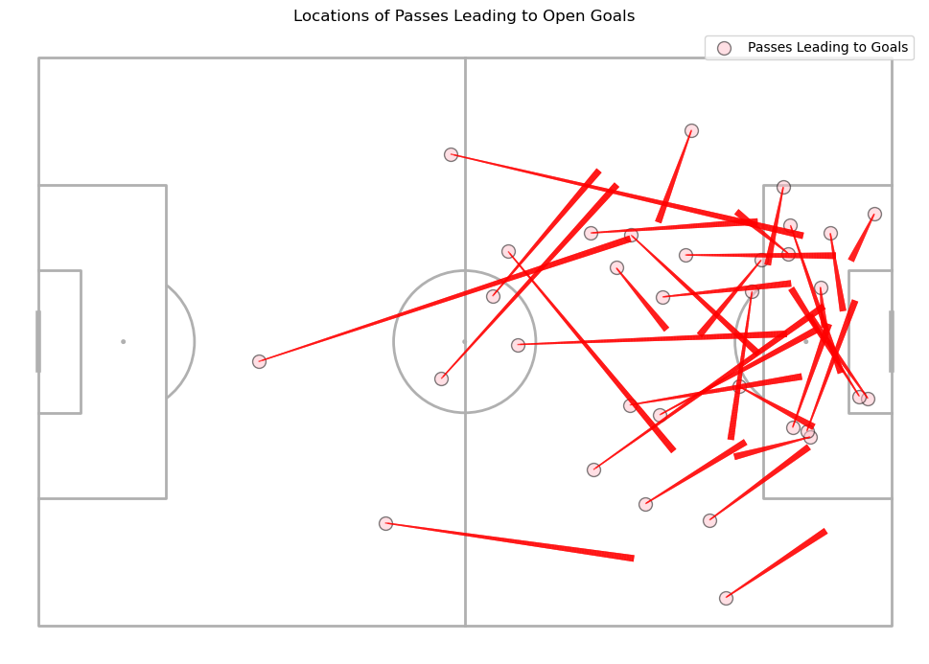
Exploring further, we can not only observe where the crosses and passes took place that led to goals but also where to.
All the crosses from the wings have been into the D, while passes that have led to goals have been from all around the opponent’s side.
We can also observe more crosses from the left wings.
CROSSES AND PASSES

Slide 13
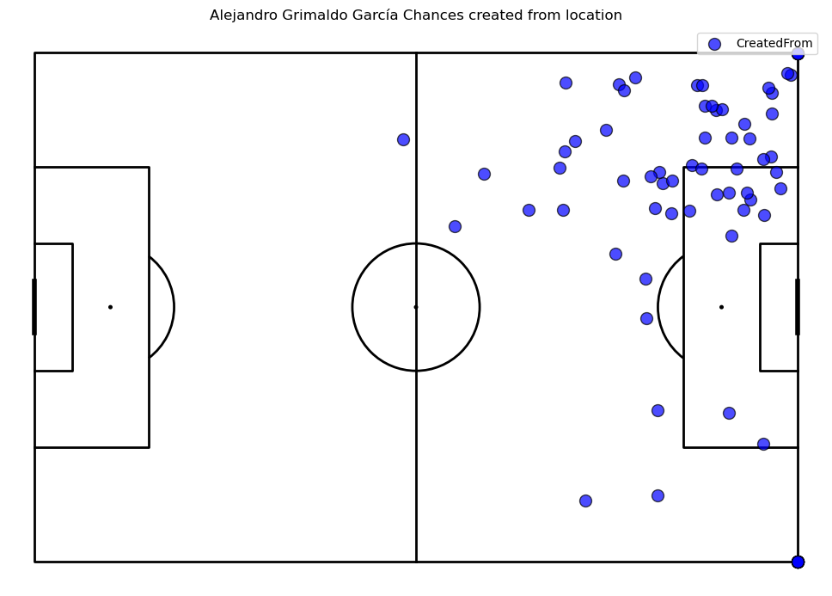
WHICH PLAYER CREATED MOST CHANCES?
It’s not just the goal scorers that are important for the team, but also the playmakers. Alejandro Garcia had created the most number of chances for Leverkusen. Here we have calculated chances as the sum of goal assists and shot assists.
in the previous slide, we saw that the left flank delivered more crosses than the right, thanks to Garcia.
You can also notice that a few blue dots on the corners which means Garcia was also good at taking corners.

Slide 14
THANK YOU

