Slide 1
Hello
No text

Slide 2
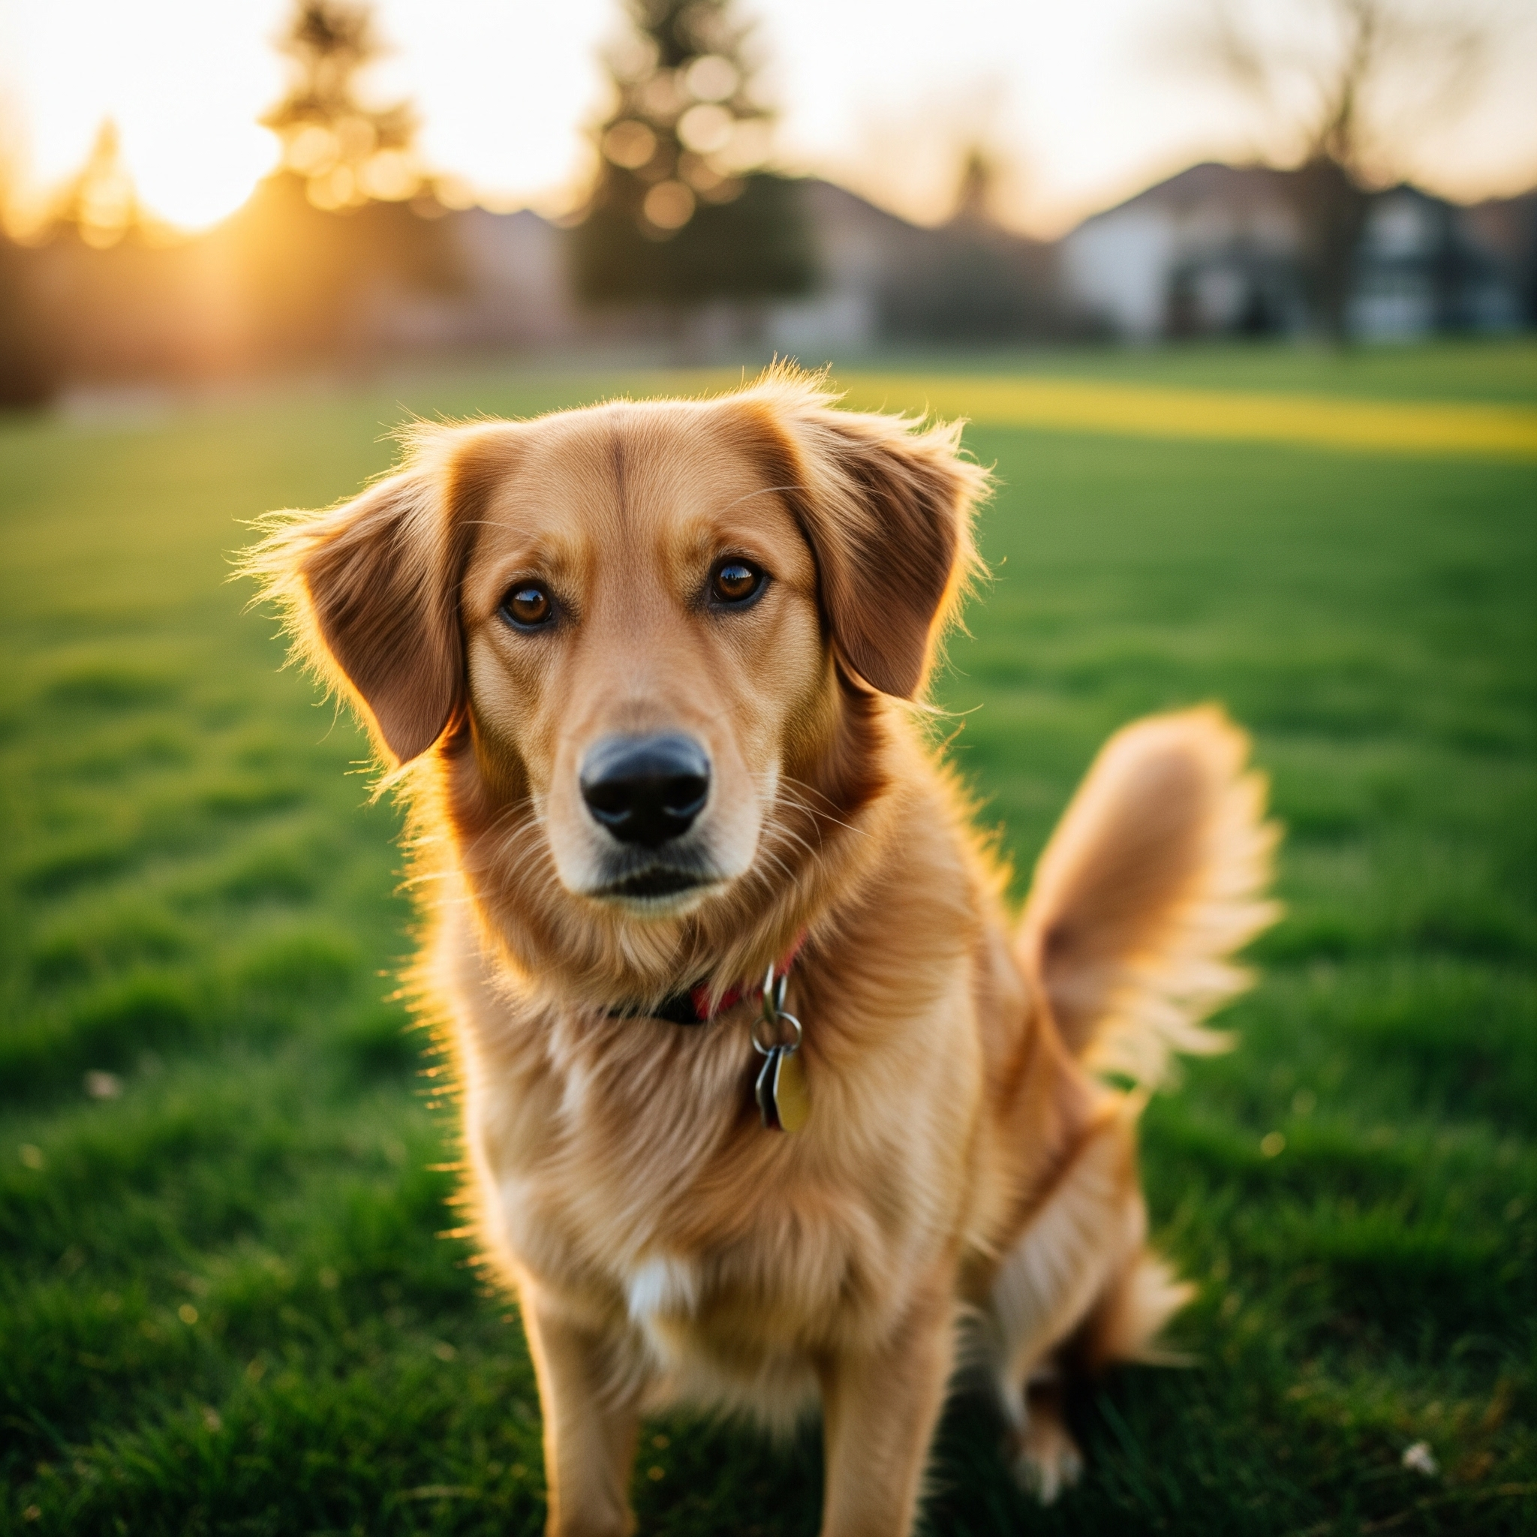
A dog

Slide 3
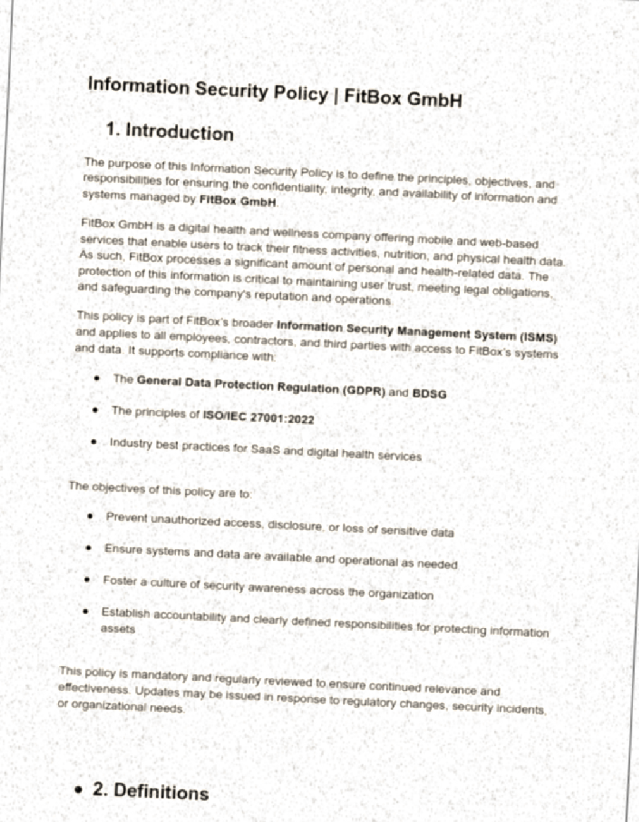
Scanned doc

