Slide 1
Cardiovascular system

Slide 3
HEART
Heart is lies in the pericardial cavity
The pericardial cavity is lined by pericardial membrane
Pericardial membrane is two layered which is filled by fluid called pericardial fluid
The pericardial fluid reduces friction by lubricating the membrane allowing the membranes to glide over each other with each heart beat.

Slide 5
Heart wall
The wall of the heart is made of
1. Epicardium – external layer
2. Myocardium – middle layer
3. Endocardium – inner layer

Slide 6
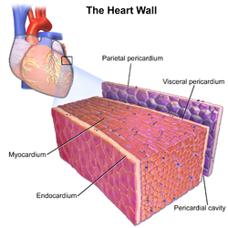

Slide 7
Heart chambers
There are four chambers in the heart
Two upper chambers called atria
Two lower chambers called ventricles

Slide 8
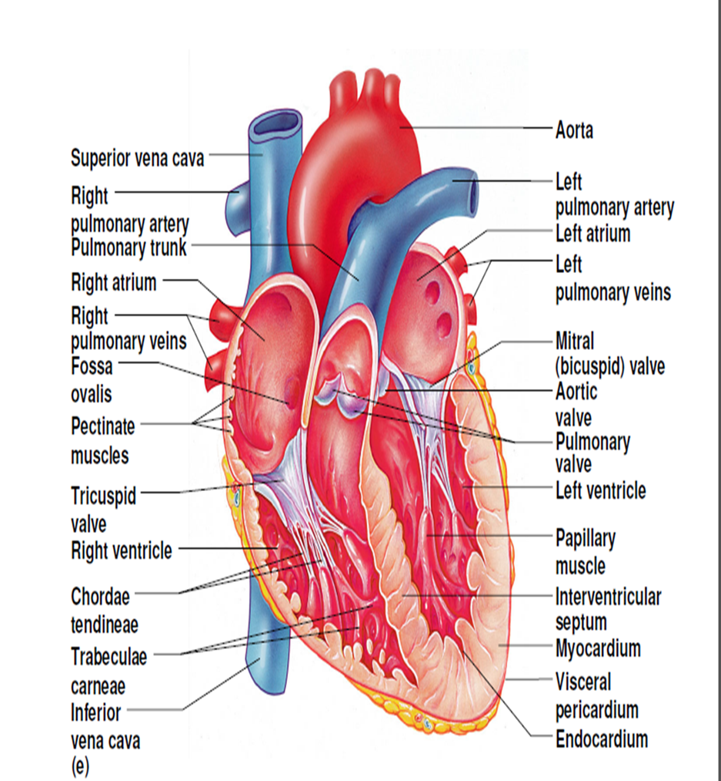
Atria of the Heart
Atria are the receiving chambers of the heart
Atria are relatively small, thin walled chambers
Blood enters right atria from superior and inferior venae cavae
Blood enters left atria from pulmonary veins

Slide 9
Ventricles of the Heart
Ventricles are the discharging chambers of the heart
Right ventricle pumps blood into the pulmonary trunk
Left ventricle pumps blood into the aorta

Slide 10
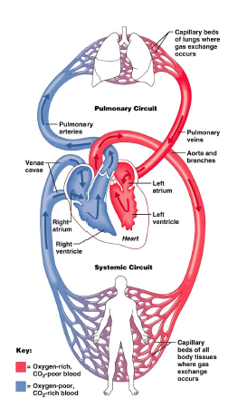
Pathway of Blood Through the Heart
Pulmonary circuit is involved with gas exchange
Systemic circuit pumps oxygenated blood to the body

Slide 11
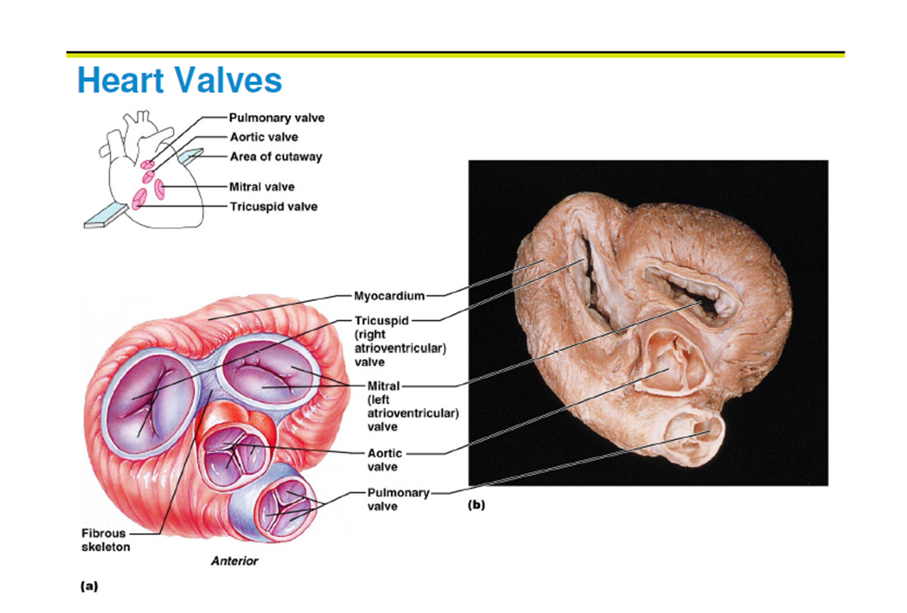
Heart Valves
Heart valves ensure unidirectional blood flow through the heart
Atrioventricular (AV) valves lie between the atria and the ventricles & prevent backflow into the atria when

Slide 12
Heart Valves
Aortic & pulmonary semilunar (SL) valves prevent backflow into the associated ventricles
Made of 3 cusps

Slide 13
Cardiac Cycle
Cardiac cycle refers to all events associated with blood flow through the heart
Cardiac cycle includes
Systole – contraction of heart muscle
Diastole – relaxation of heart muscle
During systole (contraction) the chambers of the heart empties the blood
During diastole (relaxation) the chambers of the heart fills with blood.

Slide 15
Heart Sounds
Two sounds can be distinguished when the thorax is listened with stethoscope
They are associated with the closing of heart valves
First sound occurs as AV valves close and signifies beginning of ventricular systole (contraction)
Second sound occurs when Semi lunar valves close at the beginning of ventricular diastole (relaxation)

