Slide 1

SMART INDIA HACKATHON 2026
TITLE PAGE
Problem Statement ID – SIH26101
Problem Statement Title - Develop an AI enabled learning platform that identifies competency gaps, recommends personalized training through integration with the iGOT Karmayogi ecosystem, and capable of generating Quizzes and Multiple choice questions (MCQs) from uploaded learning materials to strengthen capacity building in India's Official Statistical System.
Theme - Smart Education
PS Category- Software
Team ID – SIH26-A0H-T191
Team Name – Jaguar

Slide 2
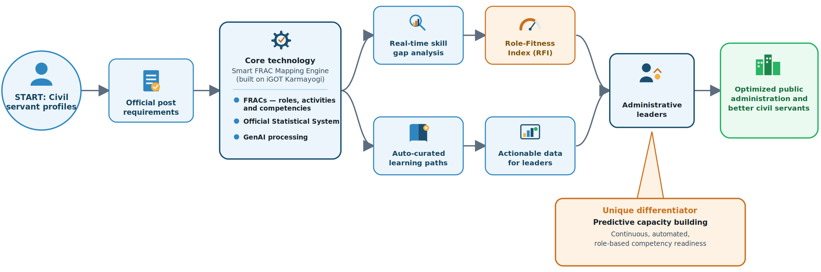

AI-Enabled Learning Platform & iGOT Karmayogi Integration
Jaguar
Proposed Solution:
The Idea: Smart FRAC Mapping Engine:
An intelligent AI recommendation engine built on top of iGOT Karmayogi that dynamically maps individual civil servant profiles to official post requirements using the Framework of Roles, Activities, and Competencies (FRACs), Official statistical system (OSS) and GenAI.
How Our Solution Works:
It analyzes employee skill gaps in real time, auto-curates personalized micro-learning paths, and generates a Role-Fitness Index (RFI) to assist administrative leaders in meritocratic work allocation and become a better civil servant serving the public administration.
Uniqueness & Innovation:
Unlike static portal catalogs, our solution introduces Predictive Capacity Building—shifting governance from reactive annual training to automated, continuous, role-based competency readiness.

Slide 3
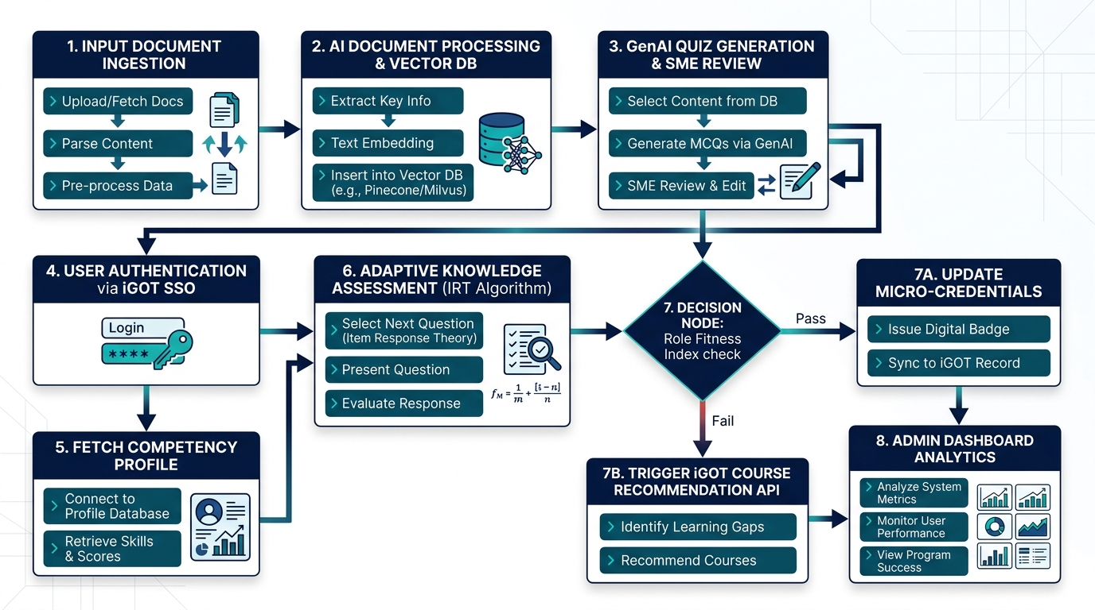




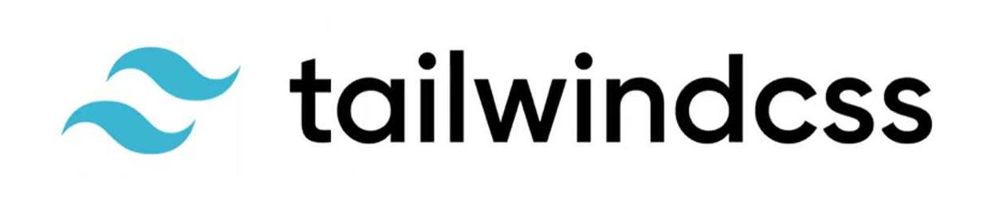

TECHNICAL APPROACH
Jaguar
Tools used:
Front-end: React.js, Streamlit (Python), Angular
Back-end: MySQL, FastAPI, Pandas
Vector DB & Search (RAG): ChromaDB
GenAI & Quiz Engine: Google Gemini API, pytorch, Ollama and a Quantized Llama 3
This Photo by Unknown Author is licensed under CC BY

Slide 4
FEASIBILITY AND VIABILITY
Jaguar
Feasibility Analysis:
Technical Feasibility: Built using robust open-source LLMs, standard microservices, and established iGOT API standards.
Operational Feasibility: Aligns directly with National Programme for Civil Services Capacity Building (Mission Karmayogi) mandate.
Financial Viability: Uses open-weight local models (e.g: Llama 3), reducing API token costs by 85%.
Potential Challenges:
Challenge / Risk | Why It Matters (Impact) | Our Mitigation Strategy
1. AI Hallucination in MCQs | Wrong statistical formulas or incorrect answer keys generated. | Strict RAG Grounding: Every question cites its exact source manual paragraph + Expert human-in-the-loop review.
2. Diverse Cadre Skill Levels | Field surveyors need basics; senior ISS officers need complex econometrics. | Dynamic FRAC Mapping: Questions automatically scale in difficulty based on official officer designation.
3. Data Privacy & Security | Risk of exposing internal government performance and assessment data. | Air-Gapped Deployment: Runs on-premise or on MeghRaj Cloud with local quantized models—zero data sent to external APIs.
4. Low Field Connectivity | Rural survey staff cannot access online tests due to bad network. | Offline PWA Engine: Progressive Web App allows downloading quizzes offline and syncing results automatically later.

Slide 5
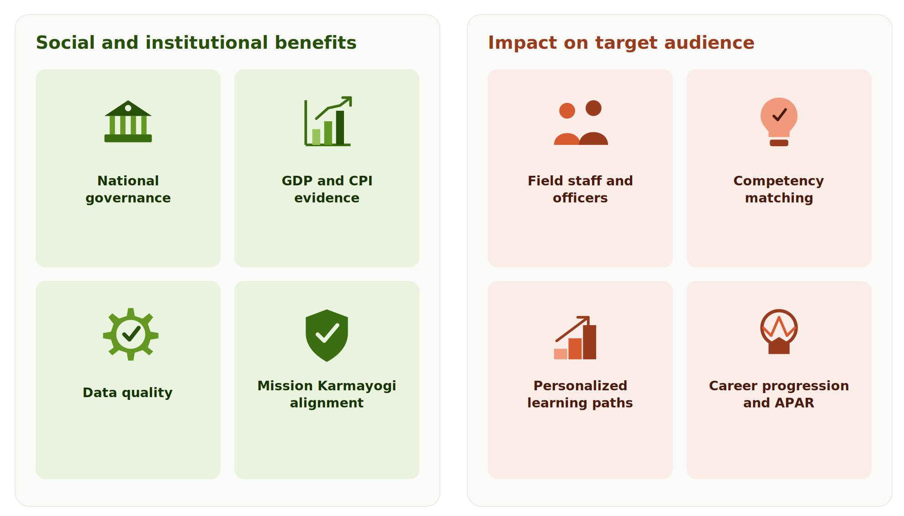
IMPACT AND BENEFITS
Jaguar
Social & Institutional Benefits | Impact on Target Audience
Data Quality for Governance Higher precision in field surveys directly improves national GDP, CPI, and IIP statistical accuracy. | Field Officers & Surveyors (SSS/NSSO) Precision micro-learning replaces generic training, delivering skills tailored to immediate survey duties.
Viksit Bharat @2047 Mandate Strengthens evidence-based policymaking across all central and state government ministries. | Statistical Officers (ISS Cadre) Advanced econometric and analytical competency paths support continuous professional development.
Mission Karmayogi Alignment Accelerates the national transition from "Rule-based" to outcome-driven "Role-based" civil service. | Trainers & Internal Evaluators RAG-driven item generation cuts assessment preparation time from weeks to seconds.
Public Resource Efficiency Reduces physical workshop costs by replacing outdated schedules with dynamic digital learning. | Career Growth & HR Transparency Objective competency diagnostic scores integrate directly into APAR performance reviews.

Slide 6
RESEARCH AND REFERENCES
Jaguar
Mission Karmayogi (iGOT Platform) | igotkarmayogi.gov.in
Capacity Building Commission (CBC) - FRAC Framework | cbc.gov.in
Ministry of Statistics and Programme Implementation (MoSPI) | mospi.gov.in
Retrieval-Augmented Generation (RAG Paper - Lewis et al.) | arxiv.org/abs/2005.11401
Item Response Theory (IRT Standard Guidelines) | psychometrics.org

