Slide 1
Javascript

Slide 2
contents
Basics:
Print statement
Operators
Datatypes
Variable declaration
Control loops & Control statements
Functions
Advanced:
Async functions
Wait
Delay

Slide 3
What is javascript?
It is a versatile and a widely used programming language which is primarily used in web development
It allows to create interactive and dynamic web pages by adding functionality and interactivity
It operates directly on a client-side machine in the web browser by handling user actions and
JS uses nodeJS in order to run server side applications. fetching data from the servers
nodeJS is a runtime environment that allows JS to be executed and run outside of the browser, on a server.

Slide 4
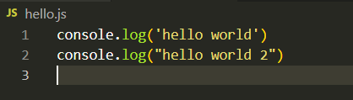

Basics: print statement
In order to print a statement in javascript we can use the following:
console.log(“statement”) (or) console.log(‘statement’)

Slide 5
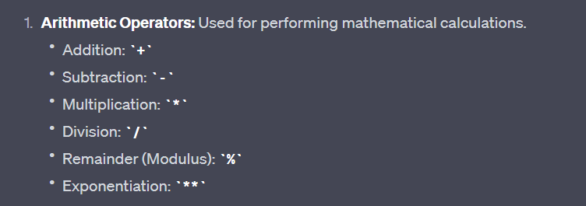
Operators:
Javascript supports many number of operators and the operations in between two variables can be performed using these operators.
They are:

Slide 6
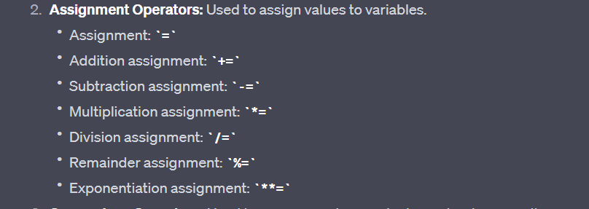
Operators:

Slide 7
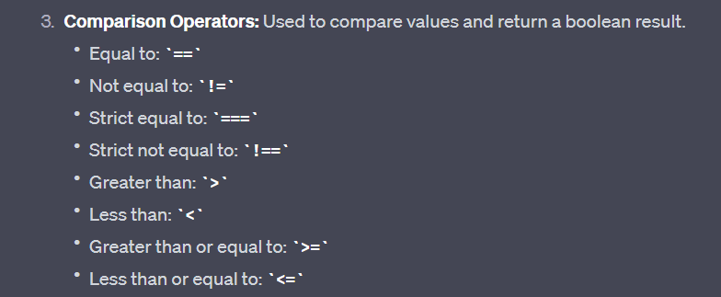
Operators:

Slide 8
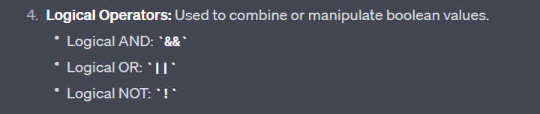
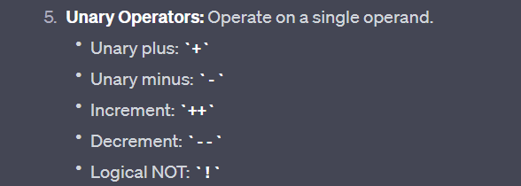
Operators:

Slide 9
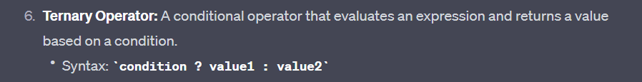

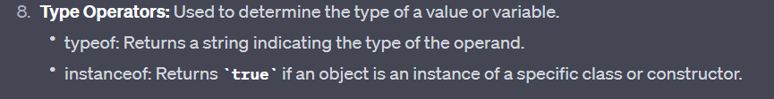
Operators:

Slide 10
Please refer to “operators.js” file in order to gain a hands on experience with operators

Slide 11
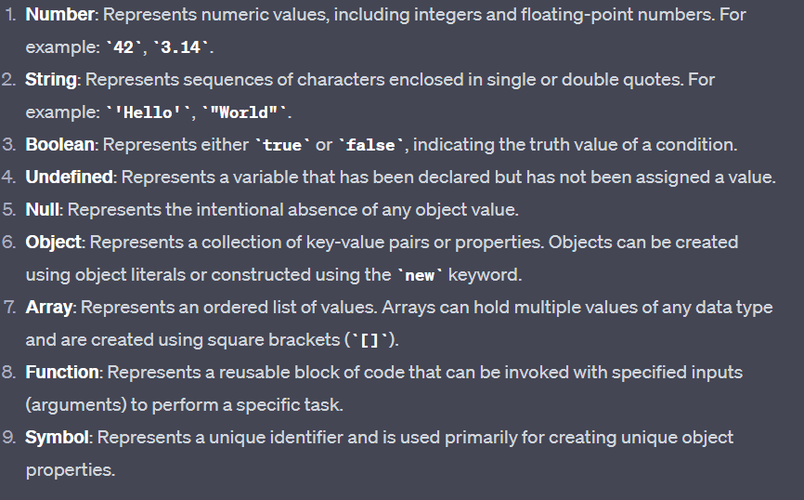
Datatypes

Slide 12
Please refer to “datatypes.js” file in order to gain a hands on experience with data types

Slide 13
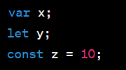
Variable declaration
We use 3 keywords in order to declare variables in javascript
var, let, const
“var” has a function level scope primarily
“let” it has a global level scope and it used program wide
“const” it has a block level scope and it is used within blocks where data is not supposed to change much often

Slide 14

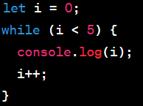
Control loops
‘for’ loop: executes a block of code a specific no.of times
‘While’ loop: Executes a block of code while a specified condition is true.

Slide 15
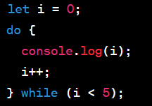
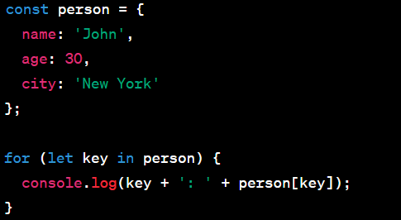
Control loops
‘do...while’ loop: Executes a block of code at least once and then repeatedly while a specified condition is true.
for...in loop: Iterates over the properties of an object.

Slide 16
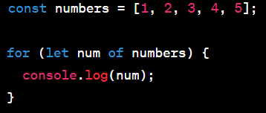
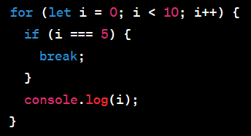
Control loops
for...of loop: Iterates over the elements of an iterable object (such as arrays or strings).
break statement: Terminates the execution of a loop.

Slide 17
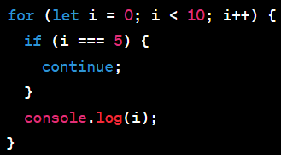
Control loops
continue statement: Skips the current iteration and continues to the next iteration of a loop.

Slide 18
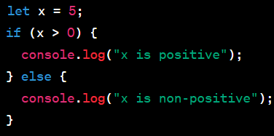
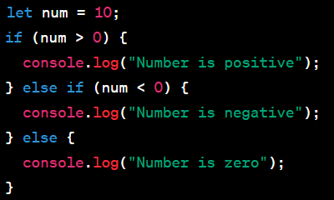
Control statements
‘if’ statement: Executes a block of code if a specified condition is true.
‘if...else if...else’ statement: Executes different blocks of code depending on multiple conditions.

Slide 19
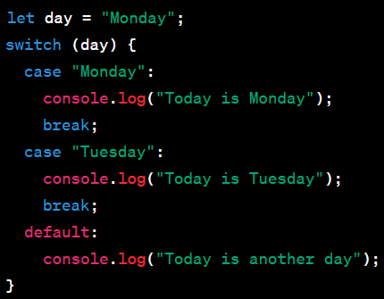
Control statements
‘switch’ statement: Allows you to select one of many code blocks to be executed based on different cases.

Slide 20
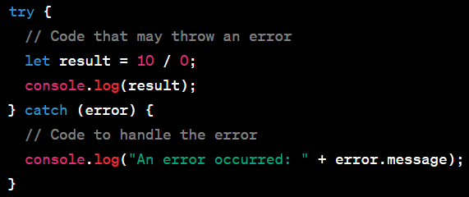
Control statements
‘try...catch’ statement: Used for error handling to catch and handle exceptions that may occur in the try block.

Slide 21
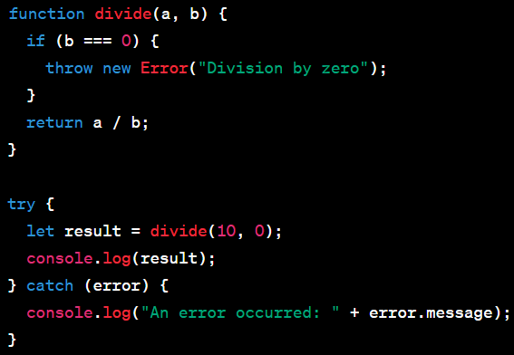
Control statements
‘throw’ statement: Used to throw custom errors or exceptions.

Slide 22
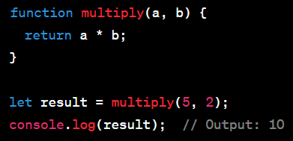
Control statements
‘return’ statement: Ends the execution of a function and returns a value.

Slide 23
Please refer to “statements.js” file in order to gain a hands on experience with control statements

Slide 24
Functions
Functions in JavaScript allow you to encapsulate reusable blocks of code that can be called and executed multiple times.
They provide modularity and help organize your code.

Slide 25
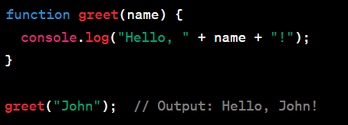
Functions
Function Declaration: You can declare a function using the function keyword followed by the function name, a list of parameters in parentheses, and the function body enclosed in curly braces.

Slide 26
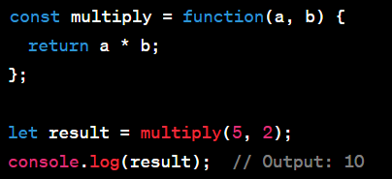
Functions
Function Expression: Functions can also be assigned to variables. In this case, the function is defined as an expression and assigned to a variable using the assignment operator (=).

Slide 27
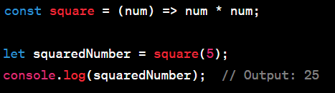
Functions
Arrow Function: Introduced in ES6, arrow functions provide a shorter syntax for defining functions, especially for simple functions that have concise bodies. They use the => syntax.
*ES6 is the latest and currently running version of JS

Slide 28
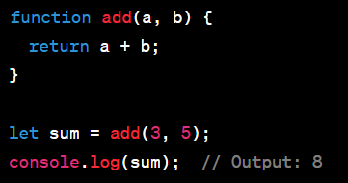
Functions
Function Parameters: Functions can accept parameters, which are variables that hold values passed to the function when it is called. Parameters are specified in the function declaration or expression within parentheses.

Slide 29
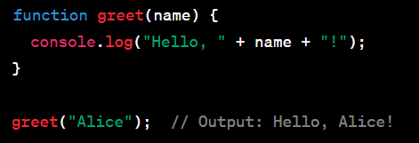
Functions
Function Invocation: To execute a function, you simply need to call it by using its name followed by parentheses. The arguments passed in the parentheses are the values that will be assigned to the function parameters.

Slide 30
Please refer to “functions.js” file in order to gain a hands on experience with functions

Slide 31
conclusion
This sums up the overall basics that anyone could learn in javascript as a beginner
There is no inclusion of advanced concepts of object orientation or async, await and promises and more. These topics are covered in intermediate or advanced javascript learning materials.

