Slide 1

Team CityLens Presents
ECOBRIDGE
GIT REPOSITORY LINK

Slide 2

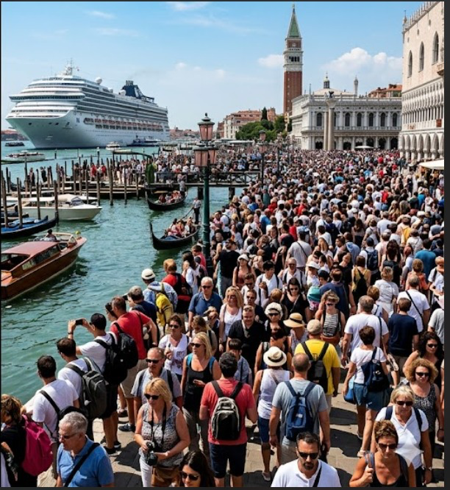
Population movement doesn’t just reshape the cities, it reshapes the environment..

Slide 3
The Problem
•⁠ ⁠Large population movements are increasing due to disasters, conflict, and economic pressure
•⁠ ⁠Destination cities are often unprepared for sudden population growth
•⁠ ⁠Increased population creates stress on:
🌬️ Air quality
🌊 Water systems
🌍 Land and waste systems
•⁠ ⁠Over time, this leads to environmental degradation and infrastructure overload

Slide 4
Why Current Solutions Fail
•⁠ ⁠Current systems track disasters or migration separately
•⁠ ⁠Environmental impacts are monitored in isolation
•⁠ ⁠No system shows the chain reaction between:
1. population movement
2. resource pressure
3. environmental degradation
•⁠ ⁠Cities usually react after damage has already started

Slide 5
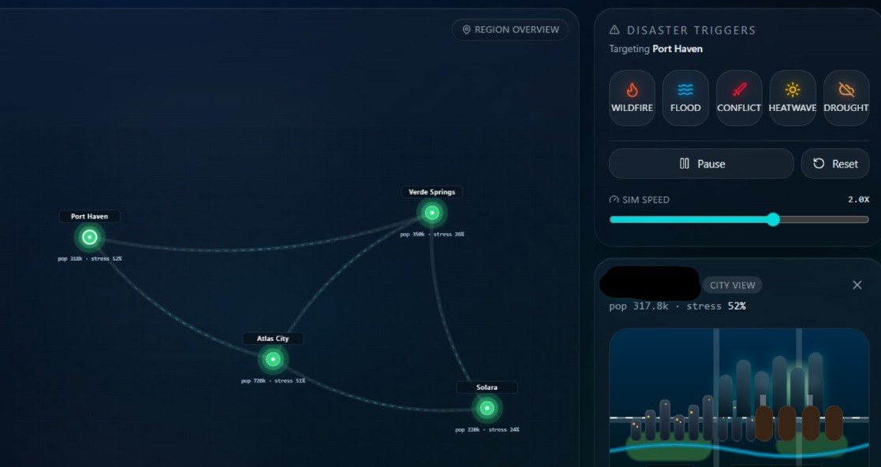
Ingoude Company
Our Solution
•⁠ ⁠A simulation platform for population-driven environmental stress
•⁠ ⁠Models how sudden population influx affects the environment
•⁠ ⁠Visualizes cascading environmental degradation over time
•⁠ ⁠Helps planners identify:
1. which systems fail first
2. where intervention is needed early

Slide 6
ECOBRIDGE - Live Demo

Slide 7
THANK YOU

