Slide 1


Jntua college of engineering (Autonomous), pulivendula
Team:
D. H. Praneeth
P. Suresh
U. Hanumanthu
Mentor:
Sri A. Naresh _{M.Tech, (PhD)}
_{Assist. Prof (Ad hoc)}

Slide 2
Regression of superconducting critical temperature

Slide 3
Contents
Introduction
Abstract
Existing System
Proposed System
Project architecture
Evaluation Metrics
Implementation
Possible Extensions

Slide 4
Introduction
Superconductivity is one of the main stream research topics in physics, chemistry and materials science.
Being studied from past 30 years
It is possible to employ statistics and Machine Learning to predict certain properties of superconductors.

Slide 5
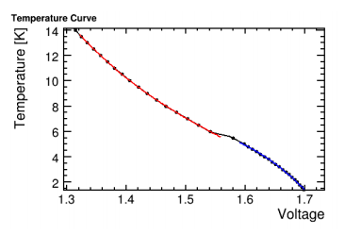
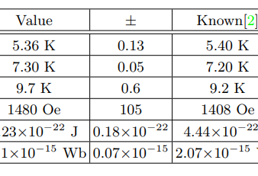
Existing System
The material’s conductivity is measured along with temperature.
Then the estimated value of Tc (critical temp.) is checked for errors.
citation: http://web.mit.edu/shawest/Public/jlab/Supercon/superpaper.pdf

Slide 6

Proposed system
Predicting critical temperature based the data about chemical compositions of the super conductor using a regression model.
citation: https://www.nature.com/articles/s41524-018-0085-8.pdf

Slide 7
Tasks Involved
Gathering data
Cleaning data
Visualizing data
Choose a Benchmark model
Train and Test the estimator
Evaluate the estimator
Conclude after modifications

Slide 8
analysis
Data Set Characteristics: | Multivariate | Number of Instances: | 21263
Attribute Characteristics: | Real | Number of Attributes: | 81
Associated Tasks: | Regression | Missing Values? | None

Slide 9
Attribute information
Some of the features include:
No. of elements
Mean atomic mass
Mean valence
Mean electron affinity
Mean Entropy and so on…

Slide 10
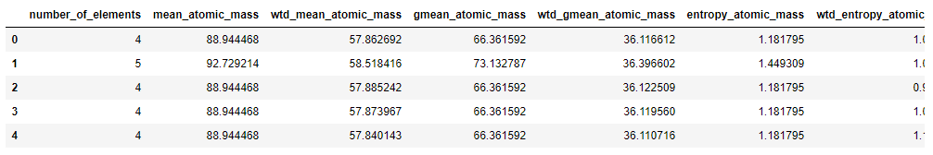
Gathering data

Slide 11
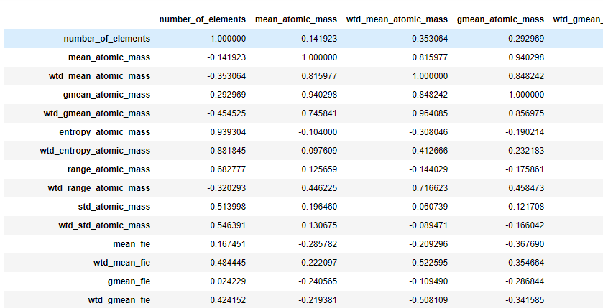
Understanding correlations

Slide 12
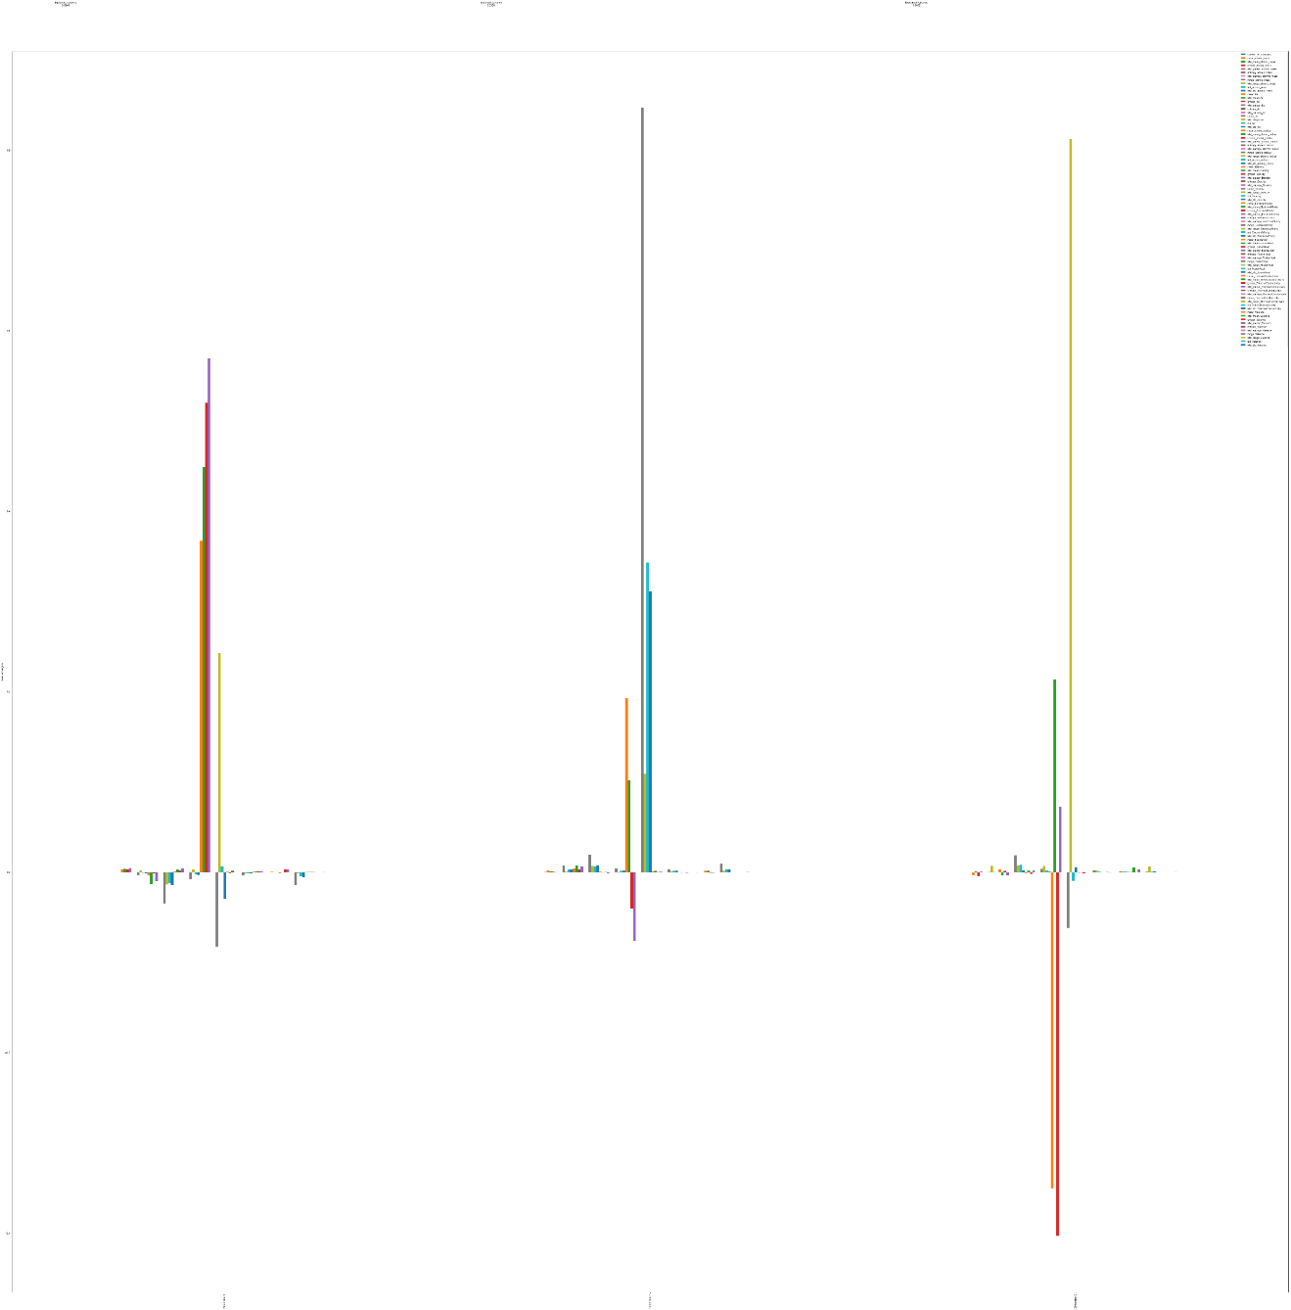
Reducing dimensions
Dimension-1 : 0.624
Dimension-2 : 0.299
Dimension-3 : 0.014

Slide 13
Benchmark model – Linear regression
Other preferred models:
  Polynomial regression
  Decision tree regression
  Random forest regression
  Xgboost regression

Slide 14
Evaluation metric
R2_score – explained variance

Slide 15
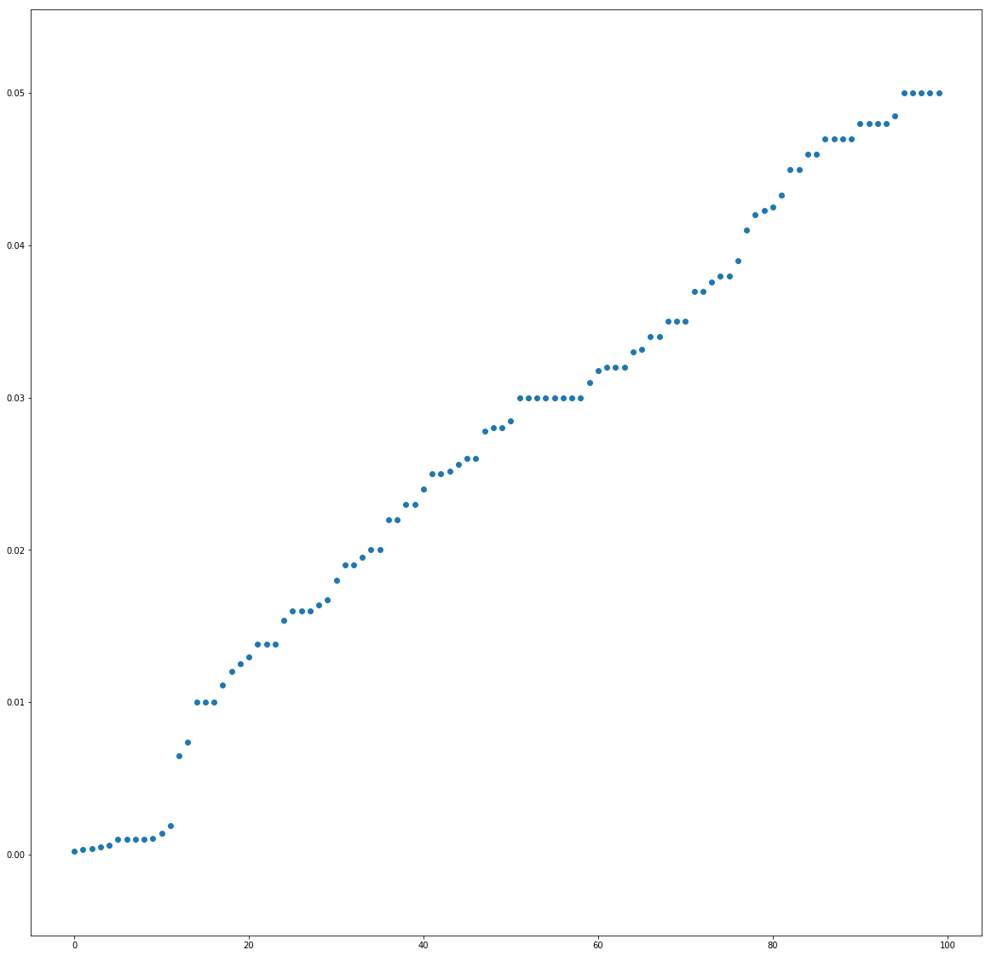
Output variable – Scatter plot

Slide 16
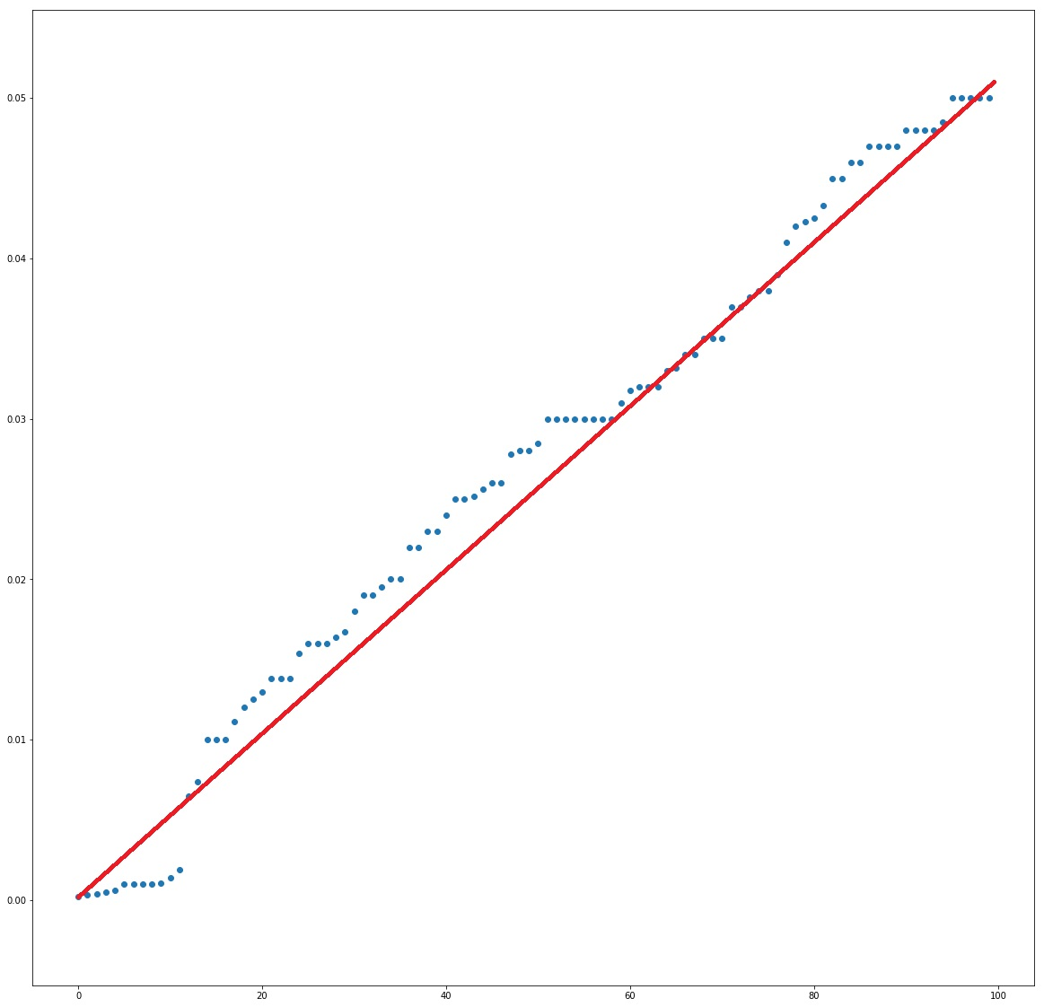
Working of Linear Regression

Slide 17
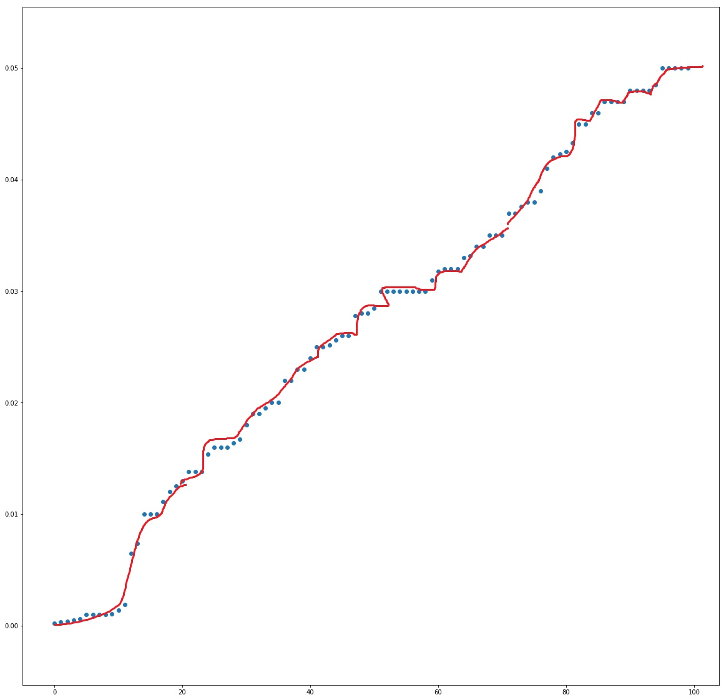
Working of Polynomial regression

Slide 18
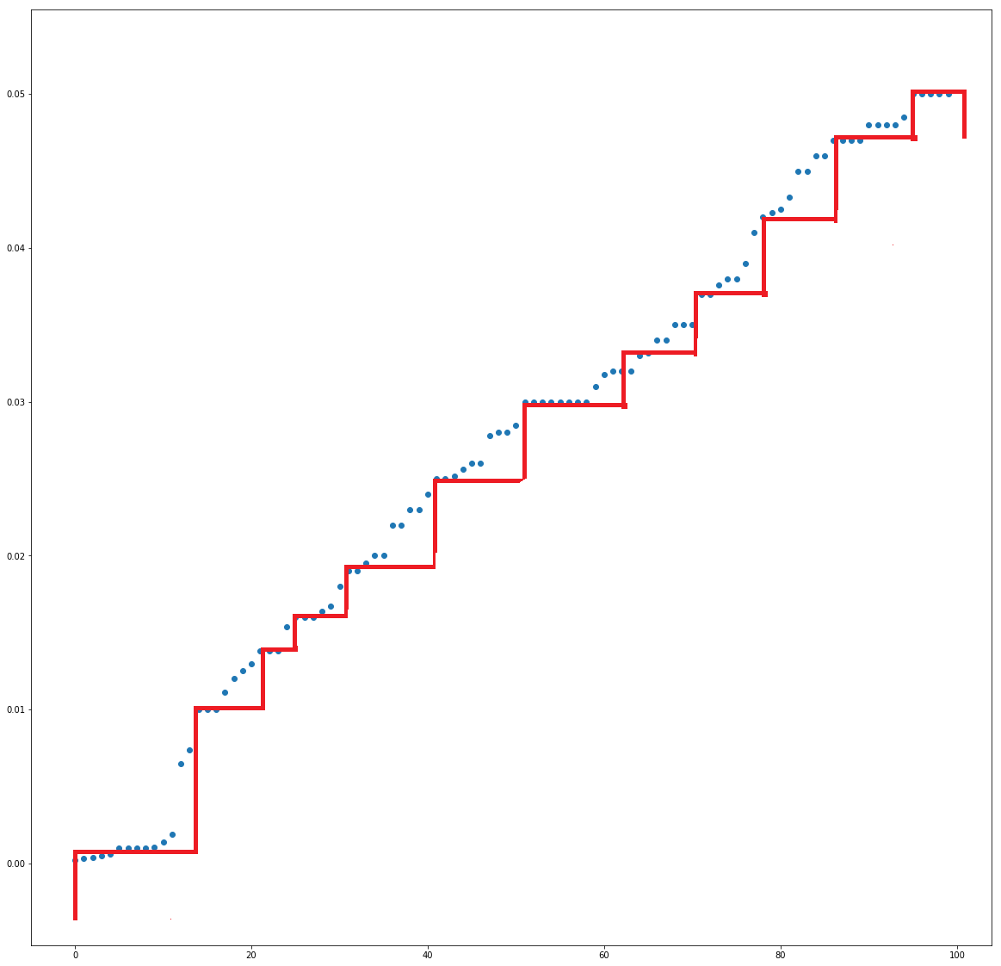
Working of Decision Tree

Slide 19
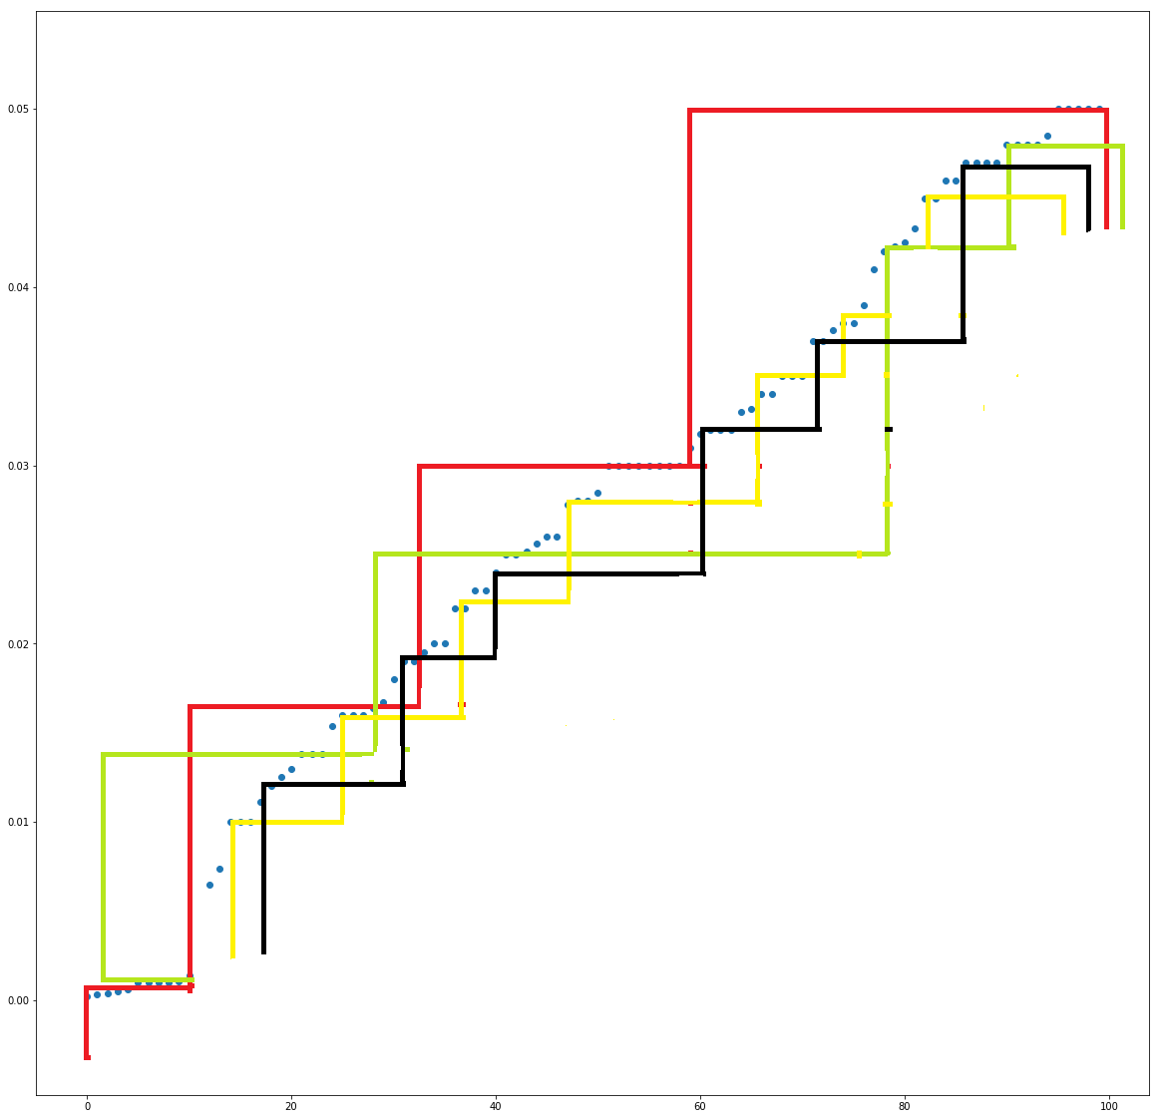
Working of Random Forest

Slide 20
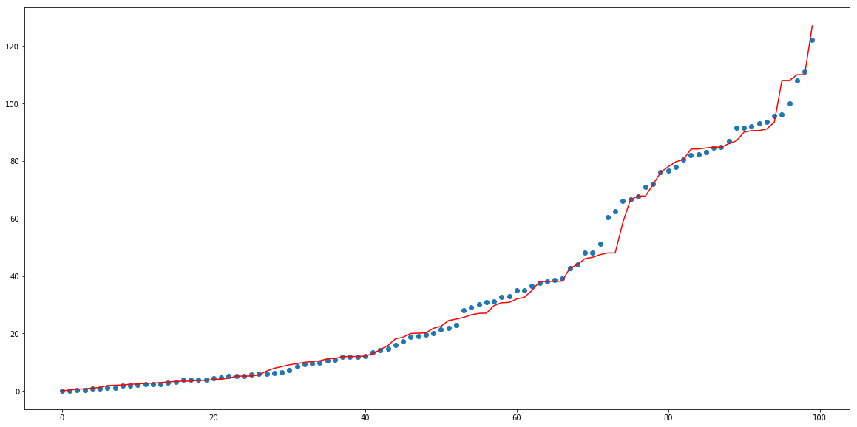
Working of XGboost

Slide 21
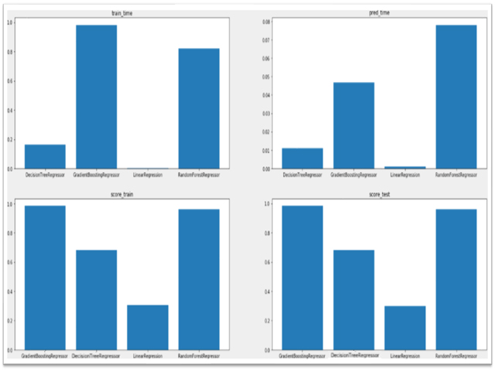
Performance Evaluation

Slide 22
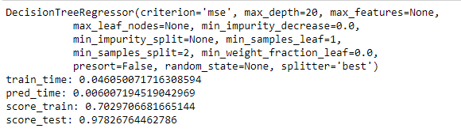
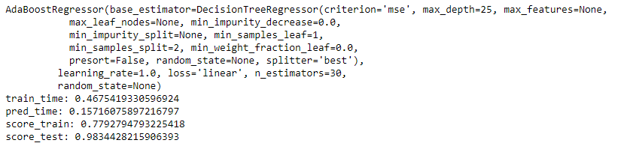
Previous model

Slide 23
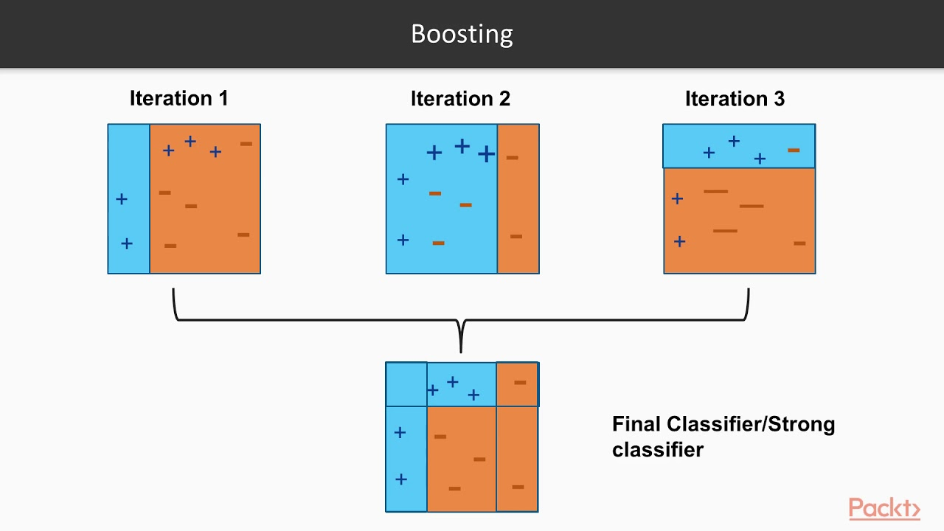
Adaboost
Initially, Adaboost selects a training subset randomly.
It iteratively trains the model by selecting the training set based on the accurate prediction of the last training.
It assigns the higher weight to wrong classified observations

Slide 24
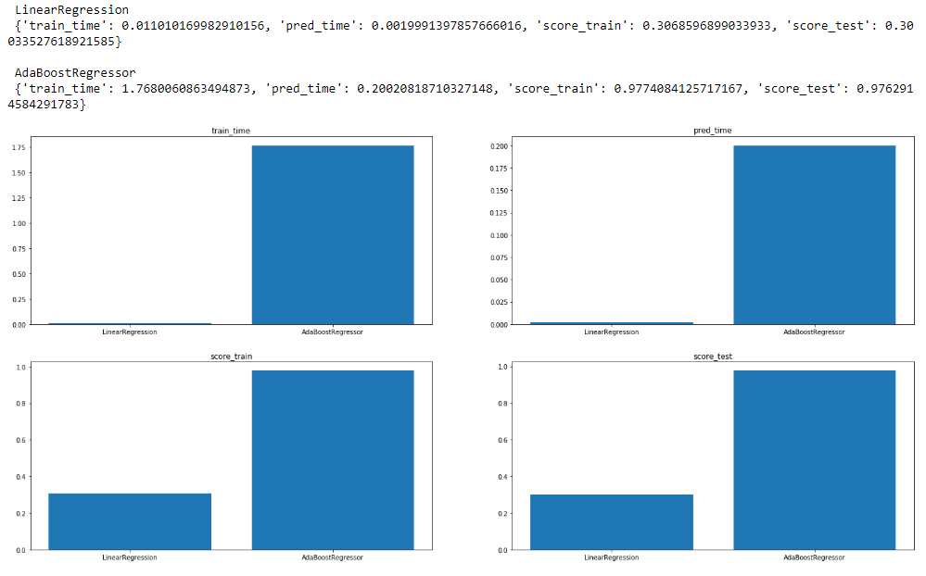
Improved model

Slide 25
COMPARISON WITH BENCHMARK

Slide 26
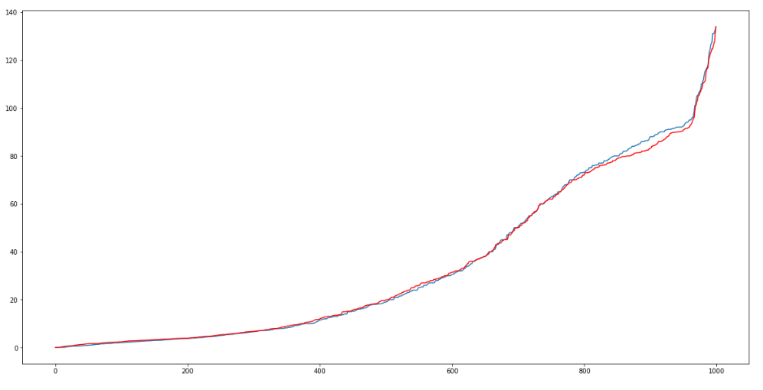
ACTUAL VALUES
VS
PREDICTED VALUES

Slide 27
conclusion
Decision Tree Regression model with AdaBoost performs better than other models according to the r2 score of the estimator in this situation.

Slide 28
Possible extensions
To further improve the predictive power of the models, another set of features can be constructed based on crystallographic and electronic information
By building a model which can extract the required features for our model from different combinations of elements we can find new possible superconductors

Slide 29
Any Queries?

Slide 30
Thank You

