Slide 1
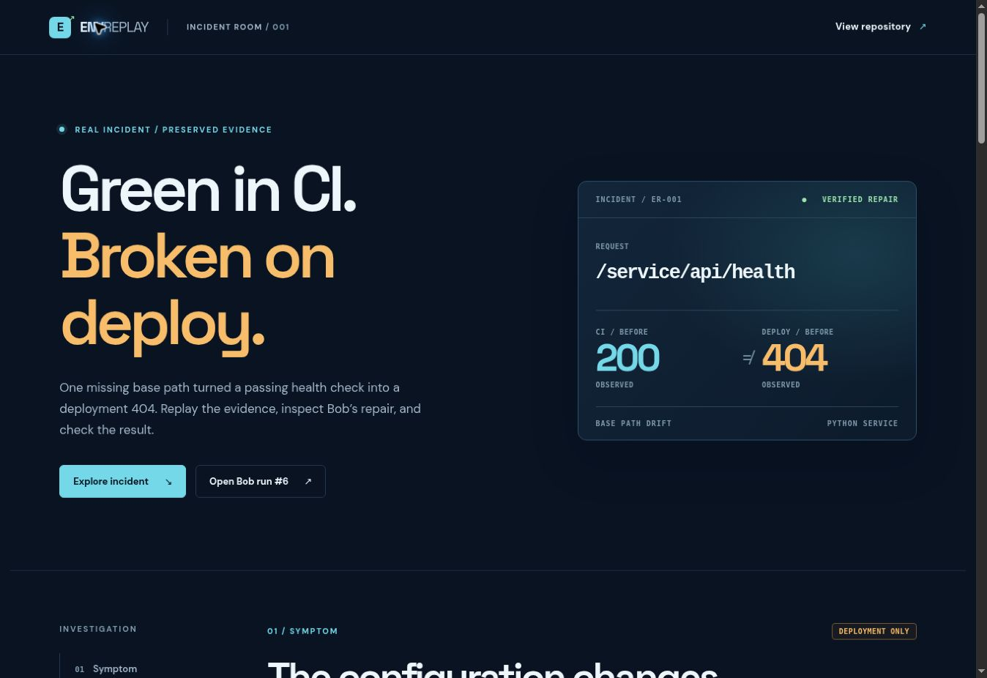
ENVREPLAY
The deployment failure
that CI could not see
One real 404. One isolated IBM Bob Shell repair.
Independent replay proves the result.
harshapriyag123.github.io/EnvReplay/
Notes:
Source: https://github.com/harshapriyag123/EnvReplay and the live GitHub Pages Incident Room. Screenshot captured from the live site.

Slide 2
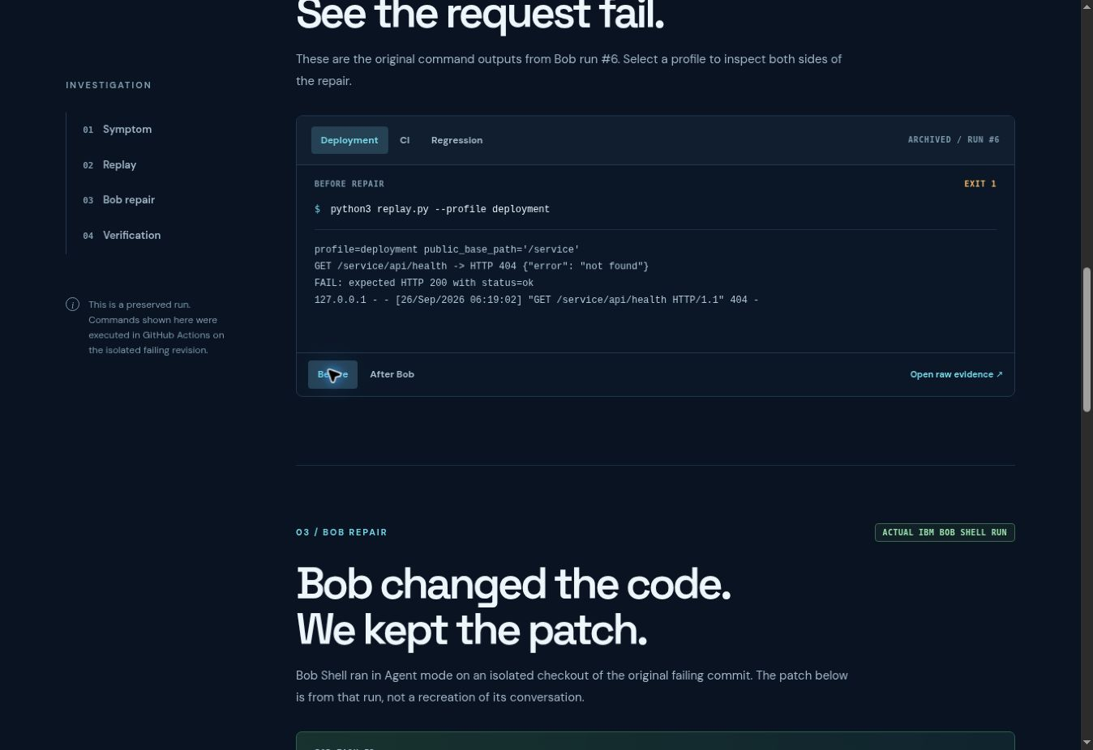
CI green, deployment 404
CI profile
public_base_path = ""
GET /api/health
HTTP 200
Deployment profile
public_base_path = "/service"
GET /service/api/health
HTTP 404
Notes:
Source: config/ci.json, config/deployment.json, evidence/bob-run-6/before.json. Screenshot is preserved real incident evidence.

Slide 3
Bob repaired the original failing revision
Bob Shell Agent mode · run #6
Task 0a1c9ea43c93eb037a283ffe760d0825
app.py
Serve the health route under the configured base path.
replay.py
Pass the deployment base path into the local server.
Bob’s patch was saved from an isolated worktree. The existing main-branch repair was authored by Codex.
Notes:
Source: evidence/bob-run-6/report.json and bob.diff, GitHub Actions run https://github.com/harshapriyag123/EnvReplay/actions/runs/36223374110. This slide describes IBM Bob Shell, not Bob IDE. Bob IDE task-session screenshots remain required.

Slide 4
Independent verification
CHECK
BEFORE
AFTER BOB
CI replay
0
0
Deployment replay
1
0
Regression suite
1
0
The Incident Room preserves commands, output, and Bob’s patch for review.
Bob IDE task-session screenshots remain to be captured.
Notes:
Source: evidence/bob-run-6/report.json. CI exit 0 to 0, deployment exit 1 to 0, regression exit 1 to 0. This pitch deck does not substitute for the required genuine Bob IDE task-session summary screenshots.

