Slide 1
HIT709 FIELD PROJECT | MTA PRESENTATION
Prasad Dental Care HMIS
Digital Patient Records, Chairside Operatory Queue & Prescription Information System
CLINICAL STAKEHOLDER PROFILE
ACADEMIC & EVALUATION CONTEXT
Clinic Name: Prasad Dental Care
Consultant Clinician: Dr. Hemanth Kumar
Qualifications: BDS, MDS – Orthodontics
Specialization: Orthodontics & Dentofacial Orthopedics
Clinic Address: N V R Buildings, Kothapeta, Kurnool, AP – 518004
Contact Phone: 8328456378
Program: PGDM Hospital & Health Management
Course: HIT709 Healthcare Management Information Systems
Evaluation Type: Mid-Term Assessment (MTA) Field Project Defense
Target Setting: Single-Doctor Dental Specialty Practice
Live Web URL: https://hmis-wine.vercel.app

Slide 2
CLINIC CONTEXT
Prasad Dental Care: Operational Setting & Context
Small-clinic outpatient environment with specialized orthodontic treatment cycles
PRACTICE ENVIRONMENT & OPERATIONAL DYNAMICS
ACADEMIC FIELD PROJECT OBJECTIVES
Single-Doctor Specialty Clinic:
Dr. Hemanth Kumar manages high patient volumes supported by a single front-desk receptionist.
Recurring Orthodontic Treatment Cycles:
Unlike general acute OPDs, orthodontic patients return every 3 to 4 weeks over 12–24 months for bracket adjustments, archwire changes, and monitoring.
Paper Record Vulnerability:
Manual registers and paper folders frequently suffer wear-and-tear, misfiling, and physical retrieval delays.
Need for Minimalist HMIS:
Monolithic hospital packages are excessively complex. The clinic requires rapid chairside entry without administrative bloat.
1. Workflow Bottleneck Identification:
Analyze physical check-in delays, appointment slot collisions, and chairside documentation gaps.
2. Tailored System Architecture:
Design and implement a cloud-native HMIS utilizing React, Supabase PostgreSQL, and Row Level Security.
3. Clinical Quality & Prescription Safety:
Introduce visual FDI tooth charting and tamper-proof immutable digital prescriptions.
4. Patient Self-Service Empowerment:
Provide 24/7 web-based record access for patients to verify prescriptions and upcoming appointments.

Slide 3
PROBLEM STATEMENT
Primary Operational Problem Statement
The clinical, administrative, and patient communication risks of manual paper workflows
5-10 MIN DELAY PER PATIENT
REPETITIVE PATIENT QUESTIONING
MEDICATION DISPENSING RISK
1. RECEPTION RETRIEVAL DELAYS
2. CHAIRSIDE INFORMATION VOID
3. HANDWRITTEN RX & RECORD LOSS
Receptionists search physical registers and storage shelves to locate folders. Misfiled or torn paper records create waiting room congestion, patient frustration, and administrative chaos during peak morning and evening clinic hours.
Dr. Hemanth Kumar has no instant digital access to past bracket adjustments, archwire gauges, or restorative history. The doctor is forced to rely on verbal patient recall, risking oversights in longitudinal orthodontic care.
Handwritten paper prescriptions present illegibility hazards for retail pharmacists. Patients frequently misplace paper slips after departure, leaving them with zero visibility into medication schedules or follow-up dates.
CORE HMIS INTERVENTION HYPOTHESIS:
By deploying a streamlined, role-separated digital HMIS, Prasad Dental Care can eliminate paper retrieval delays (<1s digital search), prevent appointment collisions, provide chairside FDI dental charting, and deliver tamper-proof digital prescriptions directly to the patient.

Slide 4
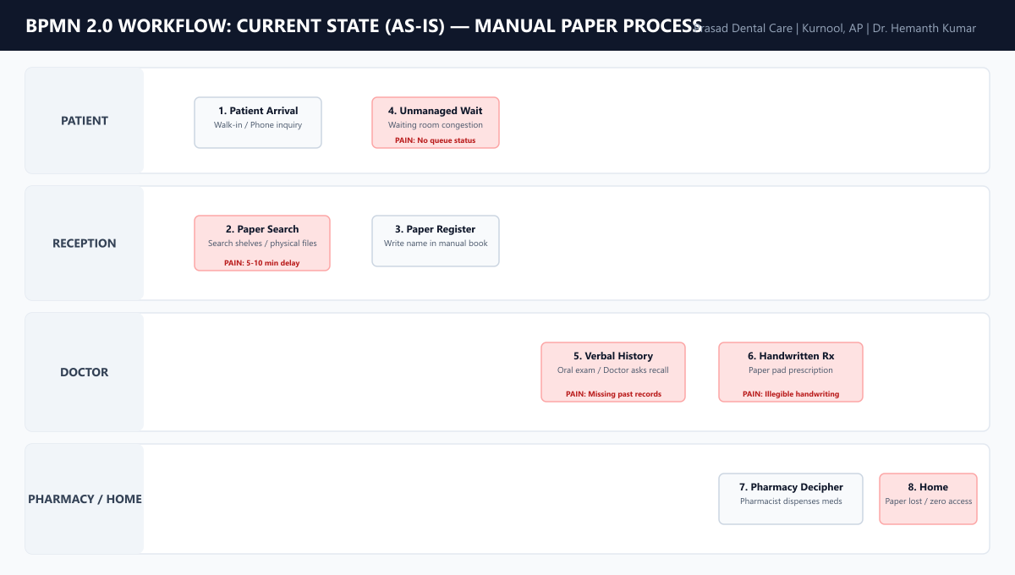
BPMN 2.0 WORKFLOW
Current State Workflow (AS-IS): Manual Paper Process
Manual paper handoffs across Patient, Reception, Doctor, and Pharmacy

Slide 5
GAP ANALYSIS
Documented Pain Points & Clinical Safety Risks
Evidence-based operational friction versus clinical safety hazards
OPERATIONAL BOTTLENECKS
CLINICAL & PATIENT RISKS
Physical File Search Delays (PP-01)
Missing Orthodontic Timeline (PP-04)
5–10 minutes spent per patient searching shelves and manual daybooks.
Historical bracket adjustments and tooth findings fragmented across paper cards.
Appointment Slot Collisions (PP-02)
Handwritten Prescription Hazards (PP-05)
Paper diaries lack automated conflict checking; double bookings occur.
Ambiguous handwriting increases medication dispensing risk at pharmacies.
Unmanaged Waiting Congestion (PP-03)
Post-Visit Communication Void (PP-06)
No queue transparency; patients wait blindly; verbal callouts.
Patients lose paper slips; zero digital access to dosage or visit history.

Slide 6
REQUIREMENTS
Client Requirements (Functional & Non-Functional)
Verified against system implementation and healthcare operational standards
FUNCTIONAL REQUIREMENTS (FR-01 TO FR-15)
NON-FUNCTIONAL REQUIREMENTS (NFR-01 TO NFR-10)
• Dual Portal Gateway: Segregated Staff & Patient portals.
• Atomic Provisioning: Sequential PDC-XXXXXX ID generation.
• Multi-Param Search: Lookup by Mobile, PDC ID, Name (<1s).
• Conflict-Free Booking: Automated slot overlap prevention.
• Live Queue Tracking: Scheduled -> Waiting -> In-Consultation.
• Chairside 1-Click Summary: Medical alerts & visit history.
• FDI Tooth Charting: Interactive 2-digit grid (teeth 11–48).
• Standardized Rx Engine: Dental formulary with auto-dosage.
• Patient Self-Service: 24/7 web access to active prescriptions.
• Security & RLS Isolation: PostgreSQL RLS ensures zero cross-patient data leaks.
• Prescription Immutability: Database-enforced write-lock on finalized prescriptions.
• Secret Isolation: Service-role & Resend keys isolated in serverless API routes.
• Sub-Second Performance: PostgreSQL indexed queries execute in <1000ms.
• High-Fidelity Printing: Standardized A4 sheet with official clinic letterhead.
• Responsive Design: Full usability across clinic smartphones, tablets, and desktops.

Slide 7
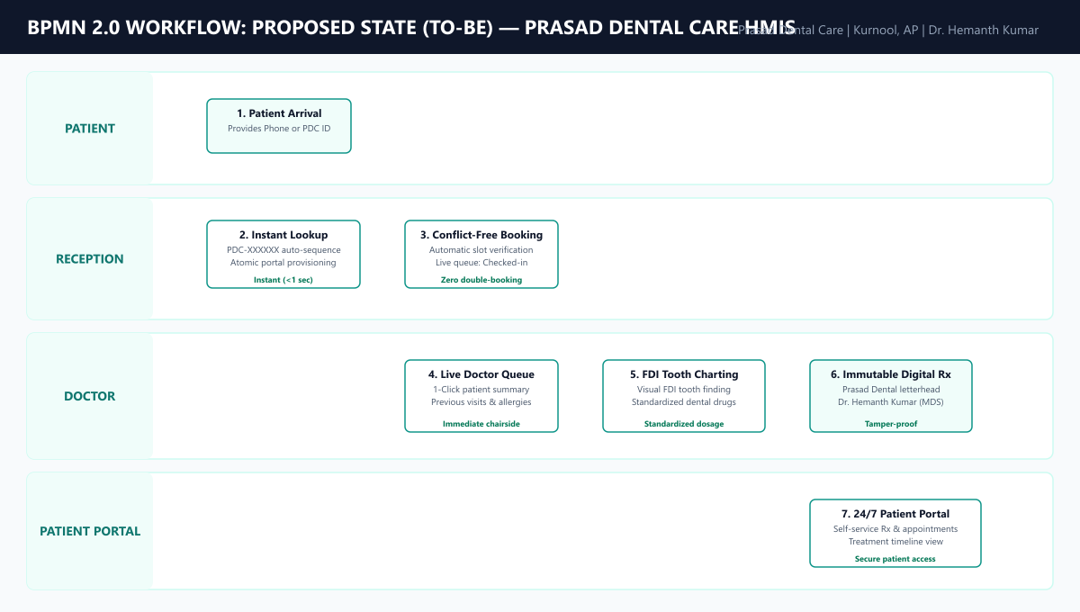
BPMN 2.0 WORKFLOW
Proposed State Workflow (TO-BE): Prasad Dental Care HMIS
End-to-end digital integration connecting Reception, Doctor, and Patient Portal

Slide 8
PRODUCT PHILOSOPHY
Product Philosophy & Design Rationale
Purpose-built for a single-doctor practice: speed, simplicity, and clinical safety
PILLAR 1
PILLAR 2
PILLAR 3
REJECTING ENTERPRISE BLOAT
CHAIRSIDE OPERATORY SPEED
DATA IMMUTABILITY & ISOLATION
Monolithic hospital software imposes dozens of mandatory administrative fields. Prasad Dental Care HMIS collects strictly vital demographic and medical alert data, ensuring registration takes seconds, not minutes.
Dr. Hemanth Kumar cannot type paragraphs while wearing sterile gloves. The interactive FDI tooth chart and standardized dental formulary allow findings and prescriptions to be documented in a few clicks.
Prescriptions are legal medical documents. PostgreSQL Row Level Security enforces database-level immutability upon finalization, preventing tampering and guaranteeing strict cross-patient privacy.

Slide 9
ARCHITECTURE
System Architecture & Cloud-Native Technology Stack
High-performance, secure, and zero-maintenance architecture
REACT 18 + VITE
SUPABASE POSTGRESQL 15
VERCEL + GOTRUE
FRONTEND SPA LAYER
DATABASE & BACKEND
IDENTITY & DEPLOYMENT
• React 18 with TypeScript 5.5 for static type safety.
• Vite 5.4 build engine producing a lightweight bundle (<600kB gzip).
• Tailwind CSS design system providing accessible healthcare contrast.
• React Router DOM v6 with role-protected route guards.
• Relational schema across 10 tables with strict foreign key constraints.
• Row Level Security (RLS) policies enforcing multi-tenant isolation.
• Atomic PL/pgSQL RPCs for transactional patient provisioning.
• Append-only immutable audit logging in public.audit_logs.
• Supabase GoTrue JWT authentication with secure session restoration.
• Vercel Global Edge Network deployment with custom SPA URL rewrites.
• Serverless API endpoint (api/send-patient-email.ts) isolating secrets.
• Cross-platform responsive support for mobile, tablet, and desktop.

Slide 10
APPLICATION FEATURES
Core System Modules & Operational Capabilities
Four interconnected modules serving administrative and clinical operations
RECEPTION MODULE
SCHEDULING ENGINE
Queue & Registration
Conflict-Free Appointments
• Live status tracker: Scheduled -> Waiting -> Completed.
• Atomic patient registration generating sequential PDC IDs.
• Multi-parameter search (<1s) by Mobile, PDC ID, or Name.
• Real-time inspection of Dr. Hemanth Kumar’s timetable.
• Prevents double-booking overlapping time slots.
• Online appointment request lifecycle management.
DOCTOR OPERATORY
PATIENT PORTAL
Chairside Dental Suite
24/7 Mobile Self-Service
• 1-Click clinical summary with systemic medical alerts.
• Interactive FDI tooth chart (teeth 11–48) for findings.
• Standardized dental formulary with auto-calculated dosages.
• Instant web access to active prescriptions and visit history.
• High-fidelity printable Prasad Dental Care letterhead.
• Strict RLS isolation blocking cross-patient record access.

Slide 11
CLINICAL WORKFLOW
End-to-End Patient Journey Through Prasad Dental Care HMIS
Tracing an encounter from arrival to post-consultation patient portal access
STEP 1
STEP 2
STEP 3
Arrival & Lookup
Atomic Provisioning
Conflict-Free Booking
Patient arrives; receptionist performs sub-second search by Mobile or PDC ID.
New patient registered; sequence allocates PDC-XXXXXX; portal credentials generated.
Slot verified against Dr. Hemanth’s schedule; status transitions to Waiting Queue.
STEP 4
STEP 5
STEP 6
Chairside Operatory
Immutable Digital Rx
Patient Self-Service
Doctor opens 1-click summary; charts teeth using FDI grid (teeth 11–48).
Standardized dental drugs selected; finalized Rx signed with official clinic letterhead.
Patient logs into Patient Portal from mobile device to review active Rx & visits.

Slide 12
SECURITY MODEL
Security Architecture & Healthcare Data Governance
Built-in privacy and legal integrity without unsupported compliance claims
DATABASE LEVEL
CLINICAL INTEGRITY
ACCESS CONTROL
Row Level Security (RLS)
Prescription Immutability
RBAC & Secret Isolation
All 10 tables enforce PostgreSQL Row Level Security. Patient queries are restricted at the engine level to records where user phone or patient ID matches the authenticated session, preventing URL/ID tampering.
Medical prescriptions cannot be modified or deleted post-finalization (rx_no_update, rx_no_delete policies evaluate USING false). Check constraints ensure no empty prescriptions are recorded.
Triggers prevent client-side privilege escalation. Private API credentials (Resend API key, Supabase service-role) are isolated exclusively in serverless API routes, never exposed to browser clients.
AUDIT TRANSPARENCY NOTICE: The application enforces robust engineering security patterns (PostgreSQL RLS, secret isolation, audit logging). No formal HIPAA or NABH certifications are claimed, reflecting academic honesty.

Slide 13
LIVE DEPLOYMENT
Working Product Verification & Live Cloud Deployment
Operational verification on Vercel Edge Network backed by automated test suites
CLOUD DEPLOYMENT STATUS
AUTOMATED VERIFICATION BATTERY
Live Production URL:
https://hmis-wine.vercel.app
Edge Hosting Platform:
Vercel Edge Network with automated SPA URL rewriting.
Database Backend:
Supabase Cloud (PostgreSQL 15, AWS ap-south-1 Mumbai).
Mobile Evaluation:
Evaluators can scan the QR code to interact with the responsive mobile patient portal on any smartphone.
ESLint Code Quality Suite
Status: PASS (0 Errors, 0 Warnings)
TypeScript & Vite Production Bundle
Status: PASS (Zero compile errors, 8.65s)
Database Migration Integrity (001–012)
Status: PASS (All 12 files verified)
E2E Workflow Test Suite (9 Suites)
Status: PASS (60/60 Assertions Passing)
Live Supabase GoTrue Auth Login
Status: PASS (Admin, Doctor, Patient verified)

Slide 14
CLIENT VALIDATION
Client Validation & On-Site Evaluation Framework
Academic integrity: live clinic evaluation in progress without fabricated quotes
CLIENT VALIDATION STATUS: IN PROGRESS (ON-SITE CLINIC EVALUATION)
In strict compliance with academic research integrity, no fictional doctor endorsements or simulated staff testimonials have been fabricated. Evaluation data is being actively collected at Prasad Dental Care.
FIELD EVALUATION PROTOCOL
INTEGRATED CLINIC FEEDBACK MODULE
• Primary Evaluator: Dr. Hemanth Kumar (BDS, MDS – Orthodontics).
• Secondary Evaluators: Front-desk reception staff & outpatient dental patients.
• Quantitative Metrics: Patient check-in duration, appointment scheduling accuracy, prescription generation time.
• Qualitative Metrics: Operatory usability, FDI tooth chart clarity, patient portal adoption.
Direct Feedback Capture at /feedback:
A dedicated feedback tool is embedded directly within the HMIS application for clinic staff and patients.
Structured Capture Fields:
1. Overall System Usability (1–5 Star Rating)
2. Feature Utility Ratings (Registration, Queue, Prescriptions)
3. Operatory Friction Notes (Text observations during clinics)
4. Suggested Functional Enhancements
Database Persistence:
Responses are securely saved to public.clinic_feedback for analysis.

Slide 15
CONCLUSION
Project Summary, Conclusions & Post-MTA Roadmap
Successful delivery of a tailored HMIS for Prasad Dental Care
KEY FIELD PROJECT DELIVERABLES
IMMEDIATE POST-MTA ROADMAP
1. Eliminated Paper File Retrieval Delays:
Replaced manual shelf searches with sub-second digital lookups.
2. Automated Conflict-Free Scheduling:
Engine enforces timetable limits and prevents slot collisions.
3. Chairside Dental Charting & Safe Rx:
Equipped Dr. Hemanth Kumar with an interactive FDI tooth chart, standardized drug master, and immutable printed prescriptions.
4. Empowered Continuous Patient Care:
Provided patients with a 24/7 self-service portal on mobile web.
1. Complete Staff Operatory Training:
Conduct guided simulation sessions with Dr. Hemanth Kumar and front-desk staff on edge cases.
2. Synthesize Quantitative Evaluation Data:
Aggregate Likert usability ratings and time-motion observations collected via the feedback module.
3. Clinic Hardware Calibration:
Fine-tune local operatory printer margins for pre-printed letterheads.
4. Production Handover:
Finalize administrative credentials and deliver complete operating manuals to Prasad Dental Care.

