Slide 1
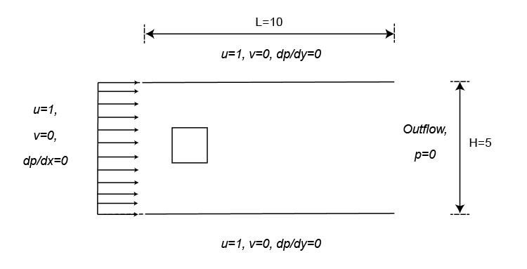
Flow past a square cylinder
Harsharaj B Parmar
December, 2019

Slide 2
Characteristics
Finite Difference algorithm using primitive variables with second order spatial discretization.
Second order time integration scheme: C-N and A-B hybrid.
Projection method to treat the velocity pressure coupling.
Immersed boundary method.
Ghost noding at the top and bottom boundaries (significant effect on computational time).

Slide 3
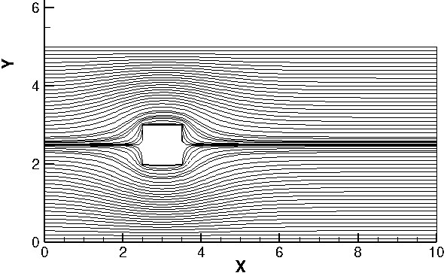
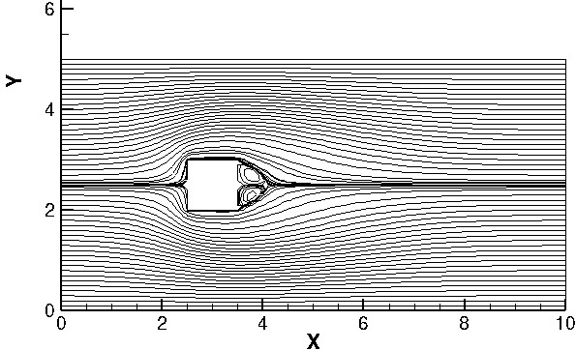
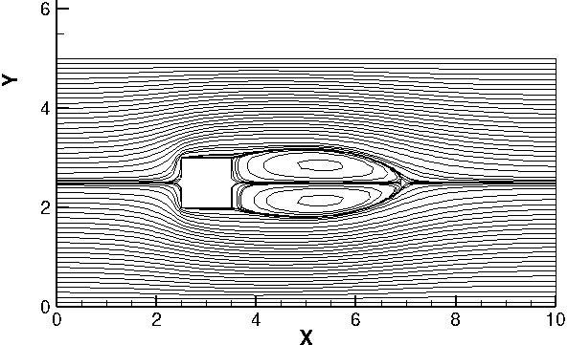
Results
Stokes
Re=10
Re=100

Slide 4
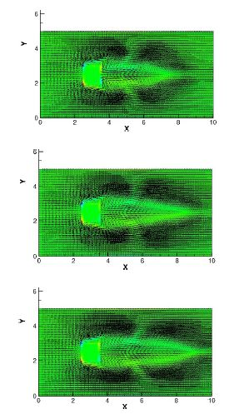
Results
Uniform inlet, Re=1000 at 12,16 and 22 sec

Slide 5
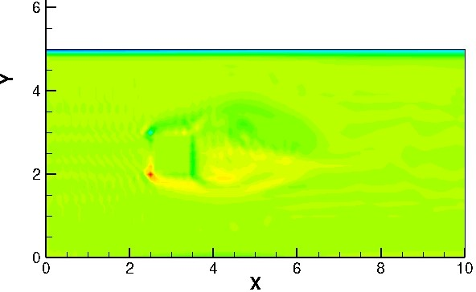
Von-Karman Vortex Shedding

Slide 6
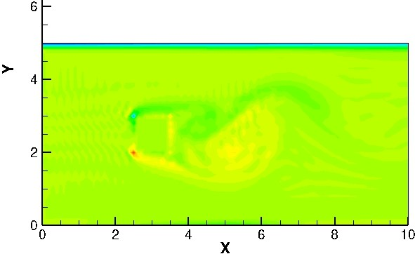
Von-Karman Vortex Shedding

Slide 7
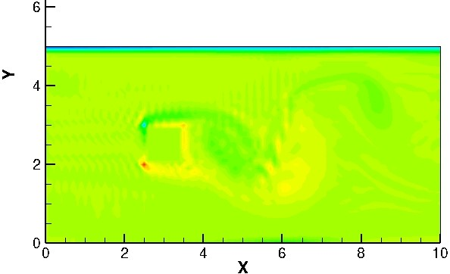
Von-Karman Vortex Shedding

Slide 8
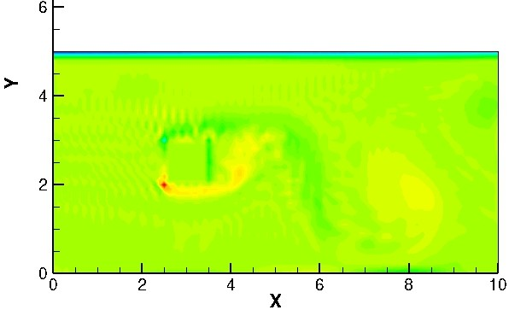
Von-Karman Vortex Shedding

Slide 9
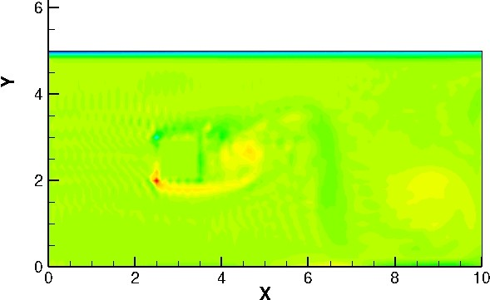
Von-Karman Vortex Shedding

Slide 10
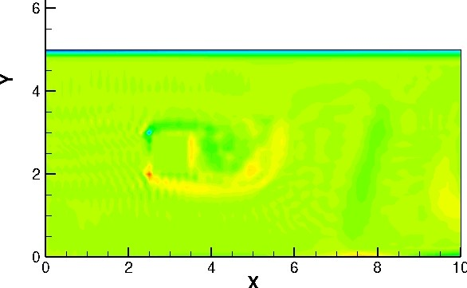
Von-Karman Vortex Shedding

Slide 11
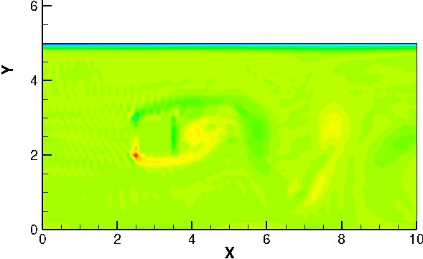
Von-Karman Vortex Shedding

Slide 12
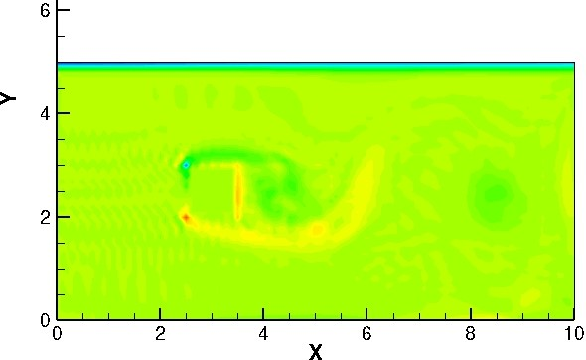
Von-Karman Vortex Shedding

Slide 13
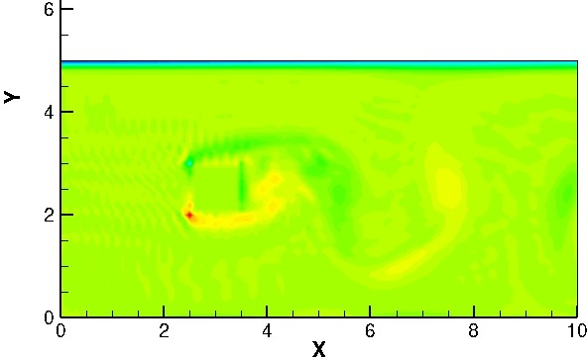
Von-Karman Vortex Shedding

Slide 14
References
[1] J. J. Martinez and P. T. Esperana. A Chebyshev collocation spectral method for numerical simulation of incompressible flow problems. Journal of the Brazilian Society of Mechanical Sciences and Engineering, 29(3), 2007, 317-328.
[2] Piyush K. Kundu, Ira M. Cohen. Fluid Mechanics. Academic Press; 6 edition (June 19, 2015).
[3] M. Cheng, D. S. Whyte, J. Lou. Numerical simulation of flow around a square cylinder in uniform-shear flow. Journal of Fluids and Structures, Volume 23, Issue 2, February 2007, Pages 207-226
Thank You

