Slide 1

CI/CD for Stock EOD Data Tracker
By HarshaVardhan Kumbhagiri

Slide 2
Agenda
Problem scenario
Tech Stack
Architecture
Code walk through
CI/CD walk through
Demo
DR & Security

Slide 3
Problem scenario – Python Application
Build a web app which has two main end points
/eod – live & historical data of a stock
/change-in-price – Price difference of a given stock for x number of days. Should only be reflected in Dev environment.
/register
/login

Slide 4

Problem scenario – CI/CD Implementation
Implement CI/CD
Development
Environment
Pre-Prod
Environment
Production release
Production
Environment
PR/Merge
Dev
branch
Main
branch

Slide 5
Tech Stack
Python – Flask, SQL Alchemy
Docker
Cloud – ACR, Azure Webapp
Azure DevOps– Repos, Pipelines

Slide 6
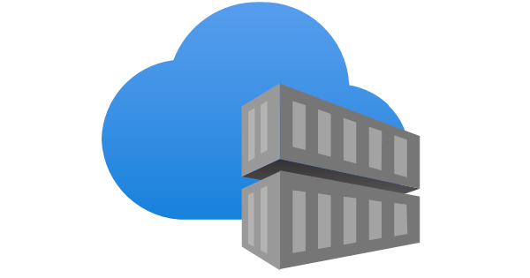
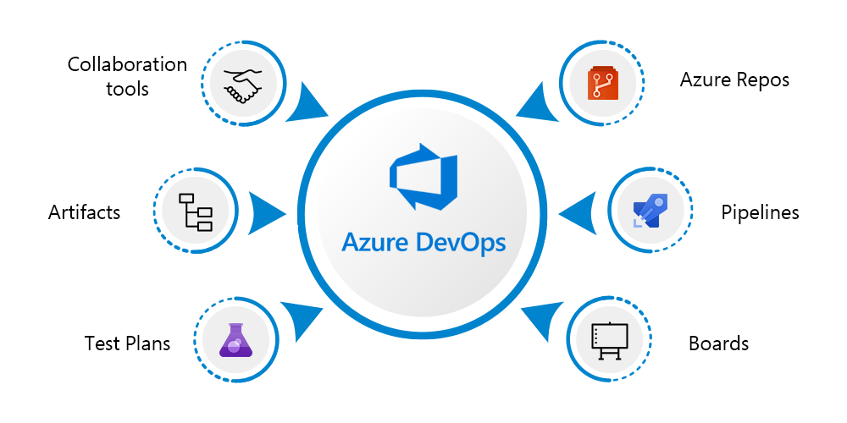



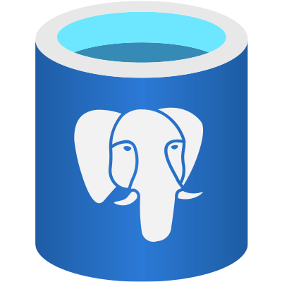
Architecture
Push to ACR
Image pull request
/dev
Pipe line
Trigger
Git PR
Docker Image Build
/QA
/pre-pod

Slide 7
Code walk through
app.py, models.py & auth.py
Dockerfile
Azure-pipeline.yml
.env

Slide 8
CI/CD walk through
Trigger
Task – Build
Task – Push
Task – Deploy

Slide 9
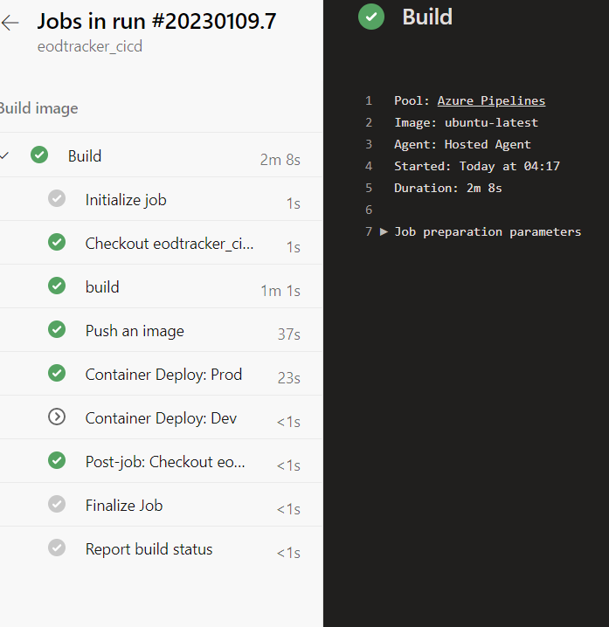
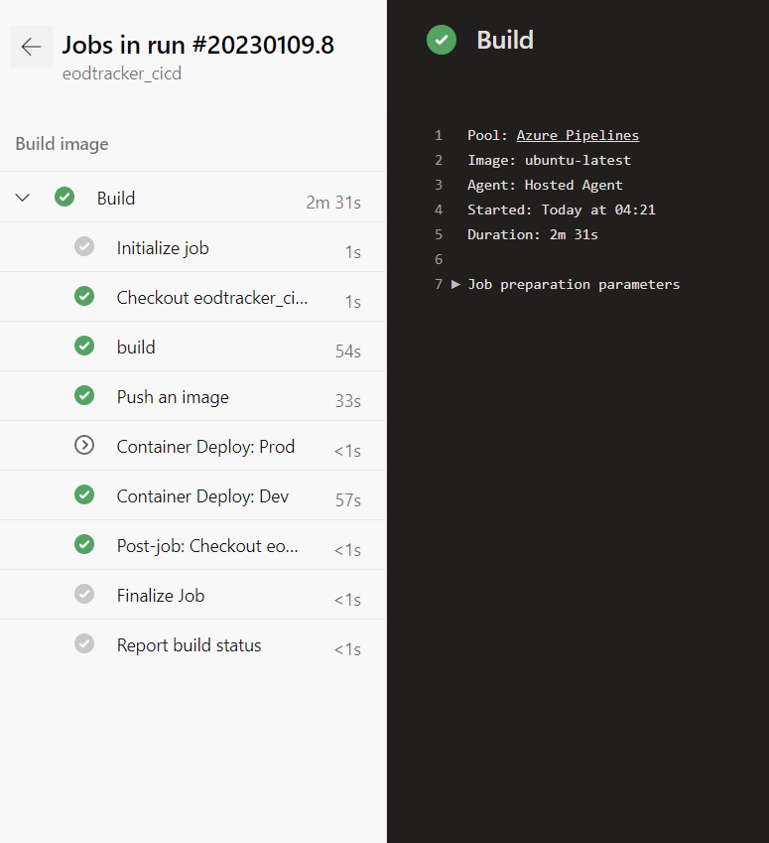
Prod VS Dev Deployment

Slide 10
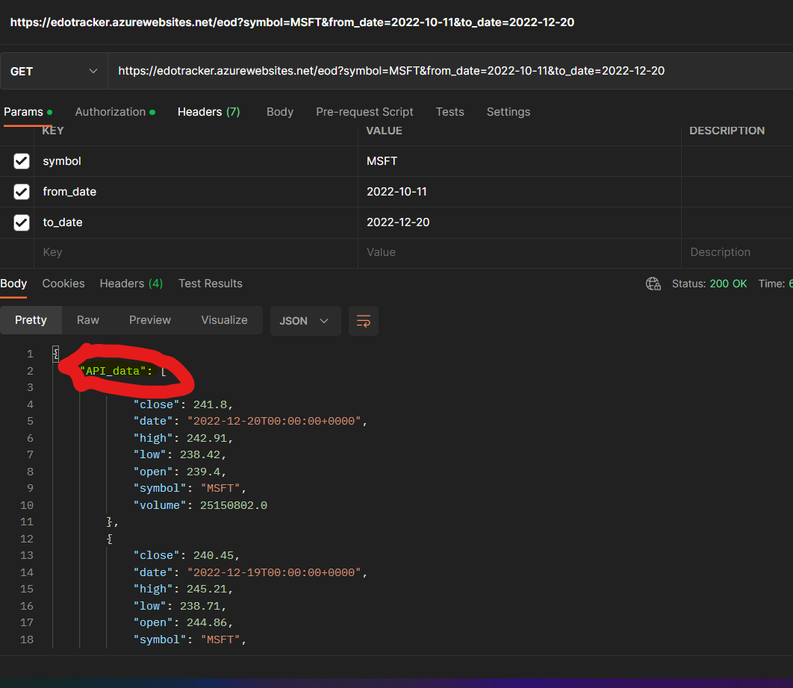
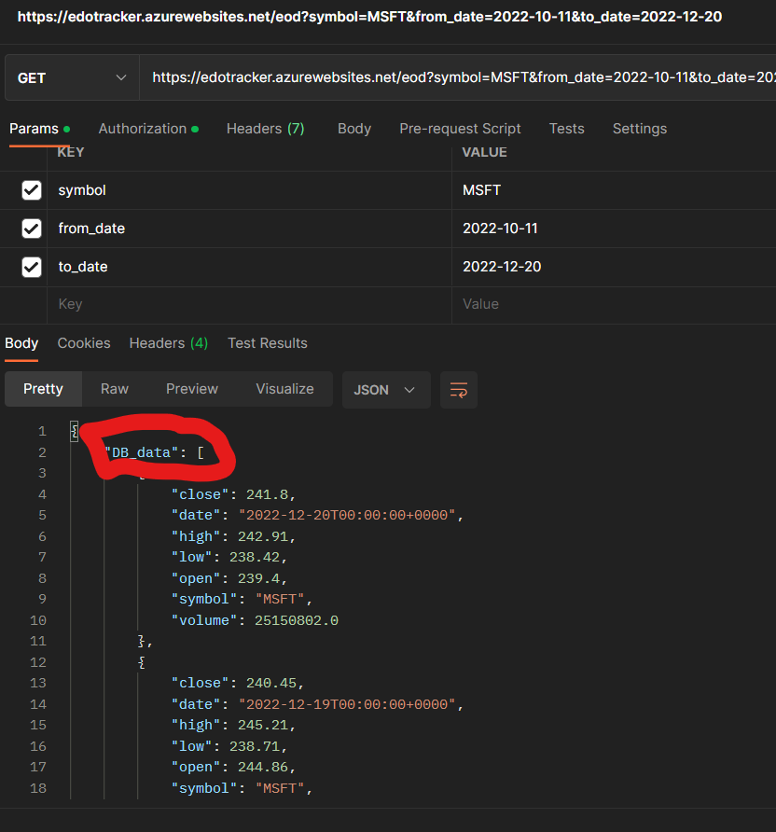
API vs DB data

Slide 11
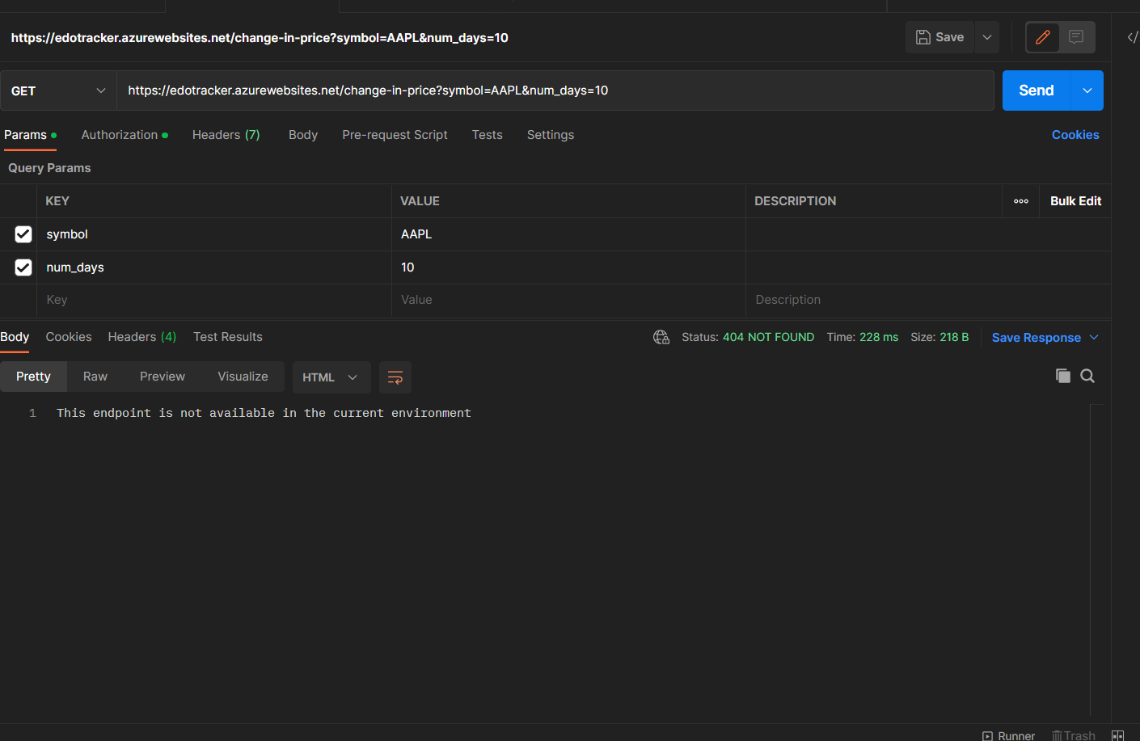
API Request results

Slide 12
Demo
End to End Deployment.

Slide 13
DR & Security
To keep the environment more secure we can provide role based access to users and developers using Azure AD authentication and enabling multi factor authentication.
By using Azure Key Vault to store secrets such as passwords and connection strings will add more security to application.
DR – we can keep standby web apps in another geo or zone regions and transfer traffics to standby webapps azure traffic manager as load banker to maintain the redundancy.
In azure we can configure DB’s to take snapshots per prescribed schedule which can be spined up with minimum down time.
In current model we are using docker to build our images. Which can easily be transfer to on-prem or other cloud providers.
This application can entirely built on Kubernetes and deployed in AKS which is an easy setup to perform lift and shift to on-prem or other cloud providers.
Implementing IAC (infrastructure as code) to build the resources in azure using terraform will add more advantage.

