Slide 1

Movie Review Analysis
Presented by
Harsha Sai Jagu

Slide 2
Dataset Introduction
Title: Large Movie Review Dataset
Source: https://ai.stanford.edu/~amaas/data/sentiment/
Purpose: Used for Binary Sentiment Classification
Size:
50,000 highly polar movie reviews
Structure:
Organized into train and test directories.
Subfolders labeled pos (positive) and neg (negative) categorize the reviews.
Each review is stored in a text file named in the format <id>_<rating>.txt.
Relevance: This dataset offers a balanced mix of positive and negative reviews, perfect for sentiment analysis tasks.
Potential for Analysis:
Allows for advanced text processing techniques using PySpark.
Supports feature engineering, including word count, sentiment word analysis, and rating correlation with sentiment.

Slide 3
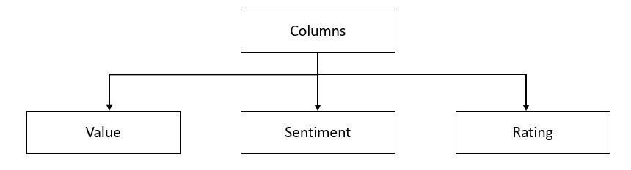
Data Processing
Data Loading
Loaded entire text files inside all directories into a single Spark DataFrame.
Added sentiment column based on folder structure (pos or neg)
Extracted rating column from file names “<id>_<rating>.txt
Initial Schema
The loaded data frame has the following columns
The `value` column is renamed to `review` for better understanding.

Slide 4
Data Transformations
Removing Punctuations
Converting to Lowercase
Remove HTML Tags
Handling Missing Values
Dropping Duplicates
Word Count
Count of Exclamation Marks
Tokenization
Stopwords Removal
Lemmatization
Sentiment (Positive and Negative) Words Analysis

Slide 5

Data Storage
Persistent Storage: Saved the processed Data Frame in a structured format in the movie_reviews_db database.
Table: Stored as a persistent table named movie_reviews.
Purpose: Ensures easy access for efficient querying and analysis.
Finally, temporary view is created to perform Exploratory Data Analysis

Slide 6
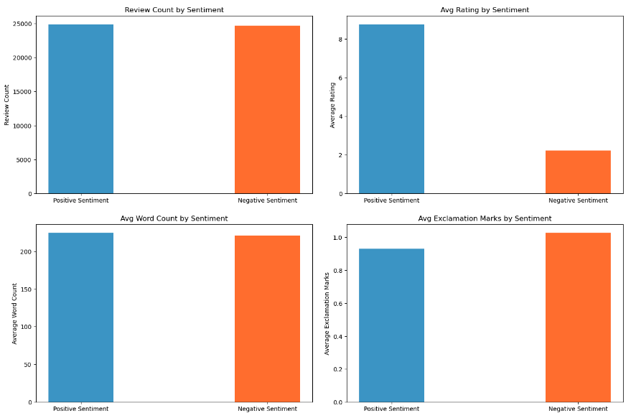
Review Characterstics vs. Sentiment

Slide 7
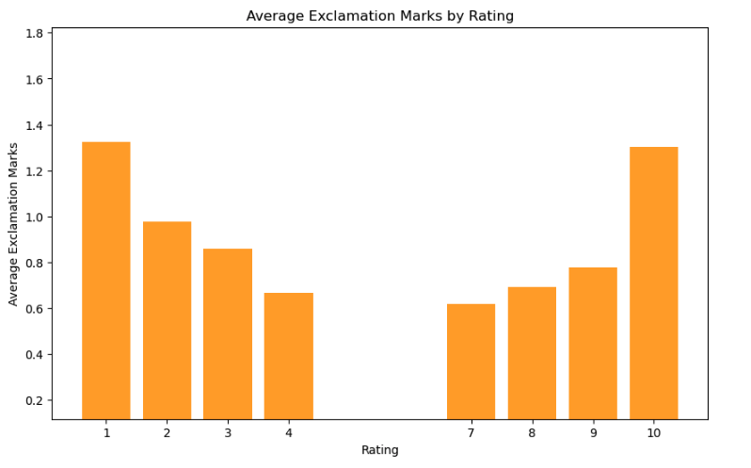
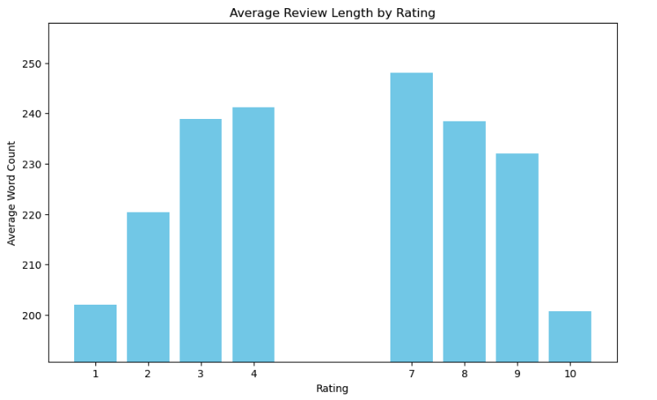
Correlation between Rating and Review Characterstics

Slide 8
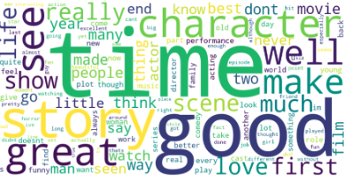
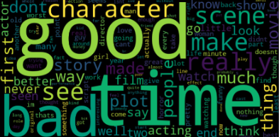
Word Cloud
Both positive and negative reviews discuss similar aspects of movies, the tone and specific descriptive words differ based on sentiment.

Slide 9
Challenges and Strategies
Challenges:
Bad Data Quality: The text data included HTML tags, punctuation, and mixed-case text, which required extensive cleaning to ensure consistency.
Performance Bottlenecks: Processing large volumes of text data with multiple transformations slowed down operations.
Filename Parsing: Extracting the sentiment and rating from filenames was a bit challenging but necessary for accurate analysis.
Data Distribution: The dataset was evenly distributed in terms of number of reviews and word count across the sentiments, making it hard for analysis.
Solutions:
Data Cleaning: Applied transformations to remove HTML tags, punctuation, and standardized all text to lowercase.
Performance Optimization: PySpark’s distributed processing improved efficiency in handling large dataset.
Filename Extraction: Used PySpark’s `input_file_name` function to accurately extract information from filenames.
Feature Engineering: Created a custom sentiment words list and added features like count of sentiment words and exclamation marks to enhance analysis.

Slide 10
Conclusion
Summary:
Balanced Sentiment: Dataset has an equal distribution of positive and negative reviews, ideal for sentiment analysis.
Emotional Expression: Extreme emotions are expressed with higher intensity through exclamation marks.
Review Length: No strong relationship between review length and sentiment, but extreme ratings (very low or very high) tend to have shorter reviews.
Surprisingly, words like “good”, “time” and “character” are common in both sentiments. But, “bad” is prominent in negative reviews.
Future Work:
Sentiment Classification Model: Build machine learning models to classify sentiment based on review content.
Additional Datasets: Apply the same approach to other datasets to generalize findings across domains.

Slide 11
Thank You!!

