Slide 1

IoT-Based Smart Asset Tracking and Inventory Monitoring System for Warehouses and Logistics Management
An intelligent IoT-powered platform for real-time asset tracking, automated inventory monitoring, and efficient logistics management.
LOCHELA HARSHA VARDHAN
323129520083

Slide 2
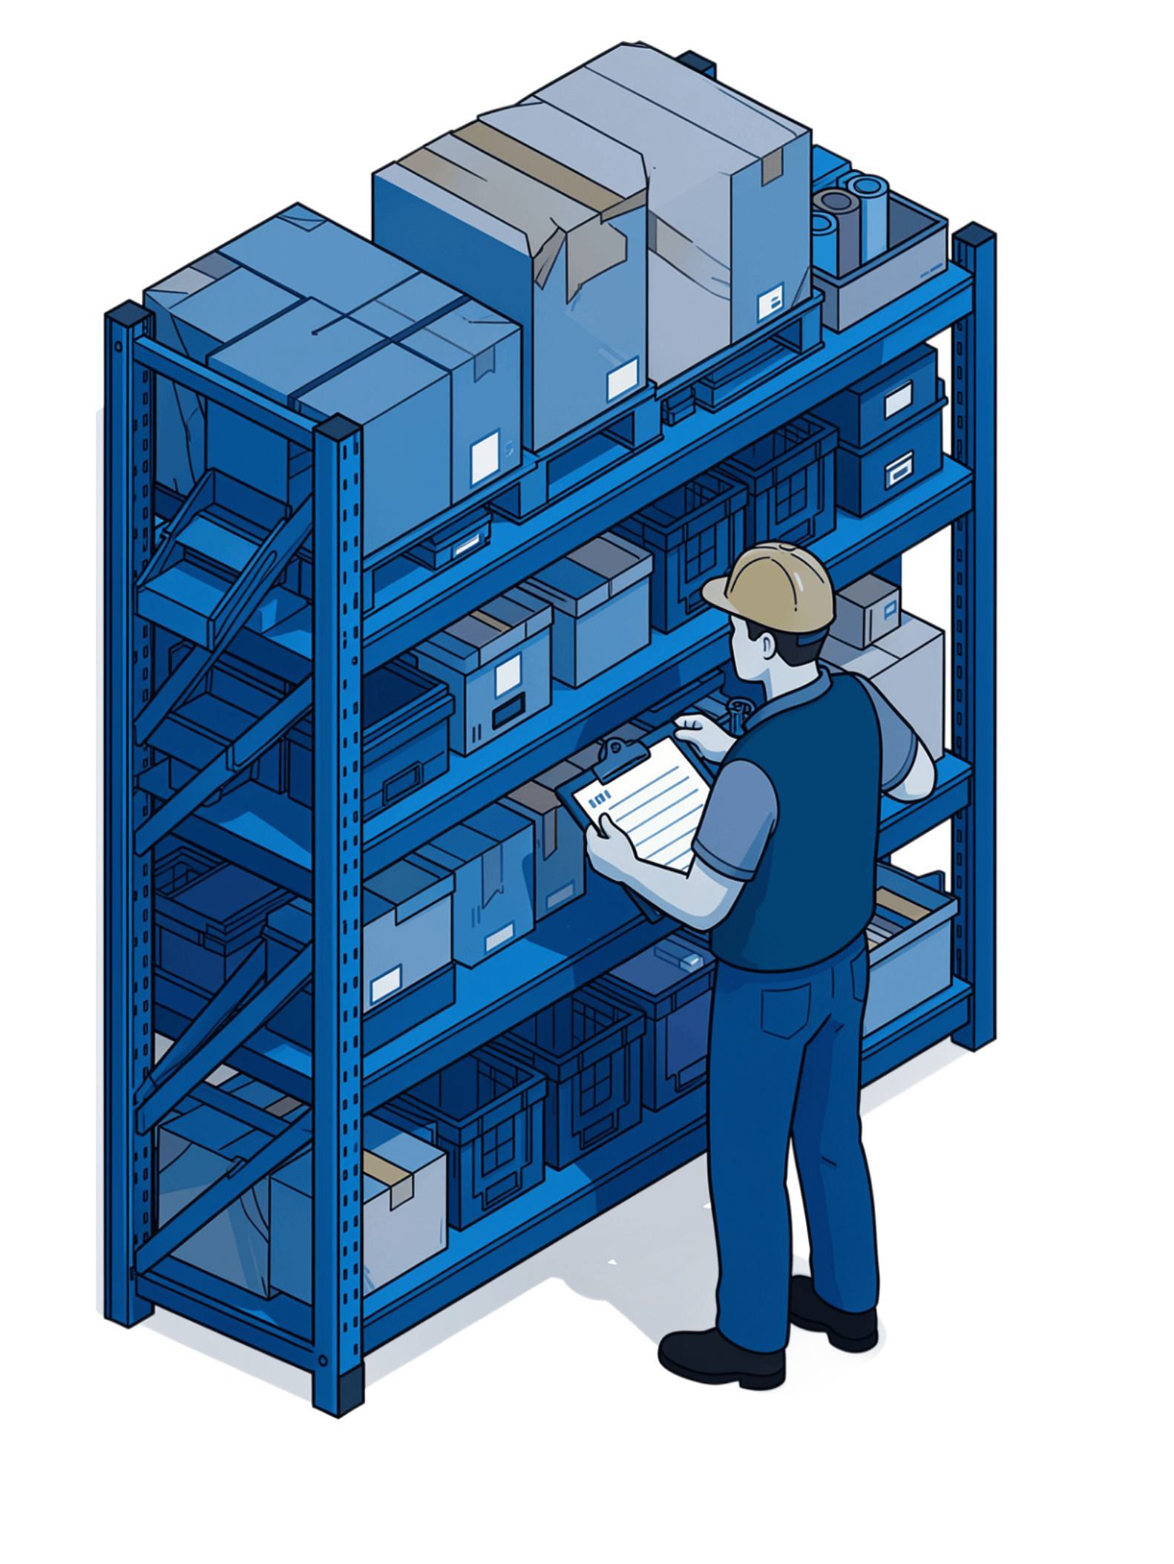
Problem Statement
Efficient asset and inventory tracking is essential for warehouses and logistics organizations. Yet most operations still rely on manual record-keeping and periodic stock verification — methods that fall short in today's fast-moving environments.
These traditional approaches make it difficult to monitor asset movement and inventory levels in real time, creating critical gaps in operational visibility.
Inventory Inaccuracies
Manual processes introduce errors that compound over time.
Operational Losses
Lack of continuous monitoring leads to misplaced assets and stock discrepancies.
Inefficient Management
No real-time visibility means reactive rather than proactive decisions.

Slide 3
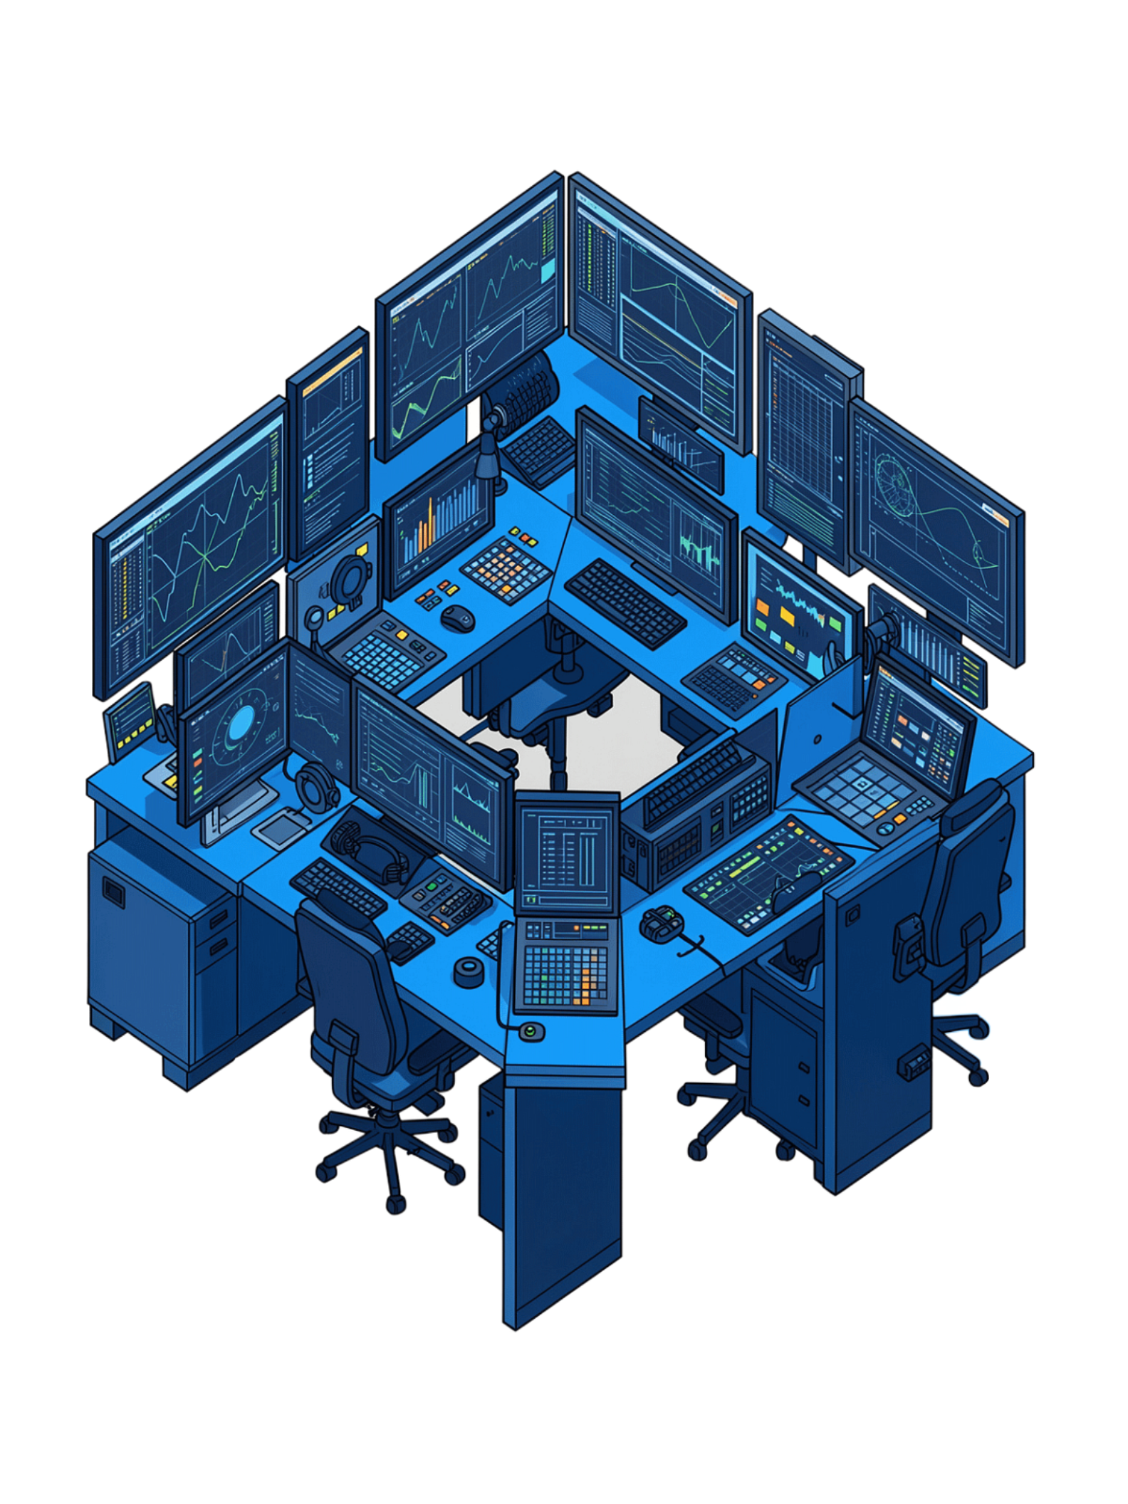
Proposed Solution
The IoT-Based Smart Asset Tracking and Inventory Monitoring System leverages IoT technologies to deliver continuous, automated oversight of assets and inventory across warehouse and logistics environments.
Continuous Tracking
Continuously track asset locations and inventory levels without manual intervention.
Centralized Platform
A single platform consolidates all asset and inventory information for unified monitoring.
Secure Interface
A secure, user-friendly interface supports system access and management for authorized personnel.
Stock Movement Visibility
Monitor stock movement in real time to maintain accurate, up-to-date inventory records.

Slide 4

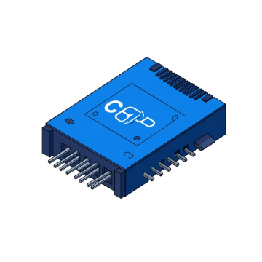
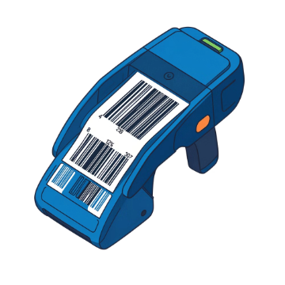
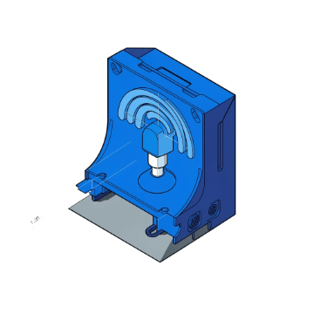
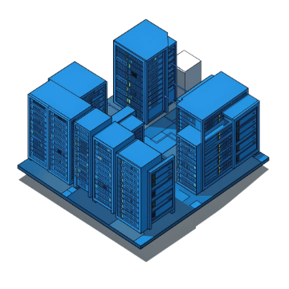
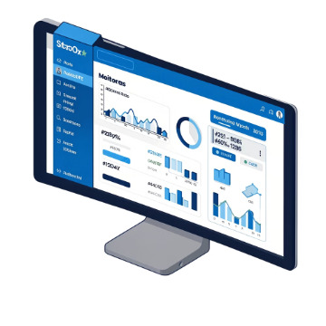
Key Technologies and Components
RFID Tags
GPS Modules
Barcode Scanners
IoT Communication Modules
Identification and tracking of individual assets throughout the warehouse.
Tracking precise asset locations, especially for logistics and in-transit assets.
Scanning and recording inventory information quickly and accurately.
Transmitting tracking and inventory data across the network in real time.
Cloud Connectivity
Real-Time Monitoring
Centralized storage and accessibility of all asset and inventory information.
Continuous visibility of assets and inventory across all operational areas.

Slide 5

System Working Process
Identify Assets
Transmit Data
Tag items with RFID or barcodes
IoT modules send data to cloud
Real-time Monitoring
Capture Data
Scan and track with devices
Platform updates locations and alerts
The system follows a seamless end-to-end pipeline — from physical identification of assets through RFID or barcodes, to cloud-based real-time monitoring and automated alerts — ensuring continuous, accurate oversight of all warehouse and logistics operations.

Slide 6
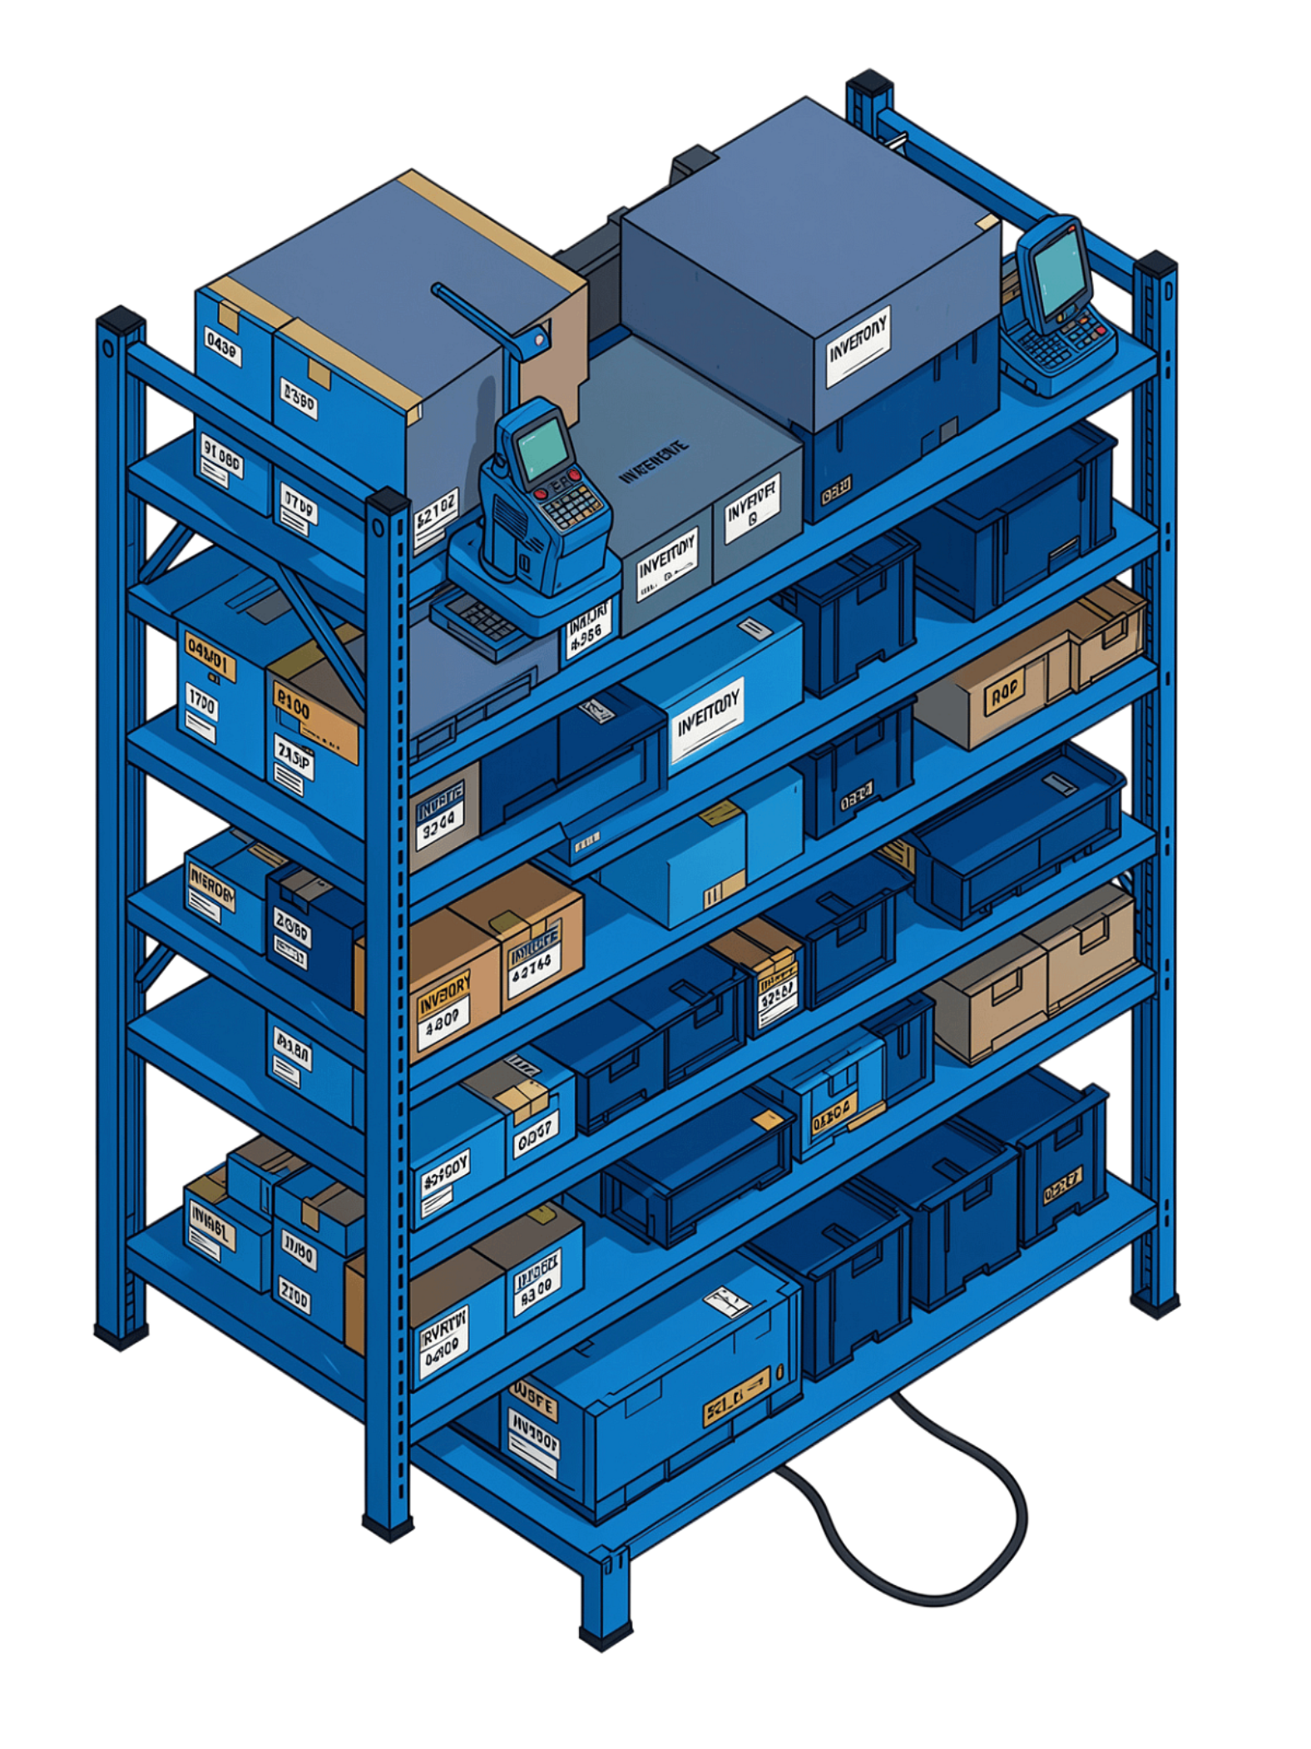
Asset Tracking and Inventory Monitoring
Asset Tracking
Inventory Monitoring
Real-time asset location tracking throughout warehouse and logistics operations
Asset information management for complete visibility
Improved asset visibility across all operational zones
Continuous inventory-level monitoring and availability tracking
Stock movement recording for accurate, up-to-date records
Automatic identification of low-stock conditions to prevent shortfalls

Slide 7
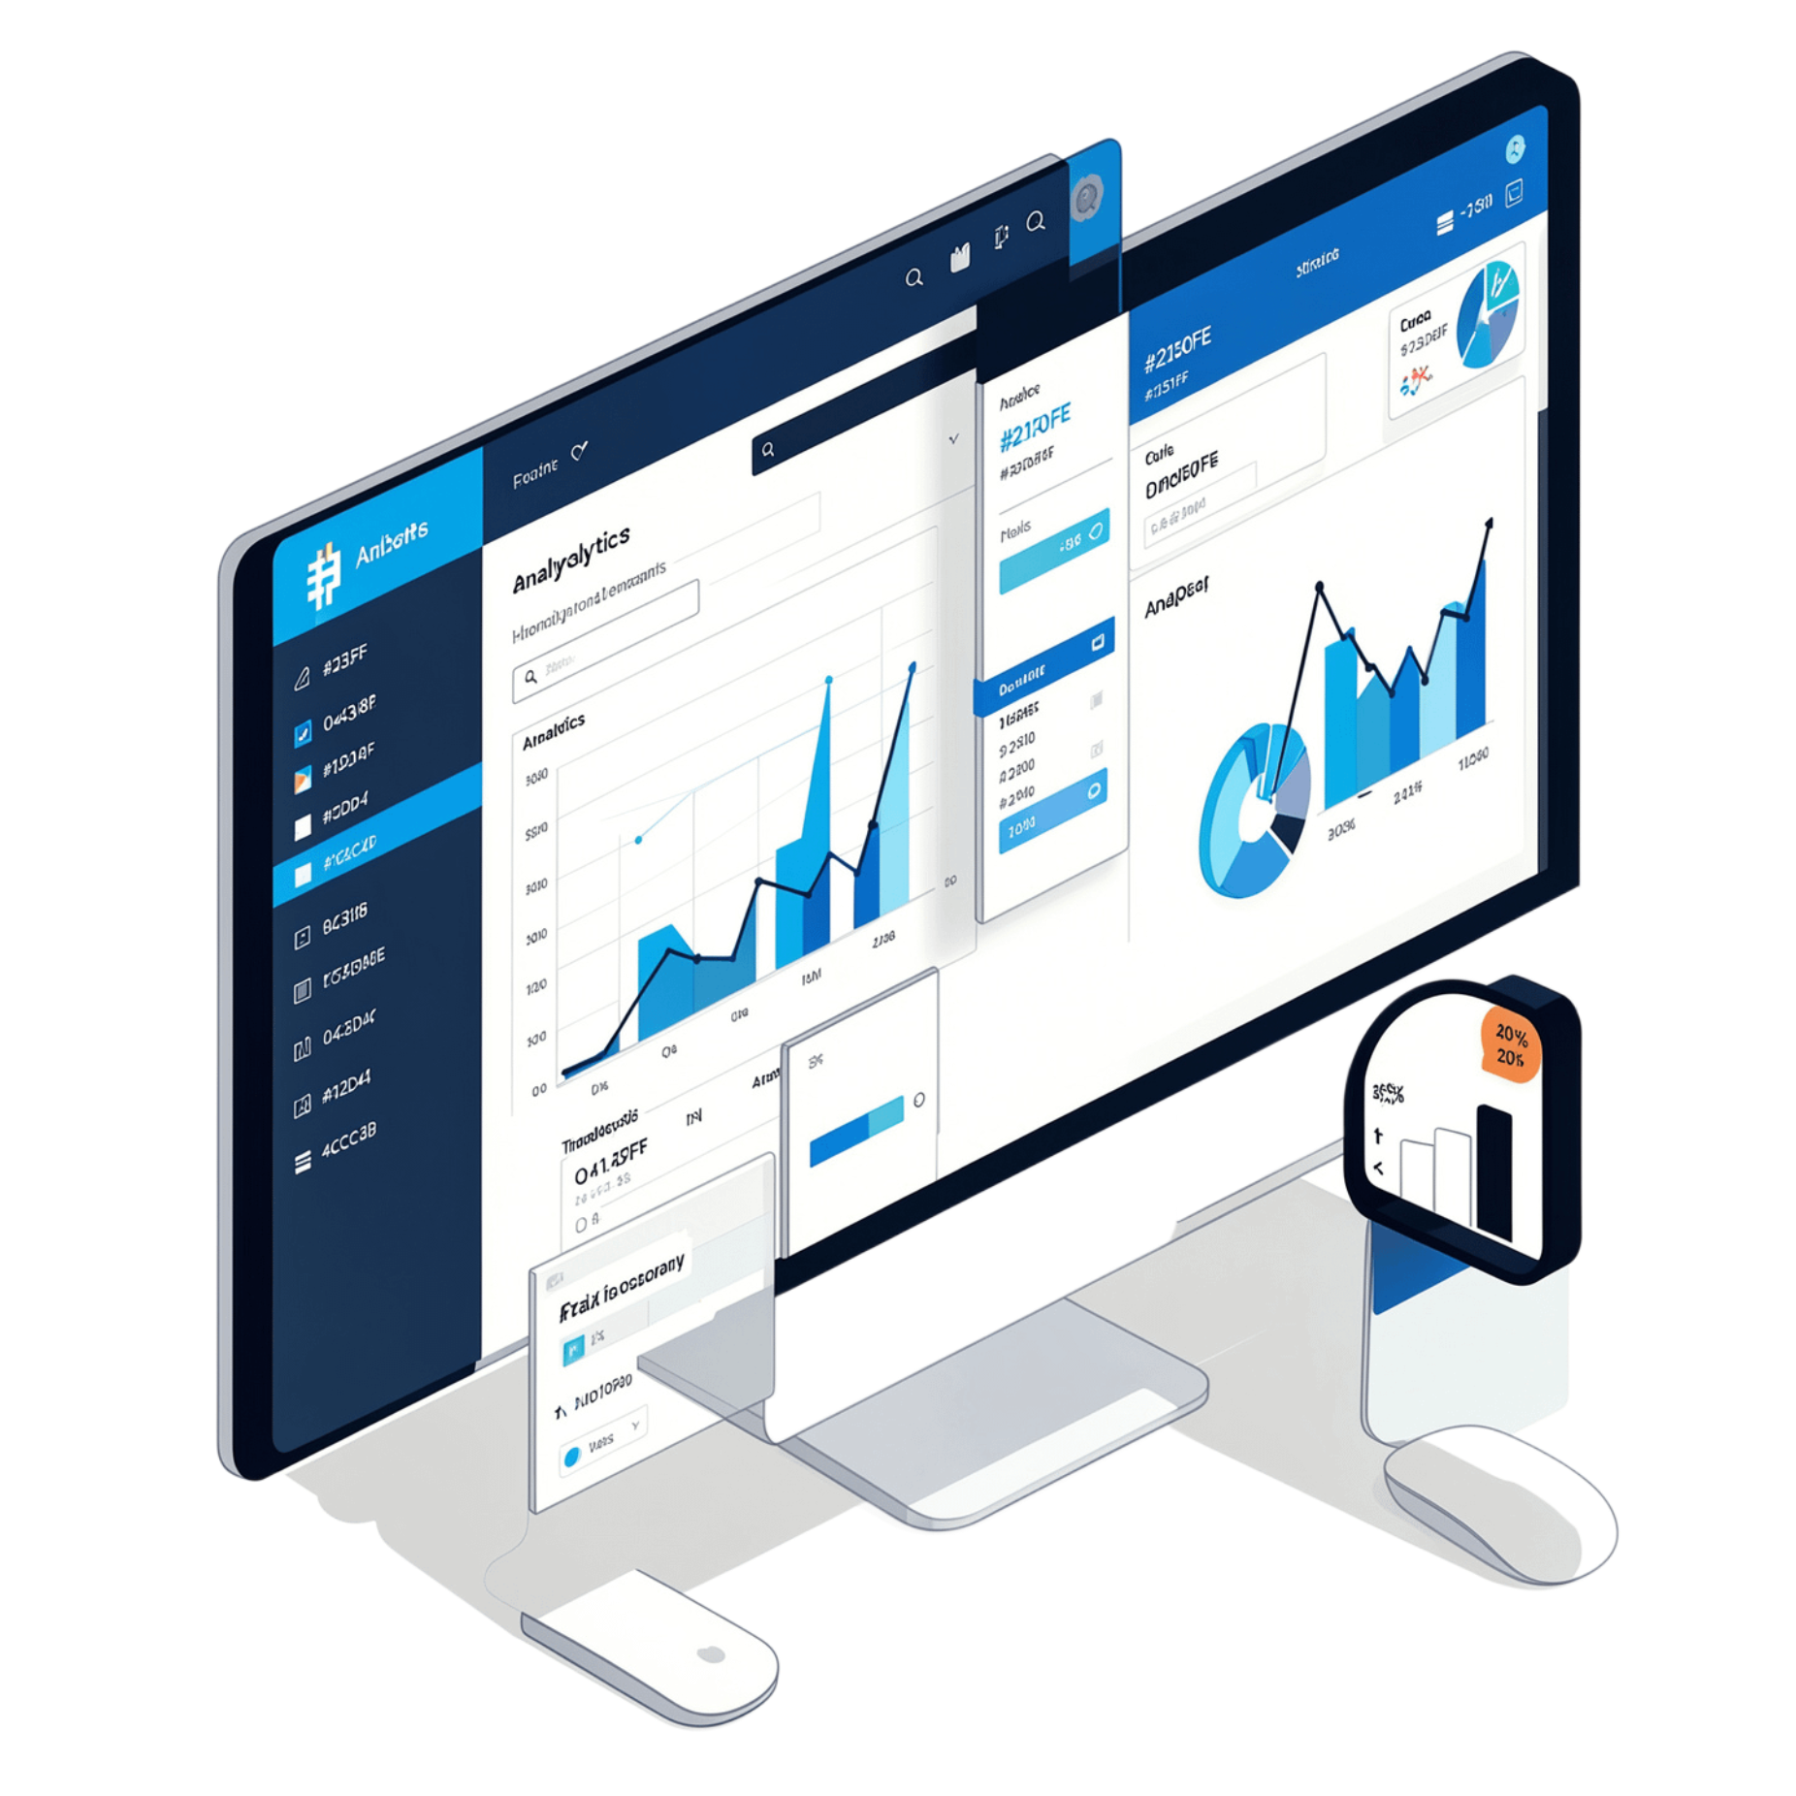
Dashboard and Analytics
Centralized Interactive Dashboard
The platform's dashboard brings together all critical operational data in one place, enabling informed decision-making across inventory and logistics functions.
Asset Locations & Inventory Status
Stock Movement History
Live view of where assets are and current stock availability.
Full audit trail of inventory changes and asset movements.
Low-Stock Alerts
Warehouse Analytics
Automated notifications when inventory falls below defined thresholds.
Review real-time asset and inventory data to support strategic decisions.

Slide 8
Benefits of the Proposed System
Improved Inventory Accuracy
Enhanced Asset Visibility
Automated monitoring eliminates manual errors and keeps records precise.
Real-time tracking provides complete awareness of asset locations at all times.
Reduced Operational Losses
Real-Time Monitoring
Continuous monitoring minimizes misplacement, theft, and stock discrepancies.
Instant data updates support proactive rather than reactive management.
Better Warehouse Management
Efficient Logistics Operations
Improved inventory and asset data drives smarter warehouse operations.
Automated processes replace manual workflows, accelerating logistics throughput.

Slide 9
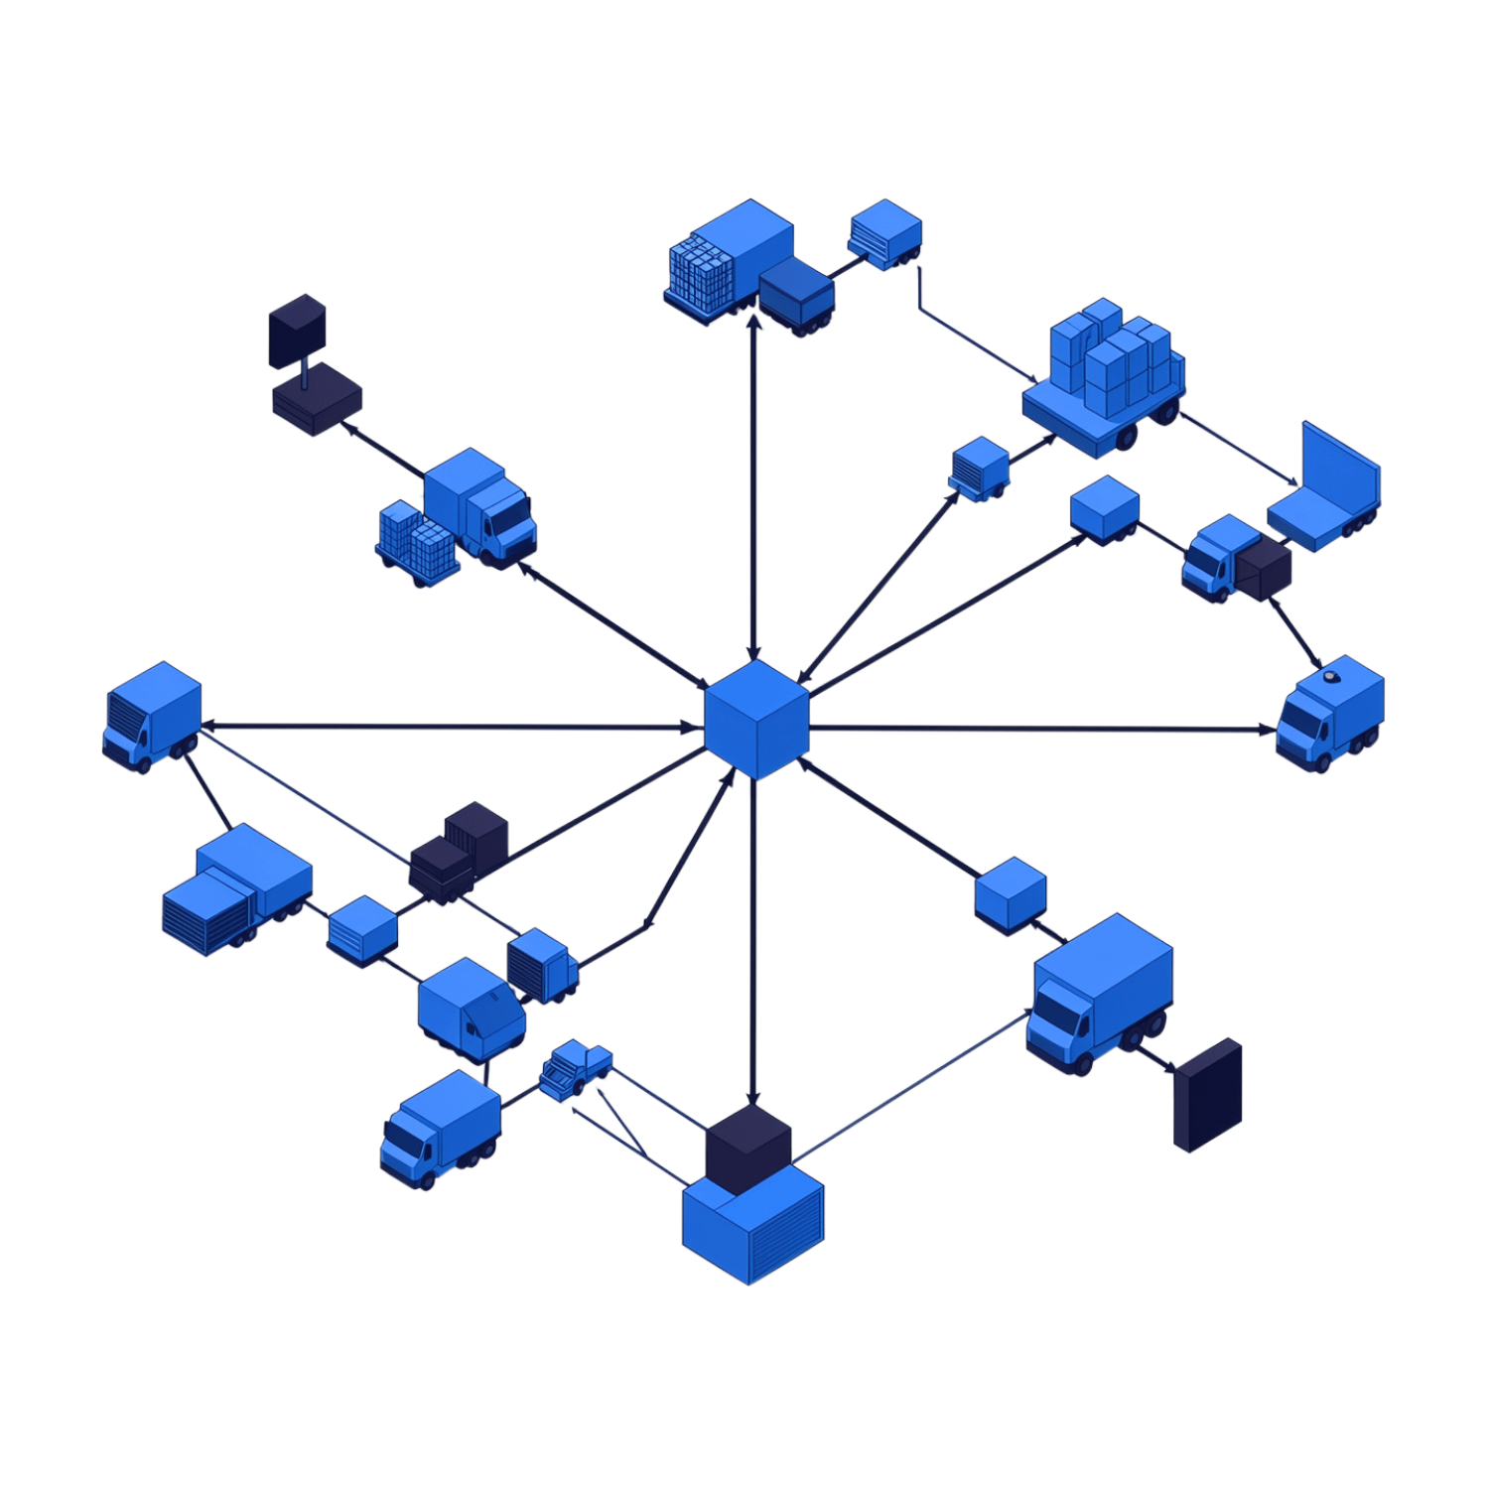
Applications and Scalability
Where the System Applies
The IoT-Based Smart Asset Tracking and Inventory Monitoring System is designed to serve a broad range of industries and operational environments:
The system is built to be secure and scalable, supporting centralized asset and inventory monitoring across different operational environments as organizations grow.
Warehouses
Logistics Companies
Manufacturing Industries
Retail Businesses
Supply Chain Management

Slide 10
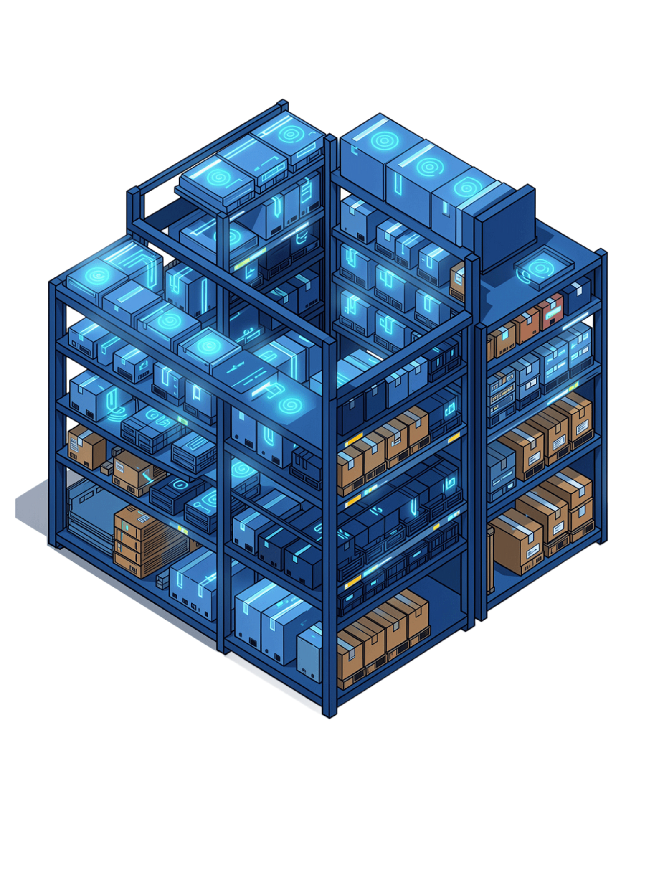
Conclusion
The IoT-Based Smart Asset Tracking and Inventory Monitoring System represents a significant advancement over traditional manual inventory practices — delivering continuous, automated, and intelligent oversight of assets and inventory across warehouse and logistics operations.
Continuous Asset Tracking
Automated Inventory Monitoring
Real-time IoT-powered tracking ensures assets are always accounted for throughout the supply chain.
Automated processes replace manual workflows, improving accuracy and reducing operational losses.
Optimized Operations
Real-time information supports effective, intelligent warehouse management and efficient logistics operations.

