Slide 1

Fake News Detection USING NLP
By: HARSHA SIKHA

Slide 2
Project Overview
Objective: To build a model that accurately classifies news articles as real or fake using various machine learning and deep learning approaches.
Techniques Used:
Natural Language Processing (NLP)
Traditional Machine Learning (Logistic Regression, Naive Bayes, SVM)
Deep Learning (LSTM)

Slide 3
Dataset Overview
The dataset contains labeled news articles classified as True or Fake. Exploratory Data Analysis was performed to understand class distribution
Sourced from Kaggle providing labeled news content.

Slide 4
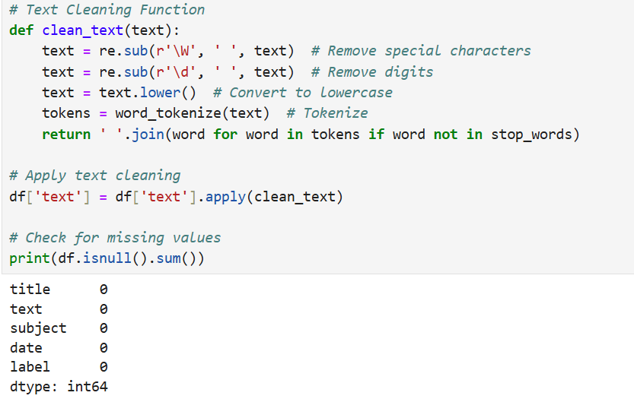
Data Preprocessing
Key preprocessing steps include:
Removing special characters
Converting text to lowercase
Tokenization
Removing stopwords

Slide 5
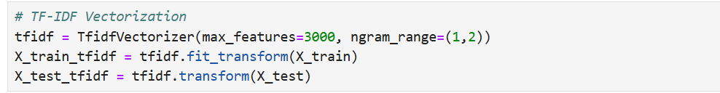
Feature Engineering
TF-IDF Vectorization was used to transform text into numerical representation. It helps in identifying important words while reducing noise.

Slide 6
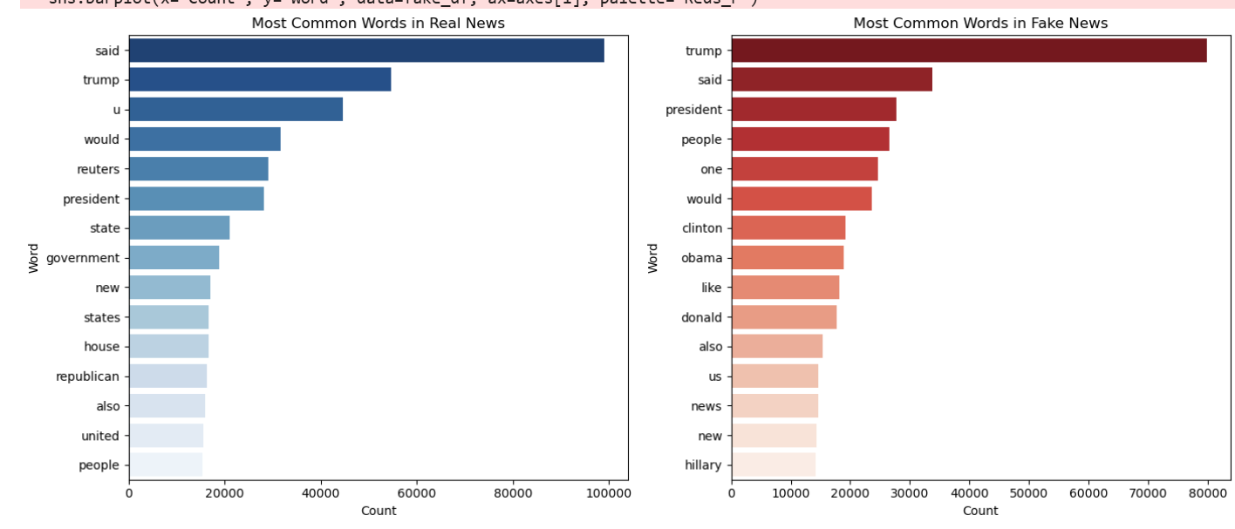
Bar Chart for Most Common Words

Slide 7
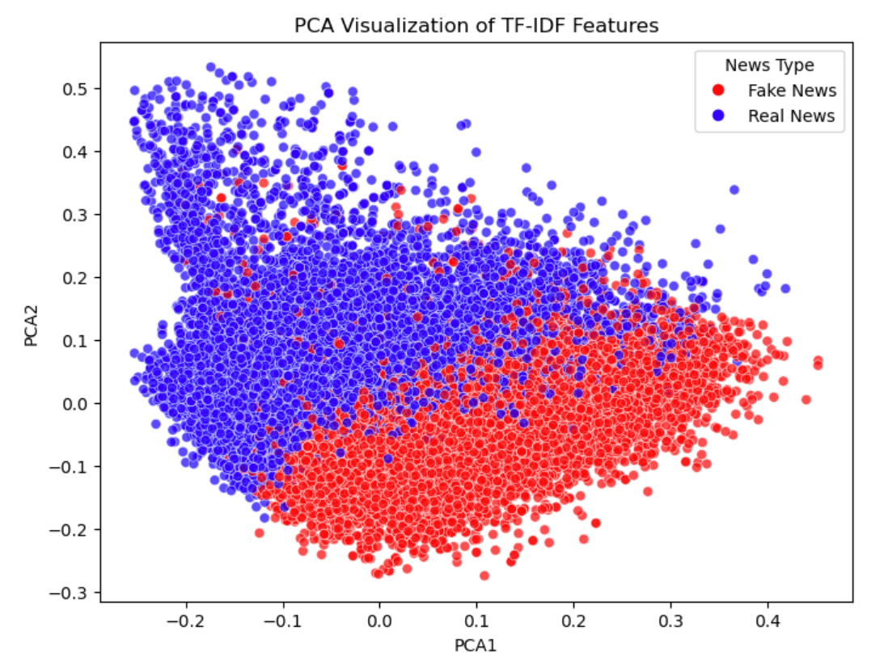
PCA Visualization of TF-IDF Features
This scatter plot illustrates the separation of real (blue) and fake (red) news articles, indicating how well the model could distinguish between the two classes based on TF-IDF features.

Slide 8
Model Training
Machine learning models trained:
SGD Classifier
A stochastic gradient descent-based linear classifier used for fast and efficient logistic regression tasks.
Naive Bayes
A probabilistic classifier that applies Bayes' theorem, ideal for text classification due to its simplicity and effectiveness with high-dimensional data.
Support Vector Machine (SVM)
A supervised learning model that finds the optimal hyperplane to maximize the margin between different classes, effective for high-dimensional spaces.
Long Short-Term Memory (LSTM)
A type of recurrent neural network designed to learn from sequences of data, particularly useful for understanding the context in text sequences.

Slide 9
Model Evaluation Scores
SGD Classifier
Efficiency: SGD is highly efficient for large-scale datasets. It updates model weights incrementally, making it faster than standard Logistic Regression.
Scalability: Can handle high-dimensional text data, making it ideal for TF-IDF feature vectors. Regularization Support: Includes L1 (Lasso) & L2 (Ridge) regularization, helping prevent overfitting.
SGD Logistic Regression Accuracy: 98.61%
High Precision (0.99): The model correctly identifies Fake News & Real News with minimal false positives.
High Recall (0.99): It successfully detects the majority of fake and real news articles.
Balanced F1-Score (0.99): Suggests a strong trade-off between precision & recall—ideal for fake news detection

Slide 10
Model Evaluation Scores
Naive Bayes
Text Classification Strength: Naive Bayes performs well with high-dimensional text data, especially with TF-IDF features.
Fast & Scalable: It is computationally efficient, making it suitable for large datasets.
Probabilistic Approach: Estimates word probabilities for each class, making it interpretable and robust to noise.
Good Precision & Recall (0.95): Naive Bayes provides a well-balanced performance for both Fake & Real News.
Slightly Lower Accuracy than SGD: While Naive Bayes (94.77%) performs well, SGD Logistic Regression (98.61%) shows better classification power.

Slide 11
Model Evaluation Scores
SVM with Stochastic Gradient Descent (SGD)
Effective for High-Dimensional Data: SVM works well with text-based features like TF-IDF.
Margin Optimization: Maximizes the margin between classes for better generalization.
Scalability: The SGD-based SVM is computationally efficient for large datasets.
Highest Accuracy (99.29%): The SVM model outperforms both SGD Logistic Regression (98.61%) and Naive Bayes (94.77%).
Excellent Precision & Recall: SVM achieves near-perfect classification, making it highly reliable.
Better at Handling Class Overlap: Unlike Naive Bayes, SVM finds the optimal decision boundary for improved classification.

Slide 12
LSTM Model
Description: A type of recurrent neural network designed to learn from sequences of data, particularly useful for understanding the context in text sequences.
Accuracy: 99.62%

Slide 13
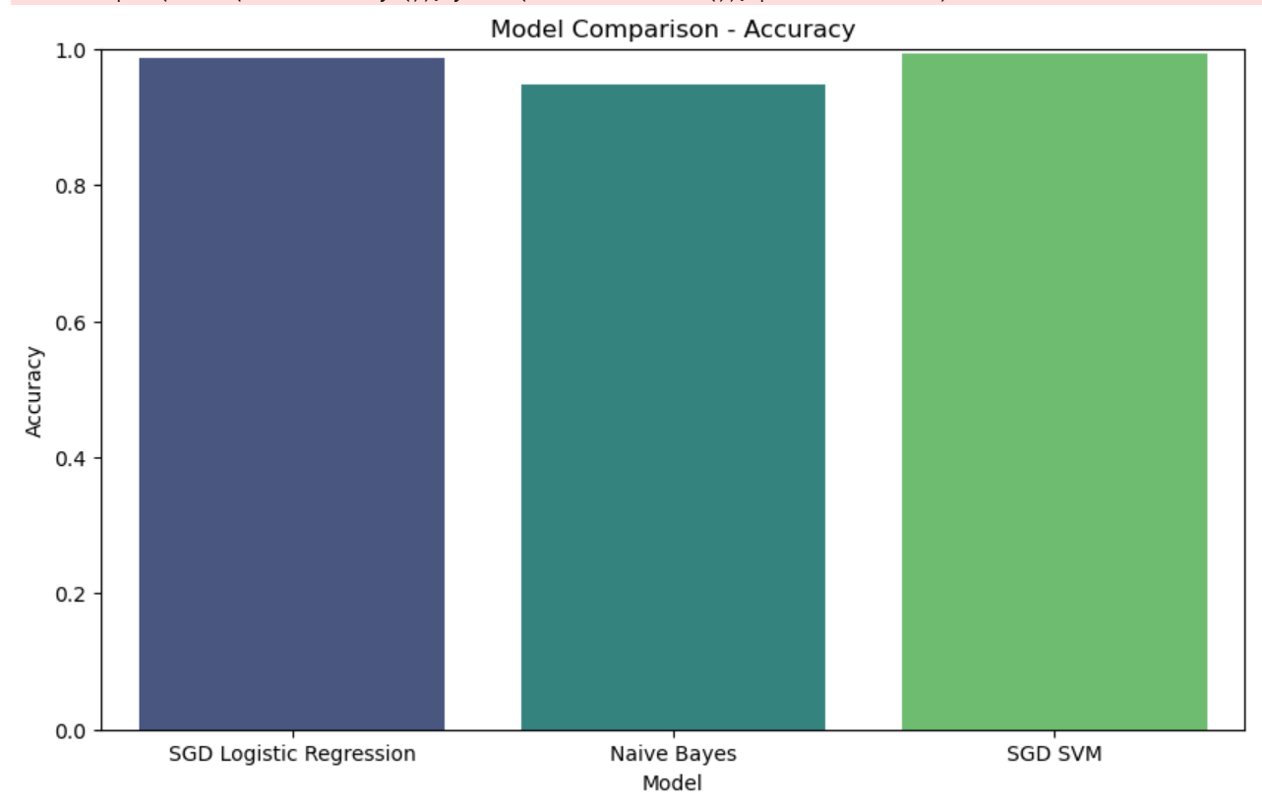
Model Comparison

Slide 14
CONCLUSION
Outcomes:
The project successfully demonstrated the capability of machine learning and deep learning models to classify news articles accurately.
LSTM achieved the highest accuracy at 99.62%, while SVM closely followed with 99.29%.
Integration with Streamlit enhances accessibility and usability for end-users.

