Slide 1
Predicting AMAZON Stock Price for Swing Trading
Venkata sai phanindra Dhavaleswarapu
NaGesh B U
Supreeth DANDU
Harsha Sikha

Slide 2
Introduction & Objective
🎯 Objective
Develop a model to predict next day’s closing price for Amazon stock
Use historical stock data & financial indicators
Deploy the best model using Streamlit
📈 Why Stock Price Prediction?
Helps traders & investors make informed decisions
Incorporates technical & fundamental analysis
Machine Learning models can uncover hidden patterns

Slide 3
Data Collection & Sources
📥 Data Sources
Yahoo Finance (Stock Data: Open, High, Low, Close, Volume)
WallStreetNumbers (Financial Data: Revenue, Net Income, OCF, etc.)
FRED API (Macroeconomic Indicators: Inflation, Interest Rates, GDP,etc.)

Slide 4
Market Data
Date
Open
High
Low
Close
Volume
Weekday
Month
Year
SP500_Close
SP500_Volume
NASDAQ_Close
NASDAQ_Volume

Slide 5
Technical Indicators
SMA_5 (Simple Moving Average 5)
SMA_10 (Simple Moving Average 10)
SMA_50 (Simple Moving Average 50)
EMA_10 (Exponential Moving Average 10)
EMA_50 (Exponential Moving Average 50)
RSI (Relative Strength Index)
ROC (Rate of Change)
Stochastic Oscillator
BB_Upper (Bollinger Bands Upper)
BB_Lower (Bollinger Bands Lower)
ATR (Average True Range)
Std_Dev (Standard Deviation)
MACD (Moving Average Convergence Divergence)
Signal_Line
OBV (On-Balance Volume)
CMF (Chaikin Money Flow)
VWAP (Volume Weighted Average Price)

Slide 6
Macroeconomic Data
GDP
GDP_Growth_Rate
UNRATE (Unemployment Rate)
Inflation_rate
CPI (Consumer Price Index)
10_Yr_Yield (10-Year Yield)

Slide 7
Financial Metrics
Revenue Growth
Net Profit Margin
Debt-to-Equity Ratio
Free Cash Flow
Operating Cash Flow
Capex (Capital Expenditures)

Slide 8
Lagged Price features
Close_t+1 (Close Tomorrow)
Close_t-1 (Close Yesterday)
Close_t-2 (Close 2 Days Ago)
Volume_t-1 (Volume Yesterday)

Slide 9
Data Selection & Justification
Stock price data from 2018 to the present.
Reasons for choosing 2018 – Current
Reflects modern market conditions.
Captures recent volatility trends (COVID-19, economic fluctuations).
Ensures relevance for current trading strategies.

Slide 10
Preprocessing Steps:
Data Cleaning: Remove missing values and outliers to maintain data integrity.
Normalization/Scaling: Standardize data to a common scale (e.g., Min-Max Scaling) for improved model performance.
Date Handling: Format and process date information for accurate time-series analysis.

Slide 11
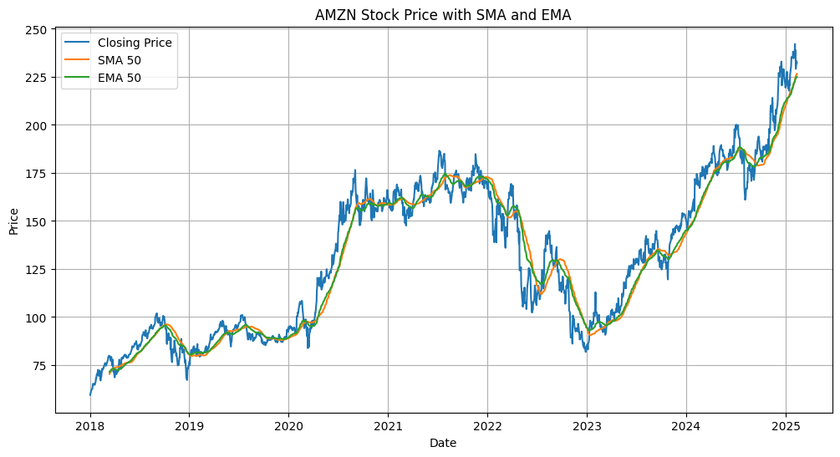
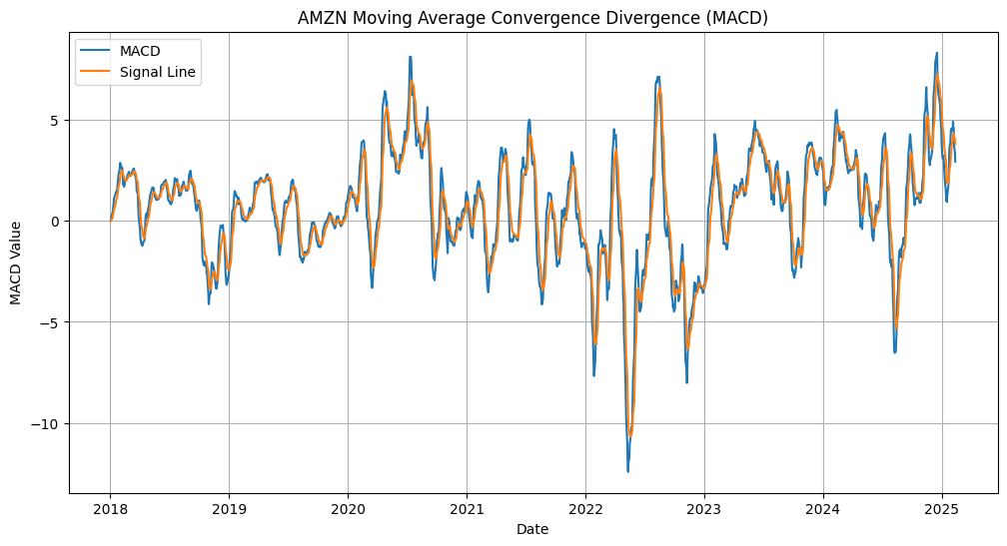

Slide 12
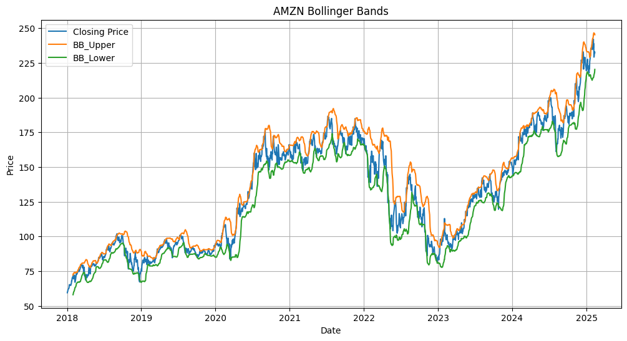
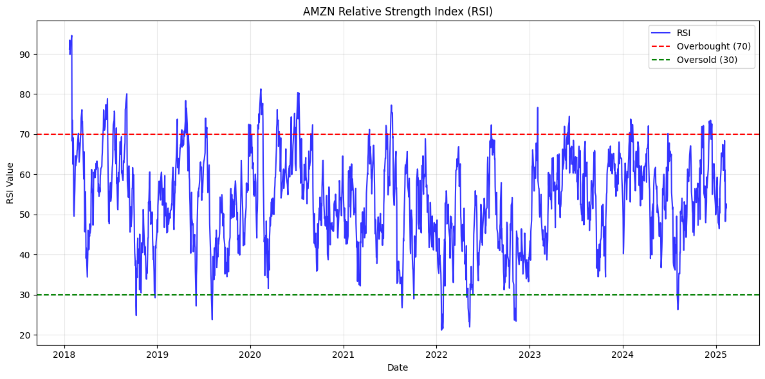

Slide 13
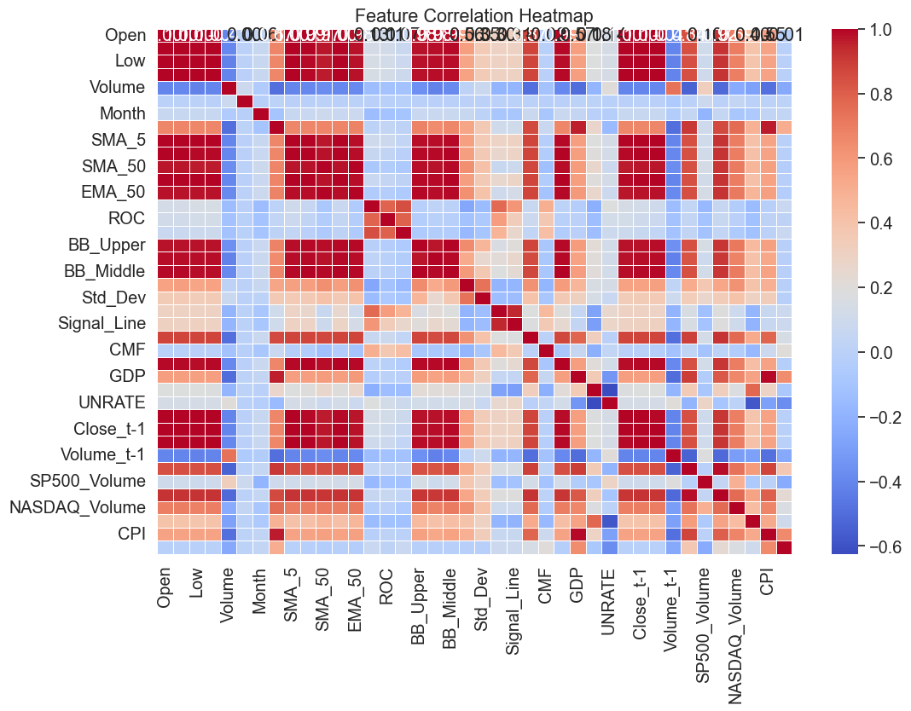
Feature Correlation Heatmap

Slide 14
Model Selection & Training
Models Used:
Machine Learning: Random Forest
Deep Learning: - LSTM (Long Short-Term Memory)
- GRU(Gated Recurrent Unit)
Training Process:
Splitting data into training and test sets.
Hyperparameter tuning for optimization.
Model evaluation using RMSE and accuracy metrics.

Slide 15
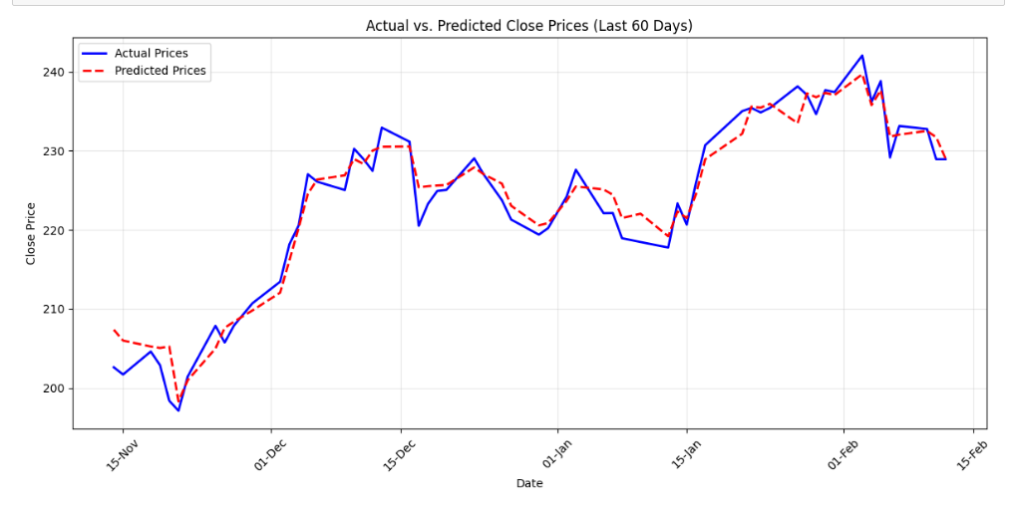
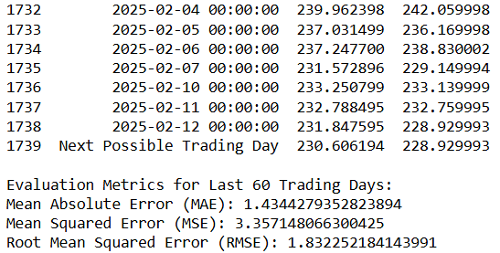
Implementation of Random Forest Classifier

Slide 16
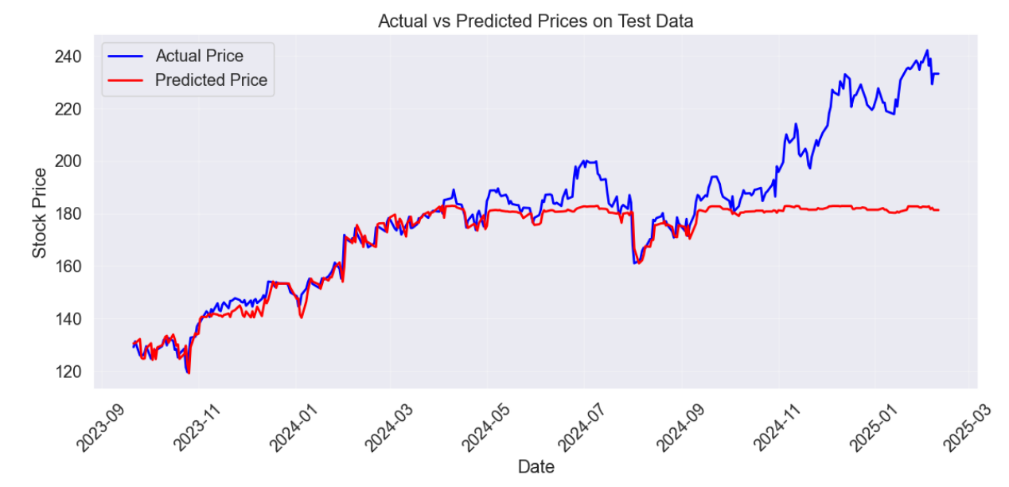
Random Forest

Slide 17
LSTM Implementation
Data Preparation:
Used 60 previous days as input (lookback period).
Features include stock prices, volume, moving averages, RSI, MACD, and economic indicators.
Data normalized using MinMaxScaler.
Split into 80% training and 20% testing.
LSTM Model Architecture:
4 LSTM layers with dropout (50, 60, 80, 120 units).
Output layer: Dense(1) for regression.
Activation function: ReLU.
Optimizer: Adam (learning rate 0.001).
Loss function: Mean Squared Error.

Slide 18
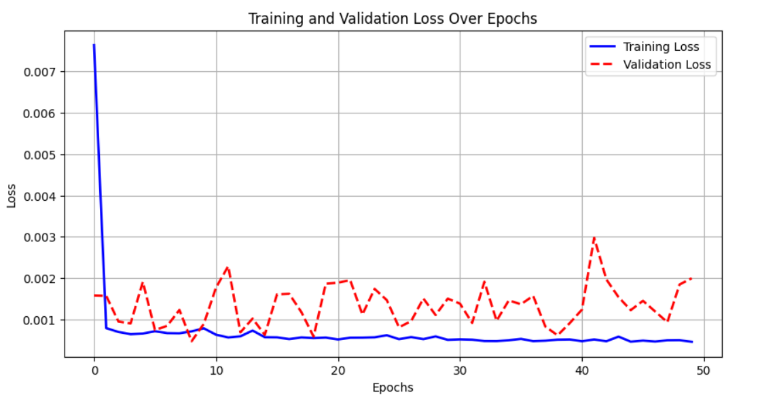
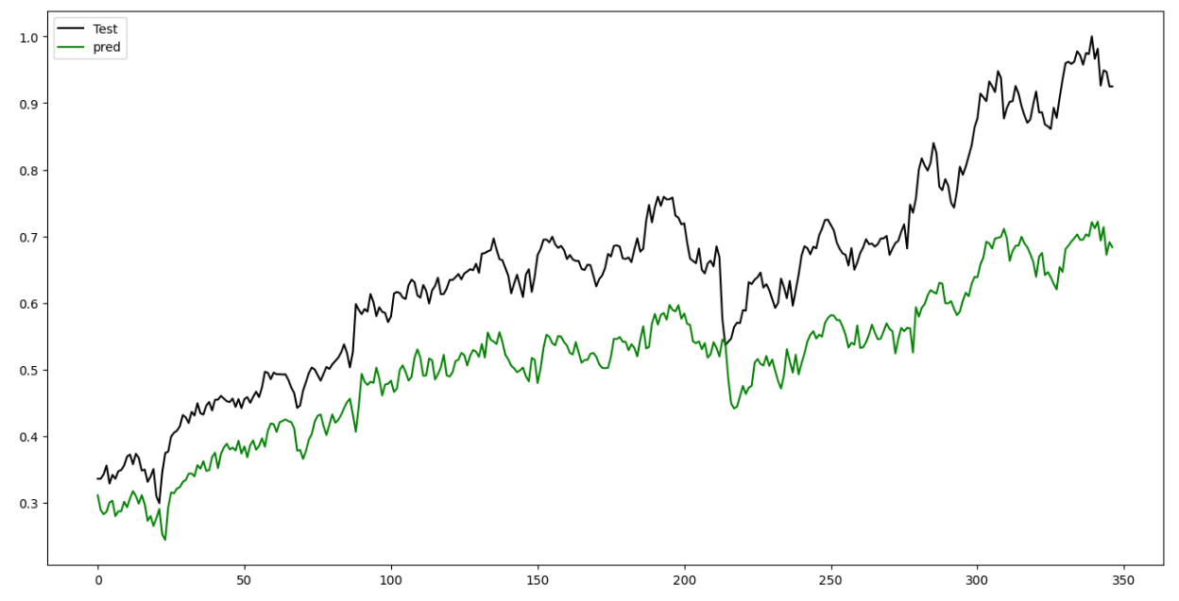
LSTM Implementation

Slide 19
Model Training & Evaluation
Training:
Batch size: 32, Epochs: 50.
Early stopping & ReduceLROnPlateau used to prevent overfitting.
Loss reduced significantly over epochs.
Evaluation:
Metrics: MSE, MAE, RMSE.
Observed overfitting as validation loss fluctuates after a few epochs.

Slide 20
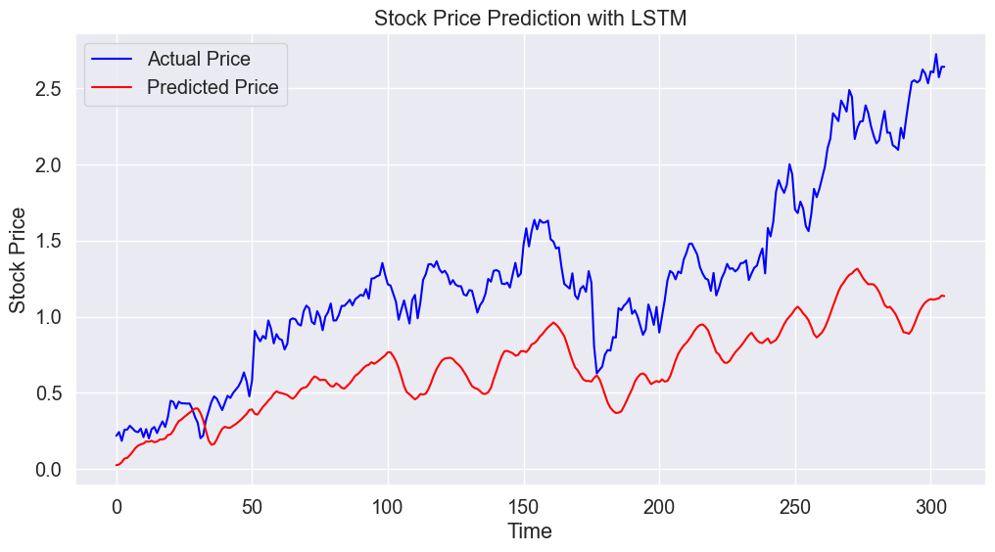
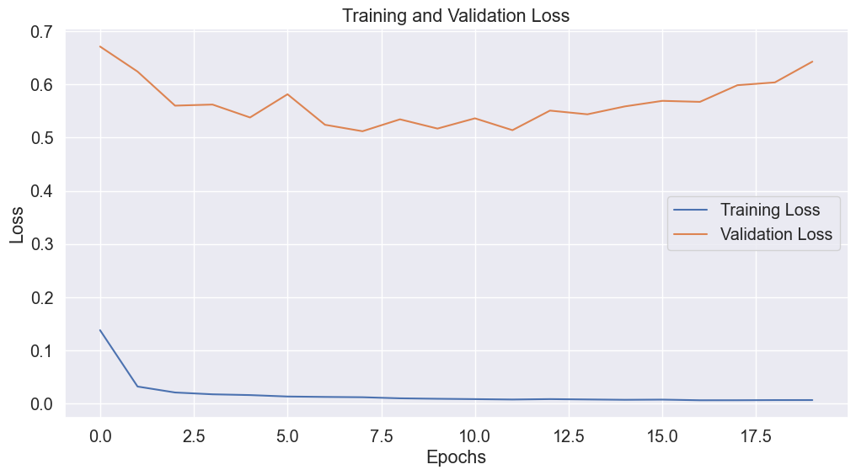
Visualizations:
Training vs Validation loss graph.
Actual vs Predicted stock prices plotted.

Slide 21
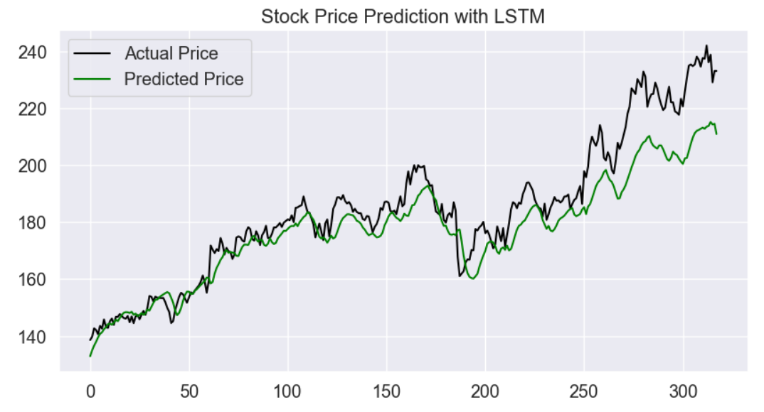
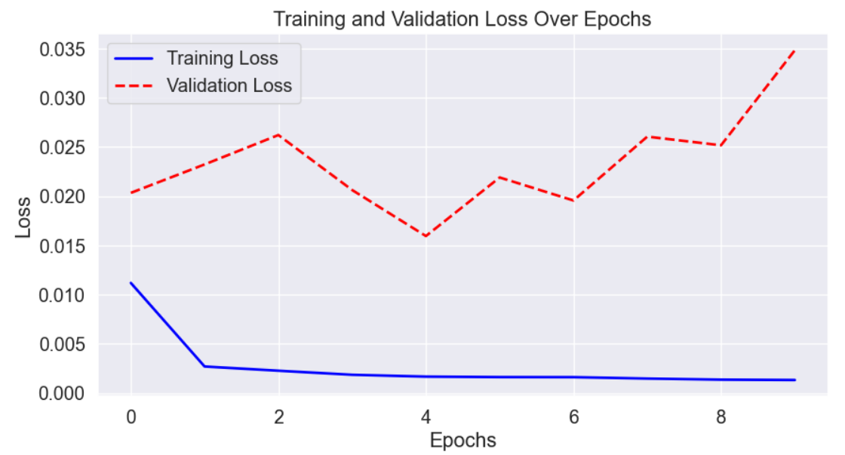
LSTM : Hyperparameter Tuning

Slide 22
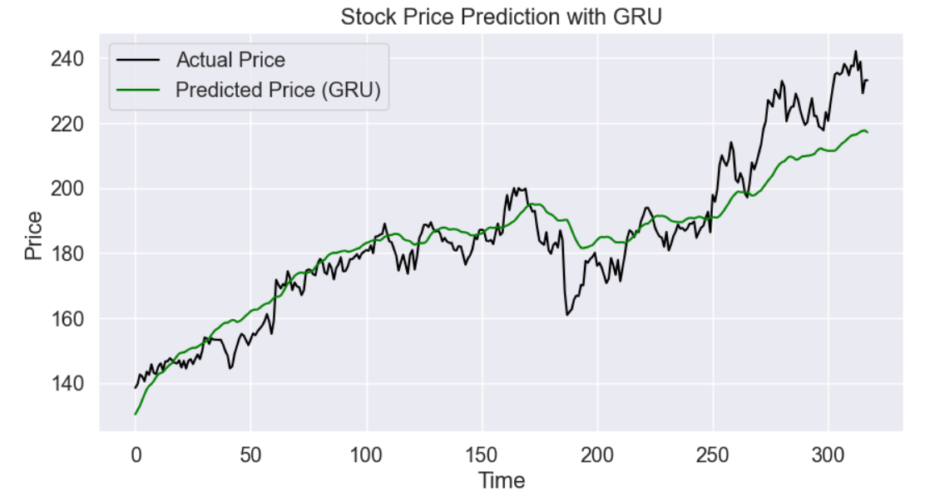
GRU (Gated Recurrent Unit)

Slide 23
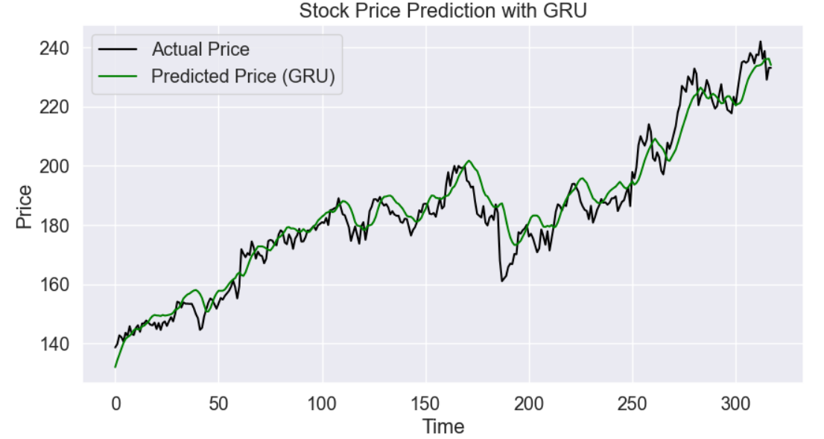
GRU : Hyperparameter Tuning
Tuning Strategy:
Used Keras Tuner (Hyperband Search)
Tuned parameters:
GRU Units: [64, 128, 256]
Dropout: [0.2, 0.3, 0.4]
Learning Rate: [0.01, 0.001, 0.0005]
Best Found Parameters:
GRU1 Units: 256
GRU2 Units: 128
Dropout: 0.4
Learning Rate: 0.001

Slide 24
Conclusion & Future Work
Key Takeaways:
GRU-based model is effective than LSTM
Incorporating financial & macroeconomic indicators improves accuracy

Slide 25
Thank You!
Questions?

