Slide 1
MY PICTURES!!!!
This thing took me a whole day!!

Slide 2
Column Name
Value
Timestamp
Column Name
Year
“2011”
2320857391734
Year
“2011”
2320765491734
Value
Timestamp
Level
“1”
2328207391734
Level
“1”
2328987691734
FirstName
“John”
1328757391734
FirstName
“Jane”
1328757392000
CourseName
“Software Engineering 101”
2328757320034
CourseName
“NetworkEngineering 101”
2324000320034
LastName
“Smith”
1328757391987
LastName
“Foo”
1328757391222
Trimester
“1”
232875200034
Trimester
“1”
232879870034
Email
“smith@example.com”
1328757391788
Email
“Foo@example.com”
1328757392777
UserID
“100”
3228757391788
CourseID
“SWEN100”
3228757391334
Age
“22”
1328757396666
UserID
“100”
3228757392323
CourseID
“NWEN101”
3228757396543
Age
“21”
1328757391998

Slide 3
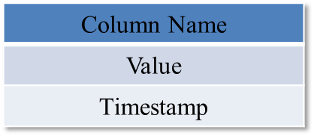
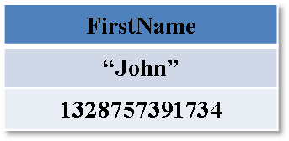
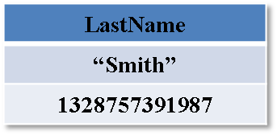
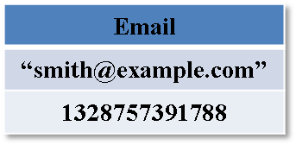
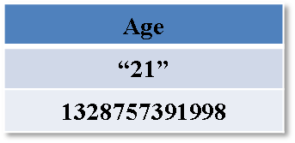
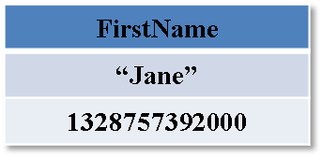
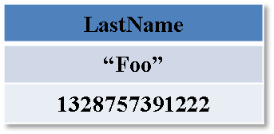
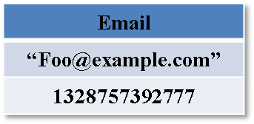
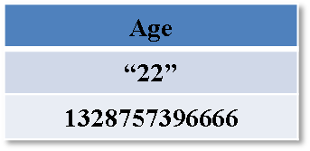
Common look-up Value | SuperColumnName
Hexadecimal Row ID
…
UserID (RowID) | Values
100
UserID (RowID) | Values
101

Slide 4
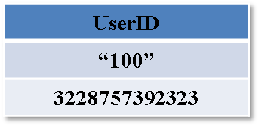
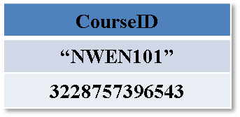
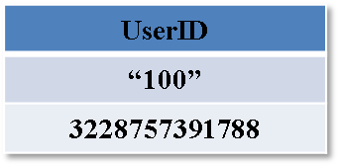

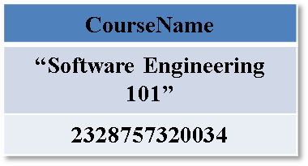
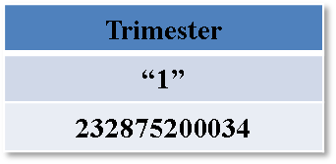
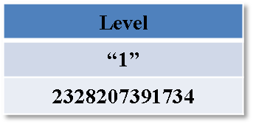
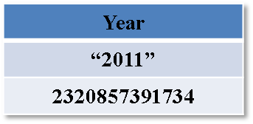
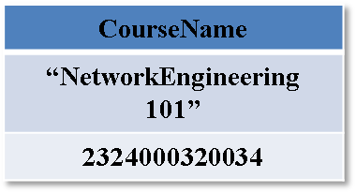
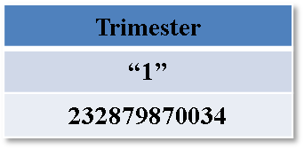
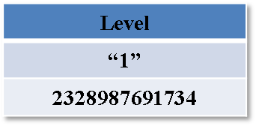
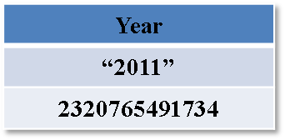
RowID | Values
2
RowID | Values
1
CourseID (RowID) | Super Column Values
SWEN101
CourseID (RowID) | Super Column Values
NWEN101

Slide 5
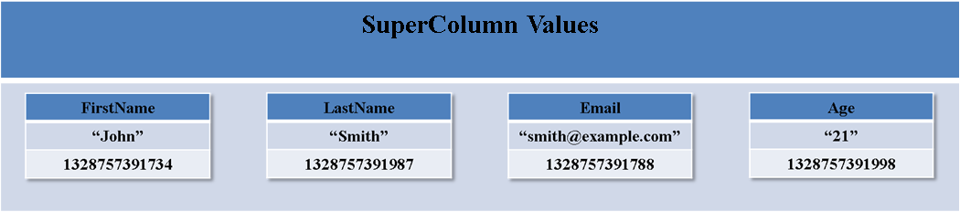
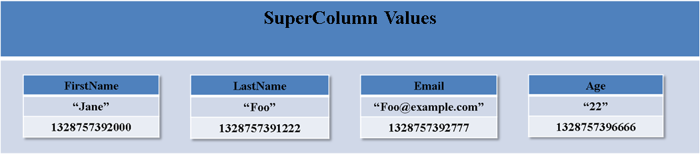
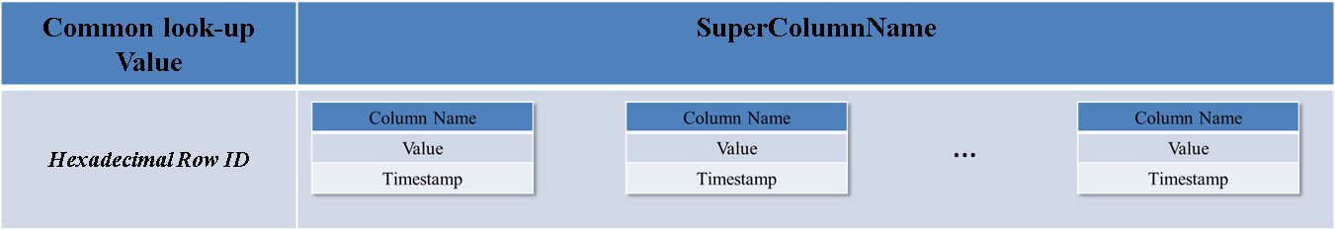
Row Key | Values
100
101
Row Key | Values
RowKey1

Slide 6
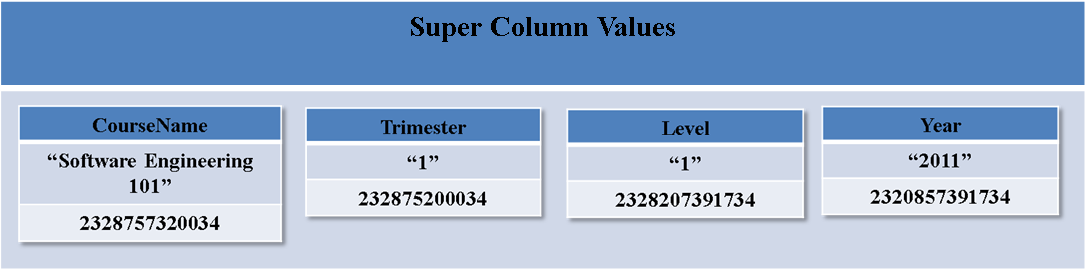
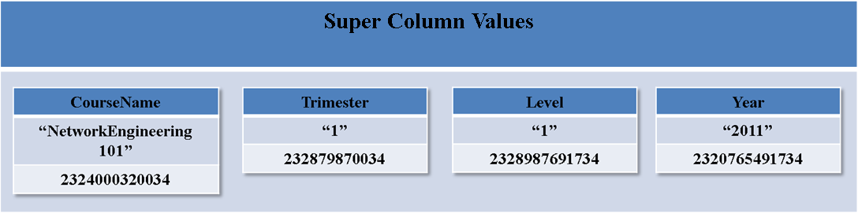
Row Key | Values
SWEN101
NWEN101

Slide 7
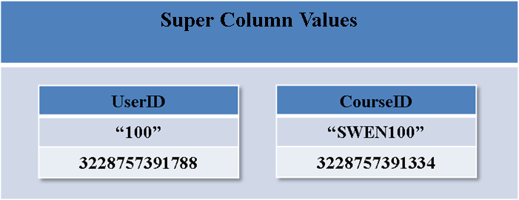
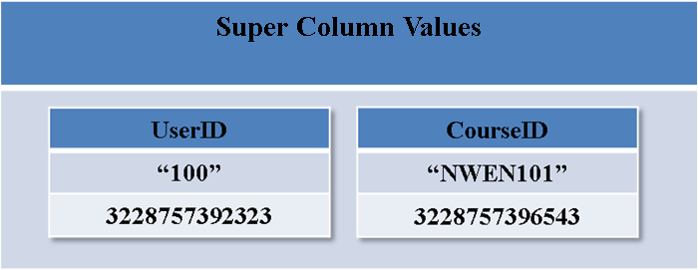
Row ID | Values
1
2
Super Column Values
Super Column Values

Slide 8
{//Column
“name”: “FirstName”,
“value”: “John”,
“timestamp”: 1328757391734
}
{//SuperColumn
“name”: 100,
“value”: {//Columns
“FirstName”: {//Column
“name”: “FirstName”,
“value”: “John”,
“timestamp”: 1328757391734
}
“LastName”: {//Column
“name”: “LastName”,
“value”: “Smith”,
“timestamp”: 1328757391987
}
“Email”: {//Column
“name”: “Email”,
“value”: “smith@example.com”,
“timestamp”: 1328757391788
}
“Age”: {//Column
“name”: “Age”,
“value”: 21,
“timestamp”: 1328757391998
}
}
}

Slide 9
{//ColumnFamily
“name”: “Student”,
“value”: {//SuperColumns
100 : {//SuperColumn
name: 100,
value: {//Columns
“FirstName”: {//Column
“name”: “FirstName”,
“value”: “John”,
“timestamp”: 1328757391734
}
“LastName”: {//Column
“name”: “LastName”,
“value”: “Smith”,
“timestamp”: 1328757391987
}
“Email”: {//Column
“name”: “Email”,
“value”: “smith@example.com”,
“timestamp”: 1328757391788
}
“Age”: {//Column
“name”: “Age”,
“value”: 21,
“timestamp”: 1328757391998
}
}
}
}
}

Slide 10
UserID | FirstName | LastName | Email | Age
100 | John | Smith | smith@example.com | 21
101 | Jane | Foo | foo@example.com | 22
102 | Foo | Bar | bar@example.com | 23
CourseID | CourseName | Trimester | Level | Year
SWEN100 | Software Engineering 100 | 1 | 1 | 2011
NWEN101 | Network Engineering 101 | 1 | 1 | 2011
COMP400 | Artificial Intelligence | 2 | 4 | 2012
RowID | UserID | CourseID
1 | 100 | SWEN100
2 | 100 | NWEN101
3 | 101 | COMP400

Slide 11

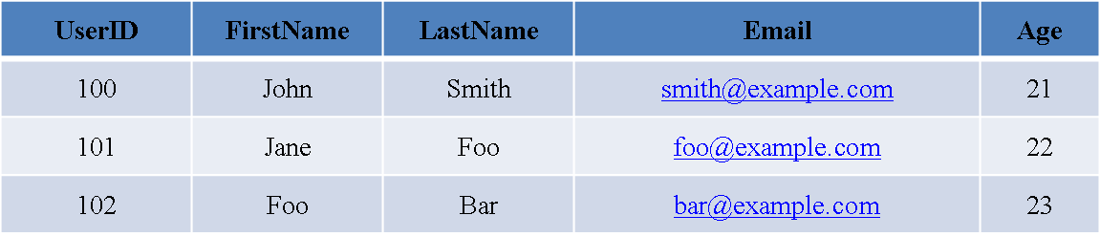

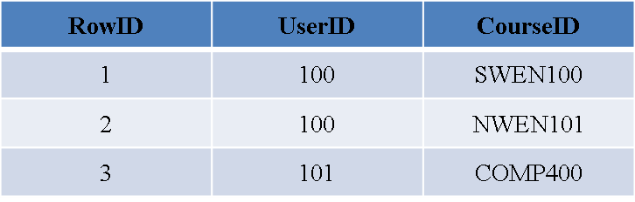
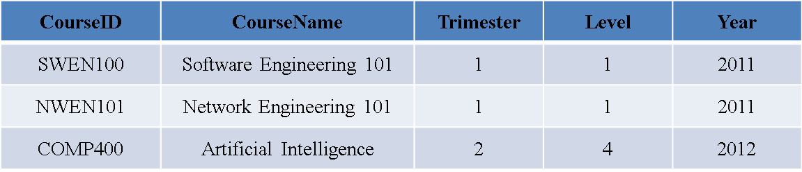

Student
University Relational Database
Course
Enrolment

Slide 12
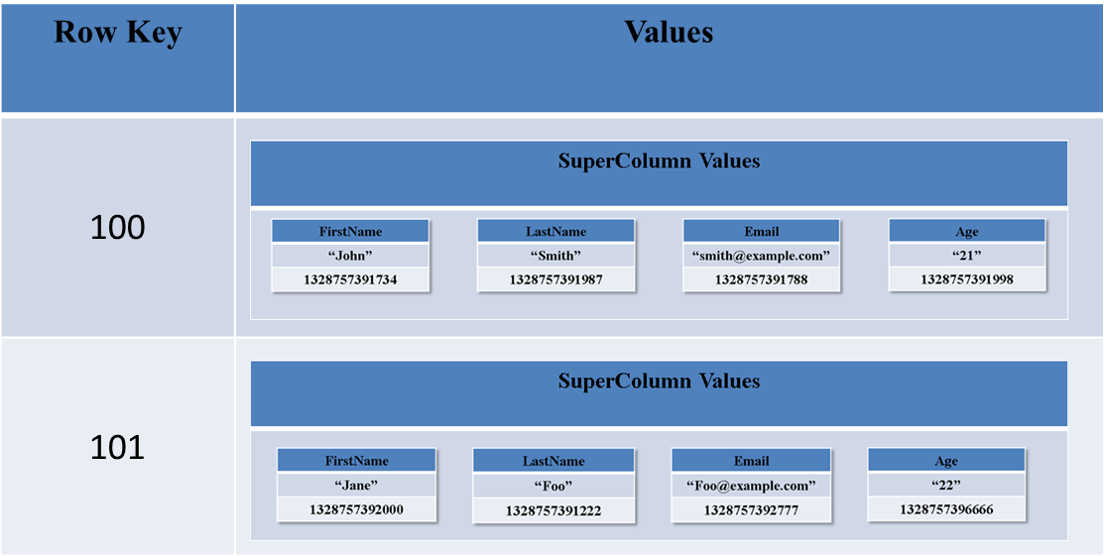
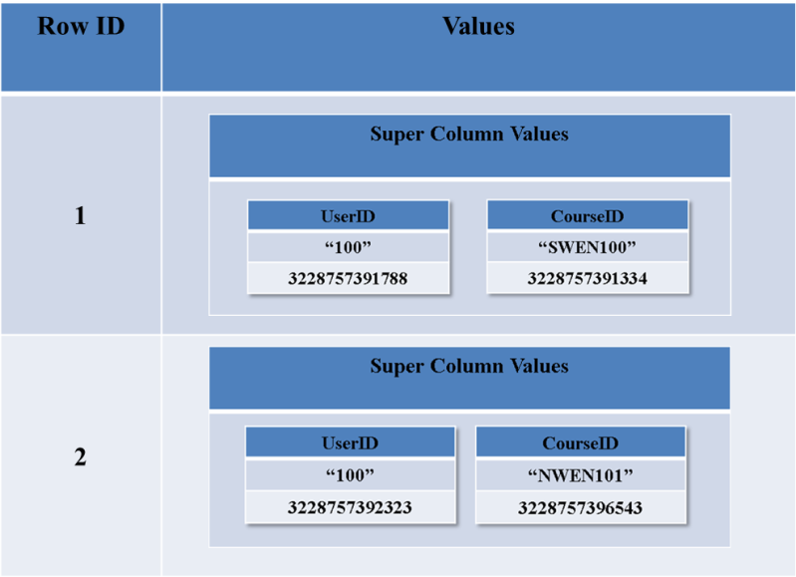
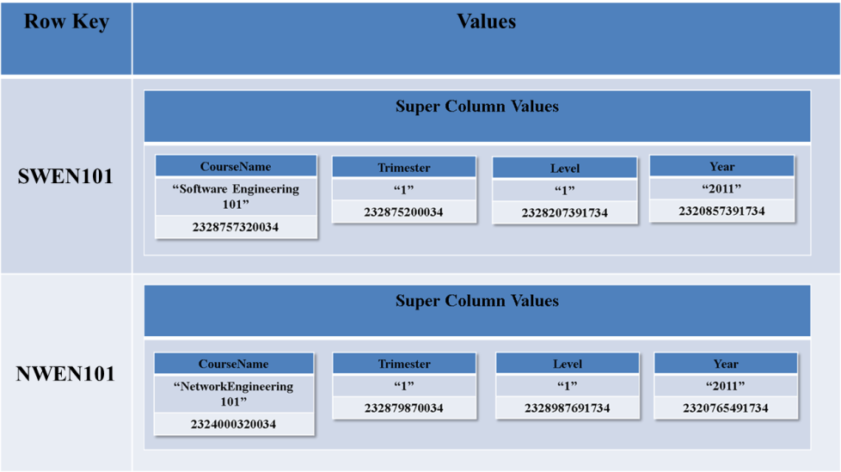
University Keyspace

Slide 13
Referential Integrity Constraint
Insert
Update
Delete
Check insertions in the refrencing table.
Check updates of the foreign key in the referencing table.
Check updates of the primary key in the referenced table
Check deletions in the referenced table

