Slide 1
GLOBAL
HEALTHCARE
CRISIS
🏥
Business Analysis & Data Analysis Project
Harsh Patel | Business Analyst | github.com/harshaug28
March 2026

Slide 2
The Scale of the Crisis
17 million people die from preventable diseases every year — not because cures don't exist, but because healthcare is out of reach.
17 Million
$122
13.6 yrs
Preventable deaths every year
Avg. healthcare spend per person
in Sub-Saharan Africa
Life expectancy gap vs.
developed nations
Key Facts
Sub-Saharan Africa carries 24% of global disease burden with just 1% of global health spending
9 countries fall below the critical Access Index of 50 — all in Africa or South Asia
Every $1 invested in LMIC healthcare returns $4 in economic productivity (WHO)
Expanding vaccination to 95%+ coverage could prevent 1.5 million child deaths per year
Harsh Patel | github.com/harshaug28 | Global Healthcare Crisis Analysis

Slide 3
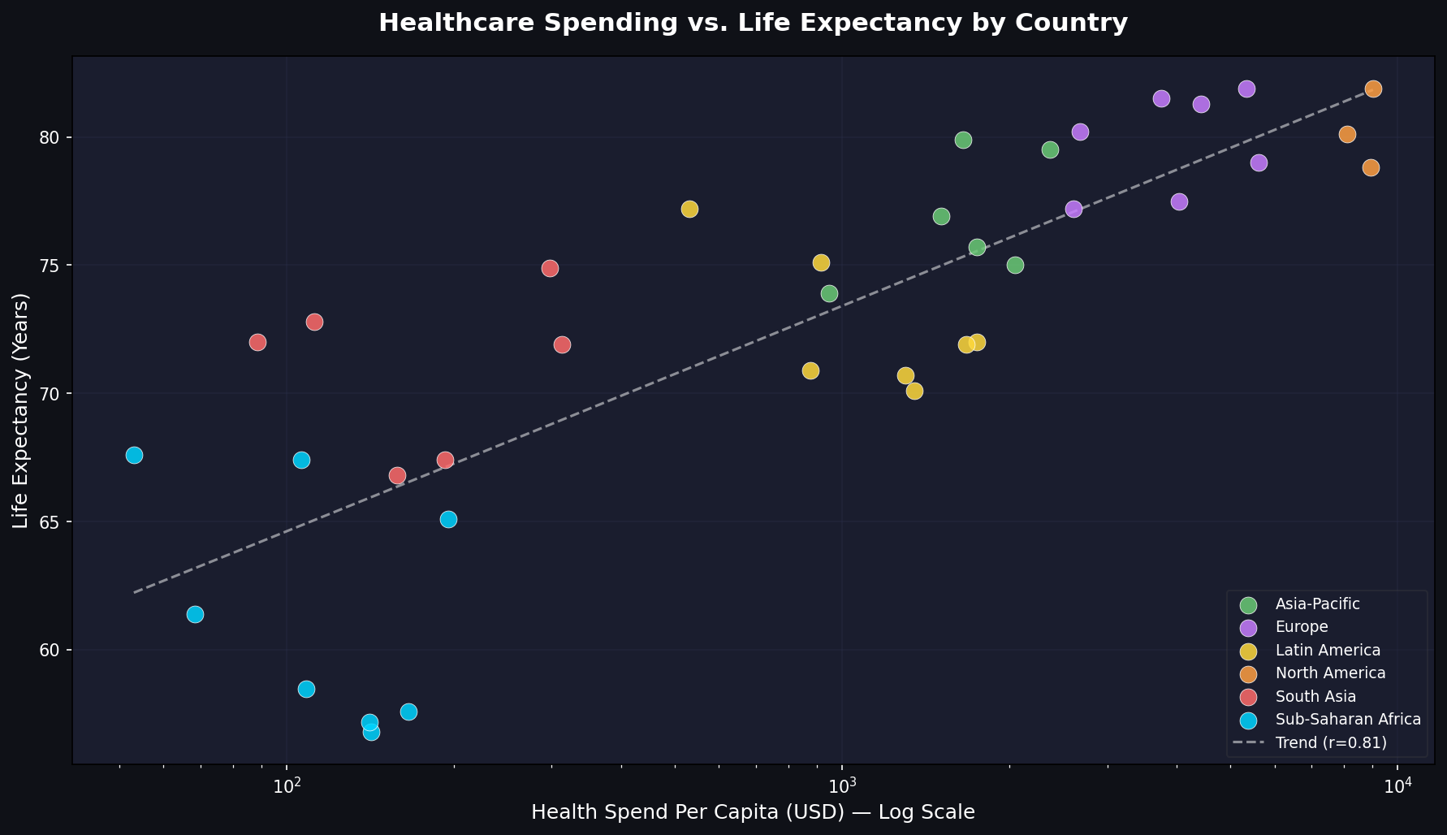
Healthcare Spending vs. Life Expectancy
Correlation
r = 0.658
Significance
p < 0.001
Key Insight
Log curve — first $500 matters most
Strong positive relationship — countries that invest more in healthcare live significantly longer lives
Harsh Patel | github.com/harshaug28 | Global Healthcare Crisis Analysis

Slide 4
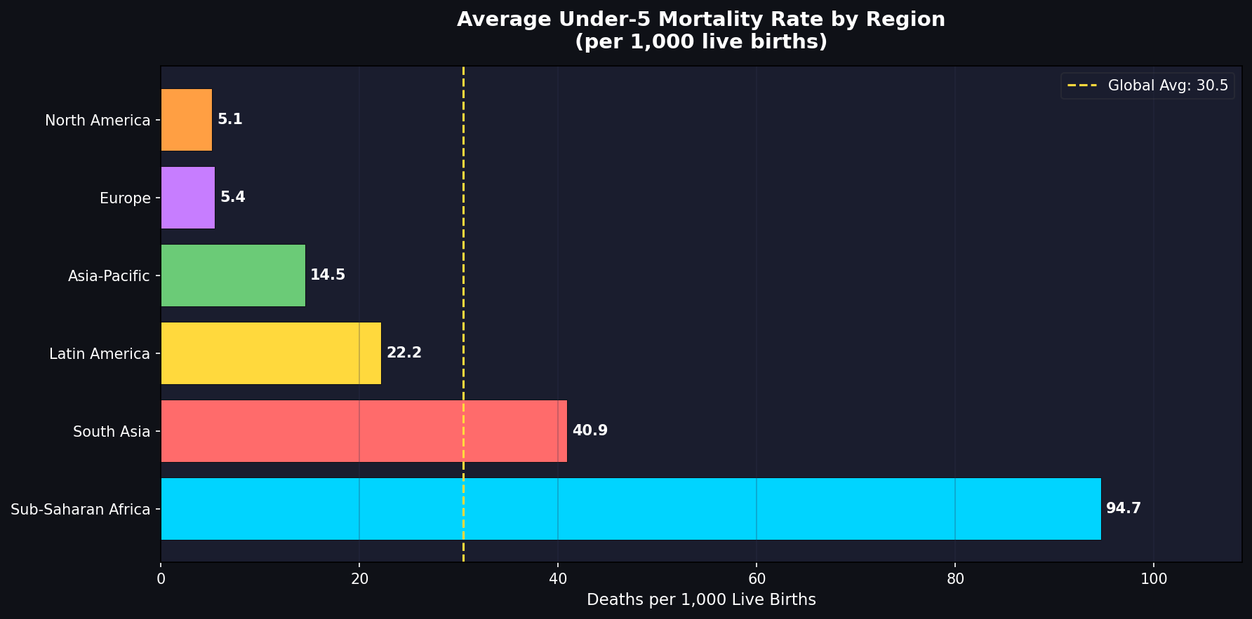
Under-5 Mortality by Region
North America
5.1/1k
Europe
5.4/1k
Asia-Pacific
14.5/1k
Latin America
22.2/1k
South Asia
40.9/1k
Sub-Saharan Africa
94.6/1k
Sub-Saharan Africa's rate is 18× higher than North America's — almost entirely from preventable causes
Harsh Patel | github.com/harshaug28 | Global Healthcare Crisis Analysis

Slide 5
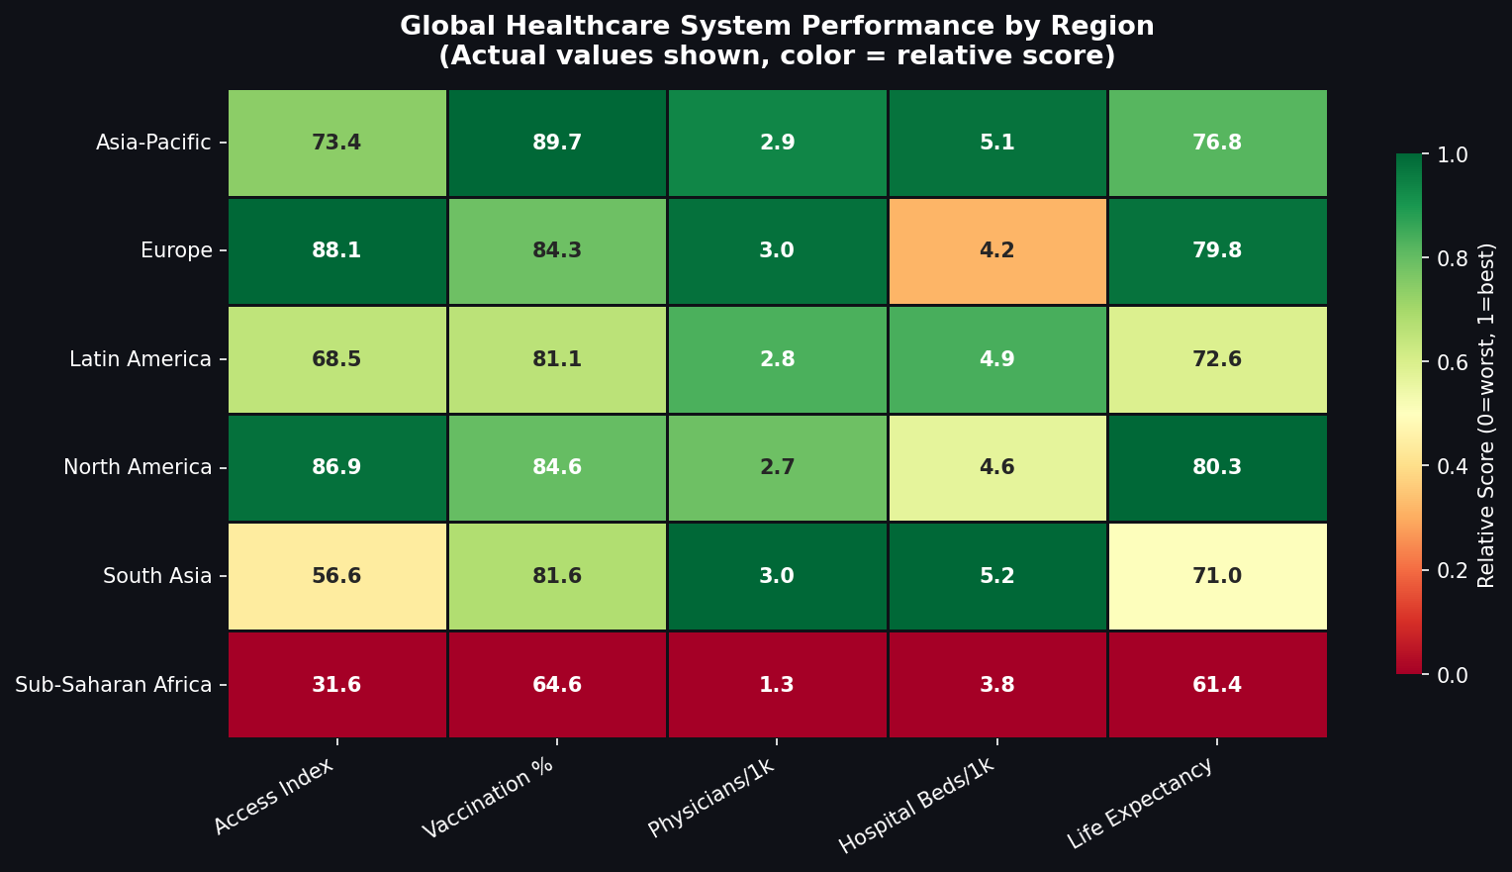
Healthcare System Performance — Regional Scorecard
Key Takeaways
Sub-Saharan Africa scores critically low across ALL five dimensions
No single dimension shows a relative strength in the worst-performing regions
Europe & North America perform near-equally — marginal differences only
South Asia: moderate vaccination, very low physicians & access scores
Harsh Patel | github.com/harshaug28 | Global Healthcare Crisis Analysis

Slide 6
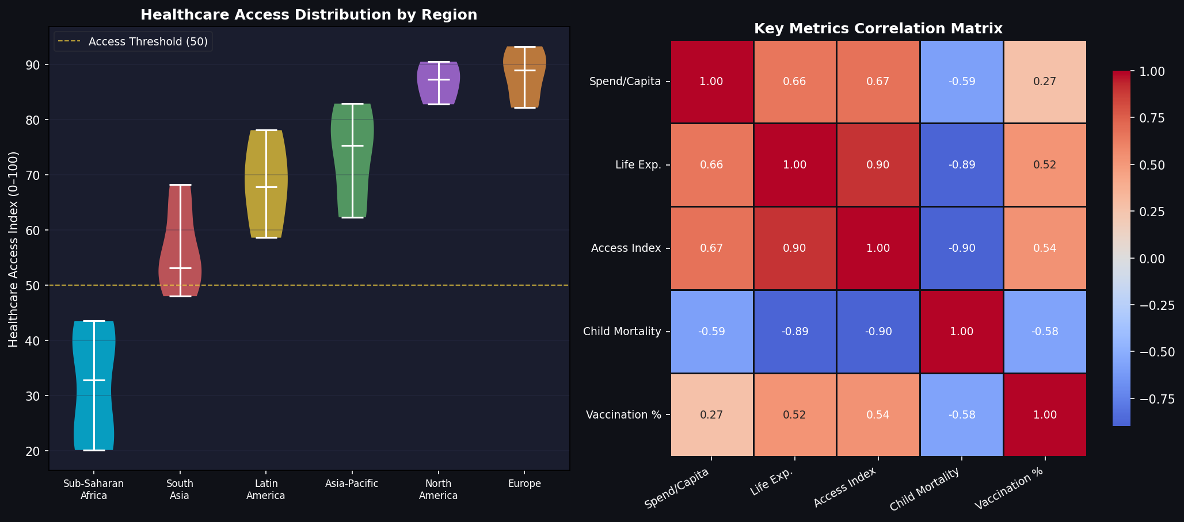
Access Distribution & Correlation Analysis
Correlations Found
Access ↔ Mortality
r = −0.896 · Very Strong
Doctors ↔ Life Exp.
r = +0.720 · Strong
Spend ↔ Life Exp.
r = +0.658 · Strong
Vaccine ↔ Mortality
r = −0.575 · Moderate
Access Index is the single strongest predictor of child mortality — stronger than spending alone. All correlations: p < 0.001.
Harsh Patel | github.com/harshaug28 | Global Healthcare Crisis Analysis

Slide 7
Gap Analysis — Healthcare Access by Region
Region | Current Score | WHO Target | Gap | Status
North America | 86.9 / 100 | 90+ | −3.1 | 🟡 Near Target
Europe | 88.1 / 100 | 90+ | −1.9 | 🟡 Near Target
Asia-Pacific | 73.4 / 100 | 80+ | −6.6 | 🟠 Action Needed
Latin America | 68.5 / 100 | 80+ | −11.5 | 🔴 Significant Gap
South Asia | 56.6 / 100 | 80+ | −23.4 | 🔴 Critical
Sub-Saharan Africa | 31.6 / 100 | 80+ | −48.4 | 🚨 Crisis Level
Root Cause:
Poverty cycle + fragmented international aid → underfunded budgets → inadequate infrastructure → inaccessible care → preventable deaths → reduced economic productivity → lower tax revenue → less health investment.
Harsh Patel | github.com/harshaug28 | Global Healthcare Crisis Analysis

Slide 8
Stakeholder Analysis
HIGH POWER
Stakeholder | Priority | Engagement | Channel
WHO / World Bank | 🟢 High | Monthly formal reports | Secure portal
Health Ministries | 🟢 High | Per milestone briefings | Video call
NGOs | 🟡 Med | Bi-monthly workshops | Email/Slack
Investors | 🟡 Med | Quarterly exec brief | Meeting
Research Team | 🔵 Low | On findings release | Email
Data Engineers | 🟢 High | Daily stand-up | Slack
KEEP SATISFIED
MANAGE CLOSELY
Investors
WHO/WB
Sponsor
Ministries
MONITOR
KEEP INFORMED
Media
Researchers
NGOs
Data Team
LOW INTEREST
HIGH INTEREST
Harsh Patel | github.com/harshaug28 | Global Healthcare Crisis Analysis

Slide 9
Strategic Recommendations
Phase 1
0–12 Months
Phase 2
1–3 Years
Phase 3
3–10 Years
Redirect 15% of donor aid to Sub-Saharan Africa's top-5 preventable disease programmes
Fund 10,000 medical scholarships across LMIC nations
Universal Health Coverage legislation for Access Index < 50 countries
Emergency vaccination campaigns in 9 Critical Zone countries
Standardise Electronic Health Records (EHR) in all LMICs
AI disease early-warning systems in 50+ LMIC nations
Deploy 500 mobile clinic units across rural Africa & South Asia
Establish 12 Regional Healthcare Hubs via public-private partnership
Essential medicine price regulation — target −40% cost
Harsh Patel | github.com/harshaug28 | Global Healthcare Crisis Analysis

Slide 10
Investment Case
$1 invested → $4 returned
$450B over 10 years = 0.5% of global GDP/yr
Economic return from healthcare investment in LMICs (WHO)
Cost to close the Sub-Saharan Africa healthcare funding gap entirely
Intervention | Annual Cost | Lives Saved/yr | ROI | Timeline
Expand vaccination programmes | $2.1B | ~1.5M children | 4:1 | 0–12 months
Mobile clinic network deployment | $800M | ~300K people | 3.5:1 | 6–18 months
Physician training programme | $1.2B (5-yr) | Long-term systemic | 6:1 | 1–3 years
Hospital infrastructure grants | $3.0B | ~600K people | 4:1 | 2–4 years
AI disease surveillance | $450M (setup) | ~500K/outbreak | 5:1 | 3–5 years
Harsh Patel | github.com/harshaug28 | Global Healthcare Crisis Analysis

Slide 11
Conclusion
"The data is clear — healthcare inequity is one of the most pressing and solvable crises of our time. The gap between what is medically possible and what billions of people actually receive is a policy failure, not a scientific one."
📊
Strong statistical evidence links access, investment, and workforce to better health outcomes across all regions
🎯
9 countries in crisis-level zones require immediate, coordinated intervention — all solutions are proven and scalable
💰
The business case is undeniable: $1 invested returns $4, and closing Africa's funding gap costs less than 0.5% of global GDP annually
Harsh Patel | Business Analyst | github.com/harshaug28 | March 2026

