Slide 1


 | Nitte Meenakshi Institute of Technology (AN AUTONOMOUS INSTITUTION AFFILIATED TO VISVESVARAYA TECHNOLOGICAL UNIVERSITY, BELGAUM) PB No. 6429, Yelahanka, Bangalore 560-064, Karnataka Telephone: 080- 22167800, 22167860, Fax: 080 - 22167805
Department of Computer Science and Engineering
Analysis of Network Traffic
Presentation By: V Venkata Sree Harsha
USN: 1NT18CS181
Company Name: Exposys Data Labs
Web: http://www.exposysdata.com/

Slide 2
TABLE OF CONTENTS
 | Nitte Meenakshi Institute of Technology (AN AUTONOMOUS INSTITUTION AFFILIATED TO VISVESVARAYA TECHNOLOGICAL UNIVERSITY, BELGAUM) PB No. 6429, Yelahanka, Bangalore 560-064, Karnataka Telephone: 080- 22167800, 22167860, Fax: 080 - 22167805
Department of Computer Science and Engineering
Introduction
Background
Problem statement
Scope of the Work
Objectives of the work
Internship Work
System Requirements
References

Slide 3
INTRODUCTION
During the month of December and January, I got the opportunity to intern under the Exposys Data Labs.
I was selected for the role of cybersecurity analyst and during my job role I got hands on experience on working on image encryption with tools like wireshark,HxD editor,tkinter, cryptocypher.
The duration of internship was 1 month during this time period I was assigned tasks related to network security and constantly mentored by senior officials working there.

Slide 4
BACKGROUND
About the company
Exposys Data Labs aims to solve real-world business problems like Automation, Big Data, and Data Science. our core team of experts in various technologies helps businesses to identify issues, opportunities, and prototype solutions using trending technologies like AI, ML, Deep Learning, and Data Science. we follow a human-focused and not technology-driven approach to achieve success in our client’s endeavors. About my role
I was many dealing with encryption tasks on a weekly basis. I had to first learn about encryption then make this application using tools like Tkinter and crypto cipher. I was also asked to make changes along the way to the project.

Slide 5
PROBLEM STATEMENT
In modern day where there is a lot of digital contents being created and transferred over the internet, there is a need for encryption to protect our data in transit by the use of encryption algorithms.
Scope of work:
Given a packet capture file
The given network snapshot might contain raw image files being transferred.
Extract the raw image file to expose the risk of middle tapping the network.
Objectives of work:
Analyse the given network snapshot to extract the raw data being transferred.

Slide 6
TECHNOLOGIES USED
Wire shark
Wireshark is an open-source network traffic analyzing tool. Using wireshark it is possible to dissect and analyze all the packets from all the different protocols of the networking stack just by a few clicks. It is very useful in network trouble shooting, analysis and software, network protocol development. The main usage for it for my tasks was for analysis.
HxD Editor
HxD editor is a hex editor or also called as binary file editor, which is used to edit data in raw binary format. Using this we can edit the compute files in the format in which they are stored in the hard disk also. The main goal for using this HxD editor was to see the contents of the packet in raw binary format.

Slide 7
Working
I was provided with the .pcap file containing all the packet information from a particular point of time.
The task was to find the image that was being carried out by a packet out of the network.
I had to first look through all of the packets which carried the data with image file extensions.
Then I had to look at the contents of the packet in raw hex format to determine from where to where the image information is stored.
After retrieving the image data, retrieve the image using HxD editor.

Slide 8
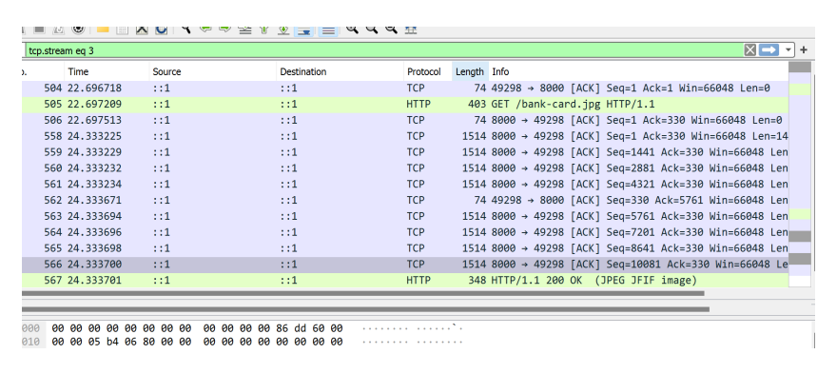
Pcap file: network snapshot

Slide 9
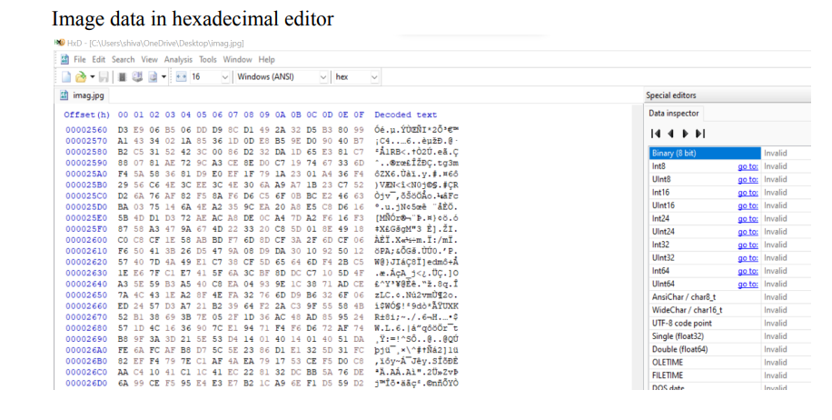
Extracted image raw data

Slide 10
REFERENCES
https://pycryptodome.readthedocs.io/en/latest/src/cipher/cipher.html
https://docs.python.org/3/library/tkinter.html
https://www.tutorialspoint.com/cryptography/triple_des.htm
https://www.python.org/

Slide 11
THANK YOU!

