Slide 1

The #1 project management tool used by agile teams

Slide 2
JIRA BACKGROUND
JIRA is an Incident Management Tool used for Project Management, Bug Tracking, Issue Tracking and Workflow. JIRA is based on the following three concepts – Project, Issue and Workflow.
Following are some of the most significant uses of JIRA.
JIRA is used in Bugs, Issues and Change Request Tracking.
JIRA can be used in Helpdesk, Support and Customer Services to create tickets and track the resolution and status of the created tickets.
JIRA is useful in Project Management, Task Tracking and Requirement Management.
JIRA is very useful in Workflow and Process management.

Slide 3
JIRA Infographics
Task Details
Business Project Template
Notifications
Boards
Power Search

Slide 4
JIRA INFOGRAPHICS
Reports
Scale with Team Growth
Add -Ins
Multilingual
Mobile App

Slide 5
JIRA-PROJECT
01
03
05
PRODUCT
Migration
CI/CD
02
Software Development Project
Migration to other platform project
04
Continuous Integration and Continuous Development
06
Market
Tickets
Tracking
Marketing Project
Manage Issues and Tickets
Track the Status of the Project

Slide 6
Project Management
Deploy and Maintain
Create Project/Tasks
Add Members and Assign Tasks
Develop & Test

Slide 7
JIRA Issues
Task of a story
Sub-task of a story
Helpdesk Ticket
Leave Request

Slide 8
JIRA – Workflow
In JIRA, workflow is used to track the lifecycle of an Issue. Workflow is a record of statuses and transitions of an issue during its lifecycle. A status represents the stage of an issue at a particular point.
An issue can be in only one status at a given point of time like Opened, To Do, Done, Closed, Assigned, etc. A transition is a link between two statuses when an issue moves from one status to another.
For an issue to move between two statuses, a transition must exist. In a simple way, a transition is some kind of work done on the issue, while status is the impact of work on that issue.

Slide 9
JIRA Workflow
In Progress Issue
Open Issue
01
02
Resolved Issue
03
04
Reopened Issue / Closed Issued

Slide 10
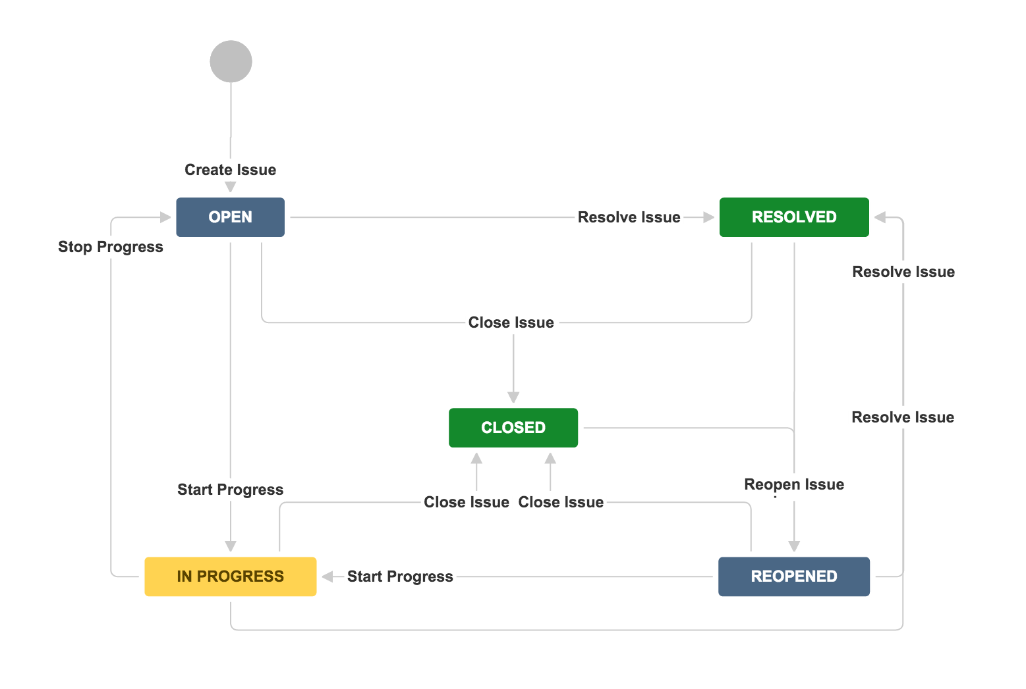
JIRA Workflow

Slide 11
JIRA CORE Values
Core Values
Build with heart and balance
Be the Change you seek
Open Company
Play as a Team

Slide 12
Types of Boards
Sprint
Backlog
Kanban
JIRA
Active
Backlog
Scrum

Slide 13
Why JIRA ?
Core
Values
Simplicity
Unity
Transparency
Adaptability

Slide 14
Starting up in JIRA
Step 1
Step 3
Select the type of Product we want to build
Choose the Board
Create a Project
Name the Project
Step 2
Step 4

Slide 15
JIRA and CI/CD
Build
Test
Plan
Deploy
Develop
Maintain

Slide 16
Agile Infographics in JIRA
Define
Design
Test
Deploy

Slide 17
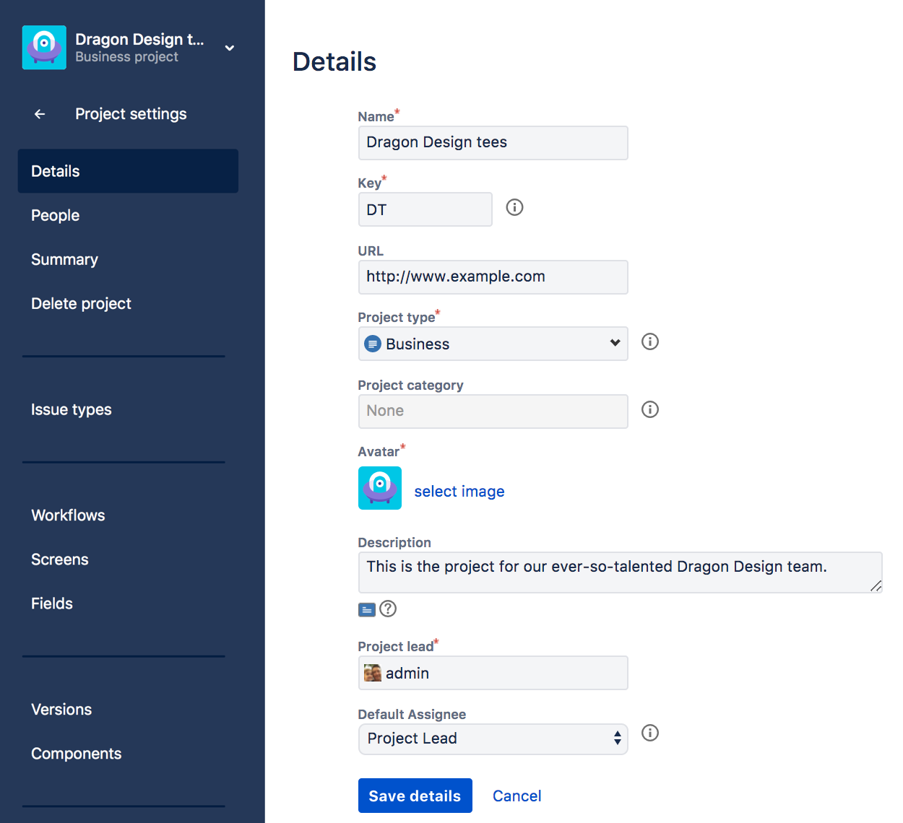
CREATING A PROJECT

Slide 18
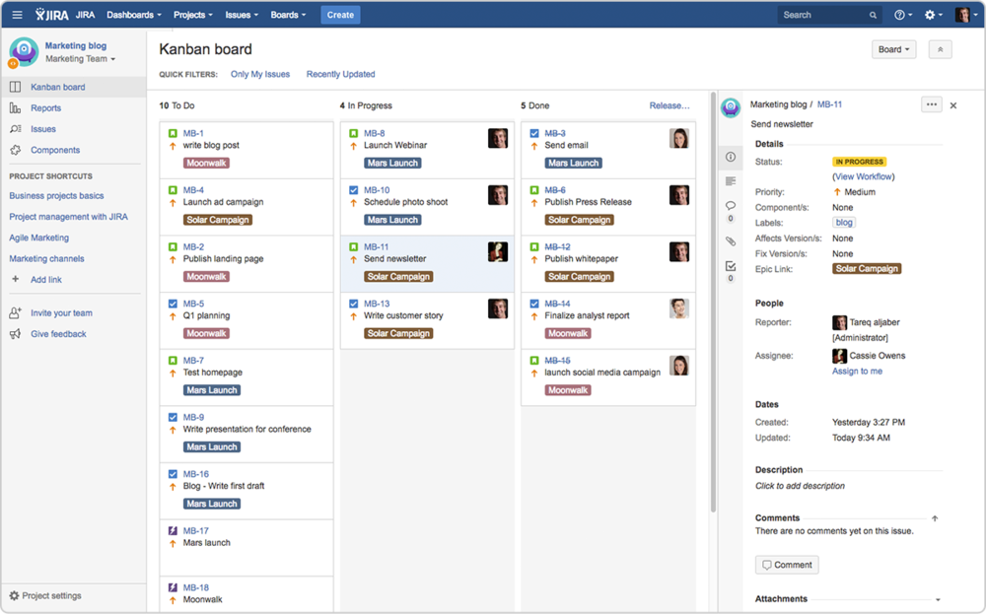
JIRA BOARD INTERFACE

Slide 19
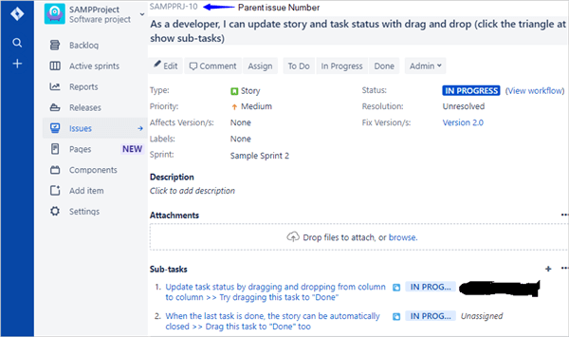
CREATE A TASK

Slide 20
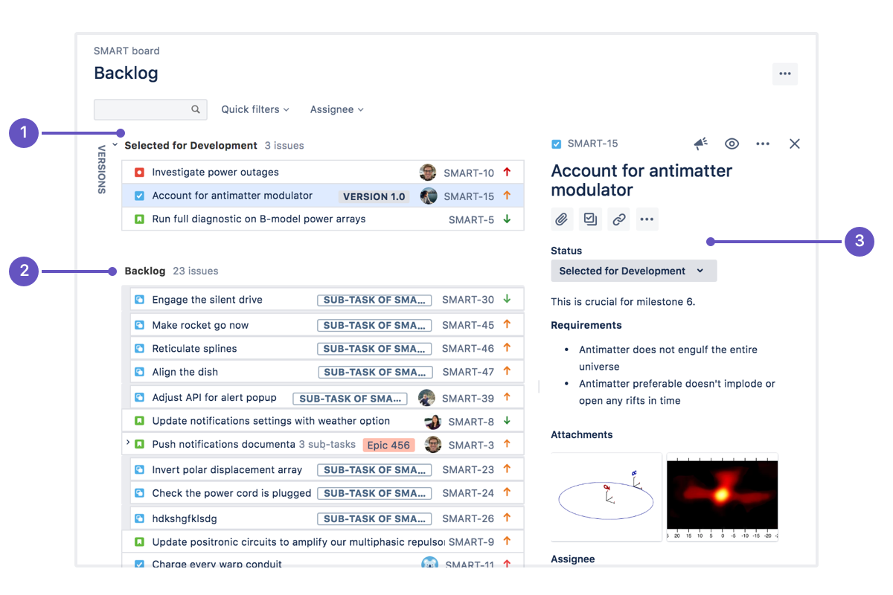
JIRA Backlog

Slide 21
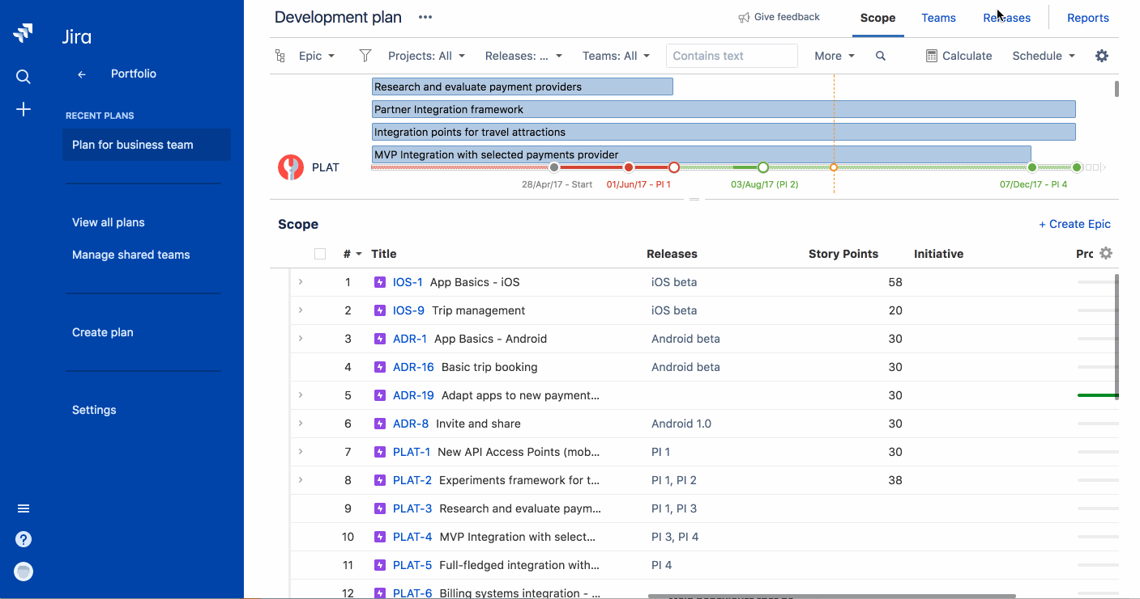
JIRA Releases

Slide 22
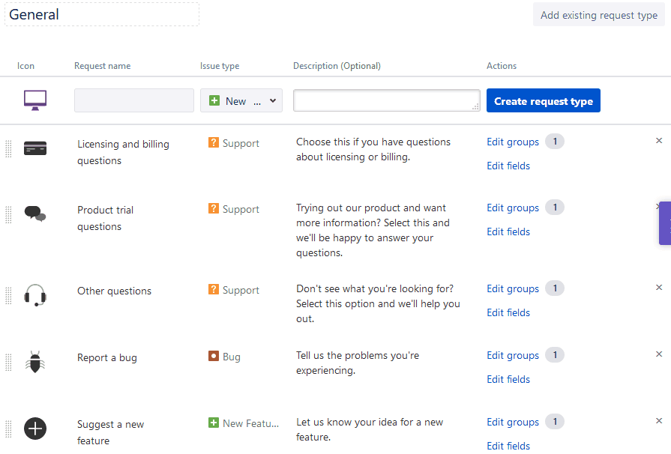
JIRA Issues and Ticketing

Slide 23
THANK YOU
By V Venkata Sree Harsha
Vasudev S

