Slide 1

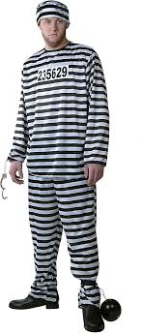

Person A
Person C
Person B

Slide 2
“Don’t Judge A Book By It’s Cover!!”

Slide 3

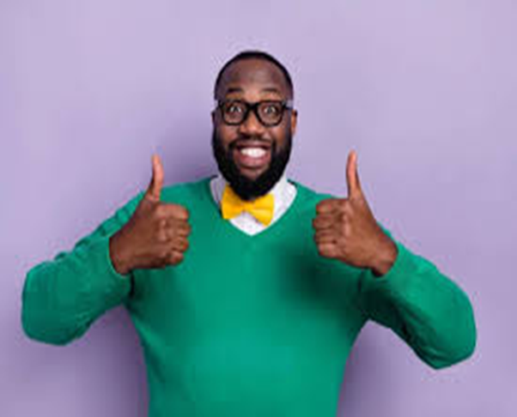
CEO
Friendly
Criminal

Slide 4

Judge a Book by its Cover – We All Do It!
B. Naveen

Slide 5
Agenda
Creates a strong first impression
Builds Confidence
Influences How Others Treat You
Reflects Your attitude and discipline

Slide 6
Creates a strong first impression
First Impressions are formed in 5-7 seconds.
Hard to change once formed
Based on:
Appearance
Body Language
Dressing Style

Slide 7
Builds Confidence
Makes you feel self-assured
Improves body language
Reduces nervousness
Boosts communication

Slide 8
Influences How Others Treat You
People judge based on appearance
Creates respect and trust
Affects opportunities
Impacts professional image

Slide 9
Reflects Your Attitude and Discipline
Shows Seriousness towards work
Reflects responsibility
Indicates self-discipline

Slide 10
Appearance is Not Everything, But it Shapes The First Perception Of Everything.

Slide 11
Thank you
B. Naveen

