Slide 1
GK:Quiz GameSystem
BY
24KB1A05CM
24KB1A05Y3
24KB1A05Y9
24KB1A05CR

Slide 2
1. Introduction
Purpose: To develop an interactive quiz game that enhances general knowledge through a structured, multi-level format.
Scope: The game features three levels, each with five questions, focusing on Indian general knowledge.
Target Audience: Students, quiz enthusiasts, and individuals seeking to test and improve their knowledge of India.

Slide 3
2. About the Quiz Game System
Game Structure:
Three levels, each containing five multiple-choice questions.
Players must score at least 3 out of 5 to qualify for the next level.
Data Handling:
Questions are stored in arrays.
Player answers are recorded using a linked list, allowing dynamic data storage and retrieval.

Slide 4
3. Objectives
Educational Goal: To provide an engaging platform for users to learn about Indian general knowledge.
Technical Goal: To implement the game using fundamental data structures in C, demonstrating practical application of arrays and linked lists.
User Engagement: To create an interactive and user-friendly interface that encourages repeated play and learning.

Slide 5
4. System Overview
User Interface:
Command-line interface (CLI) for simplicity and accessibility.
Game Flow:
Introduction screen with game instructions.
Sequential presentation of questions per level.
Immediate feedback on answers and progression to the next level based on performance.
Data Management:
Use of arrays to store questions and options.
Linked list to dynamically store player responses and scores.

Slide 6
5. Technologies and Tools
Programming Language: C
Development Environment:
Code::Blocks or any standard C IDE.
Data Structures:
Arrays for static data storage (questions and options).
Linked lists for dynamic data handling (player answers).
Compilation and Execution:
GCC compiler for compiling C code.
Command-line interface for running the game.

Slide 7
6. Working Flow
Initialization:
Load questions and options into arrays.
Initialize linked list for storing player answers.
Gameplay:
Display questions and options to the player.
Record player's answer and check for correctness.
Store answer in the linked list.
Provide immediate feedback and update score.
Progression:
If the player qualifies, proceed to the next level.
If not, end the game and display final score.

Slide 8
7. Models in This Project
Data Model:
Arrays: Store questions and multiple-choice options.
Linked List: Store player responses and scores dynamically.
Process Model:
Sequential execution of game levels.
Conditional progression based on player performance.

Slide 9
8. Challenges
Data Management:
Efficiently handling dynamic data with linked lists.
User Experience:
Designing an intuitive CLI interface.
Game Logic:
Implementing qualification criteria and level progression.
Error Handling:
Ensuring robustness against invalid inputs and unexpected behavior.

Slide 10
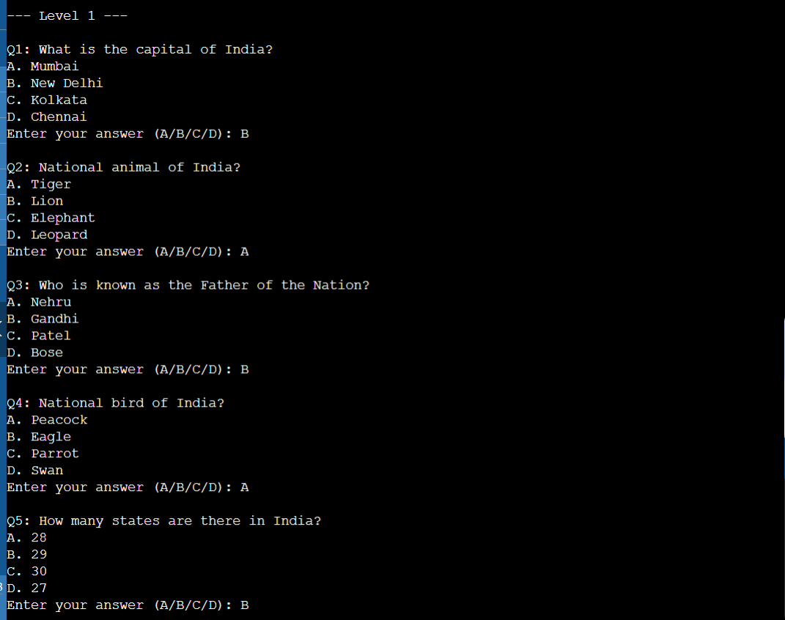
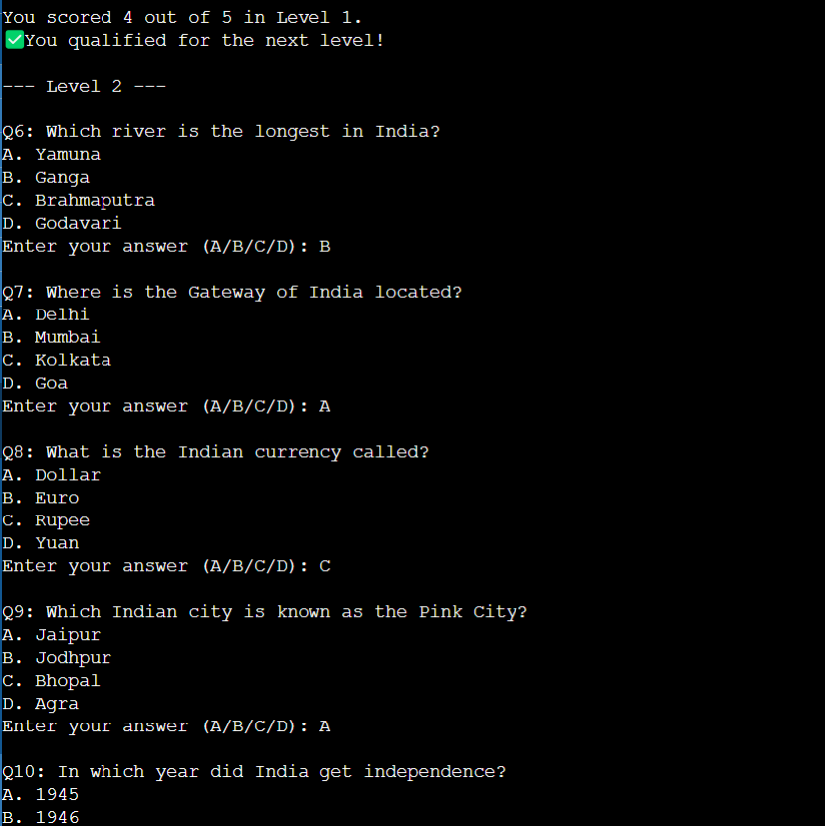
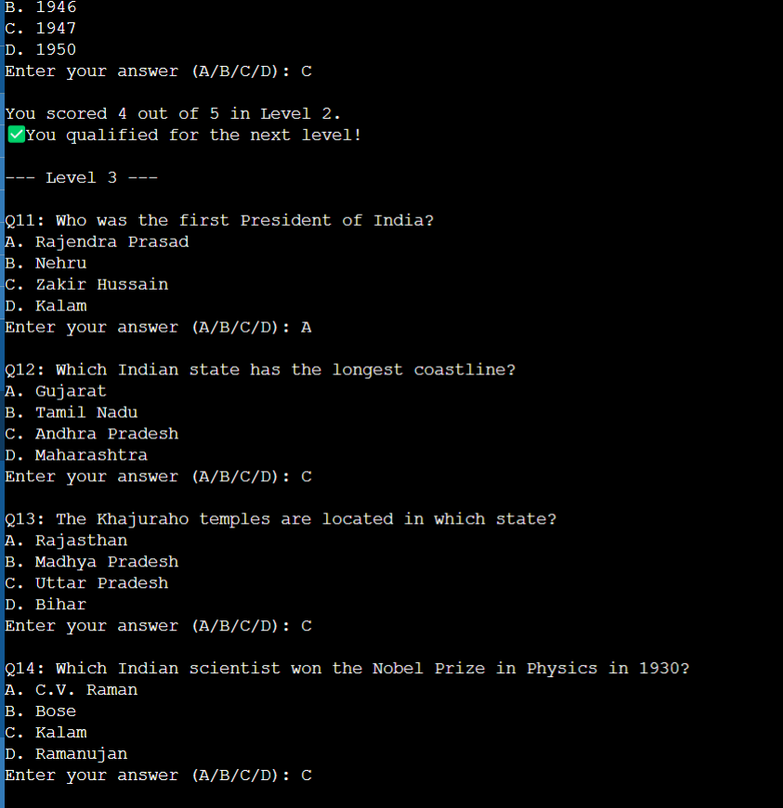
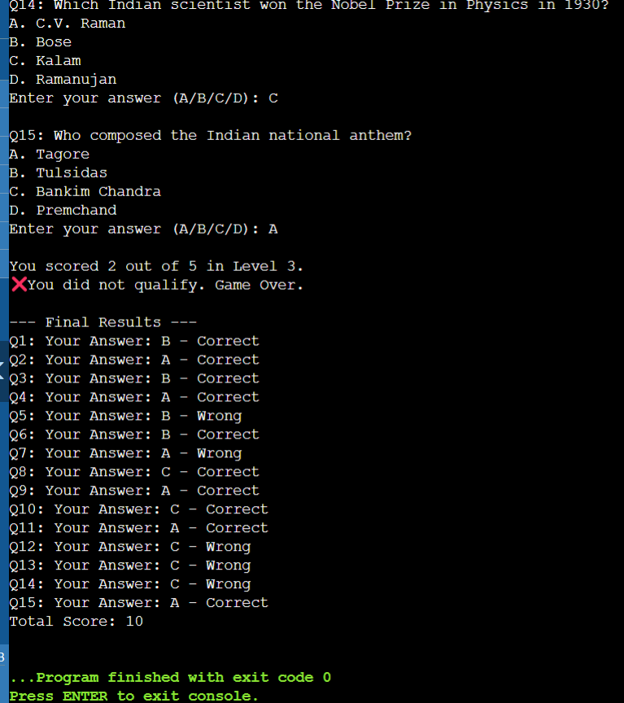
OUTPUT IMAGES

Slide 11
9. Conclusion
Achievements:
Successfully developed a multi-level quiz game using fundamental data structures in C.
Learning Outcomes:
Gained practical experience in implementing arrays and linked lists.
Future Enhancements:
Addition of more question categories.
Implementation of a graphical user interface (GUI).
Integration of a scoring system with time-based challenges.

Slide 12
THANK YOU

