Slide 1


THE NATIONAL INSTITUE OF ENGINEERING,MYSURU DEPARTMENT OF COMPUTER SCIENCE AND ENGINEERING.
MINOR PROJECT PRESENTATION
TOPIC :Brain Tumour Detection using MRI Images

Slide 2
Contents
Introduction
Objective and Scope
Literature Survey
Existing System Vs Proposed System
System Requirements
System Design
Implementation
Result
Future Enhancement and Conclusion
Reference

Slide 3
Introduction
Overview: Brain tumors are severe neurological conditions that require early and accurate diagnosis to improve patient outcomes. Traditional methods involve manual analysis of MRI scans, which is time-consuming and prone to delays.
Problem Statement: There is a critical need for an automated solution that provides timely and accurate brain tumor detection, reducing diagnostic delays and improving patient care.
Project Goal: Develop an AI-powered Brain Tumor Detection system that utilizes MRI images for real-time tumor. Identification and localization, enhancing diagnostic prediction.
Purpose: To provide healthcare professionals with a reliable, efficient, and automated diagnostic tool that enhances decision-making, reduces delays, and improves patient outcomes.

Slide 4
Objective and Scope
Objective: Create a robust and efficient system for early tumour detection in MRI images using machine learning and computer vision techniques.
Scope:
Technologies: Roboflow for dataset preparation, PyCharm IDE, and YOLOv8 model.
Data Sources: MRI images from Kaggle, Google Images, and Roboflow.
Target Audience: Healthcare providers and radiologists

Slide 5
Literature Survey
Author | Description | Drawback | Publication
[1] R. Sharma, N. Gupta, and L. K. Verma | Compared U-Net and YOLO models for automated brain tumor detection. Highlighted YOLO's real-time processing capability, making it ideal for clinical use. | Lacks thorough testing on diverse datasets. | Automated Brain Tumor Detection in MRI Images Using U-Net and YOLO Models (2021)
[2] S. Hussain, M. Muhammad, and A. B. Shams | Employed deep learning for brain tumor classification using MRI images. Evaluated different detection models, emphasizing YOLO for its efficiency and accuracy in clinical applications. | Limited focus on multi-class classification or rare tumor types. | Deep Learning-Based Detection and Classification of Brain Tumors Using MRI Images (2022)

Slide 6
[3] George Lam, Shanaya Chopra
[4] Li Wang, Sarah Mo, Ravi Shukla (2023)
Investigates the use of Roboflow for preparing and training AI models for tumor detection. Demonstrates ease of deployment and model evaluation using integrated workflows. | Focuses on workflow efficiency but lacks experimental results for model performance in diverse scenarios. | AI-Powered Brain Tumor Diagnosis with Roboflow Integration (2021)
Demonstrates YOLO's effectiveness in detecting brain tumors in MRI scans with real-time predictions and high precision. | Limited focus on other state-of-the-art models for comparative analysis. | Brain Tumor Detection Using YOLO Object Detection Algorithm

Slide 7
Literature Review
Previous Studies: Automated brain tumor detection using CNNs and object detection frameworks.
Key Findings: Traditional CNNs perform well but are often computationally intensive. Real-time models like YOLO show promise.
Gaps Addressed: Our project improves detection speed and accuracy in noisy MRI data

Slide 8
Existing System and Limitations
Current Manual Detection:
Time-consuming and subjective analysis by radiologists.
Delays in diagnosis, affecting treatment outcomes.
Automated Methods:
Basic image processing and early-stage AI models.
Limited accuracy and real-time processing for clinical use.
Challenges:
High accuracy is required to minimize false positives/negatives.
Limited real-time detection capabilities for fast decision-making in clinical settings.

Slide 9
Proposed System Overview
Our Solution:
YOLOv8 Model: Selected for real-time, accurate tumour detection.
Roboflow Platform: Provides annotation and augmentation for dataset preparation.
Benefits: Increased accuracy and faster processing for timely clinical decisions. elaborate this point to add to our project

Slide 10
System Requirements
Hardware:
GPU: Recommended for faster training.
Memory: 16GB+ RAM.
Software:
IDE: PyCharm
Libraries: OpenCV, YOLOv8, Python.
Data:
MRI dataset from Kaggle, Google Images, and Roboflow, annotated for tumour detection.

Slide 11
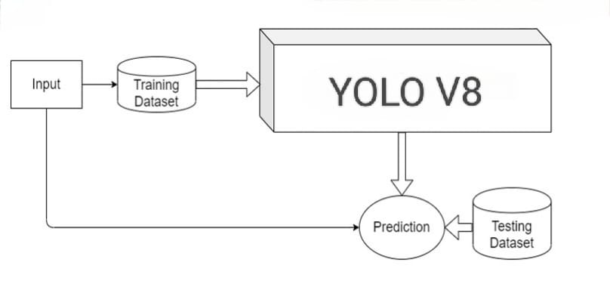
System Design
System Architecture
Input: Represents the raw data fed into the YOLO V8 model for processing.
Training Dataset: A collection of labeled images used to train the YOLO V8 model, enabling it to learn and recognize patterns.
YOLO V8: The core model used for object detection and classification tasks. It processes the training dataset to learn features and relationships.
Prediction: The output generated by the YOLO V8 model after the training, which involves identifying and classifying objects in new, unseen data.
Testing Dataset: A separate dataset used to evaluate the performance of the YOLO V8 model to ensure its accuracy and effectiveness in real-world applications.
Fig: System Architecture

Slide 12
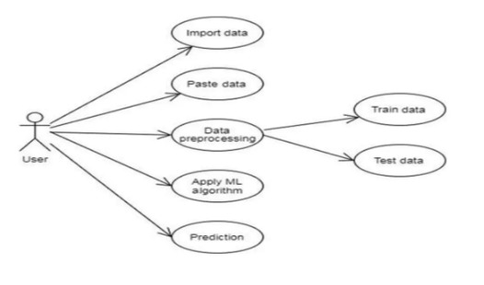
Use-Case Diagram
1.User Interaction:
- Central role of the User as the primary actor interacting with the system.
2.Data Import Options:
- Import Data: Allows users to upload datasets from local or external sources.
- Paste Data: Enables manual data entry from other applications.
3.Data Preprocessing Importance:
- Critical step for preparing data quality.
- Includes two main subsets:
- Train Data: Used for training machine learning models.
- Test Data: Used for validating model performance.
4. Machine Learning Application:
- Facilitate the application of multiple ML Algorithms on preprocessed data to derive insights.
5. Prediction Capability:
- Enables users to generate predictions using trained models on new data for real-world applicability.
Fig: Use-Case Diagram

Slide 13
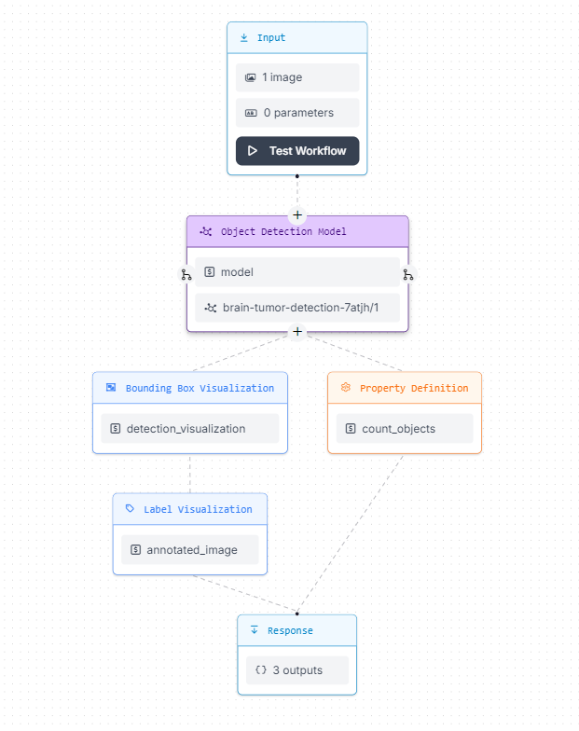
Workflow Diagram:
1.Input Stage:
- Accepts: One image
- Parameters: Zero parameters necessary
2.Object Detection Model:
- Model Used: brain-tumor-detection-7atjh/1
- Purpose: Analyzes the input image for brain tumor detection
3.Visualization Outputs:
Bounding Box Visualization:
- Outputs: detection_visualization
- Function: Displays bounding boxes around detected tumors
Label Visualization:
- Outputs: annotated_image
- Function: Shows the image with labels for detected objects
4.Property Definition:
- Outputs: count_objects
- Function: Provides a count of detected tumors
5.Response:
- Outputs: Three distinct outputs summarizing the detections

Slide 14
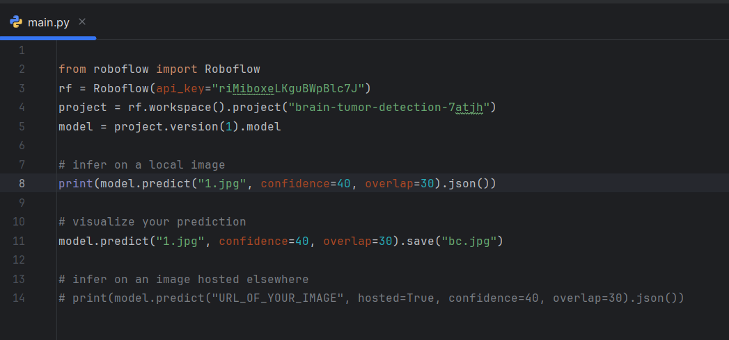
Implementation and Result

Slide 15
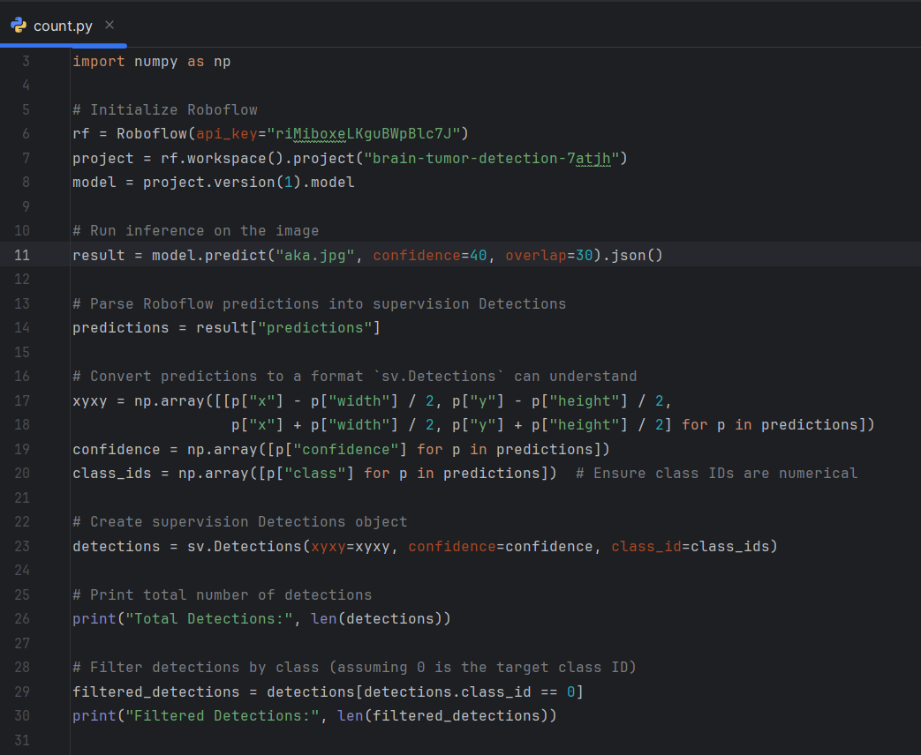
Implementation and Result

Slide 16
Future Enhancements
Integration of Additional Modalities:
Include CT and PET scans for broader applicability.
Enable comprehensive tumor analysis across diverse imaging types.
Tumor Classification:
Classify tumors into grades (e.g., benign vs. malignant) and subtypes.
Support targeted treatment planning.
Radiologist Feedback Mechanism:
Allow healthcare professionals to refine predictions.
Iterative feedback improves model accuracy and reliability.
Edge Computing:
Deploy real-time processing for rapid analysis in resource-constrained settings.
Suitable for remote or under-resourced hospitals.
Explainable AI (XAI):
Provide visual/textual explanations of predictions.
Build radiologist trust by improving output transparency.

Slide 17
Conclusion
Summary:
The YOLOv8-based AI system effectively detects brain tumors with high precision and real-time capabilities.
Reduces diagnostic delays, streamlines radiologist workflows, and minimizes human error.
Future Impact:
Multi-modal imaging, tumor grading, and explainable AI can transform the system into a comprehensive diagnostic assistant.
Collaboration with global medical institutions will improve robustness and adaptability across patient demographics.
Significance:
Demonstrates the potential of AI to revolutionize healthcare diagnostics.
Paves the way for enhanced diagnostic accuracy, improved patient outcomes, and reduced healthcare disparities worldwide.

Slide 18
Reference
Enhancing brain tumor detection in MRI images using YOLO-NeuroBoost model – PMC
Accurate Detection of Brain Tumor Lesions From Medical Images Based on Improved YOLOv8 Algorithm | IEEE Journals & Magazine | IEEE Xplore
[2309.12585] BGF-YOLO: Enhanced YOLOv8 with Multiscale Attentional Feature Fusion for Brain Tumor Detection
Labeled MRI Brain Tumor Dataset Dataset > Overview
IEEE Xplore - YOLO and U-Net for Tumor Detection​IEEE Xplore
IEEE Xplore - Brain Tumor Detection and Classification​IEEE Xplore

Slide 19
Thank You

