Slide 1


AGROSCAN: CROP DISEASE DETECTION USING IMAGE PROCESSING
Presented By:
P Avinash (192424299)
N Harshavardhan (192324189)
V Niranjan Reddy (192324125)
Guided By:
Dr. Kavitha.R

Slide 2


INTRODUCTION
AgroScan is a web-based system for detecting plant leaf diseases.
It combines image processing and deep learning technologies.
Plant diseases can cause 20–40% loss in global crop yield.
Manual disease diagnosis is often slow, costly, and unavailable in rural areas.
Farmers can capture or upload a leaf image using a smartphone.
OpenCV is used for image preprocessing and disease-region segmentation.
A CNN model is used to classify the detected plant disease.
The system provides a confidence score and disease severity level.
AgroScan gives actionable treatment recommendations to farmers.
It provides a fast, accurate, and accessible solution to reduce crop loss and unnecessary pesticide use.

Slide 3
OBJECTIVES
01
Automate image capture
Let users upload or capture a leaf photo directly from a phone or laptop.
02
Process & segment the leaf
Apply OpenCV preprocessing and segment diseased regions from healthy tissue.
03
Classify accurately
Use a trained CNN model to identify the disease with a confidence score.
04
Report & recommend
Show severity level and actionable treatment recommendations instantly.

Slide 4
PROBLEM STATEMENT
Major Yield Loss: Plant diseases destroy an estimated 20–40% of global crop yield every year worldwide.
Slow Manual Diagnosis: Expert diagnosis is slow, costly, and often unavailable in rural areas.
Frequent Misidentification: Farmers frequently misidentify diseases, leading to wrong or excessive pesticide use.
Missed Early Symptoms: Early-stage disease symptoms are easy to miss with the naked eye until damage has spread.
No Mobile-Ready Tool: No simple, automated image-based tool exists that any farmer can use directly on a smartphone.
Food Security Risk: Undetected outbreaks threaten food security and put farmer income at risk.
Inconsistent Treatment: Without accurate diagnosis, treatment and pesticide use are often inconsistent or delayed.
Need for Speed: A practical field tool must deliver an accurate diagnosis in under 3 seconds on a mobile device.

Slide 5
METHODOLOGY
1
Image Acquisition
Upload or capture a leaf photo directly from a phone or laptop camera.
2
Preprocessing
Remove noise, resize, normalize and convert to HSV/Lab color space using OpenCV.
3
Segmentation
Isolate diseased lesions from healthy tissue via K-means clustering / Otsu thresholding.
4
Feature Extraction
Extract color, GLCM texture and shape features, and compute severity %.
5
CNN Classification
Classify the disease with a trained CNN (MobileNetV2 / EfficientNet) and confidence score.
6
Result & Recommendation
Display disease name, severity level and actionable treatment advice instantly.

Slide 6
SYSTEM ARCHITECTURE
01
Frontend Layer
React + Tailwind interface for image upload, capture and result display.
02
Backend API
FastAPI server handles requests, routes images and returns diagnosis results.
03
Image Processing
OpenCV preprocessing and segmentation isolate the diseased leaf region.
04
AI Model & Storage
TensorFlow/CNN classifies the disease; results are saved in SQLite / PostgreSQL.

Slide 7
MODULE 1
PREPROCESSING & FEATURE EXTRACTION
Image Acquisition:
Upload or capture a leaf image via phone camera or file upload.
Noise Removal :
Apply Gaussian / median filtering to clean the image.
Resize & Normalize:
Scale and normalize the image to match the CNN input size.
Color Space Conversion:
Convert RGB to HSV / Lab color space and remove the background to isolate the leaf.
Segmentation :
Segment diseased lesions using K-means clustering or Otsu thresholding.
Feature Extraction :
Extract color, texture (GLCM) and shape features from the segmented lesion.
Severity Computation:
Compute severity % = diseased area / total leaf area, producing a clean feature vector.

Slide 8
MODULE 2
CLASSIFICATION & RESULT REPORTING
CNN-Based Classification
The CNN (MobileNetV2 / EfficientNet) is trained on thousands of labeled leaf images.
It learns to recognize disease-specific spots, discoloration and lesion patterns.
Confidence Scoring
Return the top-3 predictions with confidence scores for full transparency.
Disease Mapping
Map the predicted class to disease name, symptoms and treatment information.
Severity Estimation
Combine the feature-extraction severity % with the predicted disease class.
Classify severity as mild, moderate or severe for the diagnosis.
Result Display
Show the original image alongside a diseased-region overlay.
Present disease name, severity level and confidence score together.
Treatment Recommendation
Suggest actionable treatment such as fungicide use or cultural practices, and save the scan to history.
Model Evaluation
The classifier is evaluated using:
Accuracy & Precision
Recall & F1-Score

Slide 9
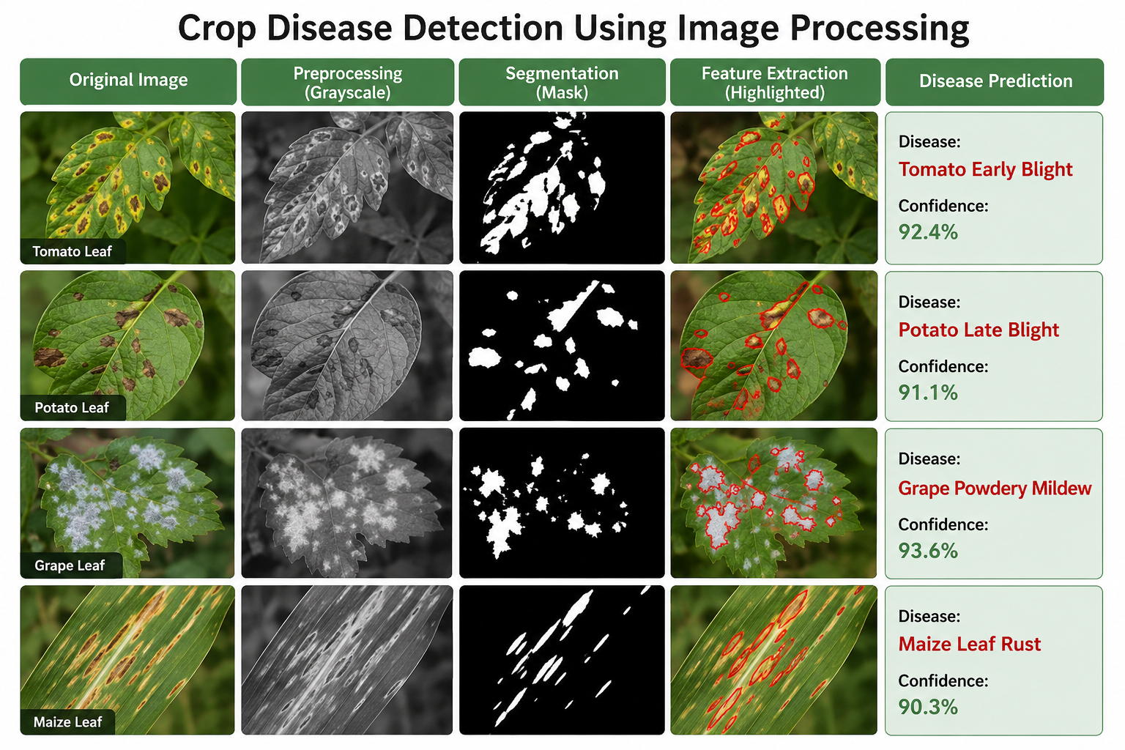
SAMPLE OUTPUT
Scan Result Example
Uploaded Leaf Image:
Tomato leaf photo captured on a smartphone in the field.
Predicted Disease :
Tomato — Early Blight.
Confidence Score:
94.2%, based on the top CNN prediction.
Severity Level:
Moderate — 23% of leaf area affected.
Diseased-Region Overlay :
Highlights the segmented lesion area on top of the original image.
Recommended Treatment :
Apply copper-based fungicide; remove infected leaves; improve airflow between plants.
Scan History:
Result is saved automatically for the farmer to track disease trends over time.

Slide 10
REFERENCE
Mohanty, S. P., Hughes, D. P., & Salathé, M. (2016). “Using Deep Learning for Image-Based Plant Disease Detection.” Frontiers in Plant Science, 7, Article 1419.
Ferentinos, K. P. (2018). “Deep learning models for plant disease detection and diagnosis.” Computers and Electronics in Agriculture, 145, 311–318.
Sladojevic, S., Arsenovic, M., Anderla, A., Culibrk, D., & Stefanovic, D. (2016). “Deep Neural Networks Based Recognition of Plant Diseases by Leaf Image Classification.” Computational Intelligence and Neuroscience, 2016, Article 3289801.
Too, E. C., Yujian, L., Njuki, S., & Yingchun, L. (2019). “A comparative study of fine-tuning deep learning models for plant disease identification.” Computers and Electronics in Agriculture, 161, 272–279.
Hughes, D. P., & Salathé, M. (2015). “An open access repository of images on plant health to enable the development of mobile disease diagnostics.” arXiv preprint arXiv:1511.08060.

Slide 11
CONCLUSION
AgroScan combines classical image processing and deep learning for intelligent crop disease detection.
It helps overcome the limitations of slow and manual disease diagnosis.
The system captures a leaf image for automated analysis.
OpenCV-based preprocessing and segmentation are used to isolate diseased regions.
It extracts important color, texture, and shape features from the leaf.
A CNN model (MobileNetV2 / EfficientNet) classifies the detected disease.
The system provides a confidence score for each prediction.
It supports 38+ crop disease classes using the PlantVillage dataset.
The average inference time is under 3 seconds, enabling fast diagnosis.
AgroScan can also estimate disease severity.
It generates actionable treatment recommendations for farmers.
The system provides a fast, accessible, and accurate solution that can be used through a phone.
It can help reduce crop losses and minimize unnecessary pesticide use.

