Slide 1
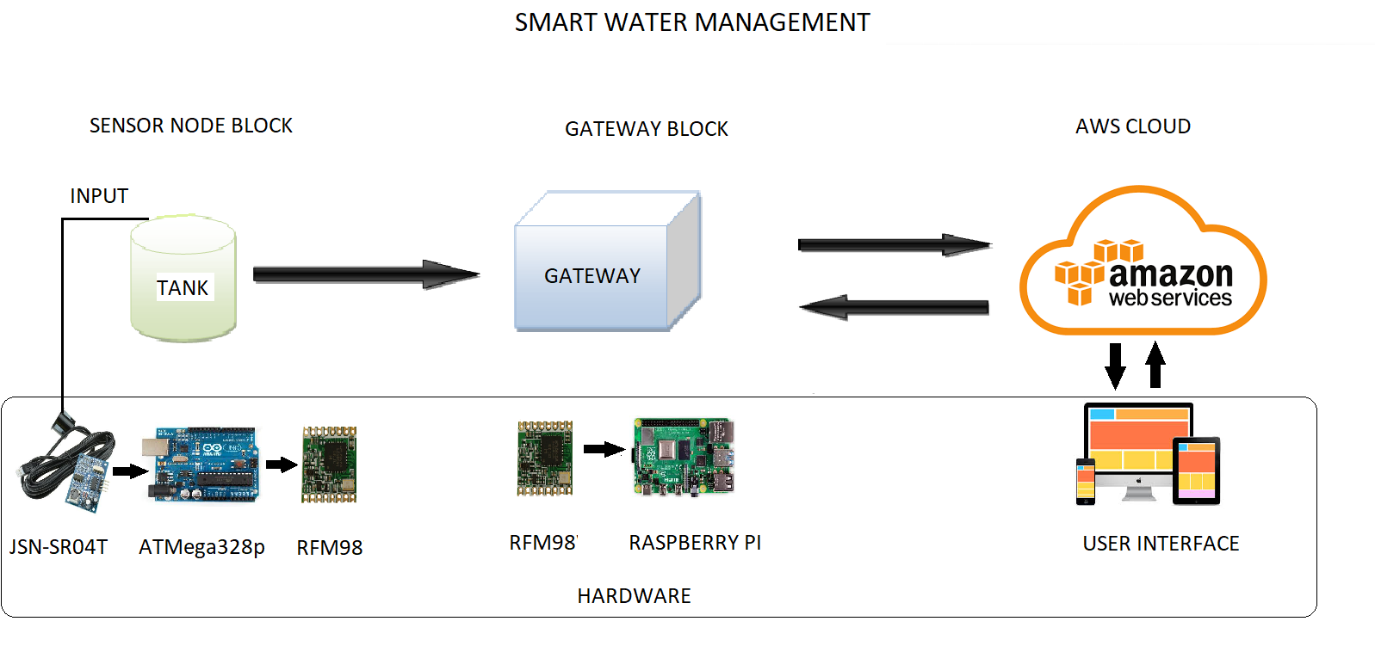
Architecture of smart water management system

