Slide 1

PROJECT TEAM
Design and Simulation of a Digital Data Transmission Error Detection System Using XOR
2620080084 — N Sai Maneesh Reddy
2620080096 — K Jaswanth
2620080117 — G Sai Harsha Vardhan
2620030298 — C Joshith
Guide: Dr. Venkanna Isampalli
Department of Freshman Engineering Department | Koneru Lakshmaiah Education Foundation
Academic Year: 2026–27
DIGITAL SYSTEMS • XOR ERROR DETECTION

Slide 2
DIGITAL SYSTEMS · GUIDED BUILD
Design and Simulation of a Digital Data Transmission Error Detection System Using XOR
From binary signals to a CPU-controlled detector
A modular simulation of transmission, corruption, checking, and reporting

Slide 3
THE PROBLEM
One flipped bit
can change the message.
What this project does
Generate and transmit a message through a noisy channel.
Inject a controlled error; the receiver checker detects corruption with XOR-based logic.
Simulate the transmitter, receiver, checker, and CPU-controlled testbench.
A receiver may see a valid-looking word even when noise changed one transmitted signal.
Error detection identifies corruption; it does not automatically repair the data.

Slide 4
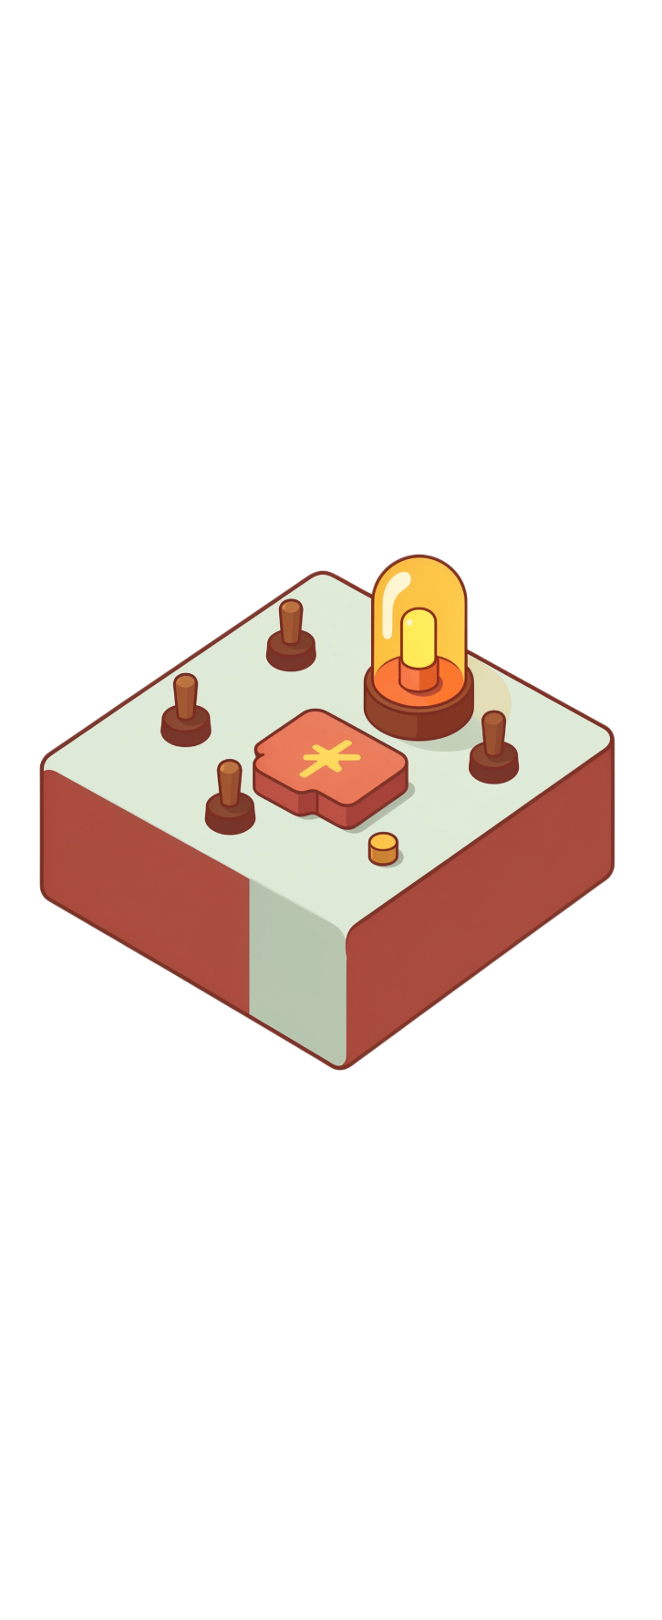

MODULE 1 · THE LOGIC ALPHABET
Bits become a parity decision
Digital circuits represent information with 0 and 1. XOR returns 1 when inputs differ and 0 when they match.
A four-input XOR tree reduces the data word to one parity bit.
d0 ⊕ d1
d2 ⊕ d3
Intermediate ⊕
Parity p

Slide 5

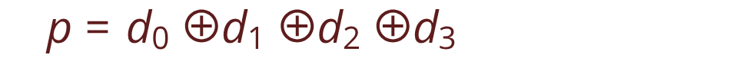
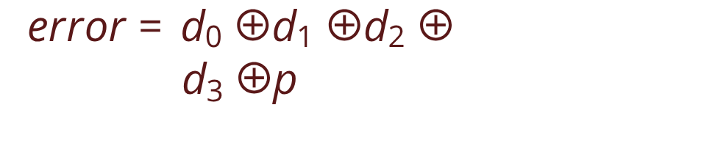
MODULE 2 · COMBINATIONAL LOGIC
The parity checker recomputes, then compares
Combinational logic depends only on the current inputs. The receiver recomputes parity from the received data and parity bit.
Generator
Checker
Creates the parity bit before transmission.
For even parity, error = 1 means the received word violates the rule.

Slide 6
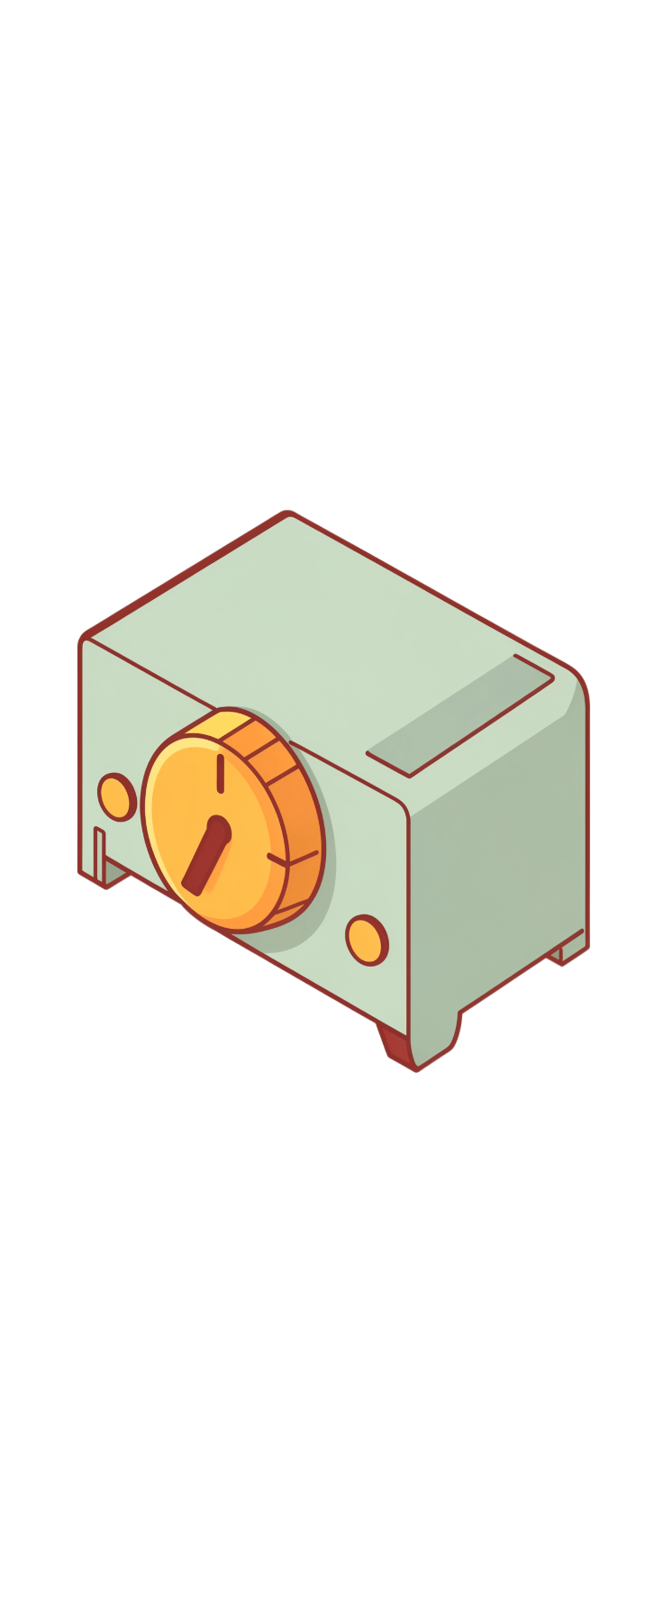





MODULE 3 · SEQUENTIAL LOGIC
A clock gives the detector a timeline
Registers hold the payload, parity bit, transmitted frame, and received frame. A clocked controller makes each phase repeatable.
IDLE
LOAD
CHECK
TRANSMIT
Milestone: a working frame register, counter, and controller FSM.

Slide 7

MODULE 4 · STORAGE
Registers and memory store the experiment
ROM supplies test vectors and expected outcomes; registers and RAM capture results for replay.
Payload → parity → frame → received frame → result register
01
02
03
ROM
Registers
RAM / result
Test vectors and expected outcomes.
Current payload, transmitted frame, and received frame.
Captured frames, error flags, and run counts. Replay clean, single-bit-error, and multi-bit-error cases.

Slide 8

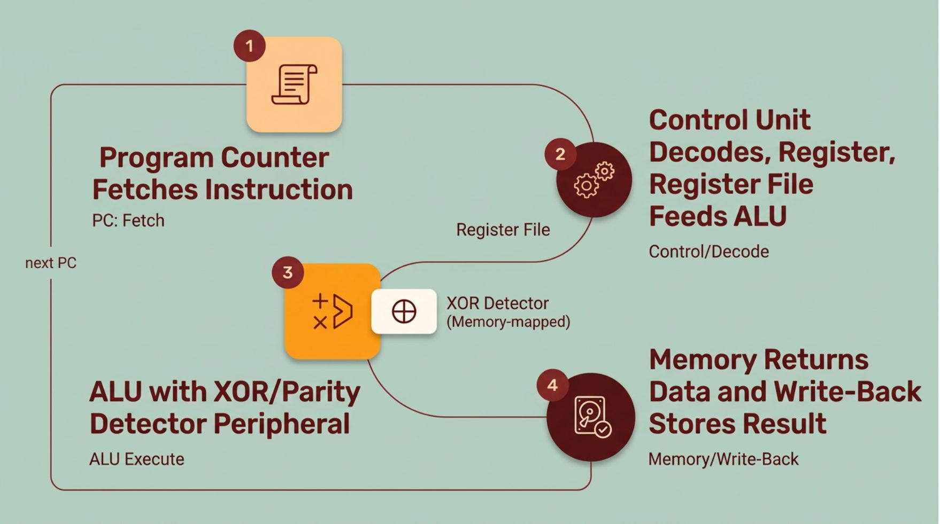
MODULE 5 · RISC-V CONTROL
The CPU turns the detector into a co-design
The RISC-V datapath fetches instructions, reads registers, drives the XOR/parity unit, and stores the result.

Slide 9

MODULE 6 · THE EXTENSION
One new operation makes the result visible
Original datapath
Added boundary
Decode the instruction.
Run the existing ALU operation.
Write the result back.
Add XOR to the decoder and ALU.
Expose error through memory-mapped output.
Verify the visible flag against the injected fault.
The CPU you built now controls a real digital design extension.

Slide 10
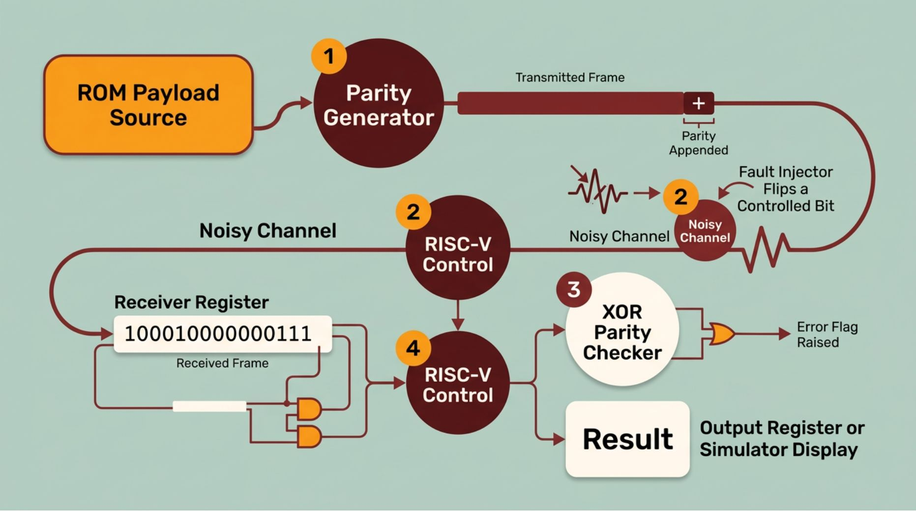
SYSTEM VIEW
Transmit → corrupt → check → report
The same frame is followed from source to visible result.
Load a payload from ROM and calculate its parity with XOR.
Append the parity bit and transmit the frame.
Inject a controlled bit flip in the channel model.
Capture the received frame in a register.
Recompute parity, raise the error flag, and write the result to the output.

Slide 11

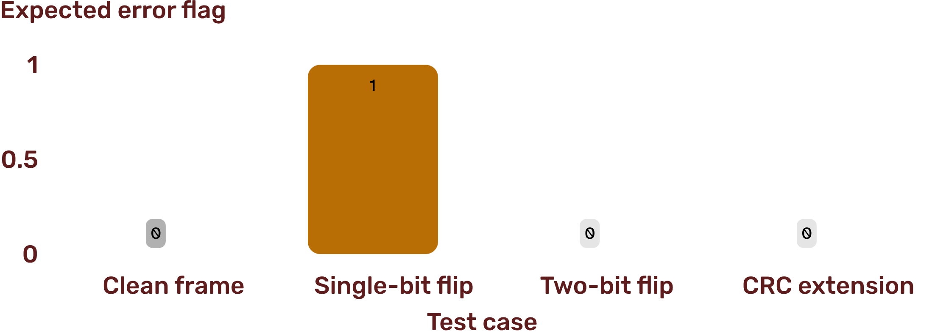
SIMULATION PLAN
Prove the detector, then expose its blind spot
Replay controlled test vectors and compare the expected flag with the simulated output. Simple parity reliably detects any odd number of flipped bits, but can miss some even-numbered errors.
Simulation test matrix · CRC extension is optional; its result depends on the generator.

