Slide 1

Vehicle Fault Diagnosis & Repair Copilot
Team NodePair: Harsha, Ghada & Hüseyin · neue fische Data Science & AI Bootcamp
Notes:
[Ghada, position 1 of 15] Quick hello. Introduce the team, one line on what this is. Hand-off map: I take 1-5 (goal through metric), Harsha takes 6-10 (dataset through advanced model), Huseyin takes 11-15 (rolling/lag through thank you).

Slide 2

THE PROBLEM
Faults get caught after they happen, not before
Caught reactively, not proactively
No early-warning signal today
One schedule doesn't fit every vehicle
A car fails, you find out later. We want to catch it earlier.
The ask
Enabling a Steady, smooth and secure journey while reducing the unexpected breakdowns to minimum: for any vehicle in the fleet, forecast whether a fault will occur in the next 6 hours, using sensor telemetry alone.
02
Notes:
[Ghada, position 2] State the problem as short reminders, say the full sentence aloud rather than reading the bullet: a car fails, you find out about it later - we want to help you find out earlier. Then: unplanned downtime costs more than scheduled maintenance, and fault rates already differ by usage profile. Land on 'the ask' line word for word.

Slide 3
TARGET USER
Who this is for, and why
Fleet maintenance manager
Watches continuous telemetry across the whole fleet
Question: readings are trending toward a fault, bring it in proactively, or is it fine?
A proactive scheduling decision, not a repair job
03
Notes:
[Ghada, position 3] Name the fleet maintenance manager as the one stakeholder that matters here. Frame it as a proactive scheduling decision, not a repair job.

Slide 4
Fleet maintenance monitoring dashboard
Select Vehicle
Upload Readings
Predict Run
Probability of Fault
Risk Level
Explanation
e.g. 80% probability, flagged above a 33% threshold
04
Notes:
[Ghada, position 4] This moved up front on purpose so you see something real before the technical detail. Walk the dashboard flow: select vehicle, upload readings, predict, see risk level, probability of fault, and explanation together. Point out the probability plus threshold example next to the Probability of Fault box - that's what turns a number into an action.

Slide 5
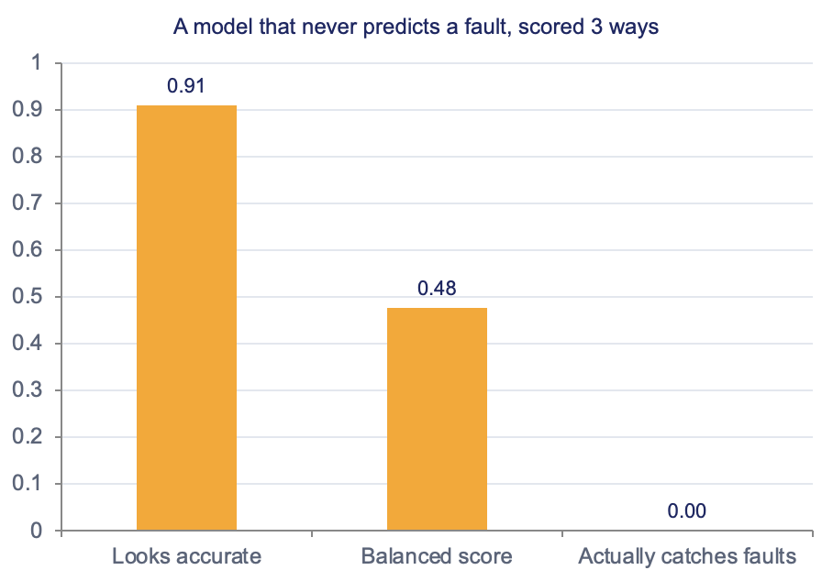
EVALUATION METRIC
F2 score: weights recall, but can’t be gamed
This is a classification task: will a fault happen in the next 6 hours, yes or no. That is why precision, recall, and F2 apply here.
✓
F2 score — chosen
Weights recall 2× precision, exactly, not roughly: missing a fault costs more than a false alarm, and it can’t be gamed by either extreme.
HEADLINE METRIC
05
Notes:
[Ghada, position 5] This is the metric slide. Say plainly: this is a classification task, will a fault happen in the next 6 hours, yes or no - that's why precision, recall, and F2 apply. F2 weights recall about twice as heavily as precision, matching the real cost of missing a fault. Hand off to Harsha here.

Slide 6
DATASET
EV sensor telemetry, 4 vehicles, 5 years
Source: Kaggle, "EV Sensors Driving-Pattern Diagnostics 2020 to 24" License: CC BY 4.0 Granularity: hourly sensor readings, per vehicle
175,176
hourly readings
10 raw sensors per reading:
4
SOC
SOH
Charging Cycles
Battery Temp
Motor RPM
Motor Torque
vehicles / usage profiles
Motor Temp
Brake Pad Wear
Charging Voltage
5 yrs
Tire Pressure
Jan 2020 to Dec 2024
06
Notes:
[Harsha, position 6] Name the source and license explicitly. Note the 4 usage profiles: daily, heavy, moderate, rare. This sets up the next slide, which explains how we turned this into the classification task Ghada just introduced.

Slide 7
FROM FORECAST TO CLASSIFICATION
How we turned this into a yes/no question
What we start with vs. what we predict
The assumption we're making
Raw data: hourly sensor readings per vehicle, grouped by usage profile (daily, heavy, moderate, rare)
Engineered target: for every hour, we look 6 hours ahead in that same vehicle's history and label it fault or no fault
Result: one classification decision per hour, yes or no, not a continuous forecast
Grouping by usage profile keeps one vehicle's history from leaking into another's label.
We assume our 4 training usage profiles represent the fleet well enough to generalize. That's a modeling choice, not a fact about the world.
The limitation
More vehicles and battery types in training would make us more confident the pattern holds outside these 4 profiles.
07
Notes:
[Harsha, position 7] This is the bridge slide the coaches asked for. Explain the conversion directly, without the term 'time series': raw hourly sensor data, grouped by usage profile, becomes one yes/no label per hour by looking 6 hours ahead in that same vehicle's history. State the assumption (4 profiles assumed representative) and the limitation (more vehicles and battery types would make it more reliable) out loud.

Slide 8
ML WORKFLOW
From raw sensors to a forecast
01
02
03
04
EDA
Feature Engineering
Feature Selection
Model & tune
→
→
Keep only the signals that actually predict a fault
→
Explore all 4 usage profiles
Turn raw sensor history into useful signals
Logistic regression baseline
tuned Random Forest & XGBoost,
08
Notes:
[Harsha, position 8] Walk the four-stage pipeline left to right: EDA, feature engineering, feature selection, model and tune. Keep it high-level - rolling and lag get explained with concrete examples two slides from now, not here.

Slide 9
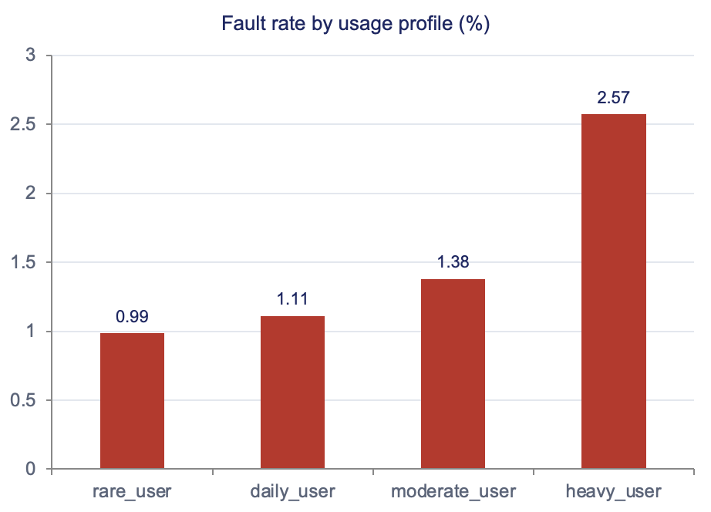
EDA
Fault rate already differs by usage profile
0
missing values across all 175,176 rows and 4 vehicle timelines
2.6×
fault-rate spread: heavy (2.57%) vs. rare (0.99%) usage profile
9.05%
of rows are positive for Fault_Within_6h, the modeling target
09
Notes:
[Harsha, position 9] Three EDA numbers to land: zero missing values, the 2.6x fault-rate spread by usage profile, and 9.05 percent positive rate for the actual modeling target.

Slide 10
BASELINE MODEL
Logistic Regression, all 4 vehicles
A simple first model, trained on all 10 raw sensors across all 4 vehicles
Predicts whether a fault will happen in the next 6 hours
Forecasts ahead, rather than just detecting a fault that's already happening
65.0%
52.0%
13.3%
0.328
Overall accuracy
% of real faults caught
% of fault alerts that were real
Our metric (F2)
Held-out test data the model never saw during training. This is the reference every later model has to beat.
10
Notes:
[Harsha, position 10] Emphasize this is the reference point, not the final answer. Catching 52% of real faults at this stage sets up the next slide's improvement story.

Slide 11
Advanced MODEL
More powerful models catch far more faults
XGBoost:
catches 85.4% of real faults, best of the three
Feature selection:
Started with 54 candidate signals, kept 53 that predict faults better than random noise or the reference model — searched on the full training set, no subsampling
Tuning:
Model settings were tuned specifically to catch more faults, not just to look accurate overall
11
Notes:
[Huseyin, position 11] Read the chart left to right as a progression: 52% to 75% to 85.4% recall, baseline to best. Precision improved too (13.3% to 26.8%), which is why F2 -- our headline metric -- nearly doubled (0.328 to 0.594). Technical detail (RandomizedSearchCV, tree depths, full training-set search) only if asked. That hands off to the next slide, where we explain what rolling and lag actually mean.

Slide 12
ADVANCED MODEL
What “rolling” and “lag” actually mean
Example: it's 2pm on the dashboard
What this means for the app
Motor_Temp_lag_3h is the Motor_Temp reading from 11am, 3 hours ago
Motor_RPM_roll_mean_24h is the average Motor_RPM over the last 24 hours
hour_of_day, day_of_week are calendar signals, not sensor readings
All of it comes from each vehicle's own historical readings, grouped by usage profile so one vehicle's history never leaks into another's.
The baseline model only needs the vehicle's current readings. The tuned models use recent history, so they need the last 6 to 24 hours of readings before they can forecast.
Known limitation
This assumes our 4 training usage profiles generalize to other vehicles. More vehicles and battery types in training would make the forecast more reliable.
12
Notes:
[Huseyin, position 12] Concrete examples of rolling and lag features, and what they mean for deployment: the baseline model only needs current readings, the tuned models need the last 6-24 hours of history. State the same generalization limitation as the earlier bridge slide - this reinforces it, doesn't repeat it word for word.

Slide 13







TECH STACK
Python
pandas
NumPy
scikit-learn
XGBoost
Jupyter
GitHub
13
Notes:
[Huseyin, position 13] Quick slide. Name the categories - this is the real, working stack behind everything just shown. Present tense throughout: this is the technology we are using, not going to use.

Slide 14
NEXT UP · RAG TRACK
Turning a fault forecast into a cited repair recommendation
The classifier tells the fleet manager that a fault is coming. The RAG layer is what tells them what to do about it — and it’s the next build.
Workstream | Status
NHTSA RAG corpus | ● Done
Chunking & embedding | ● In progress
Retrieval quality gate | ● Not started
Agent tool-calling loop | ● Not started
Fleet-manager dashboard | ● Not started
Deployment & evaluation | ● Not started
Gate before launch: retrieval must correctly surface the right NHTSA record for a set of known fault codes before the agent is allowed to use it — same discipline as the noise-floor check that shaped feature selection.
14
Notes:
[Huseyin, position 14] Be direct that most of this is not started yet. Talk through the corpus and chunking status verbally using the icons - don't read the table line by line. The gate before launch: retrieval must correctly surface the right NHTSA record before the agent is allowed to use it. Note verbally: even without the full agent loop, writing good queries against this corpus is a demonstrable skill on its own.

Slide 15
THANK YOU
Questions?
15
Notes:
[Huseyin, position 15] Close with the headline number, 85.4% of real faults caught, and open the floor for questions.

