Slide 1

Vehicle Fault Diagnosis & Repair Copilot
Team NodePair: Harsha, Ghada & Hüseyin · neue fische Data Science & AI Bootcamp
Notes:
[Ghada, position 1 of 15] Quick hello. Introduce the team, one line on what this is. Hand-off map: I take 1-5 (goal through metric), Harsha takes 6-10 (dataset through advanced model), Huseyin takes 11-15 (rolling/lag through thank you).

Slide 2

THE PROBLEM
Faults get caught after they happen, not before
Caught reactively, not proactively
No early-warning signal today
One schedule doesn't fit every vehicle
A car fails, you find out later. We want to catch it earlier.
The ask
Enabling a Steady, smooth and secure journey while reducing the unexpected breakdowns to minimum: for any vehicle in the fleet, forecast whether a fault will occur in the next 6 hours, using sensor telemetry alone.
02
Notes:
[Ghada, position 2] State the problem as short reminders, say the full sentence aloud rather than reading the bullet: a car fails, you find out about it later - we want to help you find out earlier. Then: unplanned downtime costs more than scheduled maintenance, and fault rates already differ by usage profile. Land on 'the ask' line word for word.

Slide 3
TARGET USER
Who this is for, and why
Fleet maintenance manager
Watches continuous telemetry across the whole fleet
Question: readings are trending toward a fault, bring it in proactively, or is it fine?
A proactive scheduling decision, not a repair job
03
Notes:
[Ghada, position 3] Name the fleet maintenance manager as the one stakeholder that matters here. Frame it as a proactive scheduling decision, not a repair job.

Slide 4
Fleet maintenance monitoring dashboard
Select Vehicle
Upload Readings
Predict Run
Probability of Fault
Risk Level
Explanation
e.g. 80% probability, flagged above a 33% threshold
04
Notes:
[Ghada, position 4] This moved up front on purpose so you see something real before the technical detail. Walk the dashboard flow: select vehicle, upload readings, predict, see risk level, probability of fault, and explanation together. Point out the probability plus threshold example next to the Probability of Fault box - that's what turns a number into an action.

Slide 5
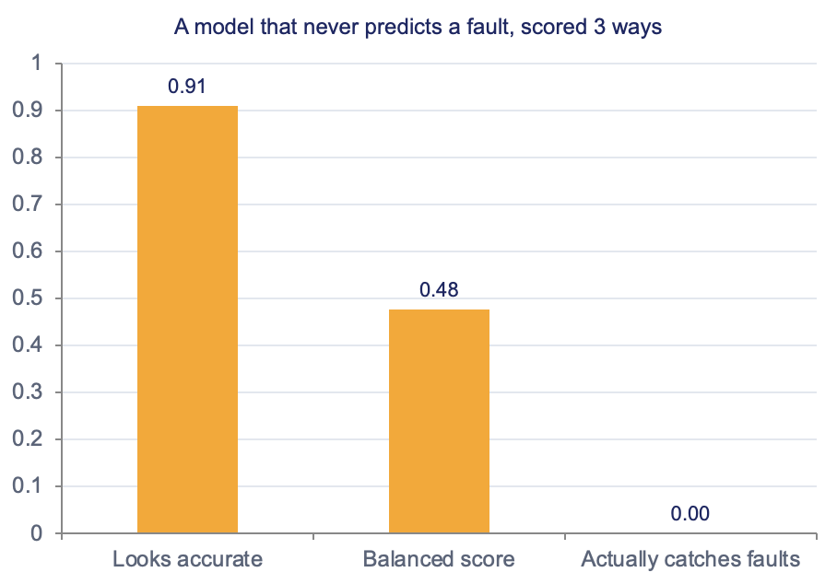
EVALUATION METRIC
F2 score: weights recall, but can’t be gamed
This is a classification task: will a fault happen in the next 6 hours, yes or no. That is why precision, recall, and F2 apply here.
✓
F2 score — chosen
Weights recall 2× precision, exactly, not roughly: missing a fault costs more than a false alarm, and it can’t be gamed by either extreme.
HEADLINE METRIC
05
Notes:
[Ghada, position 5] This is the metric slide. Say plainly: this is a classification task, will a fault happen in the next 6 hours, yes or no - that's why precision, recall, and F2 apply. F2 weights recall about twice as heavily as precision, matching the real cost of missing a fault. Hand off to Harsha here.

Slide 6
DATASET
EV sensor telemetry, 4 vehicles, 5 years
Source: Kaggle, "EV Sensors Driving-Pattern Diagnostics 2020 to 24" License: CC BY 4.0 Granularity: hourly sensor readings, per vehicle
175,176
hourly readings
10 raw sensors per reading:
4
SOC
SOH
Charging Cycles
Battery Temp
Motor RPM
Motor Torque
vehicles / usage profiles
Motor Temp
Brake Pad Wear
Charging Voltage
5 yrs
Tire Pressure
Jan 2020 to Dec 2024
06
Notes:
[Harsha, position 6] Name the source and license explicitly. Note the 4 usage profiles: daily, heavy, moderate, rare. This sets up the next slide, which explains how we turned this into the classification task Ghada just introduced.

Slide 7
FROM FORECAST TO CLASSIFICATION
How we turned this into a yes/no question
What we start with vs. what we predict
The assumption we're making
Raw data: hourly sensor readings per vehicle, grouped by usage profile (daily, heavy, moderate, rare)
Engineered target: for every hour, we look 6 hours ahead in that same vehicle's history and label it fault or no fault
Result: one classification decision per hour, yes or no, not a continuous forecast
Grouping by usage profile keeps one vehicle's history from leaking into another's label.
We assume our 4 training usage profiles represent the fleet well enough to generalize. That's a modeling choice, not a fact about the world.
The limitation
More vehicles and battery types in training would make us more confident the pattern holds outside these 4 profiles.
07
Notes:
[Harsha, position 7] This is the bridge slide the coaches asked for. Explain the conversion directly, without the term 'time series': raw hourly sensor data, grouped by usage profile, becomes one yes/no label per hour by looking 6 hours ahead in that same vehicle's history. State the assumption (4 profiles assumed representative) and the limitation (more vehicles and battery types would make it more reliable) out loud.

Slide 8
ML WORKFLOW
From raw sensors to a forecast
01
02
03
04
EDA
Feature Engineering
Feature Selection
Model & tune
→
→
Keep only the signals that actually predict a fault
→
Explore all 4 usage profiles
Turn raw sensor history into useful signals
Logistic regression baseline
tuned Random Forest & XGBoost,
08
Notes:
[Harsha, position 8] Walk the four-stage pipeline left to right: EDA, feature engineering, feature selection, model and tune. Keep it high-level - rolling and lag get explained with concrete examples two slides from now, not here.

Slide 9
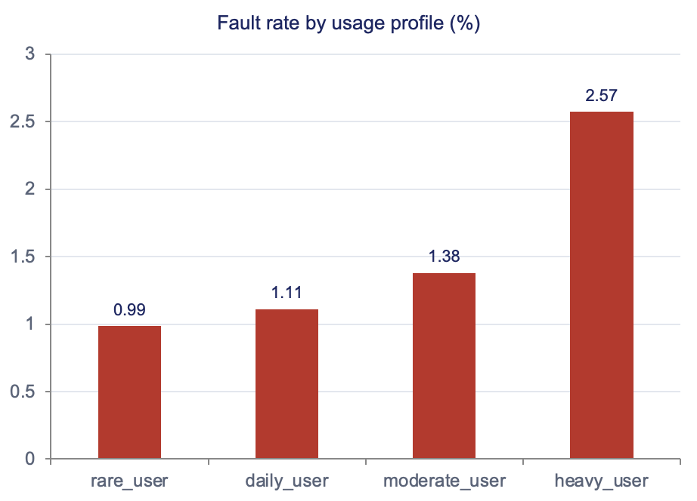
EDA
Fault rate already differs by usage profile
0
missing values across all 175,176 rows and 4 vehicle timelines
2.6×
fault-rate spread: heavy (2.57%) vs. rare (0.99%) usage profile
9.05%
of rows are positive for Fault_Within_6h, the modeling target
09
Notes:
[Harsha, position 9] Three EDA numbers to land: zero missing values, the 2.6x fault-rate spread by usage profile, and 9.05 percent positive rate for the actual modeling target.

Slide 10
BASELINE MODEL
Logistic Regression, all 4 vehicles
A simple first model, trained on all 10 raw sensors across all 4 vehicles
Predicts whether a fault will happen in the next 6 hours
Forecasts ahead, rather than just detecting a fault that's already happening
65.0%
52.0%
13.3%
0.328
Overall accuracy
% of real faults caught
% of fault alerts that were real
Our metric (F2)
Held-out test data the model never saw during training. This is the reference every later model has to beat.
10
Notes:
[Harsha, position 10] Emphasize this is the reference point, not the final answer. Catching 52% of real faults at this stage sets up the next slide's improvement story.

Slide 11
Advanced MODEL
More powerful models catch far more faults
XGBoost:
catches 85.4% of real faults, best of the three
Feature selection:
Started with 54 candidate signals, kept 53 that predict faults better than random noise or the reference model — searched on the full training set, no subsampling
Tuning:
Model settings were tuned specifically to catch more faults, not just to look accurate overall
11
Notes:
[Huseyin, position 11] Read the chart left to right as a progression: 52% to 75% to 85.4% recall, baseline to best. Precision improved too (13.3% to 26.8%), which is why F2 -- our headline metric -- nearly doubled (0.328 to 0.594). Technical detail (RandomizedSearchCV, tree depths, full training-set search) only if asked. That hands off to the next slide, where we explain what rolling and lag actually mean.

Slide 12
ADVANCED MODEL
What “rolling” and “lag” actually mean
Example: it's 2pm on the dashboard
What this means for the app
Motor_Temp_lag_3h is the Motor_Temp reading from 11am, 3 hours ago
Motor_RPM_roll_mean_24h is the average Motor_RPM over the last 24 hours
hour_of_day, day_of_week are calendar signals, not sensor readings
All of it comes from each vehicle's own historical readings, grouped by usage profile so one vehicle's history never leaks into another's.
The baseline model only needs the vehicle's current readings. The tuned models use recent history, so they need the last 6 to 24 hours of readings before they can forecast.
Known limitation
This assumes our 4 training usage profiles generalize to other vehicles. More vehicles and battery types in training would make the forecast more reliable.
12
Notes:
[Huseyin, position 12] Concrete examples of rolling and lag features, and what they mean for deployment: the baseline model only needs current readings, the tuned models need the last 6-24 hours of history. State the same generalization limitation as the earlier bridge slide - this reinforces it, doesn't repeat it word for word.

Slide 13







TECH STACK
Python
pandas
NumPy
scikit-learn
XGBoost
Jupyter
GitHub
13
Notes:
[Huseyin, position 13] Quick slide. Name the categories - this is the real, working stack behind everything just shown. Present tense throughout: this is the technology we are using, not going to use.

Slide 14
RAG TRACK · STATUS
Turning a fault forecast into a cited repair recommendation
The classifier tells the fleet manager that a fault is coming. The RAG layer tells them what to do about it — built end-to-end, corpus to cited ticket.
Workstream | Status
NHTSA RAG corpus | ● Done
Corpus indexing (TF-IDF) | ● Done
Retrieval quality gate | ● Done
Repair ticket generation | ● Done
Fleet-manager dashboard | ● Not started
Deployment & evaluation | ● Not started
Gate passed: retrieval correctly surfaces the right NHTSA record 90% of the time at rank 1, 97% of the time in the top 5 — full numbers on the results slide ahead.
14
Notes:
This is the RAG track status slide. Quick framing: the classifier tells the fleet manager THAT a fault is coming and WHY -- which sensors are driving it. That's diagnosis. RAG is the part that tells them WHAT TO DO about it, by finding real NHTSA precedent for that kind of problem. As of this build, every workstream on this table is done: the corpus is loaded and filtered, it's indexed for search, we've run a quality gate to prove retrieval actually works, and we built repair ticket generation that ties it all together. What's left is wiring this into the Streamlit dashboard visually, and formal deployment. I'll walk through each piece on the next few slides.

Slide 15
RAG TRACK · CORPUS & METHOD
What’s actually in the corpus, and how retrieval works
Two real NHTSA sources, one row per document, and a lexical search method chosen for a real constraint -- not a shortcut taken quietly.
Fact | Detail
Recall records | 202 NHTSA recall notices, filtered to TRACTION BATTERY / ELECTRICAL SYSTEM
Complaint records | 3,329 real owner complaint narratives, same subsystem filter
Chunking | One row = one document -- each record is already a short paragraph, nothing to split
Indexing method | TF-IDF + cosine similarity (scikit-learn), not neural embeddings
Why not embeddings | sentence-transformers needs torch; install failed on disk space in the dev sandbox
Is TF-IDF legitimate? | Yes -- the same lexical-matching idea BM25 search is built on; strong on short structured text
Swappable later: search_recalls_tsbs() is the only function that would need to change to move to dense embeddings later -- corpus loading and the evaluation gate are unaffected.
15
Notes:
Here's exactly what's in the corpus and how we search it. Two real NHTSA sources: 202 recall notices and 3,329 owner complaint narratives, both filtered to battery and electrical system tags so we're not diluting this with unrelated recalls. Each row is already a short paragraph, so chunking is trivial -- one row is one document, nothing to split. For the search method, we planned to use neural embeddings with sentence-transformers, but that needs torch, which failed to install in our dev environment due to a disk space limit. So we substituted TF-IDF plus cosine similarity from scikit-learn -- this is a legitimate, standard lexical retrieval technique, it's literally the same idea BM25 search engines are built on, and it works well on short structured text like this. If we want dense embeddings later, only one function needs to change -- the corpus loading and our evaluation gate don't care which method is underneath.

Slide 16
RAG TRACK · END-TO-END FLOW
From fault forecast to a cited repair ticket
01
02
03
04
Classify & Explain
Build Query
Retrieve
Compose Ticket
→
→
search_recalls_tsbs() ranks NHTSA records by TF-IDF cosine similarity to the query
→
classify_fault() gives risk + probability; explain_prediction() names the top driving sensors
_build_query() turns the top driving sensors into a plain-English search string
generate_ticket() fills a fixed template
Summary, Likely Cause, Action, cited Evidence
16
Notes:
This is the full pipeline, start to finish. Step one, Classify and Explain: classify_fault gives us the risk level and probability, and explain_prediction tells us which specific sensor readings are driving that risk. Step two, Build Query: we automatically turn those top sensors into a plain-English search phrase, like 'motor RPM hour of day' -- no manual typing required. Step three, Retrieve: that query goes into search_recalls_tsbs, which ranks all the NHTSA records by how closely their wording matches, and returns the top few with real citation numbers. Step four, Compose Ticket: generate_ticket takes all of that -- the risk, the driving sensors, the citations -- and fills a structured template: Summary, Likely Cause, Recommended Action, Supporting Evidence, and a Confidence Note. This is the piece that makes 'repair copilot' literal instead of just aspirational.

Slide 17
RAG TRACK · RETRIEVAL GATE
Retrieval gate: does it actually find the record?
No labeled fault-code answer key exists yet, so the gate uses self-retrieval instead
Sample 30 real NHTSA records, build a query from a realistic fragment of each
Check whether retrieval finds that exact record back from the fragment alone
90%
97%
30
0.923
Recall@1 (found at rank 1)
Recall@5 (found in top 5)
Records sampled for the gate
MRR@5 (mean reciprocal rank)
Self-retrieval validates the mechanism works on real data -- it is not a claim retrieval always finds the single “correct” citation for a brand-new, unseen complaint.
17
Notes:
Before trusting retrieval for anything, we built a gate to prove it actually works, the same way we validated feature selection with a noise-floor check. The honest caveat first: we don't have a hand-labeled 'fault code maps to this exact NHTSA record' answer key, because these are recall and complaint narratives, not a lookup table. So we used self-retrieval instead -- we sample 30 real records, take a realistic fragment of each one's text, like a fleet manager would actually describe a symptom, and check whether retrieval finds that same record back. The results: 90% of the time it's found at rank 1, 97% of the time it's in the top 5, and the mean reciprocal rank is 0.923 -- meaning even when it's not rank 1, it's usually very close. This validates the retrieval mechanism itself is sound on real data. It's not a claim that we'll always find the single correct citation for a brand-new complaint we've never seen -- that would need real usage feedback or a hand-labeled test set we don't have yet.

Slide 18
RAG TRACK · REPAIR TICKET
From citation to a written repair recommendation
Example: the prefault demo scenario
What this means for the app
Classifier: 68% probability, Flagged -- driven by Motor_RPM_roll_mean_24h and hour_of_day
Auto-built query: “motor RPM hour of day”
Top citation: [COMPLAINT 11609185] Kia EV6 -- rear motor overheating, similarity 0.20
The template fills Summary / Likely Cause / Recommended Action / Supporting Evidence / Confidence Note from exactly these three things -- nothing invented.
generate_ticket() is the one function that closes the loop: classify → explain → build query → retrieve → compose. Not yet wired into the Streamlit UI -- next up.
Known limitation
The ticket text is a filled template, not an LLM-written paragraph -- we priced out a real LLM call and it needs a paid API key with no free tier. Same structured, cited output, deterministic, free. Swapping in a real LLM later only means replacing one function.
18
Notes:
Here's what the whole pipeline produces, end to end, using our prefault demo scenario. The classifier flags 68% probability, driven by motor RPM and hour of day. That auto-builds the query 'motor RPM hour of day', which retrieves a real Kia EV6 complaint about rear motor overheating as the top match. generate_ticket then fills the template using only those three things -- nothing invented. One honest limitation to flag: this ticket text is a filled template, not an LLM writing a natural paragraph. We looked at using a real LLM call, and it needs a paid API key with no free tier -- not worth the cost or the dependency for a capstone demo. The template gives the same structured, cited output, deterministically and for free. If we want a real LLM voice later, it's a one-function swap -- everything upstream stays the same. What's not done yet: wiring this into the Streamlit UI so a fleet manager sees it live, which is the immediate next step.

Slide 19
THANK YOU
Questions?
19
Notes:
[Huseyin, position 15] Close with the headline number, 85.4% of real faults caught, and open the floor for questions.

