Slide 1

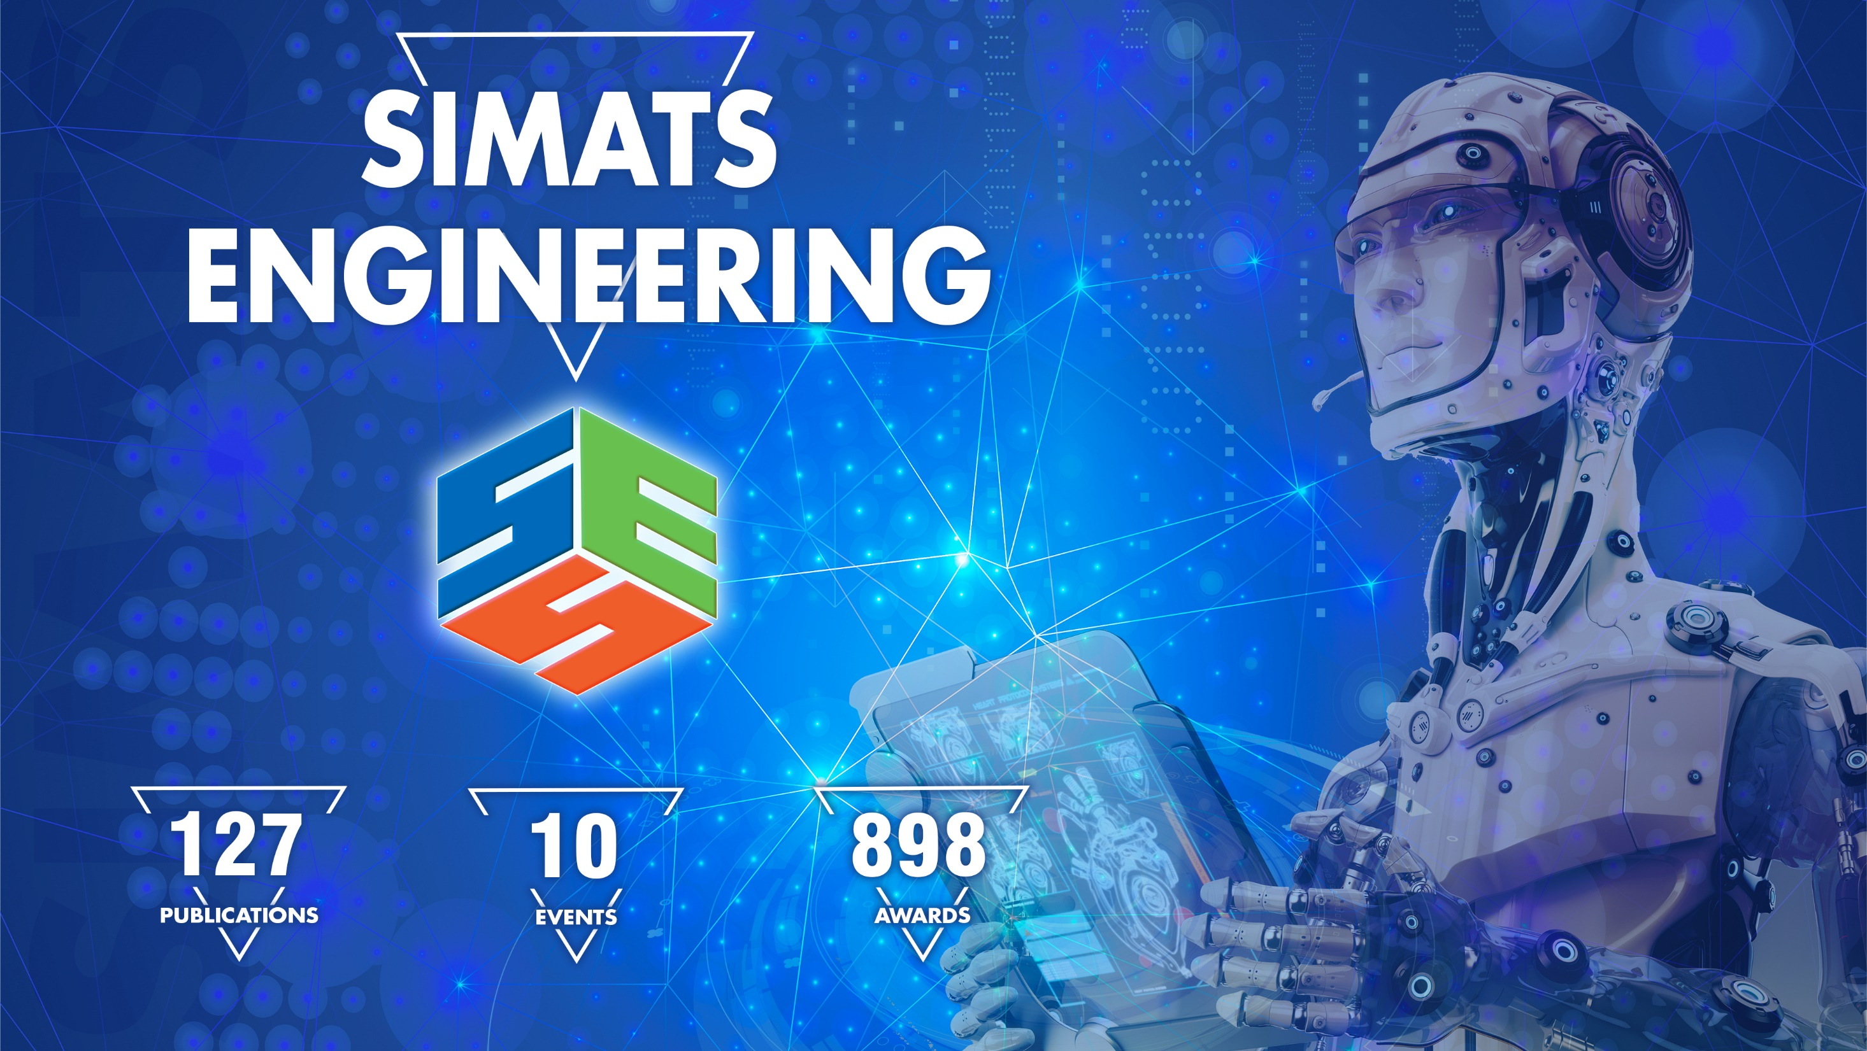

Slide 2
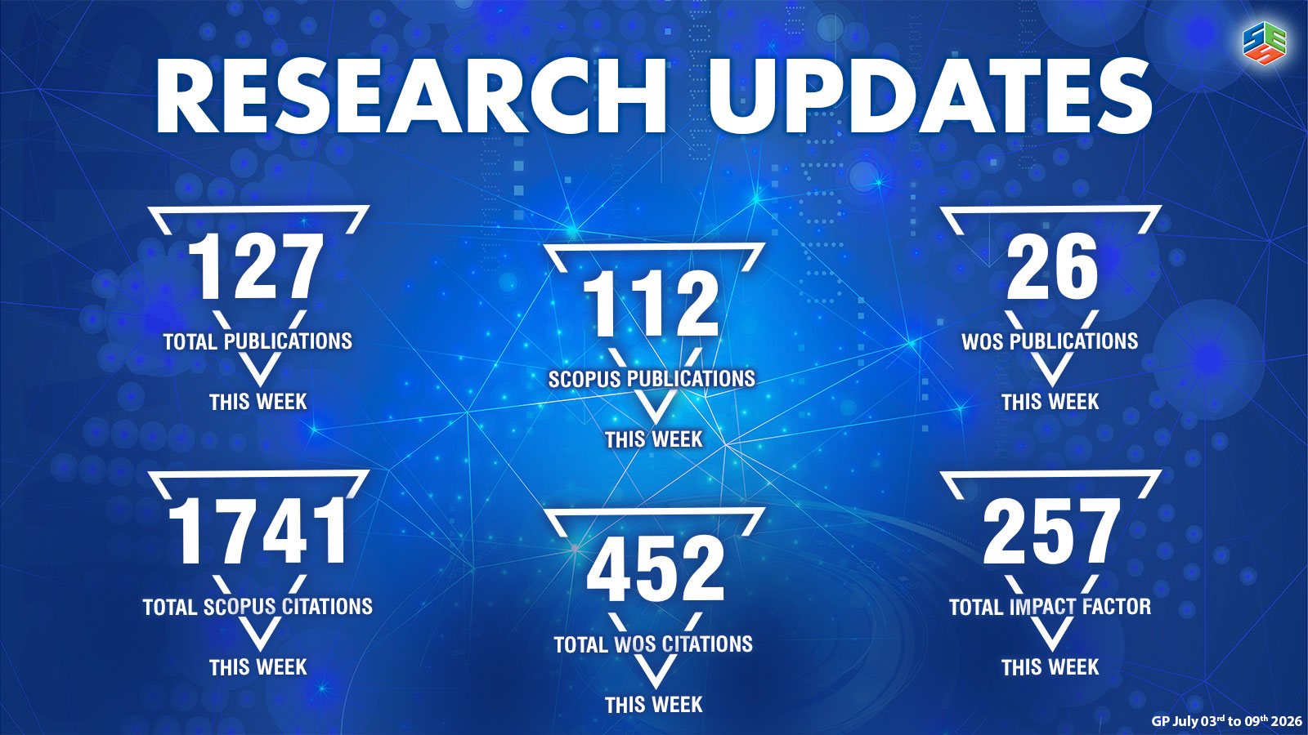

Slide 3
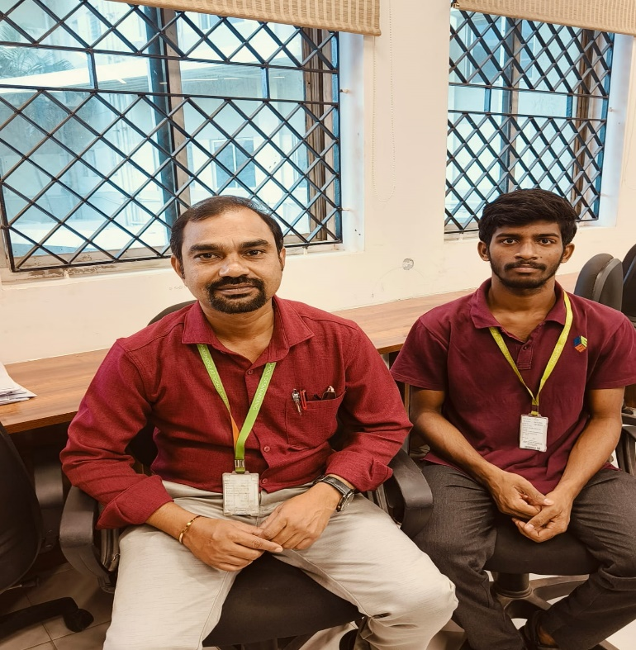
NAME : S.HARSHA VARDHAN REDDY
REG. NO: 192325029
SLOT-A-CSA5116 - CRYPTOGRAPHY AND NETWORK SECURITY
 | Attended Hours | Total Hours | Attendance % | Test Marks
Attendance | 6 | 6 | 100 | 96/100
SLOT-B-UBA2904 - TECHNICAL ENGLISH
 | Attended Hours | Total Hours | Attendance % | Test Marks
Attendance | 7 | 7 | 100 | 86/100
SLOT-C-ITA0405 - STATISTICS WITH R PROGRAMMING
 | Attended Hours | Total Hours | Attendance % | Test Marks
Attendance | 5 | 5 | 100 | 80/100
SLOT-D-UBA4701 - Statistics and Linear Algebra
 | Attended Hours | Total Hours | Attendance % | Test Marks
Attendance | 2 | 4 | 50 | 79/100
No. of arrear Courses | 0

Slide 4
SPECIFIC INTEREST: ACADEMIC FOCUS POINTS TO IMPROVE: Research skill development Dear Parents, Greetings from SIMATS School of Engineering & Dr. SAHAYA LENIN (9962585777), Mentor of your ward !!!
Mr. S Harsha Vardhan Reddy has achieved an impressive academic CGPA of 8.3 out of 10 and maintained high attendance throughout, reflecting his dedication. To ensure punctuality, he should set reminders, plan ahead, optimize travel time, establish a consistent routine, and include buffer time between activities. Your ward will be having regular MS-1 Semester classes and annual sports & cultural fest named SIMMAM-26 in the coming week. Encourage your ward to focus on Conference and hackathon event participation during the upcoming holidays Mr. Reddy has completed Java and SQL certifications from Oracle Academy and signed up for LeetCode, diligently working to finish the course. To further advance his professional skills, he has advised to attend conferences, workshops, hackathons. Additionally, exploring advanced courses on platforms like Coursera, Udacity, and edX. Mr. Reddy is clearly dedicated and capable of achieving great success, and it is important to continue seizing every opportunity for growth and learning.

