Slide 1

SMART INDIA HACKATHON 2026
RootXense : An AI-Enabled Soil-Root Health Monitoring System for Sustainable Crop Management
Problem Statement ID - 26131
Problem Statement Title - Early detection and management of crop diseases and pest infestations
Theme - Agriculture , food tech and rural
development
PS Category- Software
Team ID -
Team Name (Registered on portal) – ROOT6

Slide 2
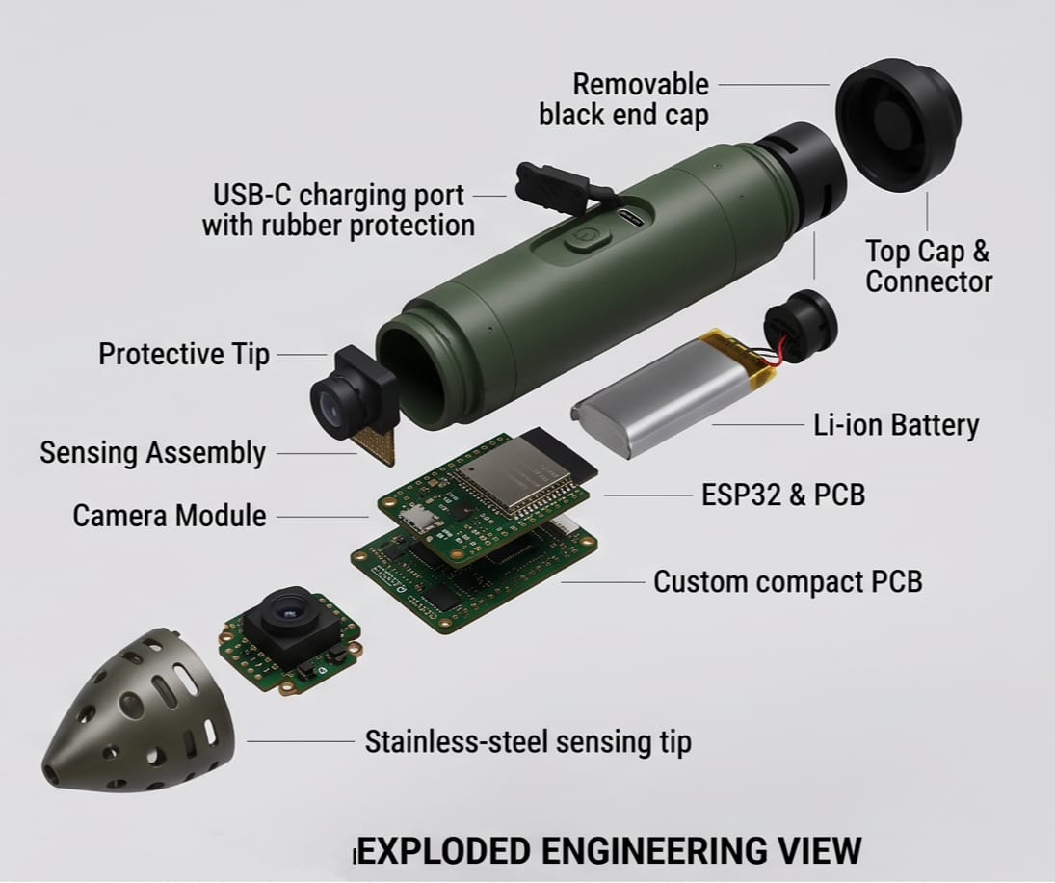
RootXense: An AI-Enabled Soil-Root Health Monitoring System for Sustainable Crop Management
ROOT6
Problem:
Late detection (only after visible symptoms)
No root-level monitoring
Proposed solution:
Smart underground probe with sensors + camera + AI
Innovation:
Detects diseases before visible symptoms
Provides Root Health Score
Detecting disease where it actually begins — at the roots

Slide 3
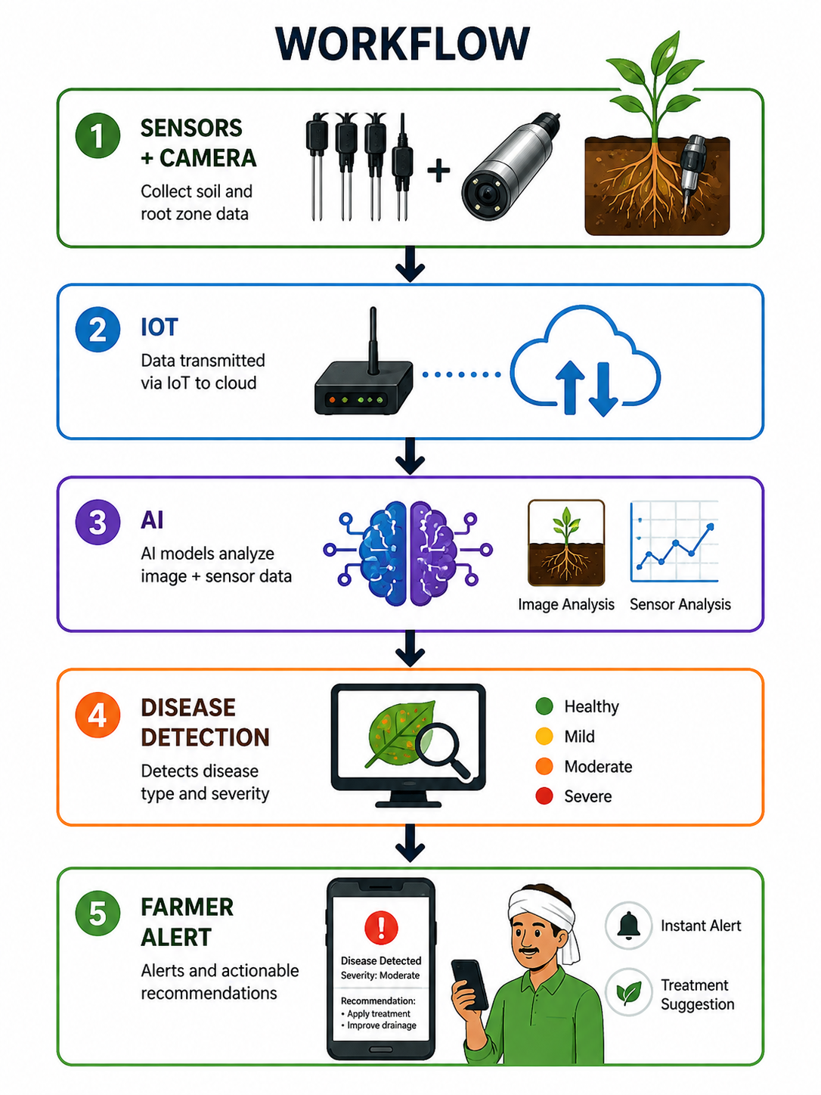
TECHNICAL APPROACH
ROOT6
TECHNOLOGIES USED:
Sensors: Moisture, pH, EC, Temperature, Oxygen
Imaging: Mini-rhizotron camera
AI Models:
CNN → Root image analysis
LSTM → Time-series soil data prediction
Fusion Model → Combines image + sensor insights for accurate disease prediction
Backend: IoT Gateway + Cloud (AWS/Firebase)
Interface: Mobile/Web dashboard
METHODOLOGY AND IMPLEMENTATION PROCESS
Data Collection : Sensors + Camera capture soil & root data
Data Transmission : Sent to cloud via IoT
Data Processing : Cleaning & preprocessing
AI Analysis : Image + sensor data analyzed
Disease Classification : Identifies type & severity
Decision Engine : Generates recommendations
Output:
Alerts + Treatment suggestions
REAL-WORLD CASE STUDY: In crops like tomato or rice, early root rot can be detected before leaf symptoms appear, enabling timely treatment and preventing crop loss.

Slide 4
FEASIBILITY AND VIABILITY
ROOT6
FEASIBILITY OF THE IDEA :
Technical Feasibility:
Uses proven technologies (IoT + AI + sensors)
Economic Feasibility:
Low-cost prototype
(approx. ₹3000–₹5000)
Scalable for different farm sizes
Operational Feasibility:
Easy to use with minimal training
Scalability:
Cloud-based → usable across regions
Prototype can be built using Arduino/Raspberry Pi + low-cost sensors
POTENTIAL CHALLENGES AND RISK :
High Initial Setup Cost for small-scale farmers
Data Accuracy Issues due to environmental variations
Limited Root Image Quality in soil conditions
Connectivity Issues in rural areas
Farmer Adoption Resistance due to lack of awareness
STRATEGIES TO OVERCOME CHALLENGES:
Cost Reduction: Use low-cost components and subsidy support
Improve Accuracy: Train AI with diverse data
Better Imaging: Optimize camera setup and processing
Connectivity: Enable offline data storage and sync
Adoption: Provide simple UI and farmer training
FUTURE/SCALING LINE: Can be scaled for multiple crops and integrated with government smart agriculture initiatives.

Slide 5
IMPACT AND BENEFITS
ROOT6
POTENTIAL IMPACT ON TARGET AUDIENCE:
Farmers: Enables early disease detection, reducing crop loss and improving yield and income.
Agri-Tech Users: Provides accurate, real-time data for better decision-making and precision farming.
Government & Agencies: Supports large-scale crop monitoring and promotes sustainable agriculture practices.
Food Supply Chain: Ensures better crop quality and consistent agricultural output.
EXPECTED OUTCOME:
Upto 20-30% reduction in crop loss
Shifts farming from reactive to preventive agriculture
BENEFITS OF THE SOLUTION :
Social Benefits: Improves farmer livelihood, reduces stress due to crop failure, and promotes smart farming awareness.
Economic Benefits: Increases productivity, reduces input costs (water, fertilizers), and boosts farmer income.
Environmental Benefits: Minimizes overuse of chemicals, conserves water, and supports sustainable soil health.
Technological Benefits: Introduces AI-driven, data-based farming for efficient and modern agriculture.
Unlike existing solutions that analyze soil or leaves, RootXense detects diseases directly at the root level in real time.

Slide 6
RESEARCH AND REFERENCES
ROOT6
1. AI + IoT Soil Monitoring https://bsssjournals.onlinelibrary.wiley.com/doi/pdf/10.1111/sum.70201
2. A IoT in Smart Agriculture https://www.sciencedirect.com/science/article/pii/S1877050925022434
3. Machine Learning + Soil
https://www.nature.com/articles/s41598-026-36017-z
4. IoT-Based Soil Health Monitoring https://ijamjournal.org/ijam/publication/index.php/ijam/article/view/1070
5. Soil Sensors & Smart Agriculture (Sensors Justification)
https://www.mdpi.com/2077-0472/16/3/359

