Slide 1

Mimar Sales
For 3 Months
Insights and Analysis

Slide 2
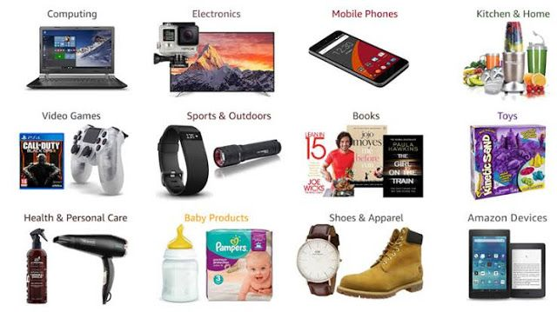
Product Analysis
6 Unique Product Lines. Out of them
Fashion and Accessories has (56144 Kyat)
Health and beauty has (46851 Kyat).
Discounts can be provided for Health and beauty
for events/celebrations in increase its sales.
3 Main Branches Yangon, Mandalay & Naypyitaw of
Myanmar.

Slide 3


Sales Analysis
Total Revenue of a month January is 116291 and highest.
Highest revenue is from Naypyita.
Least is Mandaley.
High sales is for food and beverages product line.
Sales can be improved by making discounts as month end sales/Prime Day sales.
VAT recorded is 49.65%.

Slide 4



Customer Analysis
Highest Purchase Frequency is 501 from “Member”.
Female customers are dominant with “Branch C”
Male is More consumer base in “Branch A”
Highest customer ratings for
“Branch A” on Friday (7.3), “Branch B” on Monday (7.3),
“Branch C” on Friday (7.2).
Fashion Accessories are More Consumed by Females.
Health and Beauty is more popular among males.

Slide 5
Thank you

