Slide 1

Chain Proof Validator
Submitted by,
Mr. HARSHA D B - 20201CCS0007
Mr. JAI CALVIN J - 20201CCS0011
Mr. RAHUL N - 20201CCS0044
Under the guidance of,
Dr. NIHAR RANJAN NAYAK

Slide 2
Project Overview
The Chain Proof Validator is a robust solution designed to enhance the security and reliability of blockchain networks by validating and verifying the integrity of the chain. This tool ensures the consistency of data across the distributed ledger, providing a trustworthy foundation for blockchain applications.

Slide 3
Project Objectives
Transparent Audit Trail
Maintain an accountable certificate activity log.
Privacy Control
Empower users with data privacy control.
Compatibility
Ensure seamless integration with existing systems.
Performance Evaluation
Test for reliability and scalability.
Promote Adoption
Encourage widespread use and awareness.
Continuous Improvement
Monitor and enhance system based on feedback

Slide 4
Key Features
Blockchain Integrity Checks:
Perform regular checks to confirm the integrity of each block in the chain.
Utilize cryptographic hashing algorithms to validate block contents.
Consensus Algorithm Validation:
Support multiple consensus algorithms (e.g., Proof of Work, Proof of Stake) for comprehensive validation.
Ensure that the chosen consensus mechanism aligns with the defined network rules.
Tamper Detection:
Implement mechanisms to detect and flag any attempts to tamper with the blockchain data.
Provide an audit trail of detected anomalies for forensic analysis.
Customizable Security Policies:
Allow users to define and customize security policies based on specific blockchain requirements.
Provide a flexible framework for adapting to evolving security standards.
Performance Metrics:
Offer performance metrics and analytics to assess the health and efficiency of the blockchain.
Enable users to optimize the network based on the analysis of performance data.

Slide 5
Scope & Limitations
Scope
This project's scope encompasses the design and implementation of a blockchain-based certificate validation system. It includes the development of a user-friendly web application and the integration of blockchain technology to facilitate secure, decentralized, and accessible certificate storage and validation.
Limitations
While the proposed solution offers significant improvements, certain limitations are acknowledged. These may include potential scalability challenges, the need for user education on blockchain technology, and the evolving regulatory landscape regarding digital certificates.

Slide 6
Benefits
Enhanced Trustworthiness:
Build trust among users and stakeholders by ensuring the integrity of blockchain data.
Proactive Security Measures:
Implement proactive security measures to prevent and address potential threats.
Comprehensive Validation:
Provide a comprehensive validation process that covers both data integrity and consensus mechanisms.
Easy Integration:
Facilitate seamless integration with existing blockchain networks and applications.

Slide 7
Methodology
1.Requirement Analysis
Identify certificate validation needs.
Gather stakeholder input.
2.Technology Selection
Choose blockchain platform and tools.
3.Blockchain Development
Build secure blockchain infrastructure.
Develop smart contracts.
4.Web App Design
Create user-friendly interface.
Enable certificate management

Slide 8
5.Security and Testing
Implement multi-signature authentication.
Ensure system reliability.
6.Training and Pilot
Provide user training and documentation.
Launch a pilot phase for feedback.
7.Deployment and Adoption
Roll out the system to users.
Promote widespread adoption.
8.Monitoring and Improvement
Continuously monitor for performance.
Gather feedback for enhancements.

Slide 9
Timeline Of Project
Month 1: Project Initiation and Planning
Define project objectives and scope. Assemble the project team and assign roles. Conduct initial requirements analysis. Select blockchain technology and tools. Develop a high-level project plan.
Month 2: Blockchain and Web Application Development
Set up the blockchain infrastructure. Develop critical smart contracts for access control. Begin building the web application interface.
Month 3: Application Integration and Testing
Continue web application development. Implement blockchain functionality into the
web app. Conduct initial usability testing. Perform security testing and address critical issues.
Month 4: Pilot Phase and Deployment
Launch a small-scale pilot with selected users. Gather user feedback and assess
system performance. Make necessary refinements based on pilot results. Prepare for
the wider deployment of the system

Slide 10
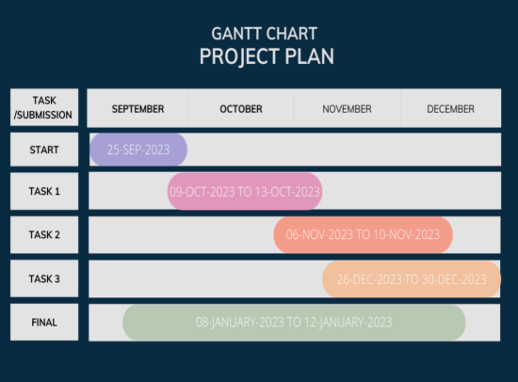

Slide 11
Expected Outcomes
Streamlined Certificate Management
Efficient and user-friendly storage.
Reduced administrative burden.
Improved Certificate Verification
Real-time validation, cost savings.
Enhanced trust and credibility.
Enhanced Security and Privacy
Tamper-resistant storage.
Privacy compliance and control.
Compatibility and Adoption
Seamless integration.
Increased system adoption.
Continuous Improvement
Adaptability to evolving needs.

Slide 12
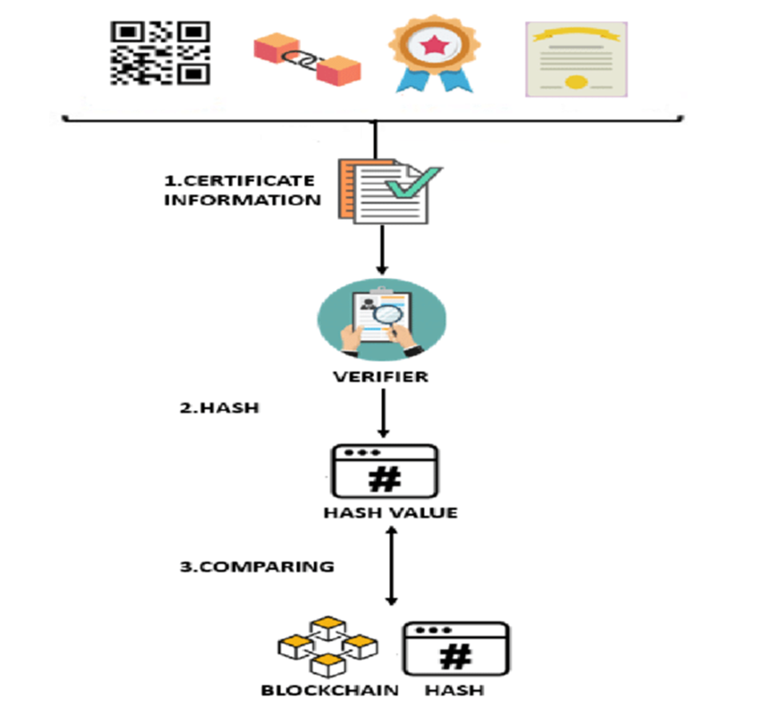
Working Of Validator

Slide 13
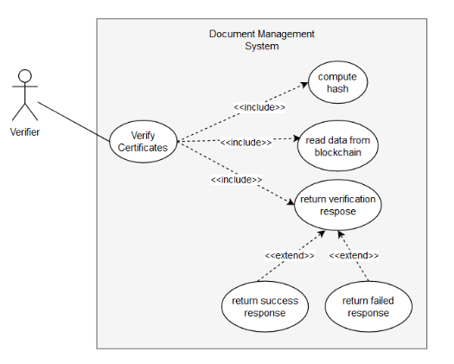
Flow Chart Of Validator

Slide 14
Conclusion
The Chain Proof Validator is a crucial tool for organizations and developers seeking to bolster the security and reliability of their blockchain networks. By ensuring the integrity of the chain and implementing proactive security measures, this project aims to contribute to the ongoing evolution and adoption of blockchain technology.

Slide 15


