Slide 1
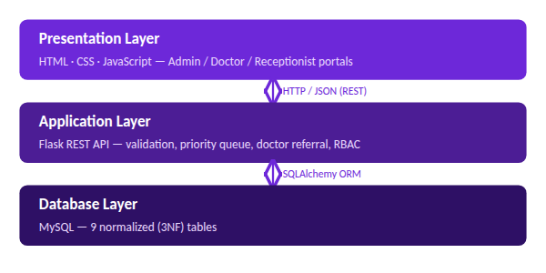
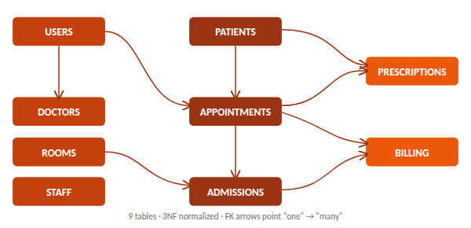
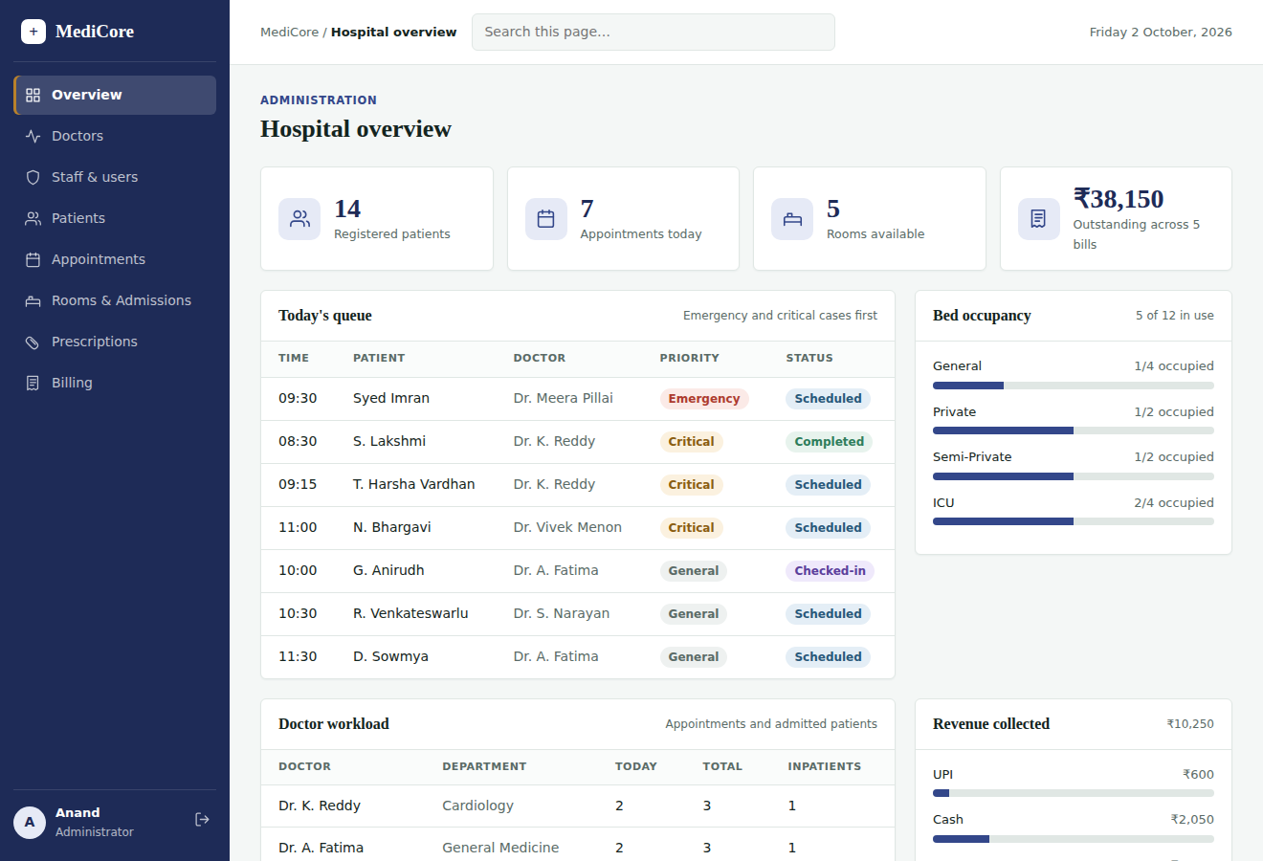
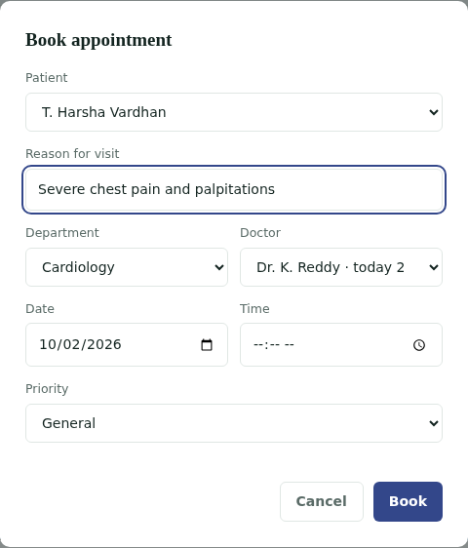
KLH Logo
MediCore HMS — Hospital Management System
Team ID: 20 | Section: S13 | Members: T. Harsha Vardhan (2520080047), G. Anirudh (2520080058) | Guide: Dr. ______
Database Systems Engineering and Distributed Backend Development (25CS1302E) | KLH Bachupally Campus, CSE | PBL 2026-27
Abstract
Tools & Technologies
Centralizes registration, scheduling, room allocation, prescriptions and billing for hospitals — HTML/CSS/JS, Flask REST APIs, 9-table normalized MySQL.
Outcome: priority scheduling + doctor referral cut per-task time from minutes to under a second.
Front-End: HTML5, CSS3, vanilla JavaScript
Back-End: Python, Flask, Flask-SQLAlchemy, Flask-CORS
Database: MySQL 8 (SQLite for local dev)
Tools: VS Code, MySQL Workbench, GitHub, Playwright
Problem Statement & Objectives
Problem: Manual, paper-based records cause duplication, slow retrieval and billing/scheduling errors.
Objective 1: Centralize records in a normalized MySQL database.
Objective 2: Priority scheduling (Emergency>Critical>General) + doctor referral.
Objective 3: Role-based access for Admin, Doctor, Receptionist.
Scope: Registration, scheduling, admissions, prescriptions, billing.
System Architecture
Existing vs Proposed System
Feature | Existing System | Proposed System
Records | Paper, duplicated | Normalized MySQL DB
Scheduling | First-come, first-served | Priority queue (E>C>G)
Doctor pick | Manually guessed | Auto dept + load-balanced
Access | One shared login | Role-based, 3 portals
Gap | No combined option | All 4 in one prototype
ER Diagram & Database Design
Feasibility Study
Technical: Free mainstream stack; schema, front-end, API already built & tested.
Economic: Zero licensing cost — open-source only; runs on an ordinary laptop.
Operational: Plain-language, role-specific UI; no training beyond a walkthrough.
Schedule: Core modules done; integration + MySQL migration planned this trimester.
Implementation Screenshots
Results & Testing
Conclusion
Future Scope
12+ endpoints tested incl. edge cases (409 on dup. room/admission).
Priority queue verified; CRUD, validation, role checks pass on all 3 portals.
Working 3-tier HMS: normalized DB, tested API, role-based front-end.
Meets all objectives: centralized records, smart scheduling, RBAC.
Wire front-end to live API; migrate to MySQL with 2,000+ records.
Add hashed-password auth; load-test under concurrent users.
References: [1] Elmasri & Navathe, Fundamentals of Database Systems [2] Flask/SQLAlchemy docs — flask.palletsprojects.com [3] MySQL 8.0 Reference Manual
Add GitHub repo QR

