Slide 1
MDM Company
June 1, 2021
DIGITAL BRAINSTORM
A creative way to encourage everyone to think and share ideas.

Slide 2
Team Details
LEDGER
Project Details
1
Department of CSE
3
Digital Brainstorm
2
Guide Details
4
Summary and Action Items

Slide 3




Offline. Private. Smart.
Your Rules.
Tomas and Chloe
Your Money.
INTRODUCTION
Tomas and Chloe will be our facilitators for this session.
The goal of our session is to turn chaos into clarity. As facilitators,
our role is to keep the session on track and to ensure everyone participates in the discussion.

Slide 4


Data harvesting
1
2
3
Offline tracking fails
Browse and click the Emoji or GIF you want to use.
How are you feeling?
Choose an Emoji, GIF, or image from a mood meter that best represents how you feel at the moment.
Why Ledger Exists
The privacy problem
Time: 5 minutes

Slide 5
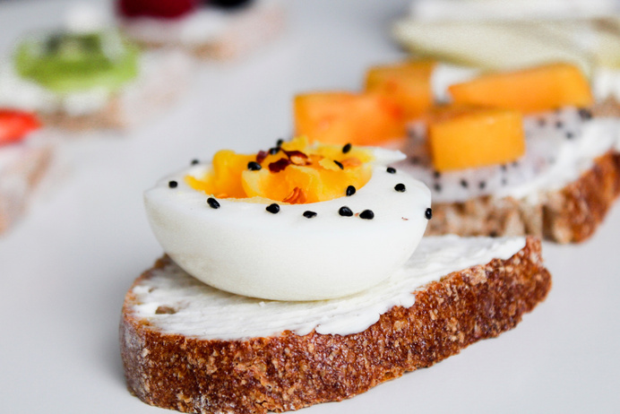
ICEBREAKER
Copy a sticky note, then write your thoughts.
Copy a sticky note, then write your thoughts.
Before we start with the session, let's warm up a little
with this icebreaker question:
What did you have for breakfast today?
Third-party servers
The Problem
Time: 5 minutes

Slide 6
100% Offline Capable
Objectives
GET THOSE CREATIVE JUICES FLOWING!
Let's begin.

Slide 7
Wallet - Paid features
Literature Survey
1
DIGITAL BRAINSTORM
Copy a sticky note, then write your thoughts.
Copy a sticky note, then write your thoughts.
Copy a sticky note, then write your thoughts.
Starting on a new project begins with a curation of ideas. This digital brainstorm session will allow us to lay down
and organize all our thoughts, ideas, and inspiration.
Next, we will vote on ideas that are promising
and add comments.
Splitwise - Server reliant
2
Mint - Data harvesting
3
Yes!
This is
great!

Slide 8
Existing vs Ledger
1
2
3
Copy a sticky note, then write your thoughts.
Add your
idea here
Accounts vs Anonymous
Vote for your favorite
ideas with these stickers.
Put these reaction stickers to any
promising ideas.
Ads vs Ad-Free
Cloud vs Local
Our favorite ideas

Slide 9
Sub-second logging
What Makes Us Different
ACTION ITEMS
1
Local AI Coaching
Type your idea here.
Type your idea here.
Type your idea here.
Let's go back to the previous pages and
synthesize what next actions are appropriate
for us to move forward as a group.
Zero databases
2

Slide 10

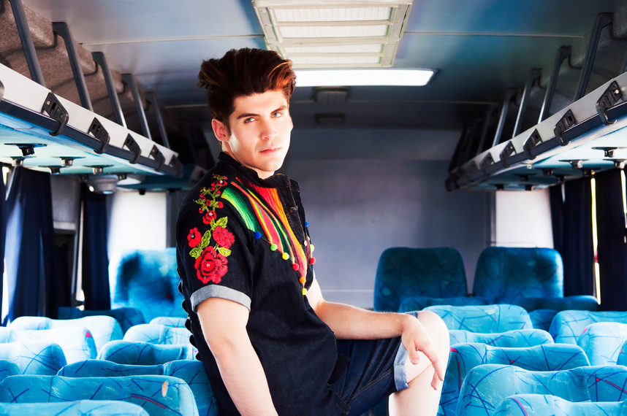


How Ledger Works
Action 1
Action 2
1
1. Open app
2. Log instantly
2
Action 3
Action 4
Type your idea here.

Slide 11
React Frontend
Architecture
THE MIND IS JUST LIKE
A MUSCLE — THE MORE YOU EXERCISE IT, THE STRONGER IT GETS AND THE MORE
IT CAN EXPAND.
Idowu Koyenikan

Slide 12
React 19
Technology Stack
THAT'S A WRAP!
Thank you for participating.

Slide 13
Categorized Logging
Core Features
Icons and Illustrations
ICONS AND ILLUSTRATIONS RESOURCE PAGE
Groq AI Advisor
Streaks Gamification
Use these free recolorable icons and
illustrations in your Canva design.
Type your idea here.

Slide 14

Dynamic limits
Budget Warnings
Icons and Illustrations
ICONS AND ILLUSTRATIONS RESOURCE PAGE
Visual alerts
Real-time updates
Use these free recolorable icons and
illustrations in your Canva design.
Type your idea here.

Slide 15
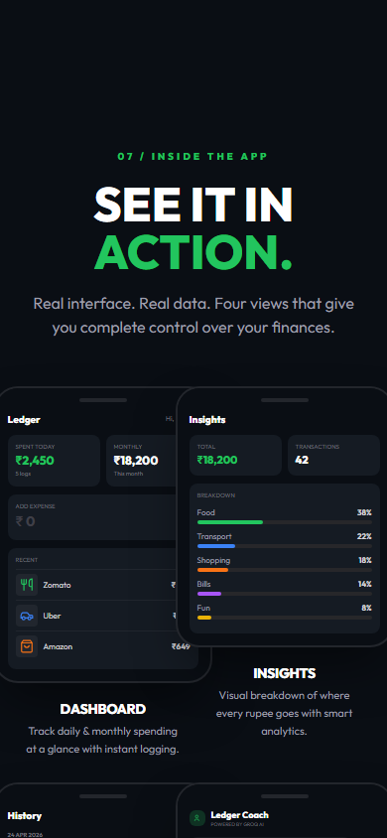
Top categories
Analytics & Insights
Icons and Illustrations
ICONS AND ILLUSTRATIONS RESOURCE PAGE
Visual progress
Monthly trends
Use these free recolorable icons and
illustrations in your Canva design.
Type your idea here.

Slide 16

No backend
Privacy First
Icons and Illustrations
ICONS AND ILLUSTRATIONS RESOURCE PAGE
Total data ownership
No trackers
Use these free recolorable icons and
illustrations in your Canva design.
Type your idea here.

Slide 17
Service Workers
Offline First
Icons and Illustrations
ICONS AND ILLUSTRATIONS RESOURCE PAGE
Works completely off-grid
Instant booting
Use these free recolorable icons and
illustrations in your Canva design.
Type your idea here.

Slide 18
Transaction Engine
Implementation
Icons and Illustrations
ICONS AND ILLUSTRATIONS RESOURCE PAGE
AI Coach
Budget System
Use these free recolorable icons and
illustrations in your Canva design.
Type your idea here.

Slide 19
0ms Latency
Results
Icons and Illustrations
ICONS AND ILLUSTRATIONS RESOURCE PAGE
100% Private tracking
Native App Feel
Use these free recolorable icons and
illustrations in your Canva design.
Type your idea here.

Slide 20
Custom Categories
Future Scope
Icons and Illustrations
ICONS AND ILLUSTRATIONS RESOURCE PAGE
Biometric Lock
Recurring Logs
Use these free recolorable icons and
illustrations in your Canva design.
Type your idea here.

Slide 21
Fast. Secure. Private.
Conclusion
Icons and Illustrations
ICONS AND ILLUSTRATIONS RESOURCE PAGE
Ready to scale locally.
Use these free recolorable icons and
illustrations in your Canva design.
Type your idea here.

Slide 22
React Documentation
References
Icons and Illustrations
ICONS AND ILLUSTRATIONS RESOURCE PAGE
Tailwind CSS Guides
MDN PWA Specs
Use these free recolorable icons and
illustrations in your Canva design.
Type your idea here.

Slide 23
LEDGER
Thank You
Icons and Illustrations
ICONS AND ILLUSTRATIONS RESOURCE PAGE
Questions?
Use these free recolorable icons and
illustrations in your Canva design.
Type your idea here.

